Slide 1
Figure 1. Data generating process.
Notes:
Figure 1. Data generating process.
Unless provided in the caption above, the following copyright applies to the content of this slide: © The Author 2016. Published by Oxford University Press.This is an Open Access article distributed under the terms of the Creative Commons Attribution Non-Commercial License (http://creativecommons.org/licenses/by-nc/4.0/), which permits non-commercial re-use, distribution, and reproduction in any medium, provided the original work is properly cited. For commercial re-use, please contact journals.permissions@oup.com

Slide 2
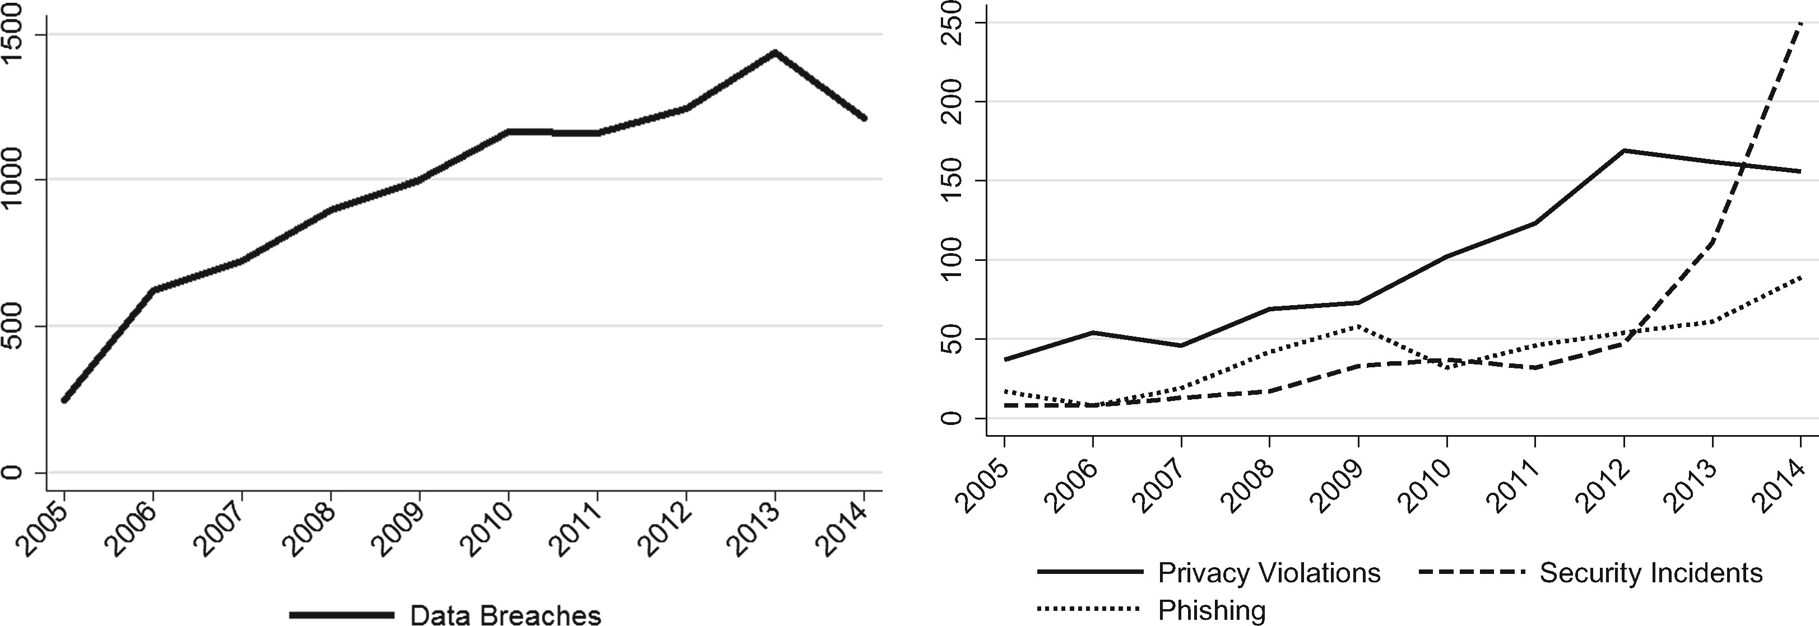
Figure 2. Four types of cyber events.
Notes:
Figure 2. Four types of cyber events.
Unless provided in the caption above, the following copyright applies to the content of this slide: © The Author 2016. Published by Oxford University Press.This is an Open Access article distributed under the terms of the Creative Commons Attribution Non-Commercial License (http://creativecommons.org/licenses/by-nc/4.0/), which permits non-commercial re-use, distribution, and reproduction in any medium, provided the original work is properly cited. For commercial re-use, please contact journals.permissions@oup.com

Slide 3
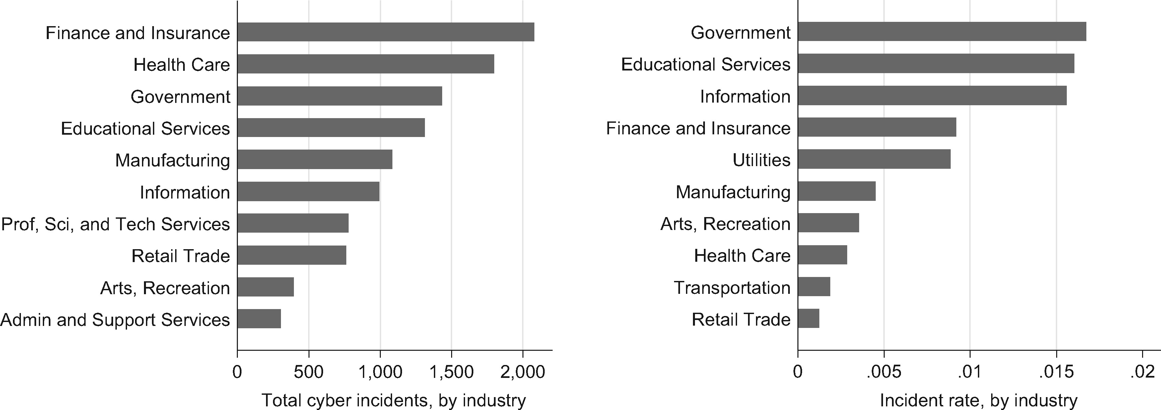
Figure 3. Cyber incidents, and rates, by industry.
Notes:
Figure 3. Cyber incidents, and rates, by industry.
Unless provided in the caption above, the following copyright applies to the content of this slide: © The Author 2016. Published by Oxford University Press.This is an Open Access article distributed under the terms of the Creative Commons Attribution Non-Commercial License (http://creativecommons.org/licenses/by-nc/4.0/), which permits non-commercial re-use, distribution, and reproduction in any medium, provided the original work is properly cited. For commercial re-use, please contact journals.permissions@oup.com

Slide 4
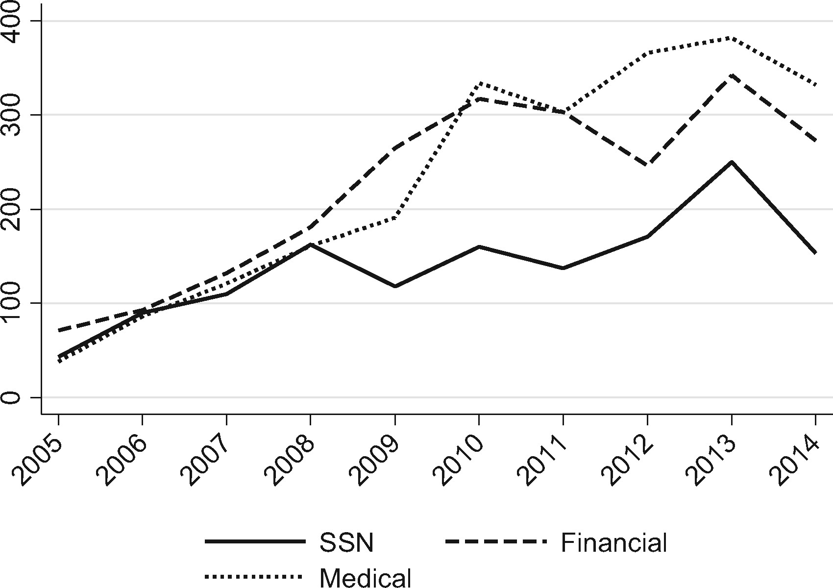
Figure 4. Cyber events by type of information compromised.
Notes:
Figure 4. Cyber events by type of information compromised.
Unless provided in the caption above, the following copyright applies to the content of this slide: © The Author 2016. Published by Oxford University Press.This is an Open Access article distributed under the terms of the Creative Commons Attribution Non-Commercial License (http://creativecommons.org/licenses/by-nc/4.0/), which permits non-commercial re-use, distribution, and reproduction in any medium, provided the original work is properly cited. For commercial re-use, please contact journals.permissions@oup.com

Slide 5
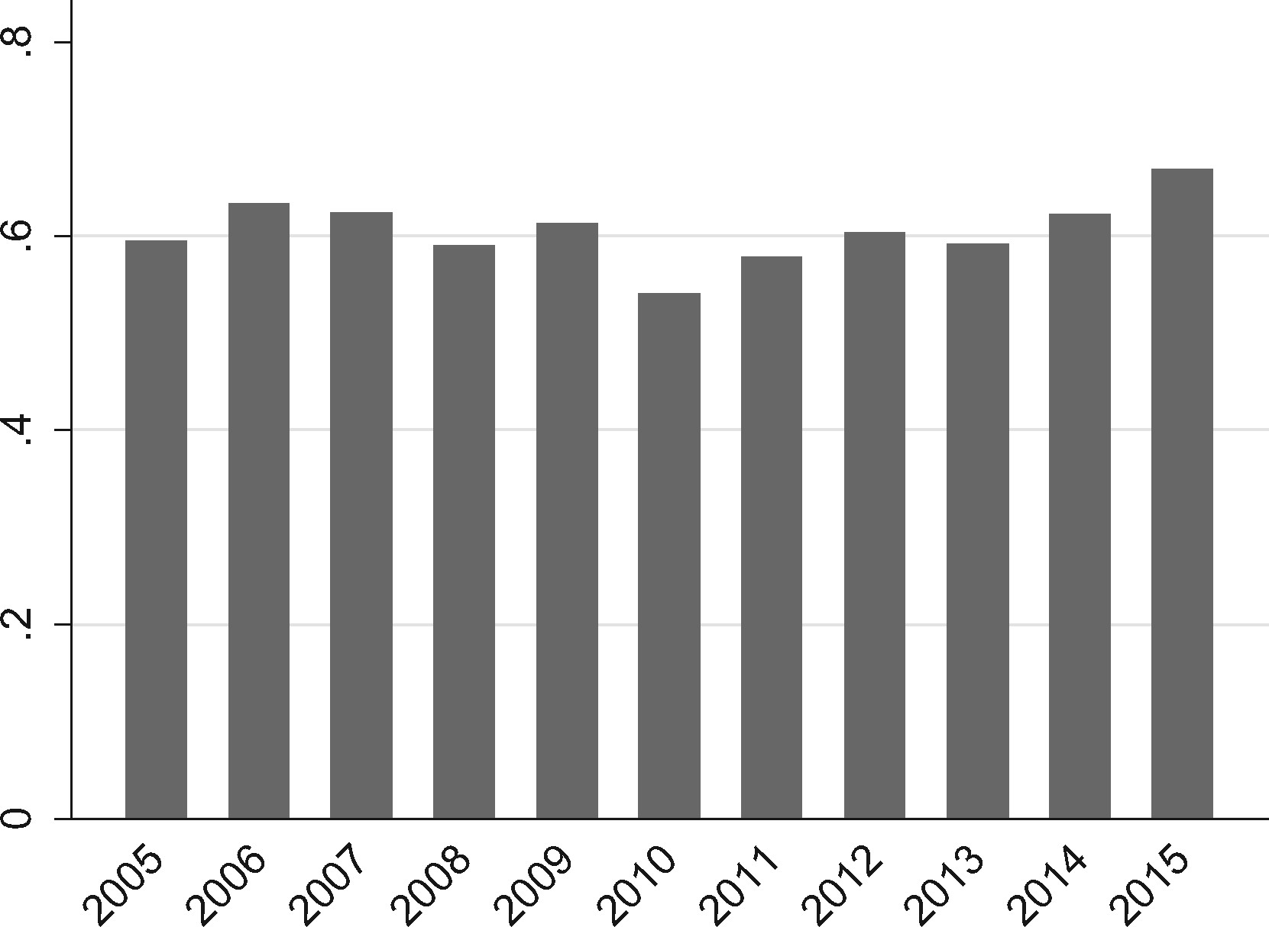
Figure 5. Rates of malicious events.
Notes:
Figure 5. Rates of malicious events.
Unless provided in the caption above, the following copyright applies to the content of this slide: © The Author 2016. Published by Oxford University Press.This is an Open Access article distributed under the terms of the Creative Commons Attribution Non-Commercial License (http://creativecommons.org/licenses/by-nc/4.0/), which permits non-commercial re-use, distribution, and reproduction in any medium, provided the original work is properly cited. For commercial re-use, please contact journals.permissions@oup.com

Slide 6
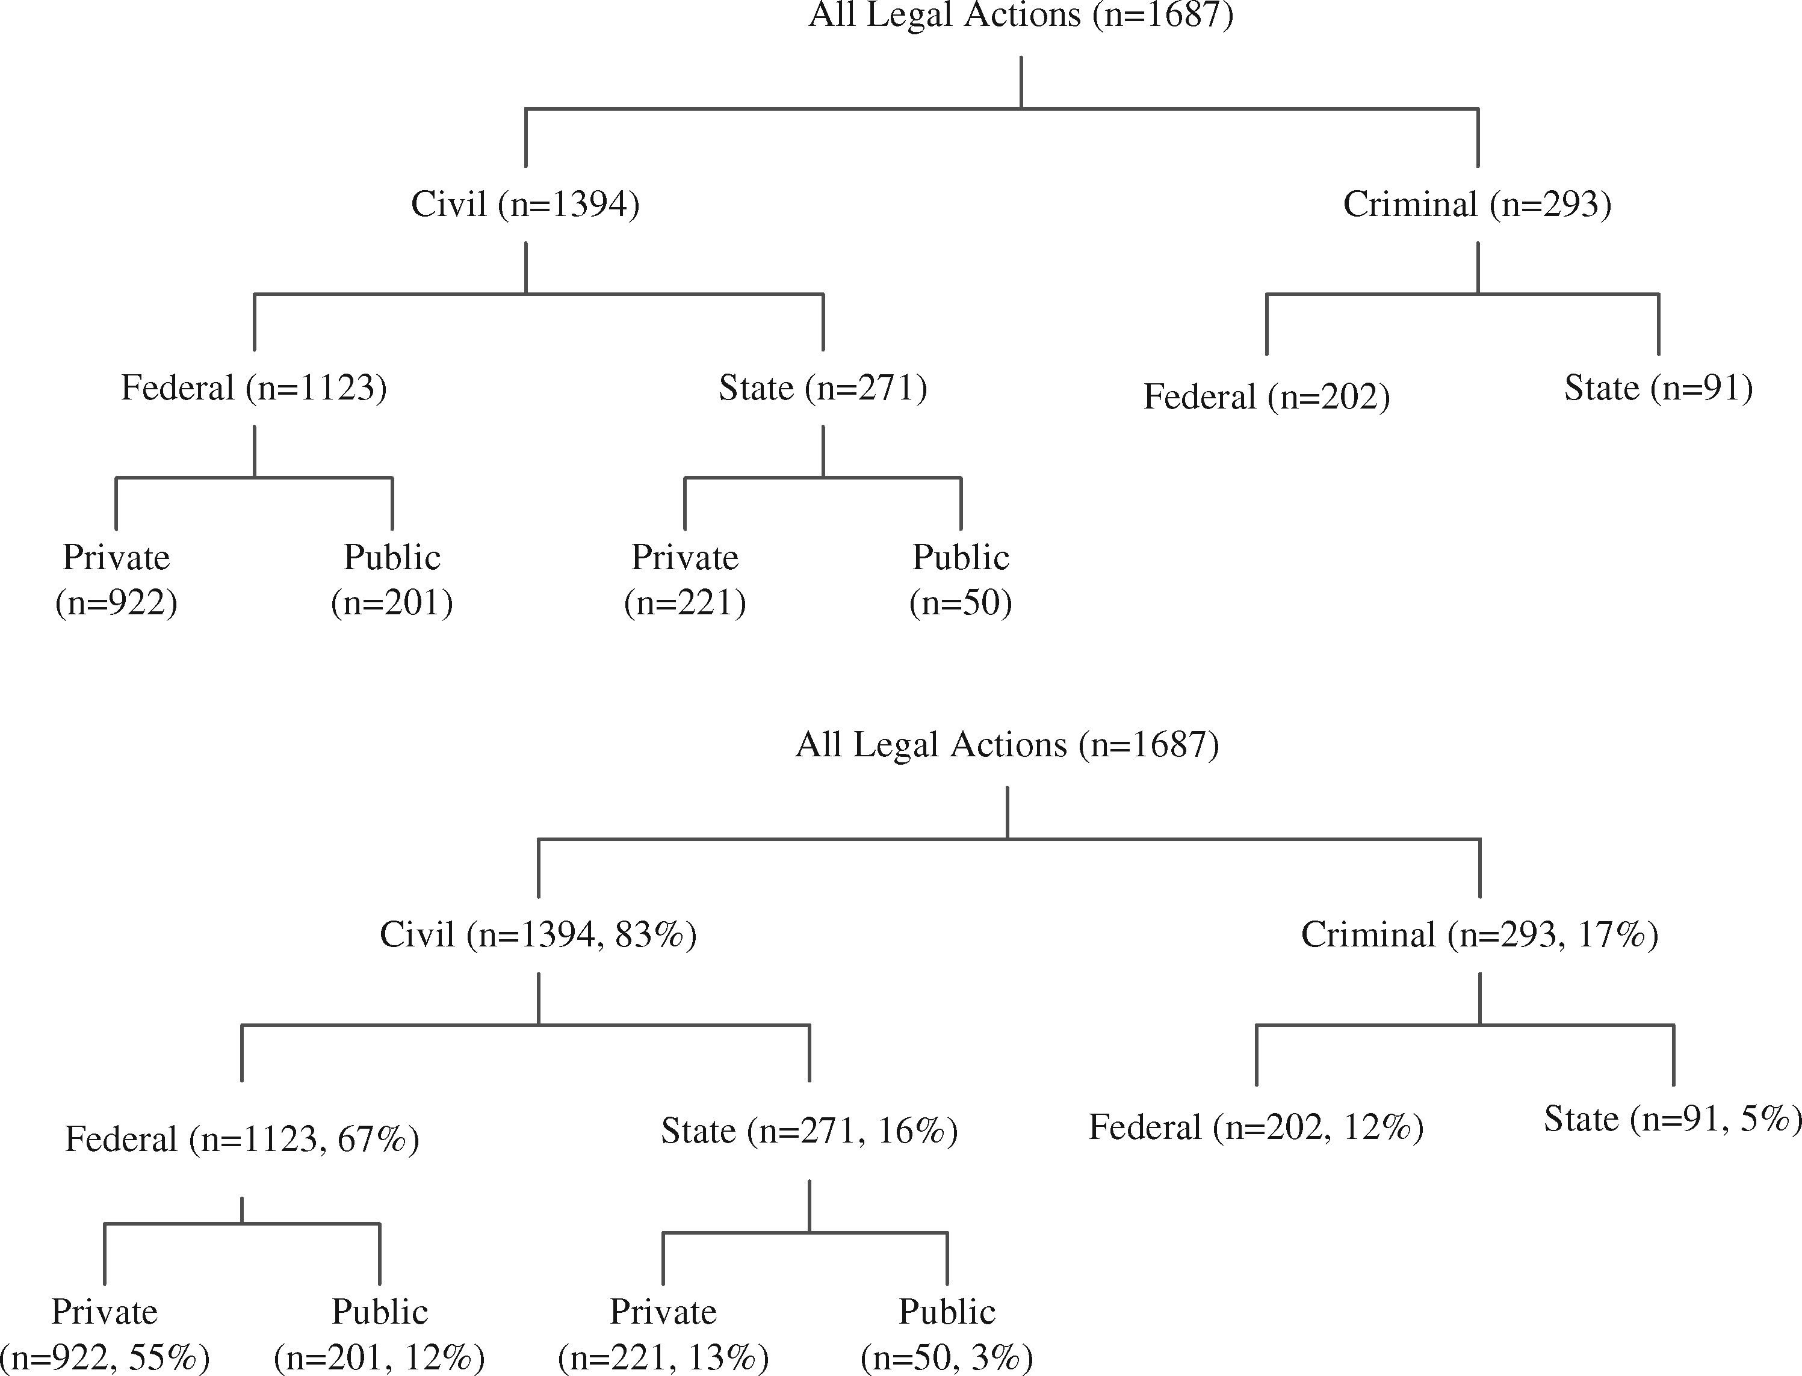
Figure 6. Composition of legal actions.
Notes:
Figure 6. Composition of legal actions.
Unless provided in the caption above, the following copyright applies to the content of this slide: © The Author 2016. Published by Oxford University Press.This is an Open Access article distributed under the terms of the Creative Commons Attribution Non-Commercial License (http://creativecommons.org/licenses/by-nc/4.0/), which permits non-commercial re-use, distribution, and reproduction in any medium, provided the original work is properly cited. For commercial re-use, please contact journals.permissions@oup.com

Slide 7
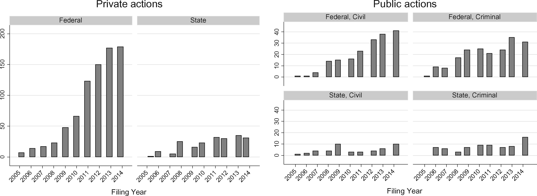
Figure 7. Count of private and public legal actions by year.
Notes:
Figure 7. Count of private and public legal actions by year.
Unless provided in the caption above, the following copyright applies to the content of this slide: © The Author 2016. Published by Oxford University Press.This is an Open Access article distributed under the terms of the Creative Commons Attribution Non-Commercial License (http://creativecommons.org/licenses/by-nc/4.0/), which permits non-commercial re-use, distribution, and reproduction in any medium, provided the original work is properly cited. For commercial re-use, please contact journals.permissions@oup.com

Slide 8
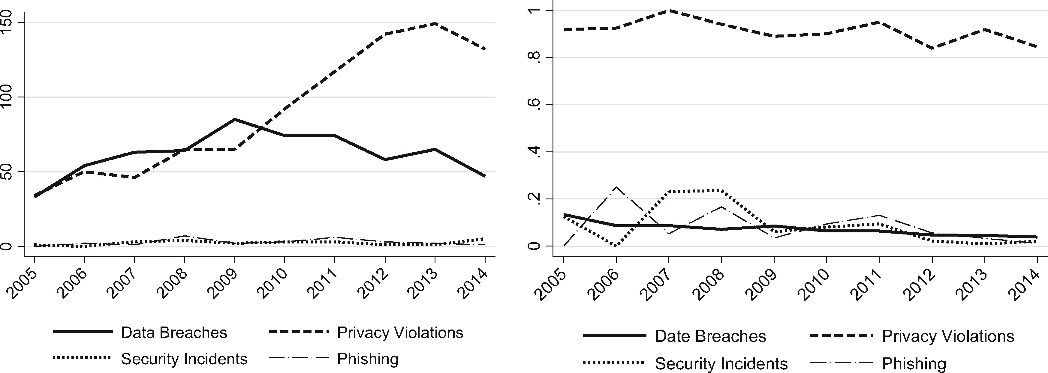
Figure 8. Legal actions and litigation rates, by type of cyber event.
Notes:
Figure 8. Legal actions and litigation rates, by type of cyber event.
Unless provided in the caption above, the following copyright applies to the content of this slide: © The Author 2016. Published by Oxford University Press.This is an Open Access article distributed under the terms of the Creative Commons Attribution Non-Commercial License (http://creativecommons.org/licenses/by-nc/4.0/), which permits non-commercial re-use, distribution, and reproduction in any medium, provided the original work is properly cited. For commercial re-use, please contact journals.permissions@oup.com

Slide 9
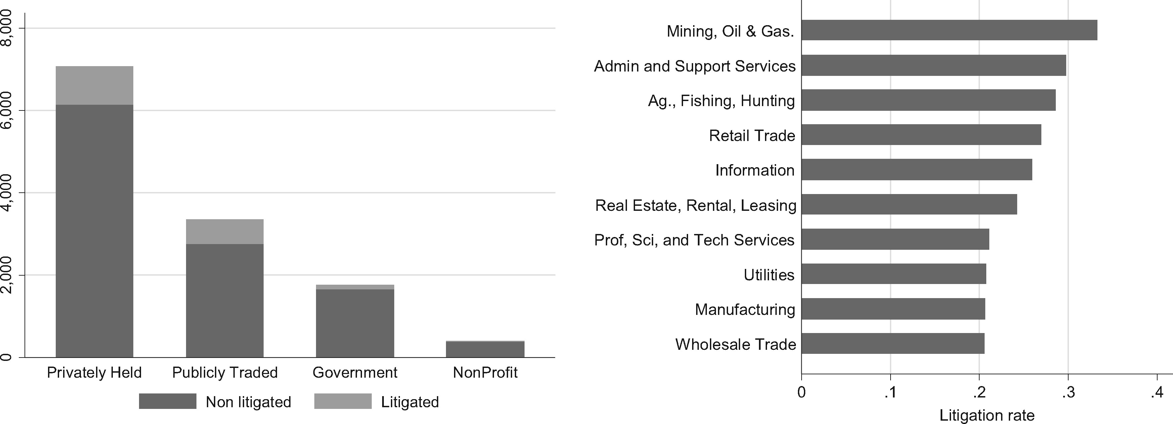
Figure 9. Litigation rate by organization type, and industry.
Notes:
Figure 9. Litigation rate by organization type, and industry.
Unless provided in the caption above, the following copyright applies to the content of this slide: © The Author 2016. Published by Oxford University Press.This is an Open Access article distributed under the terms of the Creative Commons Attribution Non-Commercial License (http://creativecommons.org/licenses/by-nc/4.0/), which permits non-commercial re-use, distribution, and reproduction in any medium, provided the original work is properly cited. For commercial re-use, please contact journals.permissions@oup.com

Slide 10
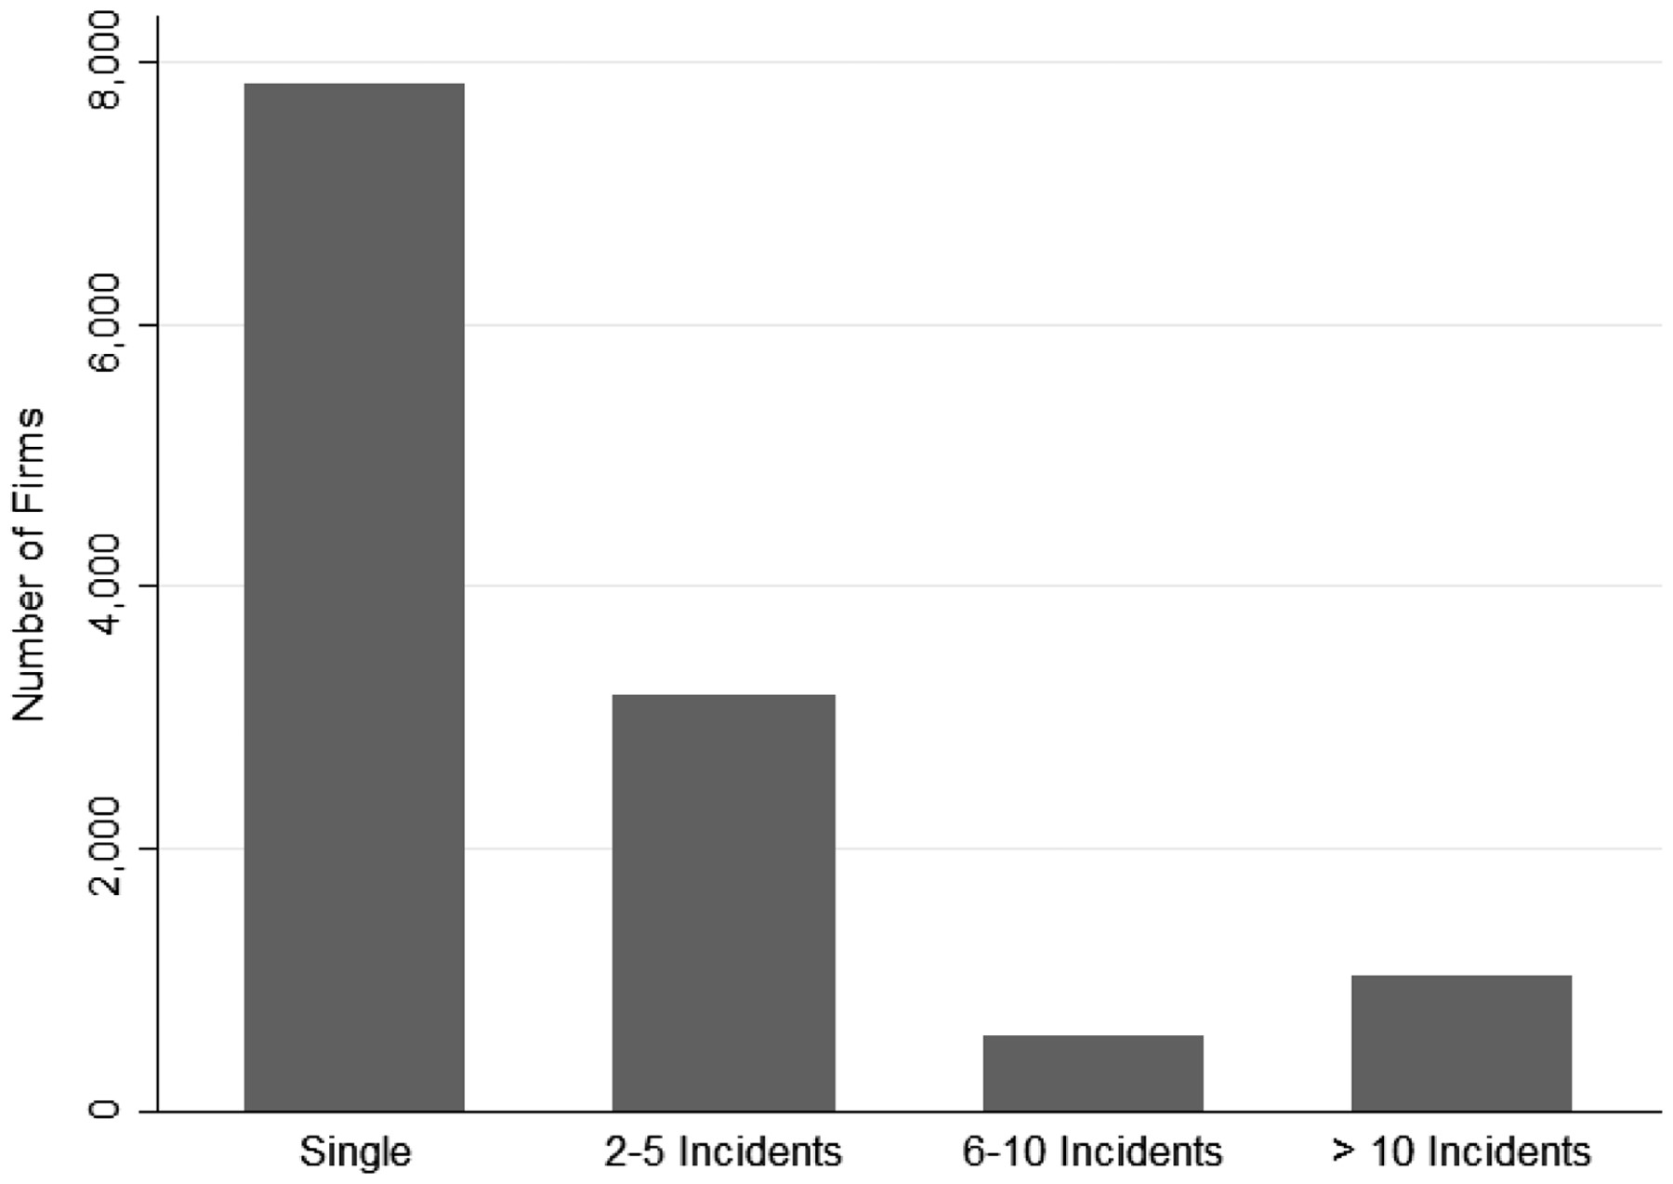
Figure 10. Distribution of repeat players.
Notes:
Figure 10. Distribution of repeat players.
Unless provided in the caption above, the following copyright applies to the content of this slide: © The Author 2016. Published by Oxford University Press.This is an Open Access article distributed under the terms of the Creative Commons Attribution Non-Commercial License (http://creativecommons.org/licenses/by-nc/4.0/), which permits non-commercial re-use, distribution, and reproduction in any medium, provided the original work is properly cited. For commercial re-use, please contact journals.permissions@oup.com

Slide 11
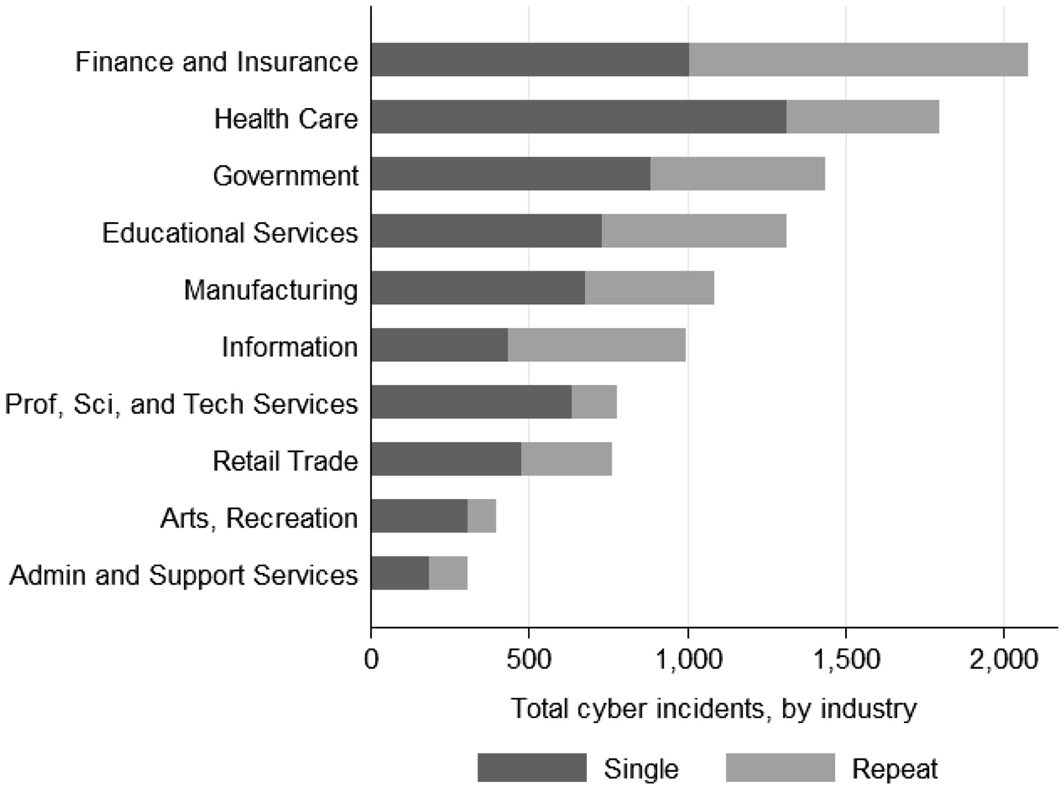
Figure 11. Repeat incidents by industry.
Notes:
Figure 11. Repeat incidents by industry.
Unless provided in the caption above, the following copyright applies to the content of this slide: © The Author 2016. Published by Oxford University Press.This is an Open Access article distributed under the terms of the Creative Commons Attribution Non-Commercial License (http://creativecommons.org/licenses/by-nc/4.0/), which permits non-commercial re-use, distribution, and reproduction in any medium, provided the original work is properly cited. For commercial re-use, please contact journals.permissions@oup.com

Slide 12
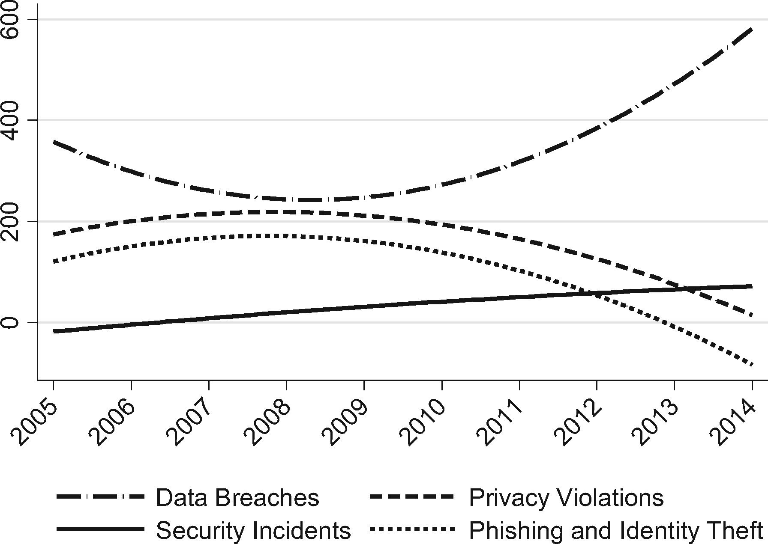
Figure 12. Total cost of cyber events over time.
Notes:
Figure 12. Total cost of cyber events over time.
Unless provided in the caption above, the following copyright applies to the content of this slide: © The Author 2016. Published by Oxford University Press.This is an Open Access article distributed under the terms of the Creative Commons Attribution Non-Commercial License (http://creativecommons.org/licenses/by-nc/4.0/), which permits non-commercial re-use, distribution, and reproduction in any medium, provided the original work is properly cited. For commercial re-use, please contact journals.permissions@oup.com

Slide 13
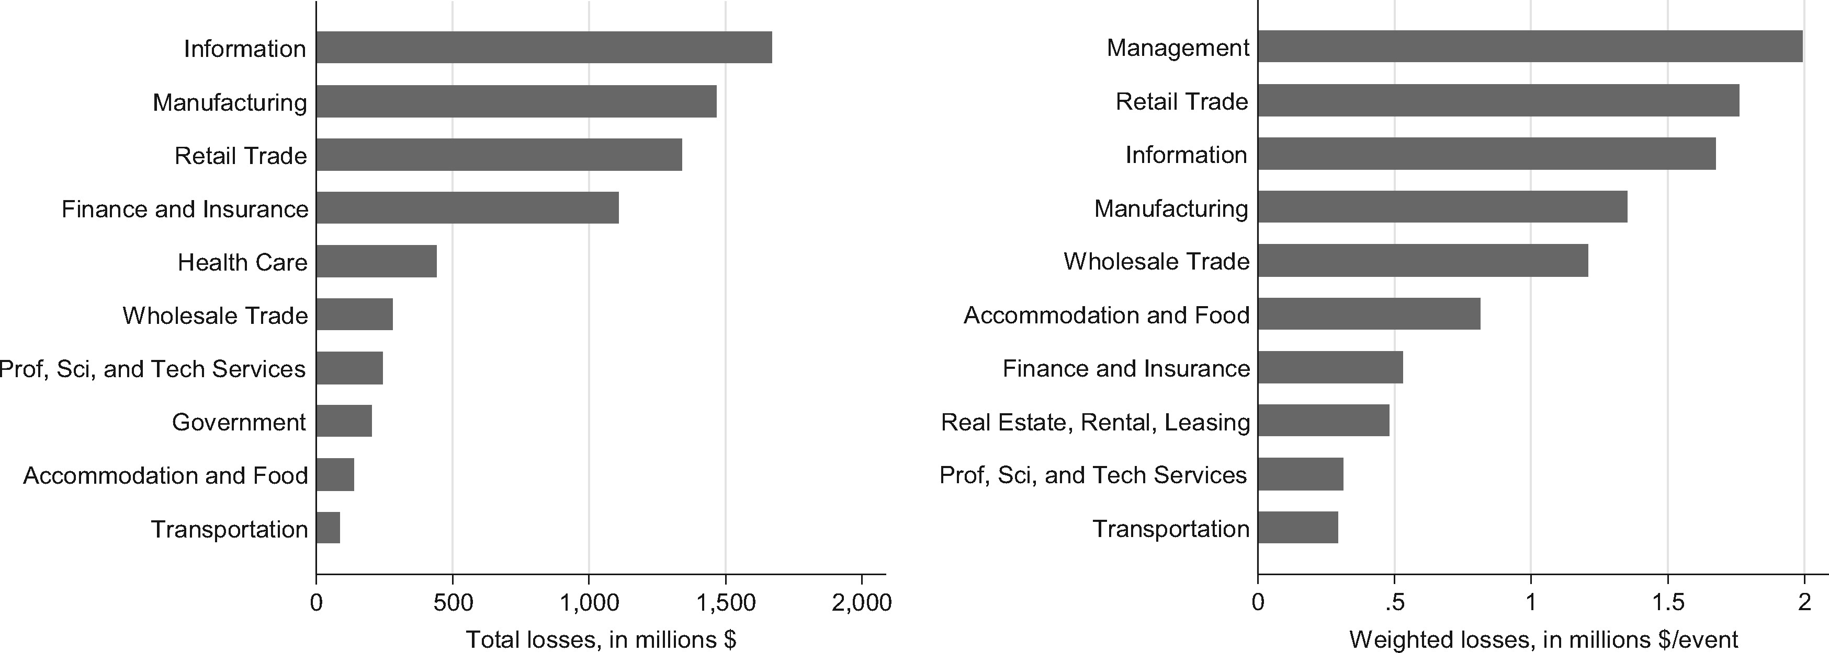
Figure 13. Losses by industry.
Notes:
Figure 13. Losses by industry.
Unless provided in the caption above, the following copyright applies to the content of this slide: © The Author 2016. Published by Oxford University Press.This is an Open Access article distributed under the terms of the Creative Commons Attribution Non-Commercial License (http://creativecommons.org/licenses/by-nc/4.0/), which permits non-commercial re-use, distribution, and reproduction in any medium, provided the original work is properly cited. For commercial re-use, please contact journals.permissions@oup.com

Slide 14
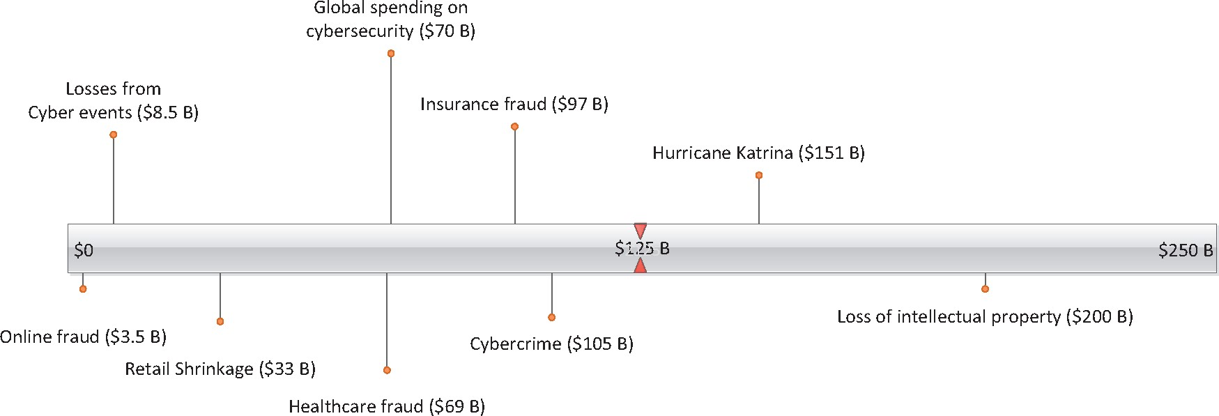
Figure 14. Relative costs and losses (annual, in billions of US dollars) (Indeed, there may be some overlap between ...
Notes:
Figure 14. Relative costs and losses (annual, in billions of US dollars) (Indeed, there may be some overlap between some categories (i.e. intellectual property and cyber crime). However, these descriptions are presented as informational estimates only.).
Unless provided in the caption above, the following copyright applies to the content of this slide: © The Author 2016. Published by Oxford University Press.This is an Open Access article distributed under the terms of the Creative Commons Attribution Non-Commercial License (http://creativecommons.org/licenses/by-nc/4.0/), which permits non-commercial re-use, distribution, and reproduction in any medium, provided the original work is properly cited. For commercial re-use, please contact journals.permissions@oup.com

Slide 15
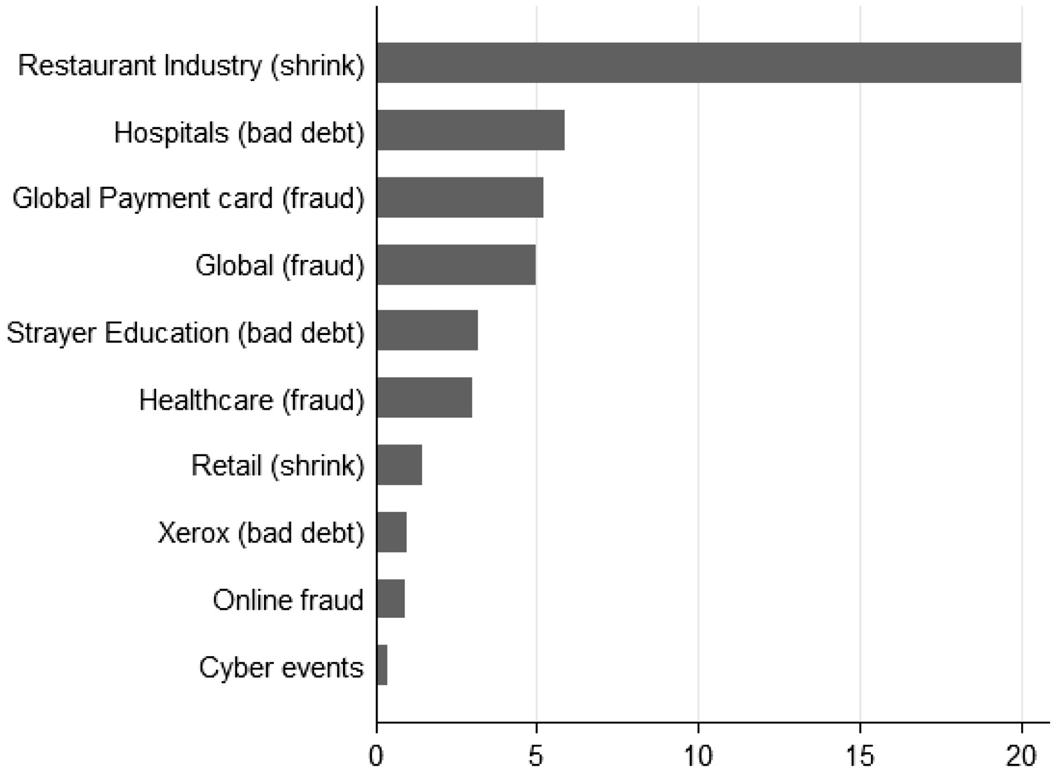
Figure 15. Loss as a percentage of revenues.
Notes:
Figure 15. Loss as a percentage of revenues.
Unless provided in the caption above, the following copyright applies to the content of this slide: © The Author 2016. Published by Oxford University Press.This is an Open Access article distributed under the terms of the Creative Commons Attribution Non-Commercial License (http://creativecommons.org/licenses/by-nc/4.0/), which permits non-commercial re-use, distribution, and reproduction in any medium, provided the original work is properly cited. For commercial re-use, please contact journals.permissions@oup.com

Slide 16
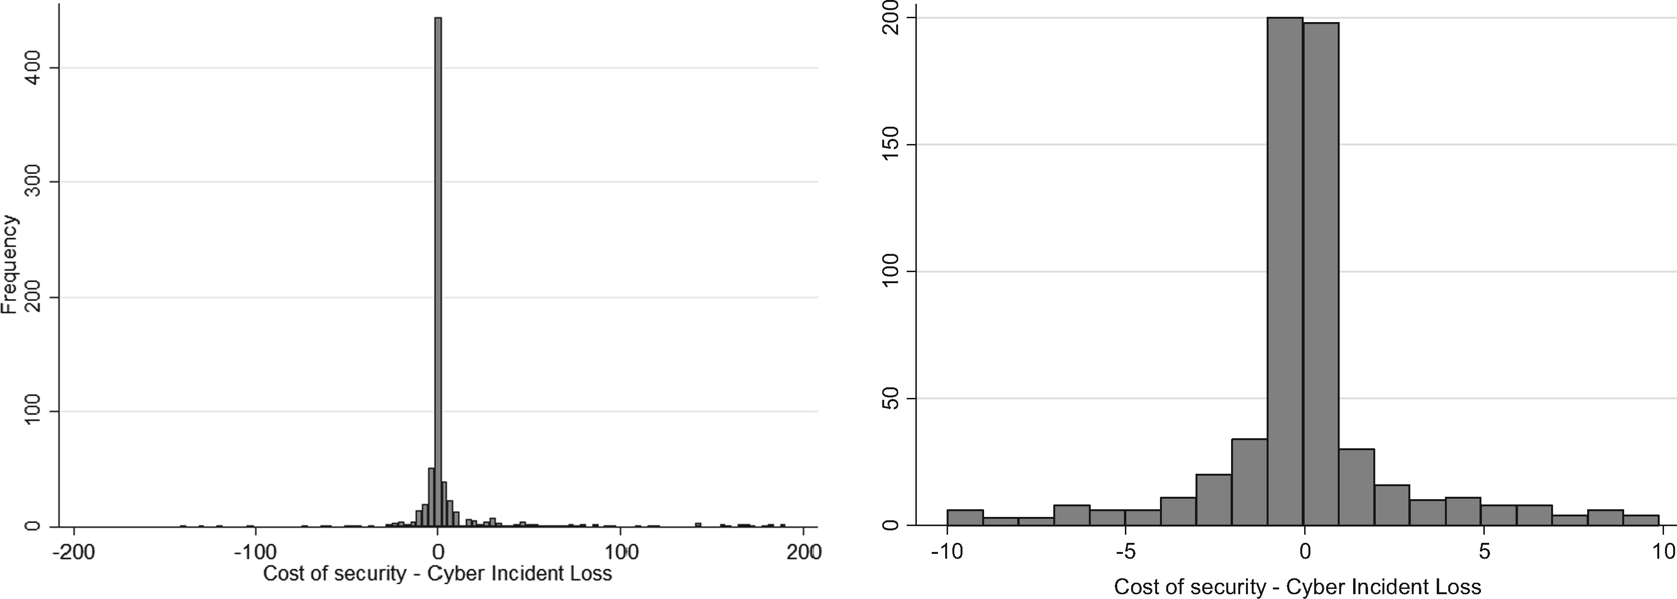
Figure 16. Incident costs – security spending (in millions of $).
Notes:
Figure 16. Incident costs – security spending (in millions of $).
Unless provided in the caption above, the following copyright applies to the content of this slide: © The Author 2016. Published by Oxford University Press.This is an Open Access article distributed under the terms of the Creative Commons Attribution Non-Commercial License (http://creativecommons.org/licenses/by-nc/4.0/), which permits non-commercial re-use, distribution, and reproduction in any medium, provided the original work is properly cited. For commercial re-use, please contact journals.permissions@oup.com

