Slide 1
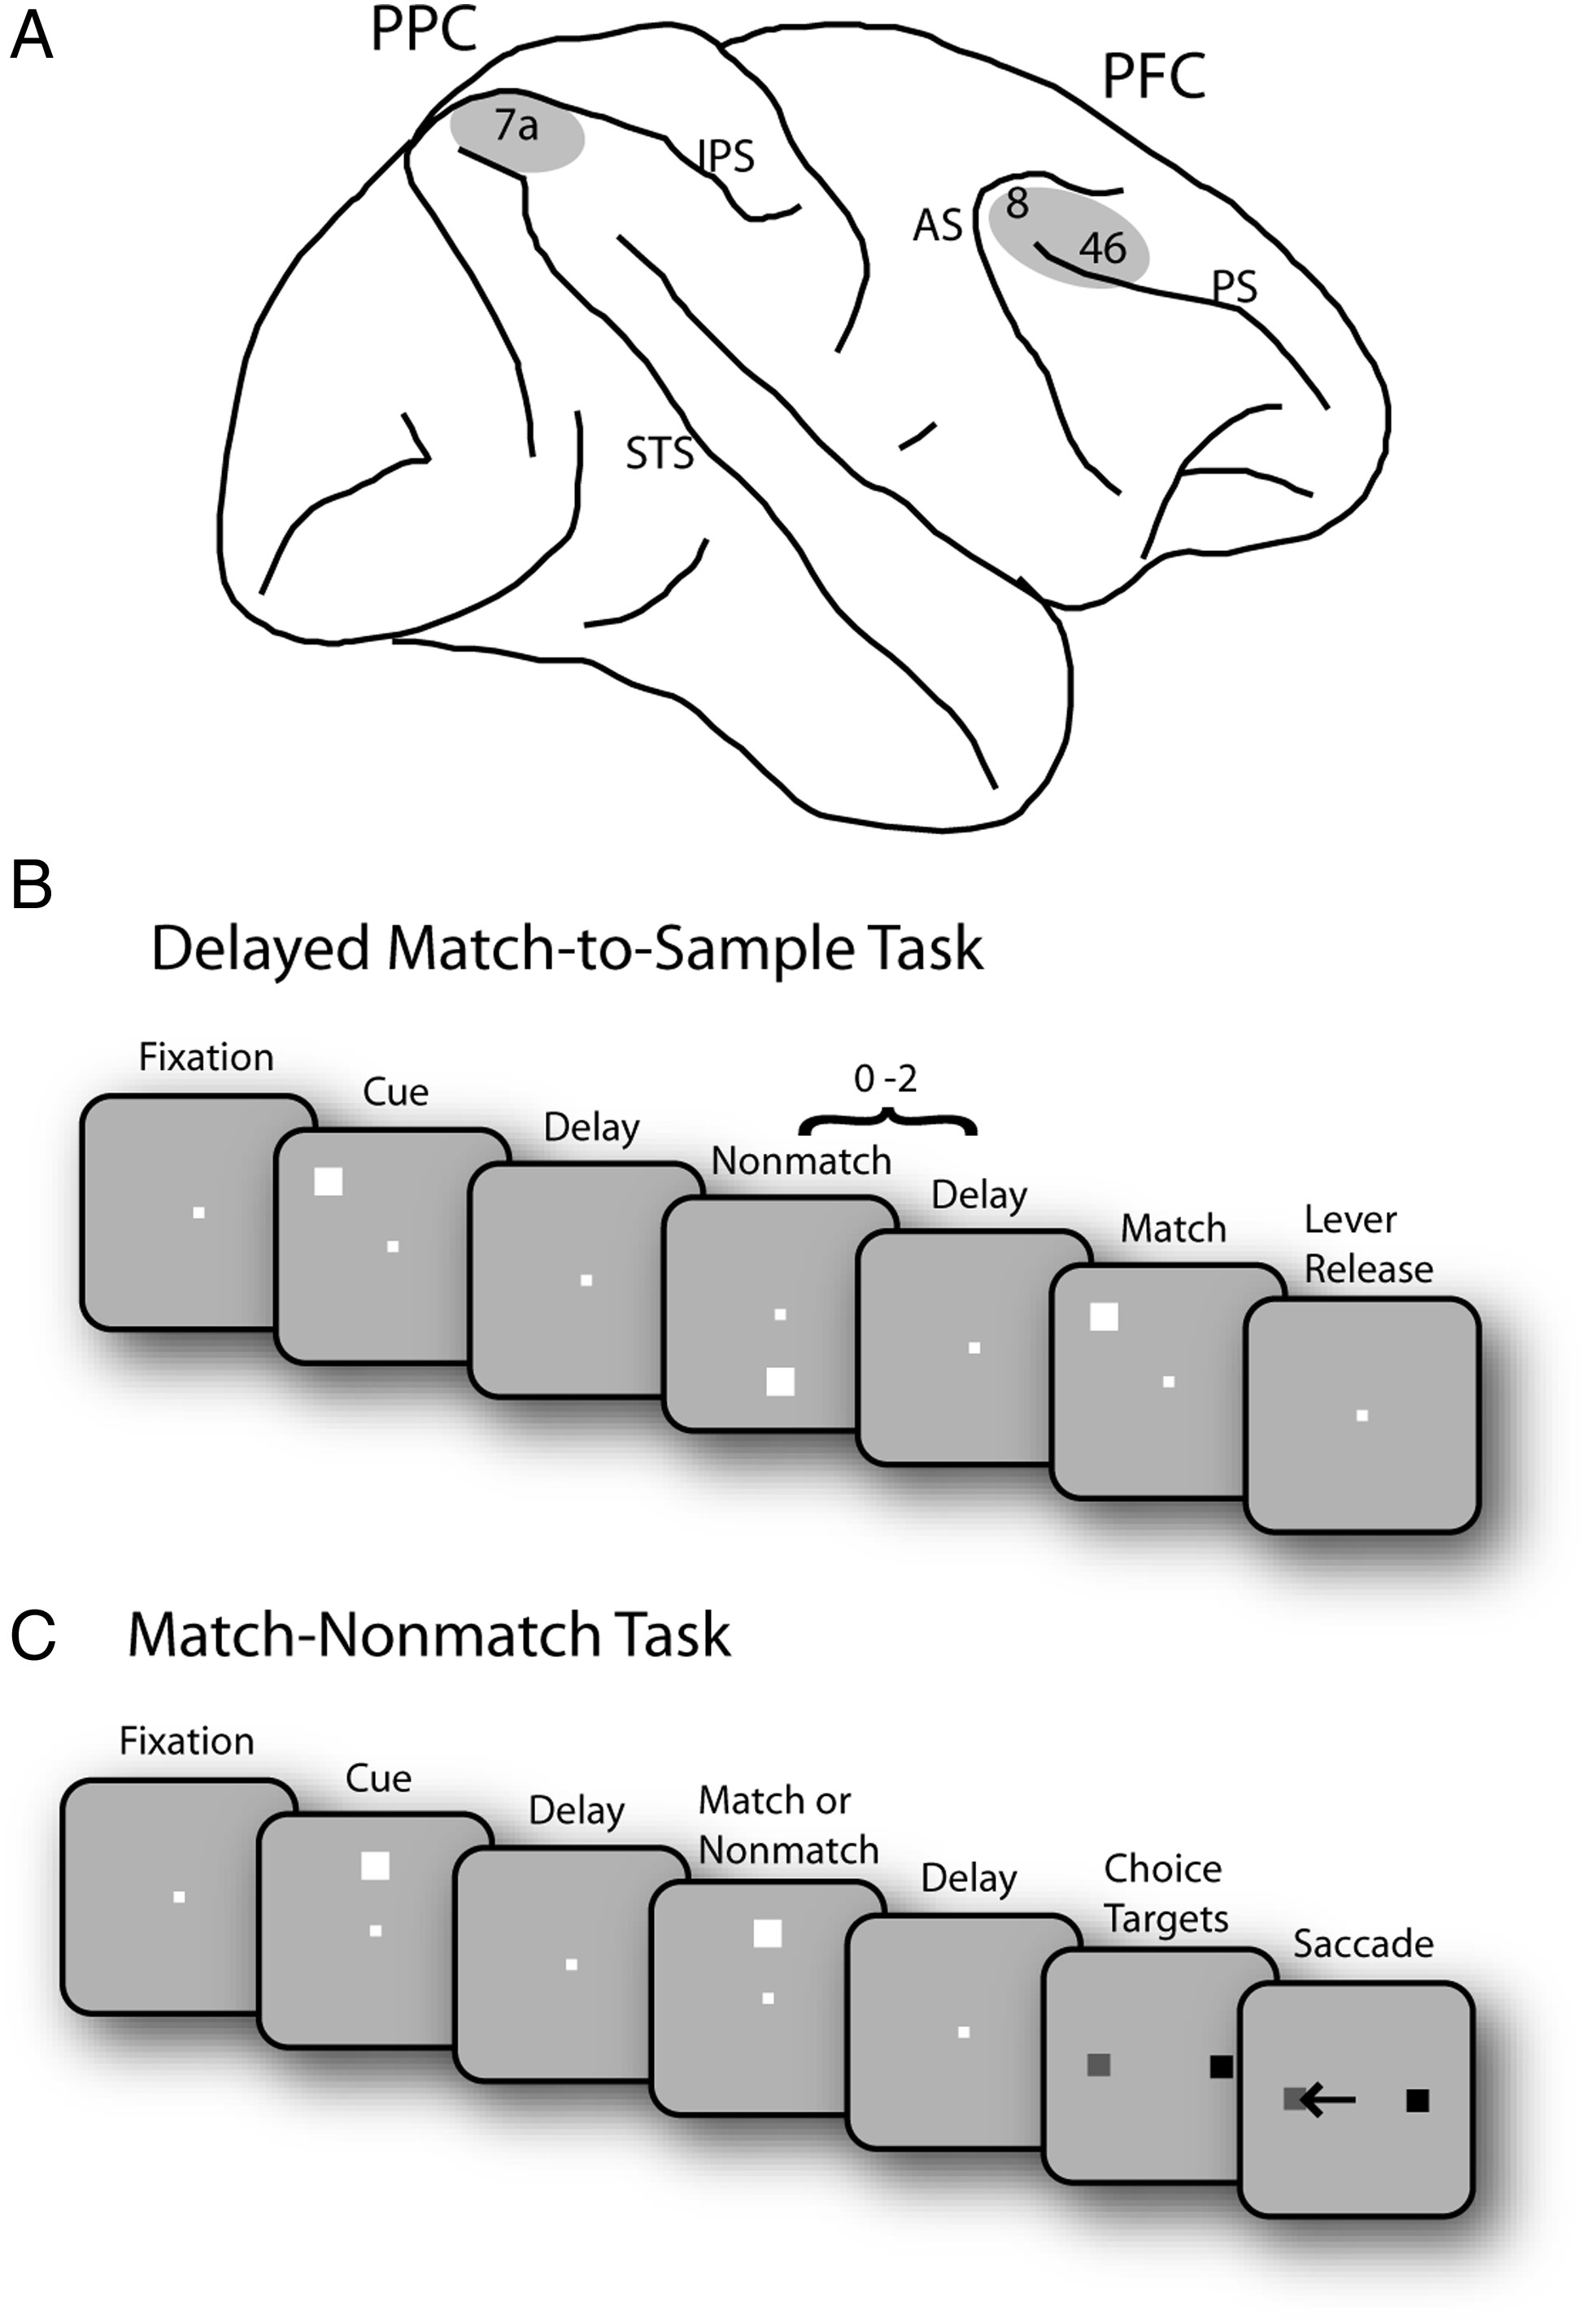
Figure 1. Brain areas and tasks. (A) Schematic diagram of the monkey brain. The areas of recordings are highlighted. ...
Notes:
Figure 1. Brain areas and tasks. (A) Schematic diagram of the monkey brain. The areas of recordings are highlighted. AS, arcuate sulcus; IPS, intraparietal sulcus; PS, principal sulcus; STS, superior temporal sulcus. (B) Successive frames illustrate the sequence of stimulus presentations in the Delayed Match-to-Sample task. Following the cue presentation, a match or nonmatch stimulus appeared. The monkeys were required to remember the location of cue stimulus and release a lever when a subsequent stimulus appeared at the cued location. (C) Schematic illustration of the Match/Nonmatch task. Two choice targets were presented at the end of a trial, and the monkey was required to saccade to a green target (colored in gray in the figure); in case the 2 stimuli were matching and to a blue target (colored in black) otherwise.
Unless provided in the caption above, the following copyright applies to the content of this slide: © The Author 2013. Published by Oxford University Press. All rights reserved. For Permissions, please e-mail: journals.permissions@oup.com

Slide 2
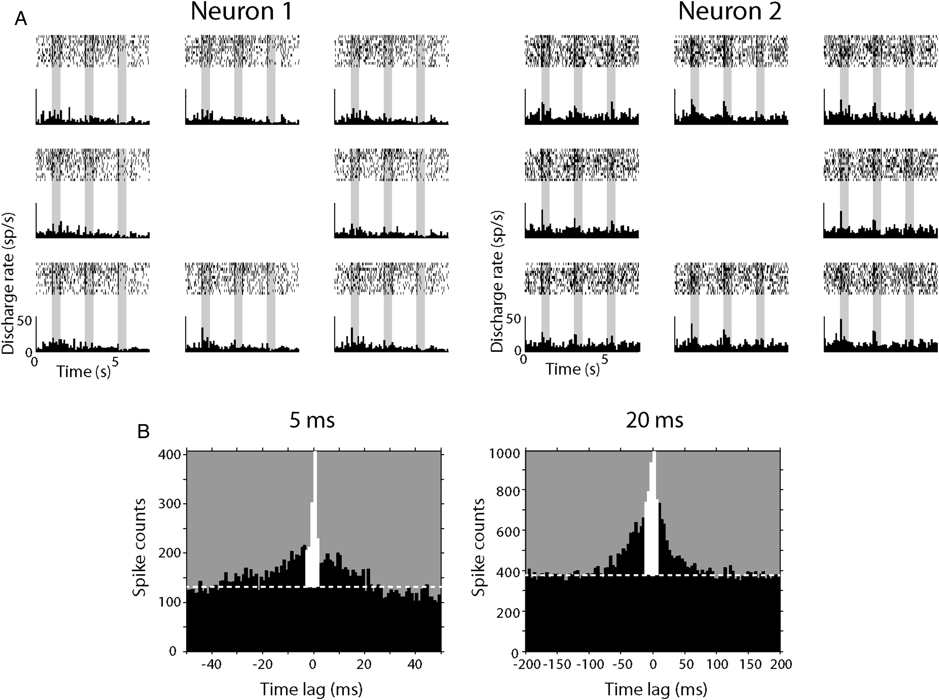
Figure 2. Cross-correlation analysis. (A) Sample rasters and histograms of 2 parietal neurons recorded simultaneously ...
Notes:
Figure 2. Cross-correlation analysis. (A) Sample rasters and histograms of 2 parietal neurons recorded simultaneously from separate electrodes. Rasters and histogram panels are arranged at locations corresponding to the relative cue stimulus location in the screen. (B) Examples of cross-correlation histograms (CCH). Horizontal dotted white lines represent CCH baseline. The strength of functional interactions between 2 neurons was estimated by calculating the percentage of spikes under the center 5 ms (left) or 20 ms (right) of the CCH (colored in white).
Unless provided in the caption above, the following copyright applies to the content of this slide: © The Author 2013. Published by Oxford University Press. All rights reserved. For Permissions, please e-mail: journals.permissions@oup.com

Slide 3
Figure 3. Effective connectivity as a function of distance. (A–C) Cross-correlation strength of prefrontal and parietal ...
Notes:
Figure 3. Effective connectivity as a function of distance. (A–C) Cross-correlation strength of prefrontal and parietal cortex as a function of electrode separation plotted for each of 3 animals. Each dot represents data from a pair of neurons. Blue and red dots and lines represent the parietal cortex and the prefrontal cortex, respectively. Dotted lines represent 95% confidence intervals. Up to 10 outliers appear outside the minimum or maximum bounds of the axes in each panel. (D) Cross-correlation strength averaged across monkeys. Data were first binned separately for each monkey, then averaged together at each distance, weighing equally each monkey. Error bars at each point represent standard error of the mean across monkeys. Blue and red curves represent average of curves in panels A–C. Inset illustrates average cross-correlation strength computed for neuron pairs with distances of ≤0.3 mm for each monkey. The center 5 ms of CCH peak was used. Blue and red bars represent the parietal and prefrontal cortex, respectively. Stars indicate statistically significant differences at the 0.05 significance level (t-test).
Unless provided in the caption above, the following copyright applies to the content of this slide: © The Author 2013. Published by Oxford University Press. All rights reserved. For Permissions, please e-mail: journals.permissions@oup.com

Slide 4
Figure 4. Predictor-corrected effective connectivity. (A) Shift-predictor corrected cross-correlation strength of ...
Notes:
Figure 4. Predictor-corrected effective connectivity. (A) Shift-predictor corrected cross-correlation strength of prefrontal and parietal neuron pairs, averaged across monkeys. (B). Cross-correlation strength as in A, but using a surrogate spike train predictor. (C). Cross-correlation strength as in A, but using a spike train predictor based on jittering the timing of each spike within a 50 ms window. (D) Proportion of pairs with significant cross-correlation peaks, based on the predictor of panel C. Data points represent values averaged across monkeys, weighing each monkey equally.
Unless provided in the caption above, the following copyright applies to the content of this slide: © The Author 2013. Published by Oxford University Press. All rights reserved. For Permissions, please e-mail: journals.permissions@oup.com

Slide 5
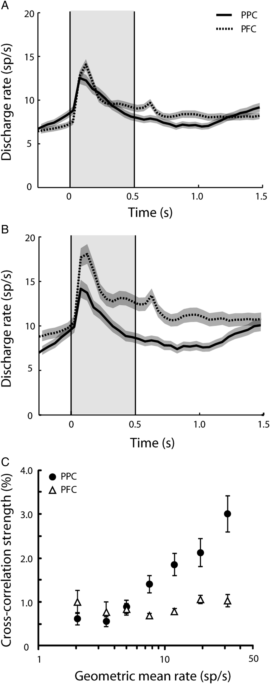
Figure 5. Firing rate of neurons used in cross-correlation analysis. Peristimulus time histogram represents average ...
Notes:
Figure 5. Firing rate of neurons used in cross-correlation analysis. Peristimulus time histogram represents average firing rate for neurons recorded from the posterior parietal cortex (solid) and the prefrontal cortex (dotted). (A) All neurons in our sample. (B) Neurons from pairs with electrode separation ≤0.3 mm. Shaded area along each trace represents 1 standard error of mean computed across neurons. Gray shaded area represents the cue presentation period. (C) Relationship between cross-correlation strength and firing rate. Geometric mean rate was computed for each neuron pair with electrode separation ≤0.3 mm.
Unless provided in the caption above, the following copyright applies to the content of this slide: © The Author 2013. Published by Oxford University Press. All rights reserved. For Permissions, please e-mail: journals.permissions@oup.com

Slide 6
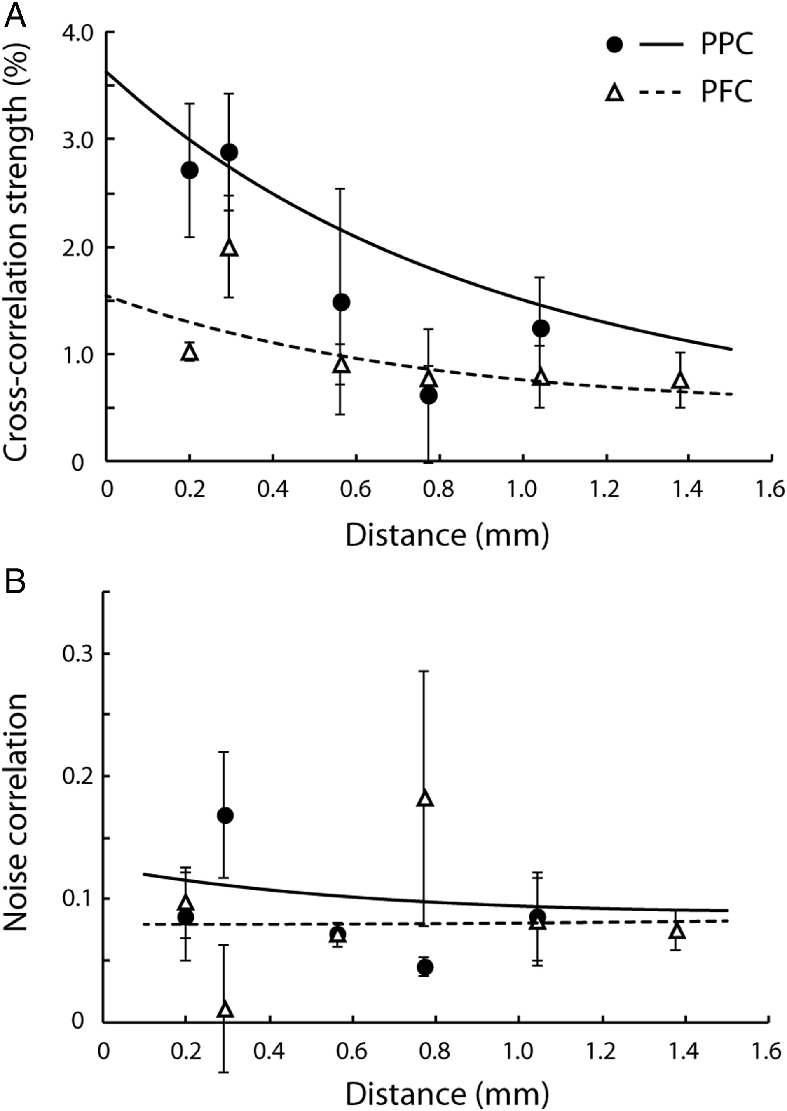
Figure 6. Effective connectivity computed in different time scales. Mean cross-correlation strength and noise ...
Notes:
Figure 6. Effective connectivity computed in different time scales. Mean cross-correlation strength and noise correlation averaged across monkeys. Circles/solid lines and triangles/dotted lines represent the parietal cortex and prefrontal cortex, respectively. Curves were fit based on all raw data points and superimposed on the average data points. Error bars represent standard error of the mean across monkeys. (A) Predictor-corrected average cross-correlation strength as a function of electrode separation. The center 20 ms of CCH peak was used. (B) Average noise correlation in the fixation period is plotted as a function of electrode separation.
Unless provided in the caption above, the following copyright applies to the content of this slide: © The Author 2013. Published by Oxford University Press. All rights reserved. For Permissions, please e-mail: journals.permissions@oup.com

Slide 7
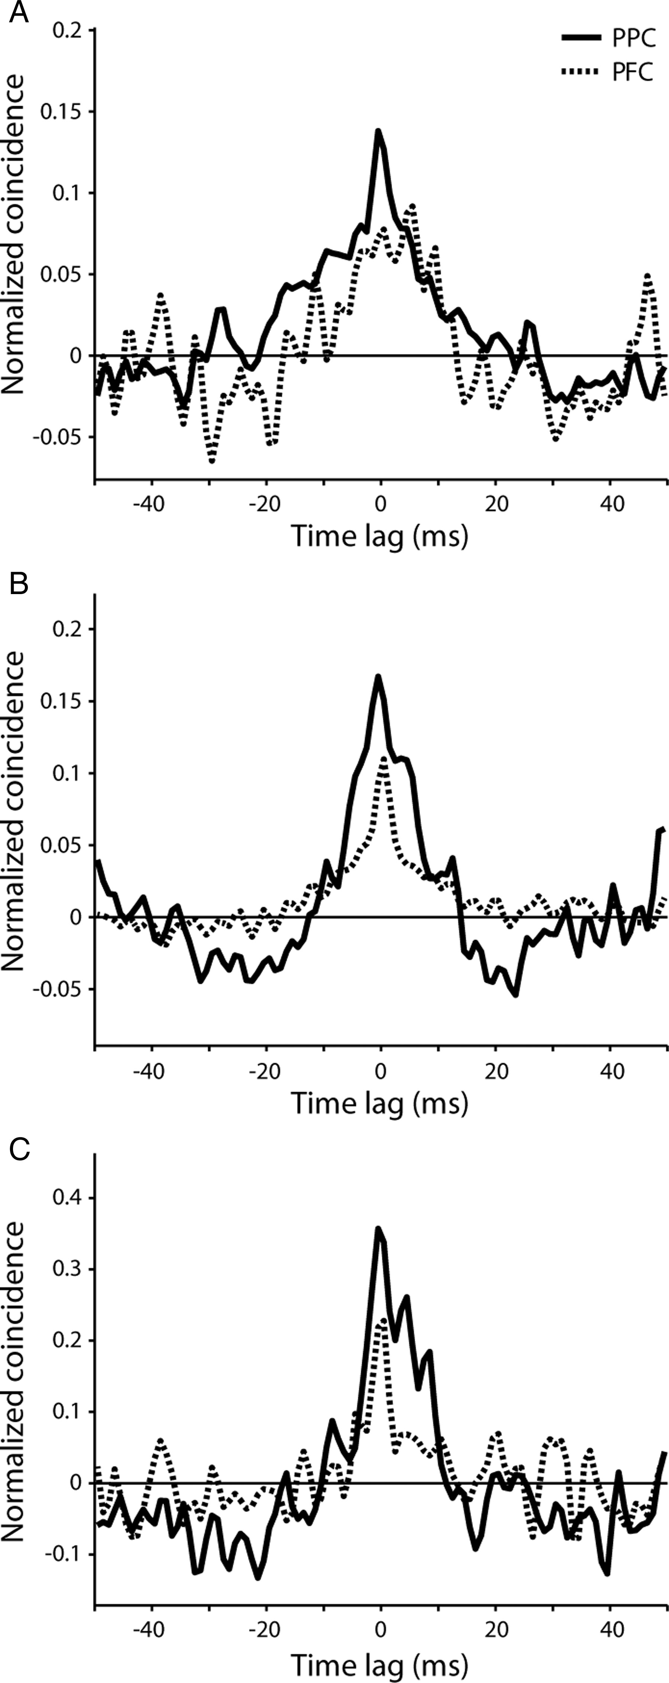
Figure 7. Average cross-correlation in each monkey. (A–C) Average cross-correlation histogram for the prefrontal and ...
Notes:
Figure 7. Average cross-correlation in each monkey. (A–C) Average cross-correlation histogram for the prefrontal and posterior parietal cortex from pairs of neurons recorded within 0.3 mm from each other, shown separately for each monkey in each panel. Histograms have been smoothed with a 3-point triangular filter.
Unless provided in the caption above, the following copyright applies to the content of this slide: © The Author 2013. Published by Oxford University Press. All rights reserved. For Permissions, please e-mail: journals.permissions@oup.com

Slide 8
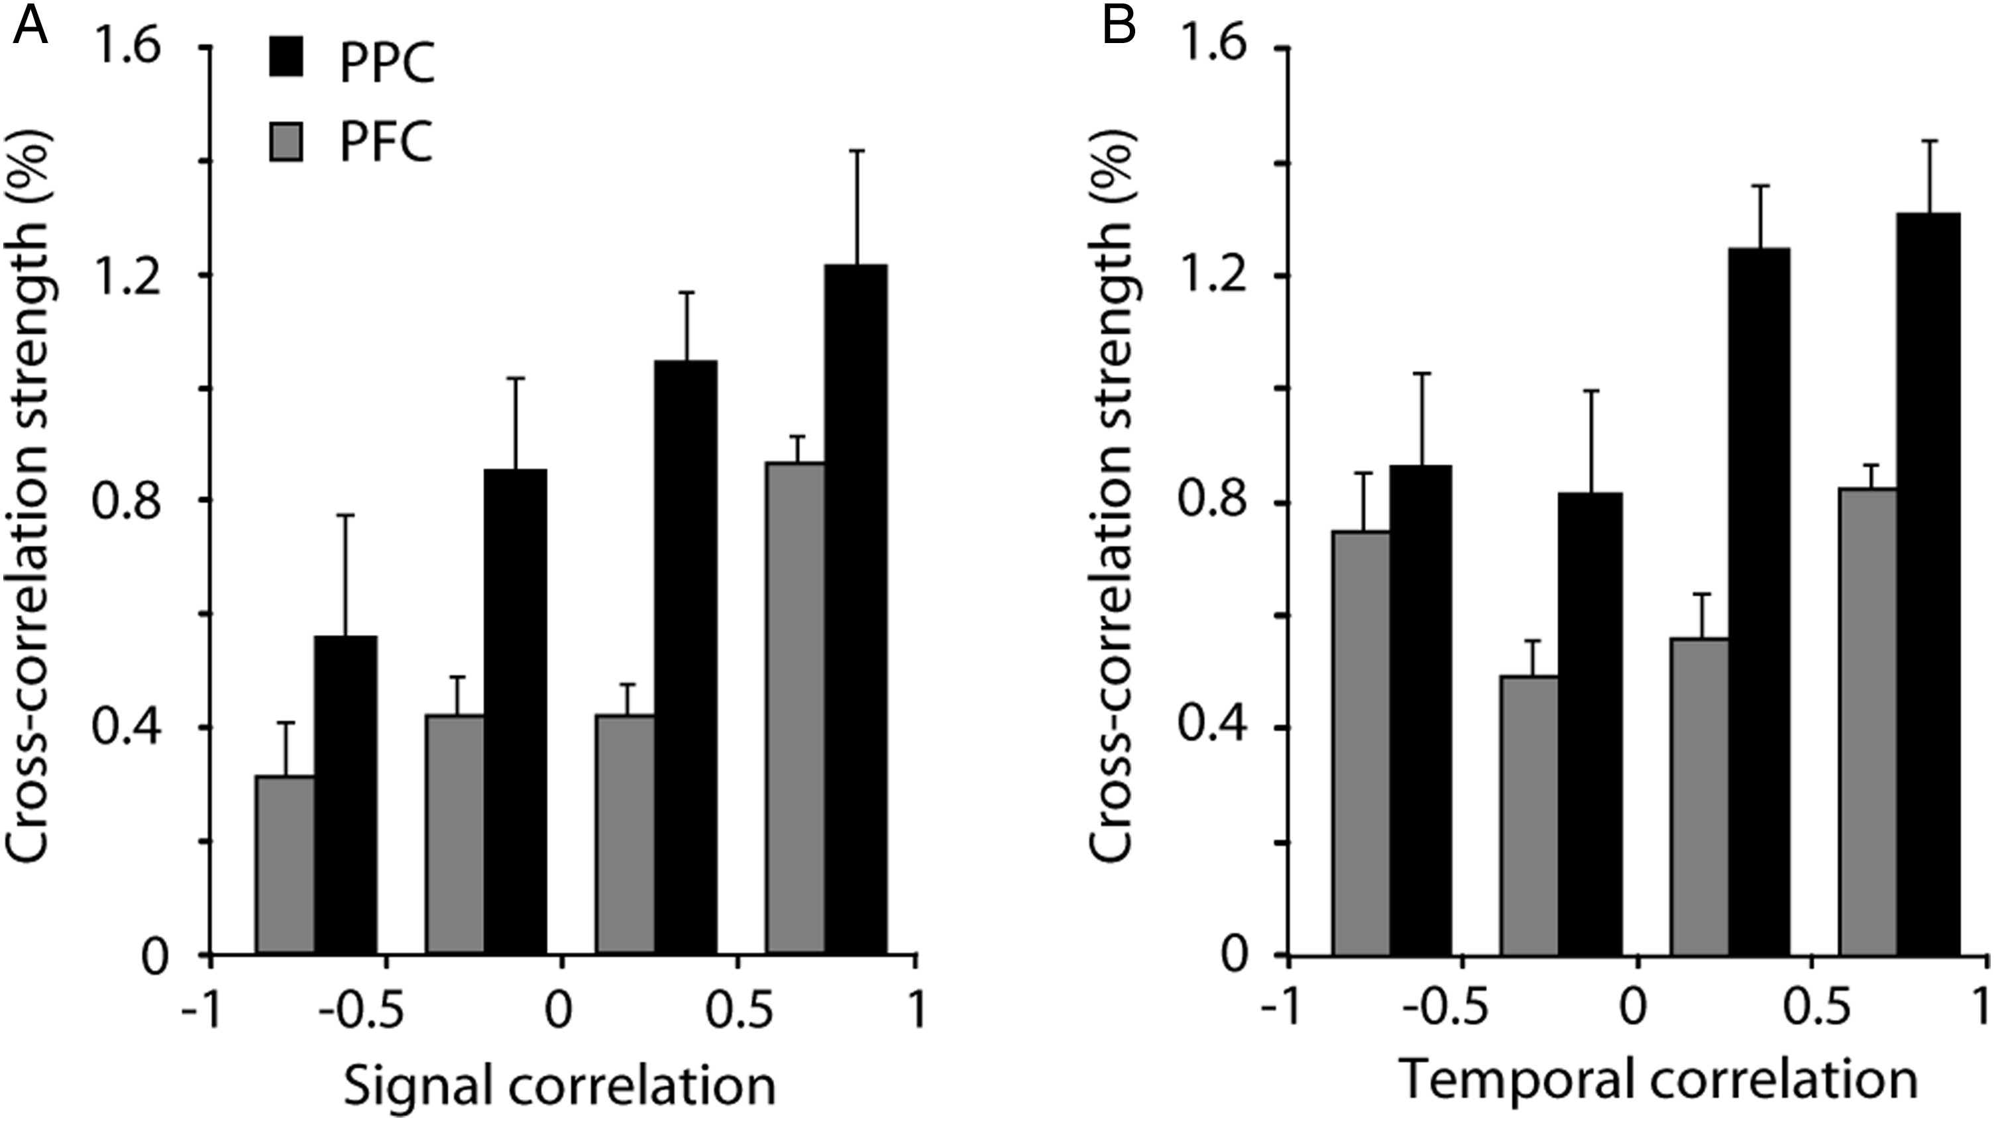
Figure 8. Relationship between response selectivity and effective connectivity. (A) Average cross-correlation strength ...
Notes:
Figure 8. Relationship between response selectivity and effective connectivity. (A) Average cross-correlation strength versus signal correlation. (B) Average cross-correlation strength versus temporal correlation. Black and gray bars represent the parietal cortex and prefrontal cortex, respectively. Error bars represent standard errors of the mean across neuron pairs.
Unless provided in the caption above, the following copyright applies to the content of this slide: © The Author 2013. Published by Oxford University Press. All rights reserved. For Permissions, please e-mail: journals.permissions@oup.com

Slide 9
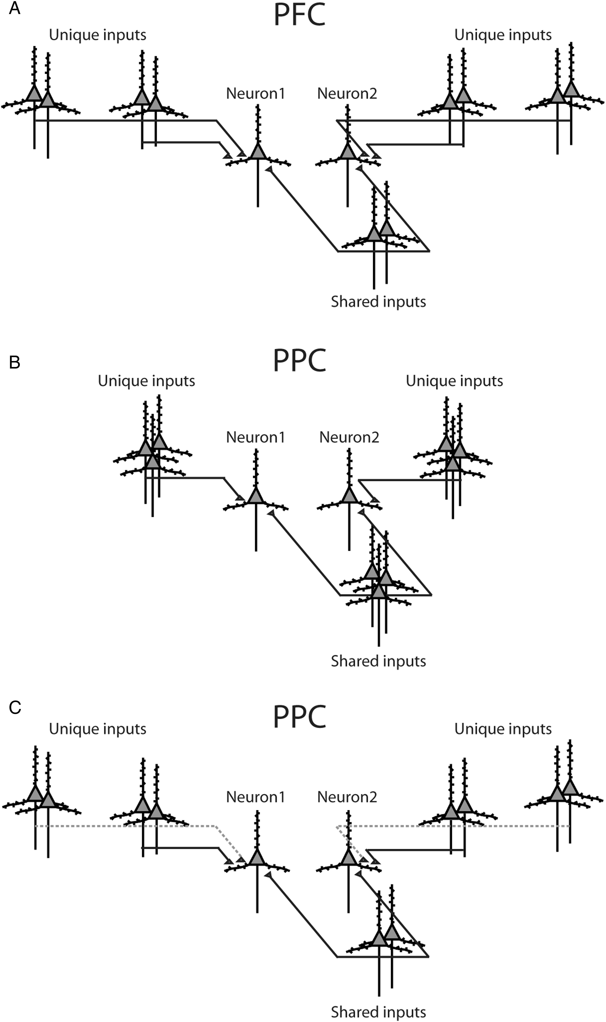
Figure 9. Schematic models of intrinsic functional organization. (A) Diagram illustrates distributions of synaptic ...
Notes:
Figure 9. Schematic models of intrinsic functional organization. (A) Diagram illustrates distributions of synaptic inputs onto a pair of prefrontal neurons. (B) Distributions of posterior parietal inputs. Parietal neurons may integrate inputs over a shorter range of distances compared with prefrontal neurons. (C) An alternative model for posterior parietal organization. Spatial distribution of inputs is identical to prefrontal cortex, but long distance connections exhibit proportionally lower functional strengths (represented with dotted lines).
Unless provided in the caption above, the following copyright applies to the content of this slide: © The Author 2013. Published by Oxford University Press. All rights reserved. For Permissions, please e-mail: journals.permissions@oup.com

Slide 10
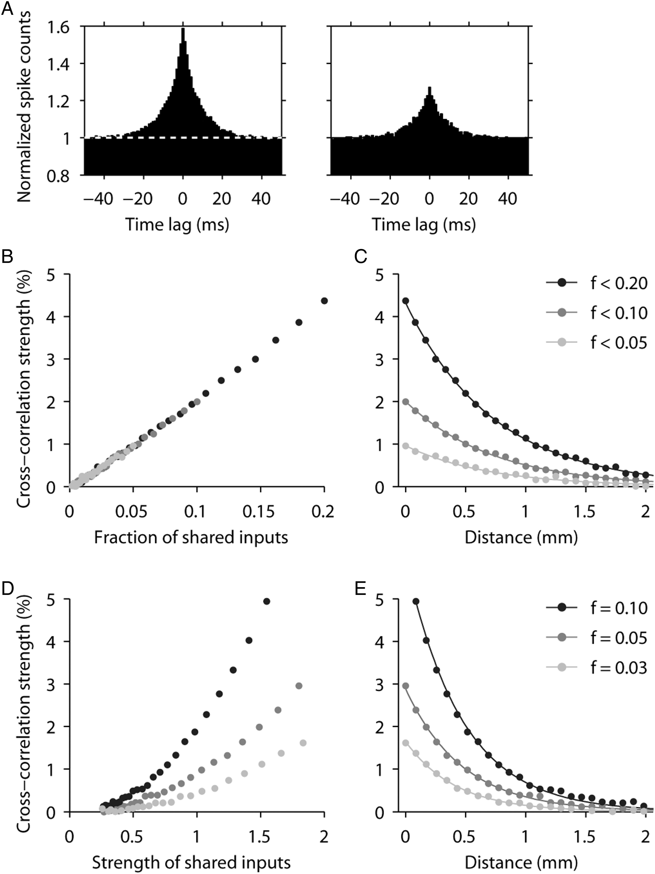
Figure 10. Simulating cross-correlations through shared input. Pairs of integrate-and-fire model neurons were simulated ...
Notes:
Figure 10. Simulating cross-correlations through shared input. Pairs of integrate-and-fire model neurons were simulated and CCHs were obtained for different values of f and w, where f is the fraction of shared inputs and w the mean synaptic weight per shared input, expressed as a fraction of the mean synaptic weight. (A) Examples of simulated CCHs obtained with f = 0.2 (left) and f = 0.1 (right); w = 1 in both cases. Spike counts were normalized so that the baseline was equal to 1. (B) Cross-correlation strength as a function of f. Gray shades indicate 3 simulation runs with maximum f values of 0.05 (light gray), 0.1 (dark gray), and 0.2 (black). For all points, w = 1. (C) Expected dependence of cross-correlation strength on distance, assuming that f decreases exponentially with distance; space constant was 0.8 mm. Values on the y-axis are the same as in B. Continuous lines are exponential fits to the simulated data points (dots). (D) Cross-correlation strength as a function of w. Gray shades indicate 3 simulation runs with f values of 0.03 (light gray), 0.05 (dark gray), and 0.1 (black). (E) Expected dependence of cross-correlation strength on distance, assuming that w decreases exponentially with distance; space constant was 0.8 mm. Values on the y-axis are the same as in D. Continuous lines are exponential fits to the simulated data points (dots).
Unless provided in the caption above, the following copyright applies to the content of this slide: © The Author 2013. Published by Oxford University Press. All rights reserved. For Permissions, please e-mail: journals.permissions@oup.com

