Slide 1
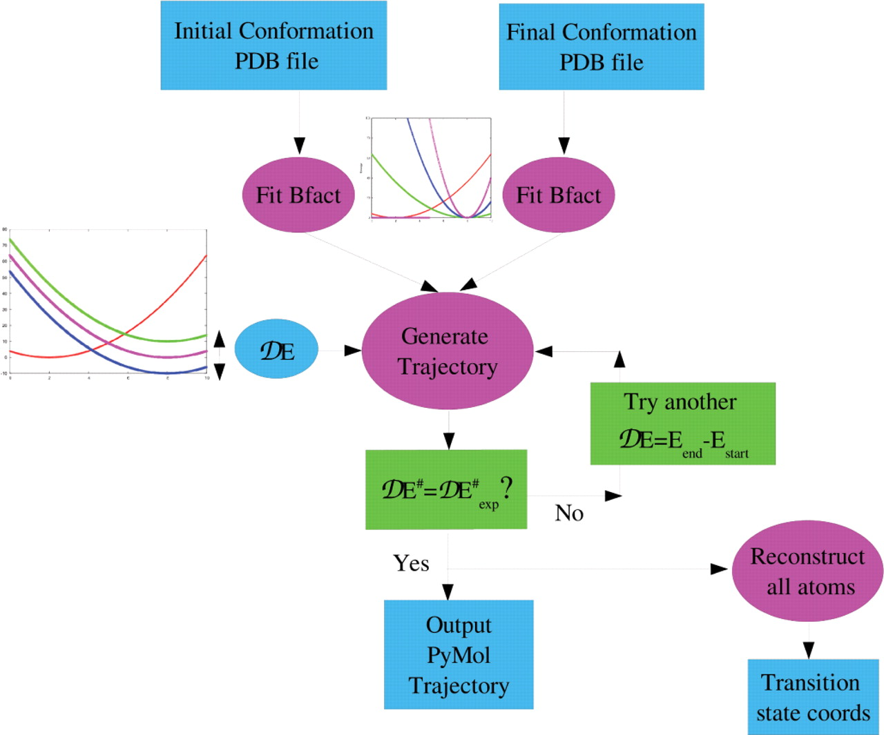
Figure 1. Flow chart of the web site. The input consists of two PDB files of one macromolecule in two different ...
Notes:
Figure 1. Flow chart of the web site. The input consists of two PDB files of one macromolecule in two different conformations, the estimated energy difference between the two states, the ENM cutoff (10–12 Å) and the elastic constants for the two states, which can be estimated on-line. The returned output is the most probable trajectory between the two states (loadable by PyMol) and the coordinates of the transition state, its energy E# with respect to the initial state and the value of the minimized action Stot in the trajectory. Insert: One-dimensional representation of the shift on the crossing point of the two harmonic curves when using different energy differences between the two states, and when using an increasing elastic constant for the end state.
Unless provided in the caption above, the following copyright applies to the content of this slide: © 2007 The Author(s)This is an Open Access article distributed under the terms of the Creative Commons Attribution Non-Commercial License (http://creativecommons.org/licenses/by-nc/2.0/uk/) which permits unrestricted non-commercial use, distribution, and reproduction in any medium, provided the original work is properly cited.

Slide 2
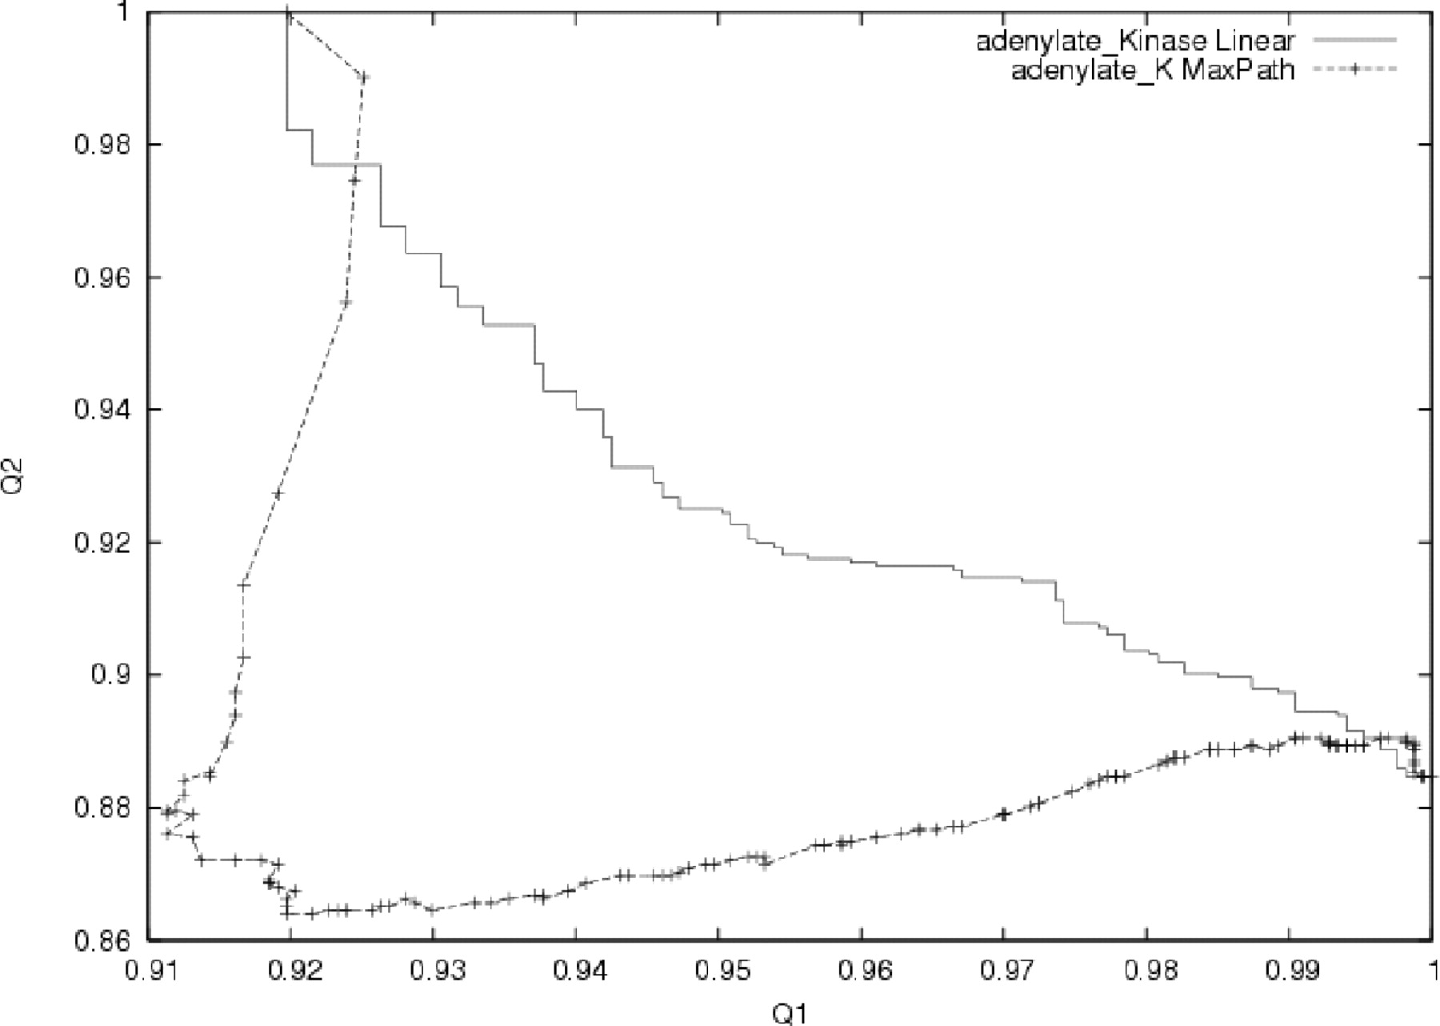
Figure 2. Q1 versus Q2 plot for adenylate kinase transition (4AKE and 1AKE). Q1 (resp. Q2) is the fraction of native ...
Notes:
Figure 2. Q1 versus Q2 plot for adenylate kinase transition (4AKE and 1AKE). Q1 (resp. Q2) is the fraction of native contacts (dij < Rc) as in the initial form (resp. in the final form). The trajectory is identical, within machine precision, if one exchanges the role of the initial and final states. For comparison, the same plot is drawn for a trajectory generated according to UMMS (26,27).
Unless provided in the caption above, the following copyright applies to the content of this slide: © 2007 The Author(s)This is an Open Access article distributed under the terms of the Creative Commons Attribution Non-Commercial License (http://creativecommons.org/licenses/by-nc/2.0/uk/) which permits unrestricted non-commercial use, distribution, and reproduction in any medium, provided the original work is properly cited.

