Slide 1
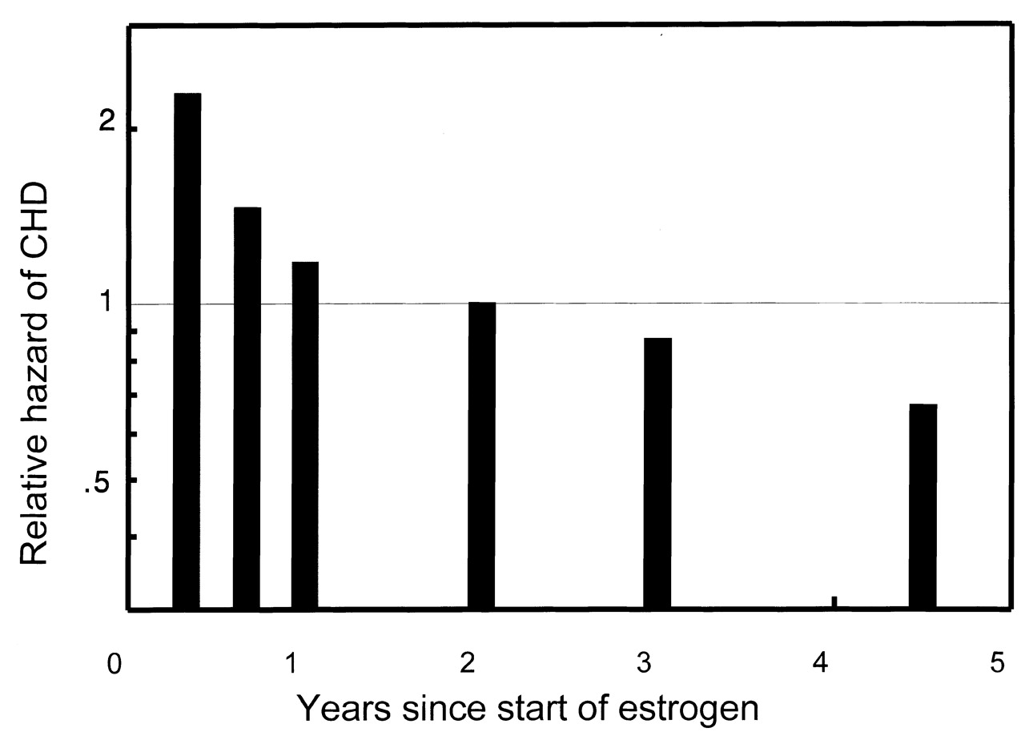
FIGURE 1. Relative hazard of coronary heart disease (CHD) events in the Heart and Estrogen/Progestin ...
Notes:
FIGURE 1. Relative hazard of coronary heart disease (CHD) events in the Heart and Estrogen/Progestin Replacement Study (HERS II) reported by Hulley et al. (1), which was conducted among 2,763 postmenopausal women with CHD recruited from 20 US clinical centers. The hazard ratios compare women randomized to replacement estrogen/progestin with those randomized to placebo and are shown by time (years) since randomization.
Unless provided in the caption above, the following copyright applies to the content of this slide:

