Slide 1
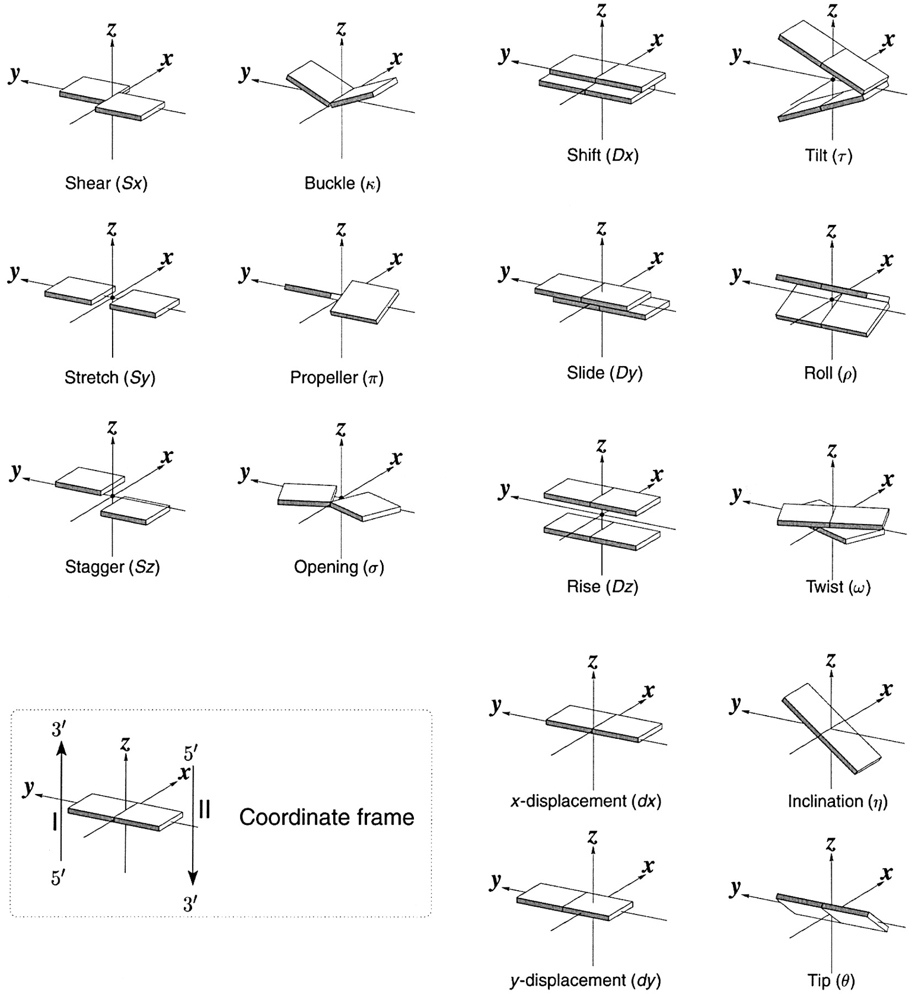
Figure 1. Pictorial definitions of rigid body parameters used to describe the geometry of complementary (or ...
Notes:
Figure 1. Pictorial definitions of rigid body parameters used to describe the geometry of complementary (or non‐complementary) base pairs and sequential base pair steps (19). The base pair reference frame (lower left) is constructed such that the x‐axis points away from the (shaded) minor groove edge of a base or base pair and the y‐axis points toward the sequence strand (I). The relative position and orientation of successive base pair planes are described with respect to both a dimer reference frame (upper right) and a local helical frame (lower right). Images illustrate positive values of the designated parameters. For illustration purposes, helical twist (Ωh) is the same as Twist (ω), formerly denoted by Ω (19,20) and helical rise (h) is the same as Rise (Dz).
Unless provided in the caption above, the following copyright applies to the content of this slide:

Slide 2
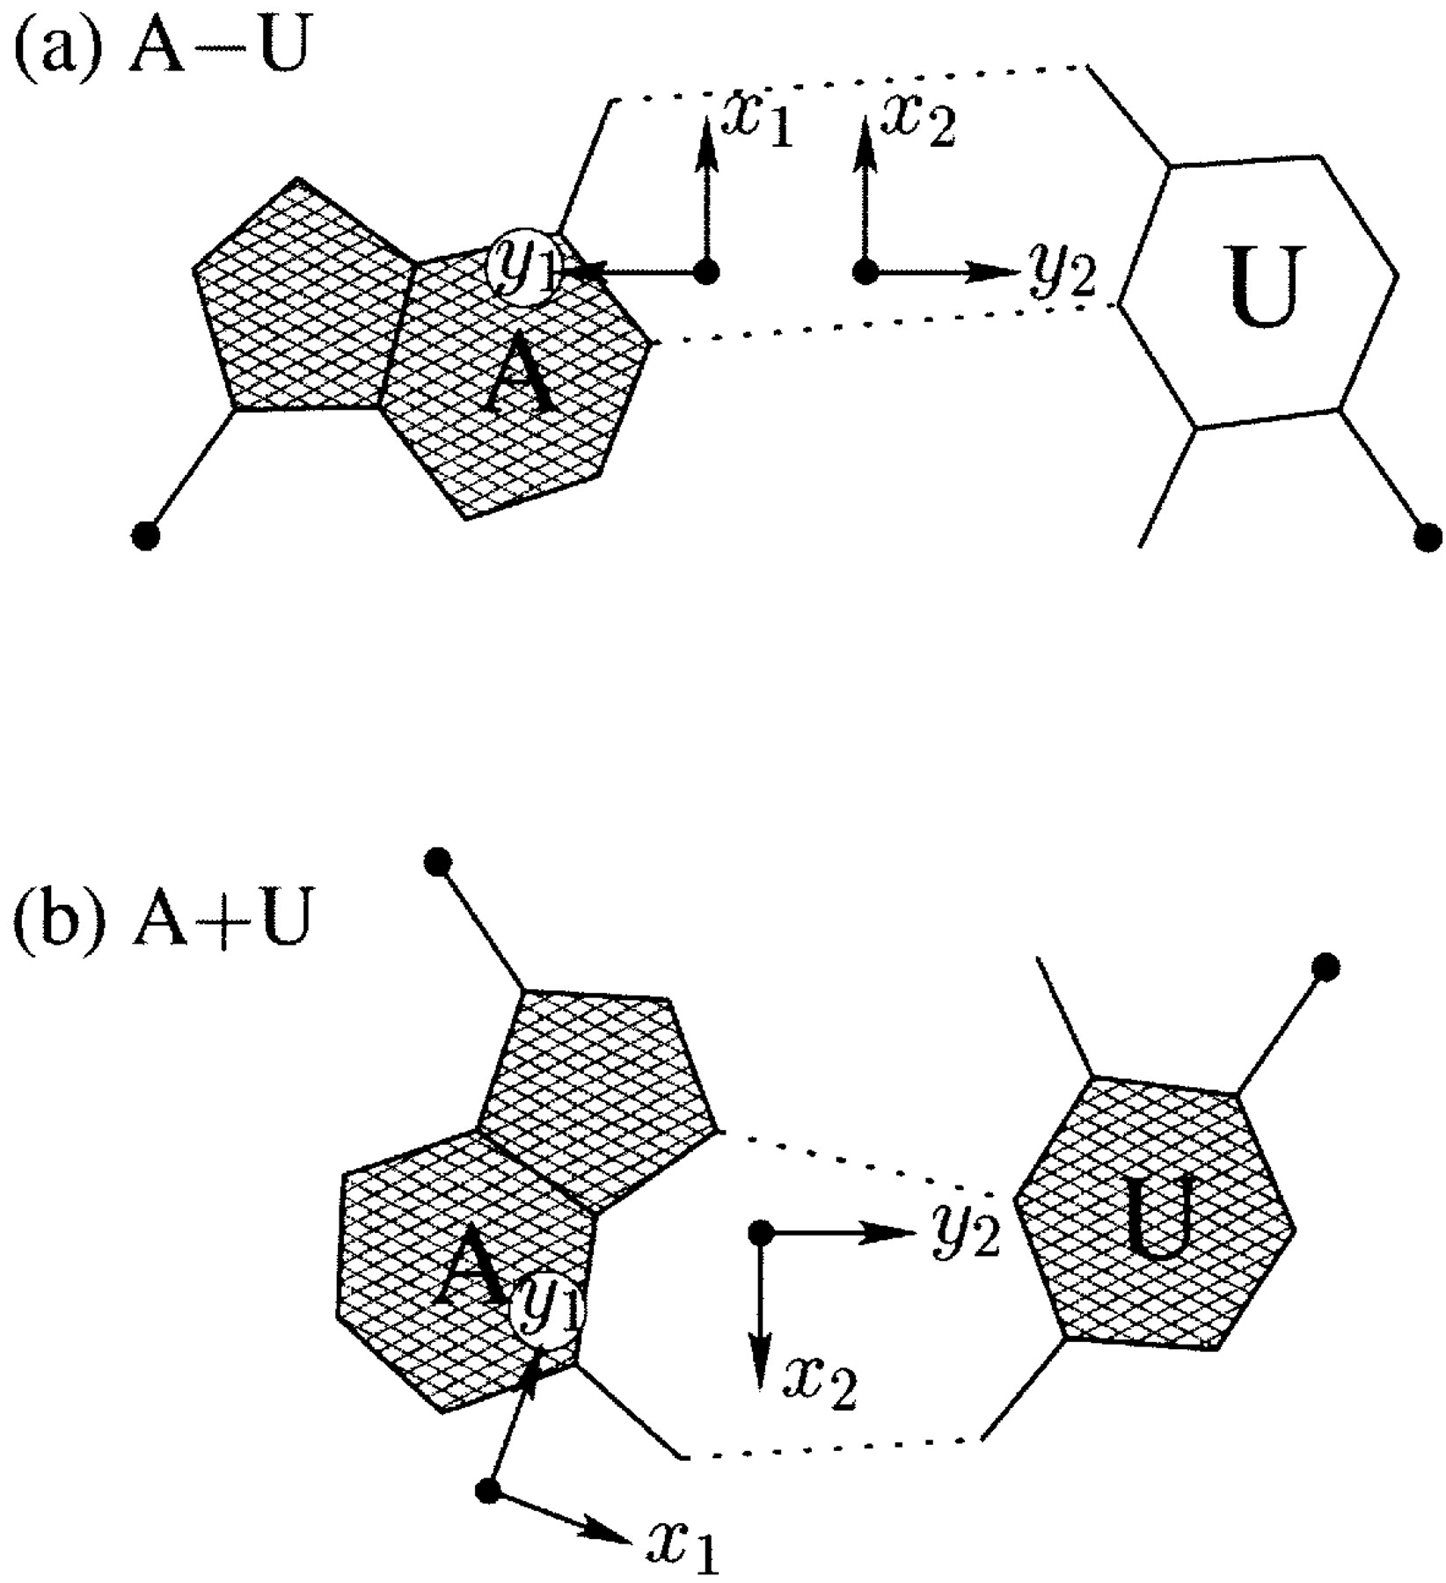
Figure 2. Antiparallel and parallel combinations of adenine (A) and uracil (U) base pair ‘faces’: (a) the ...
Notes:
Figure 2. Antiparallel and parallel combinations of adenine (A) and uracil (U) base pair ‘faces’: (a) the antiparallel Watson–Crick A–U pair with opposing faces (shaded versus unshaded) and a 1.5 Å Stretch introduced to separate the two base reference frames; (b) the parallel Hoogsteen A+U pair with base pair faces of the same sense. Black dots on bases denote the C1′ atoms on the attached sugars.
Unless provided in the caption above, the following copyright applies to the content of this slide:

Slide 3
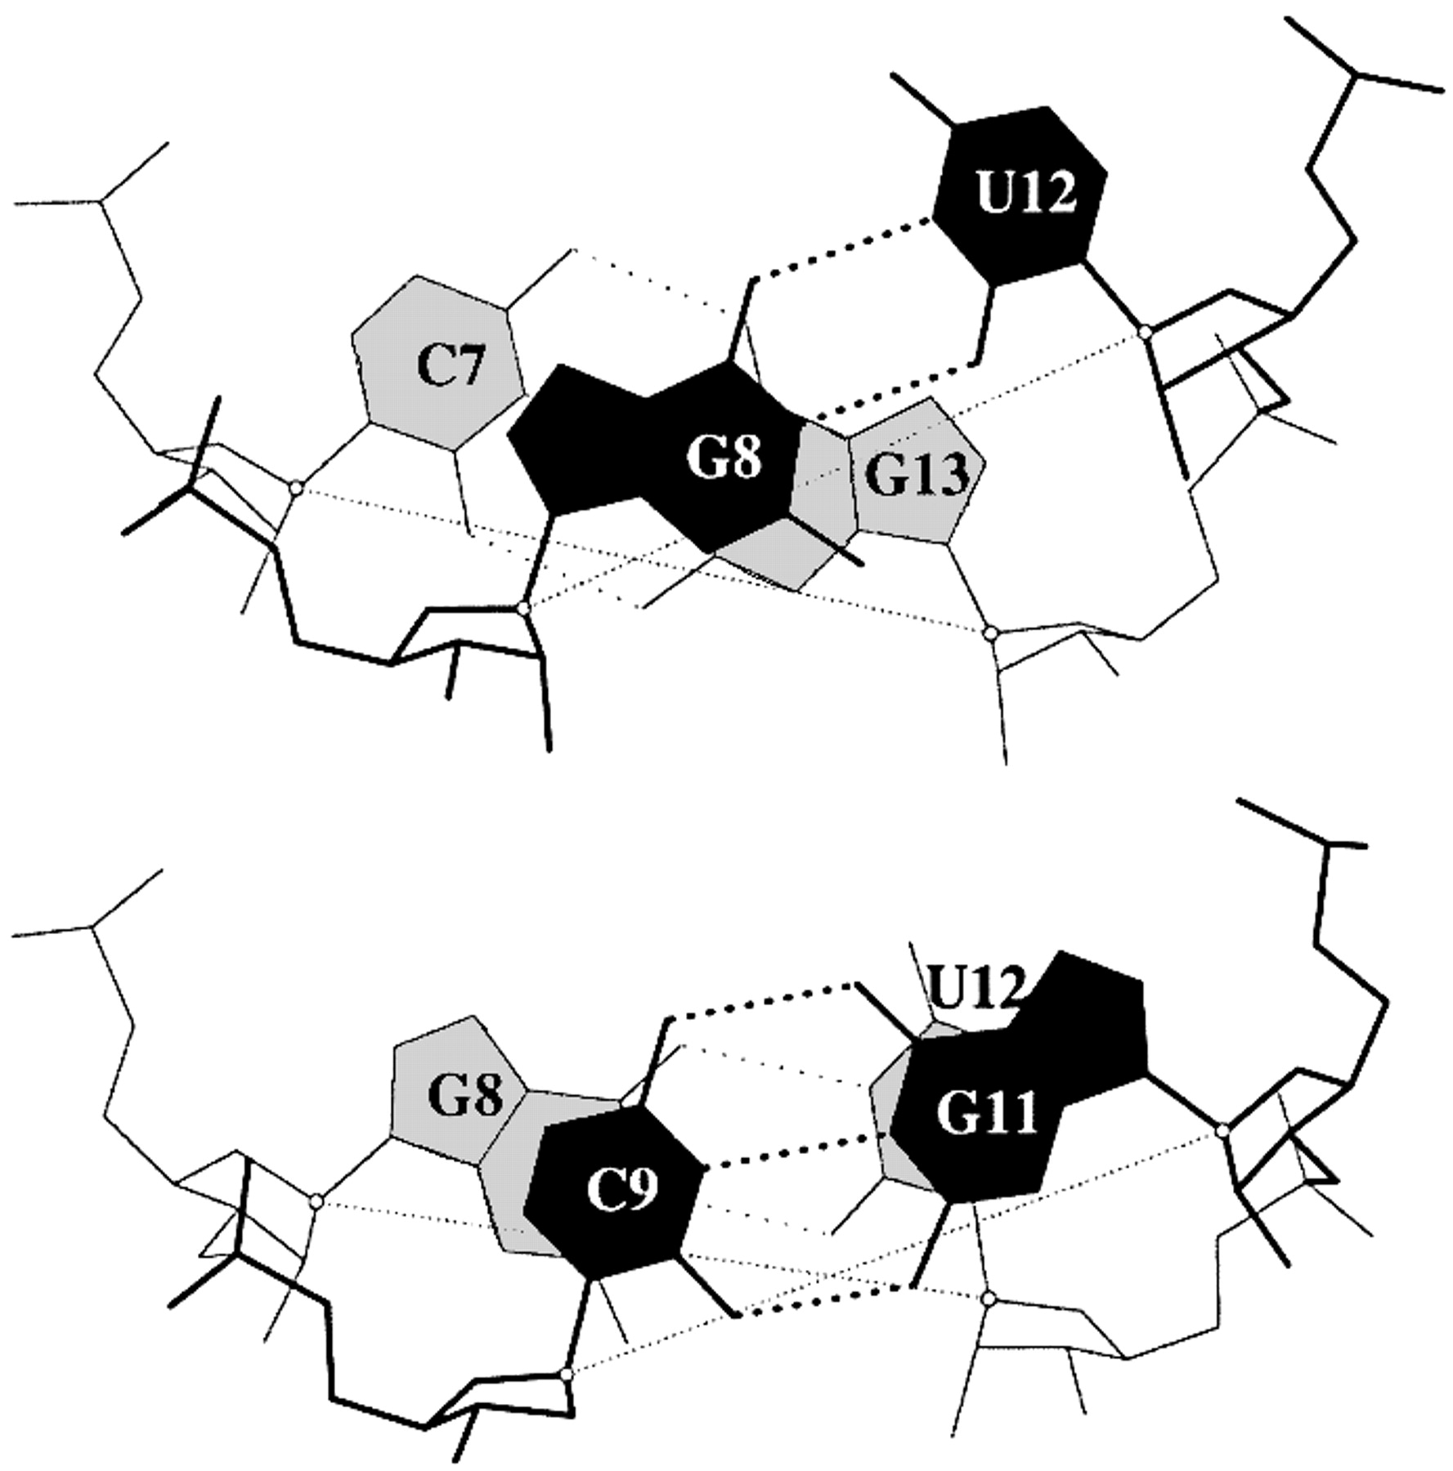
Figure 3. Large Shear of the G–U wobble base pair influences the calculated but not the ‘observed’ Twist. The ...
Notes:
Figure 3. Large Shear of the G–U wobble base pair influences the calculated but not the ‘observed’ Twist. The 3DNA numerical values of Twist, 20° (top) and 43° (bottom), differ from the visualization of nearly equivalent Twist suggested by the angle between successive C1′···C1′ vectors (finely dotted lines). Illustrated dimer steps flank the G(8)–U(12) base pair in the crystal structure of the acceptor stem of E.coli tRNAAsp (NDB_ID: ar0019) (60).
Unless provided in the caption above, the following copyright applies to the content of this slide:

Slide 4
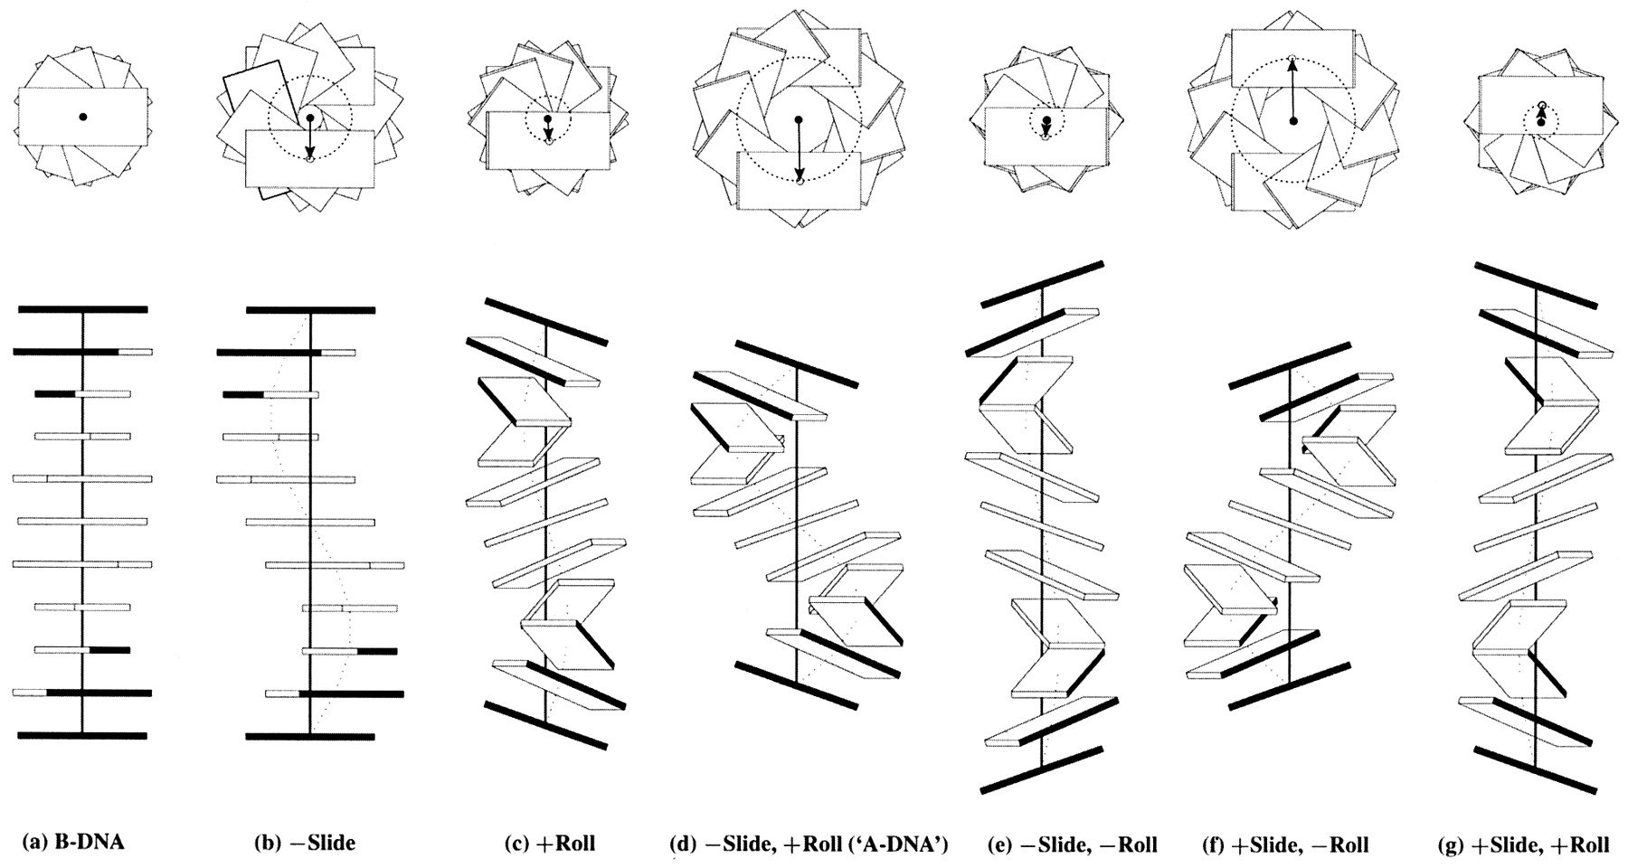
Figure 4. Influence of non‐zero Slide and Roll at sequential dimer steps on overall DNA helical conformation. ...
Notes:
Figure 4. Influence of non‐zero Slide and Roll at sequential dimer steps on overall DNA helical conformation. Images generated with 3DNA building upon the principles of Calladine and Drew (42). The radii of the (dashed) circles in the upper row of images, defined by the loci of points from the helical axes (filled circles) to the base pair origin (open circles), correspond to the x‐displacement. The values of dimeric Twist are adjusted, following equation 4, to keep the helical twist angle at 36°. The A‐like model is highlighted in quotes to emphasize that the structure contains 10 rather than 11 residues per turn.
Unless provided in the caption above, the following copyright applies to the content of this slide:

Slide 5
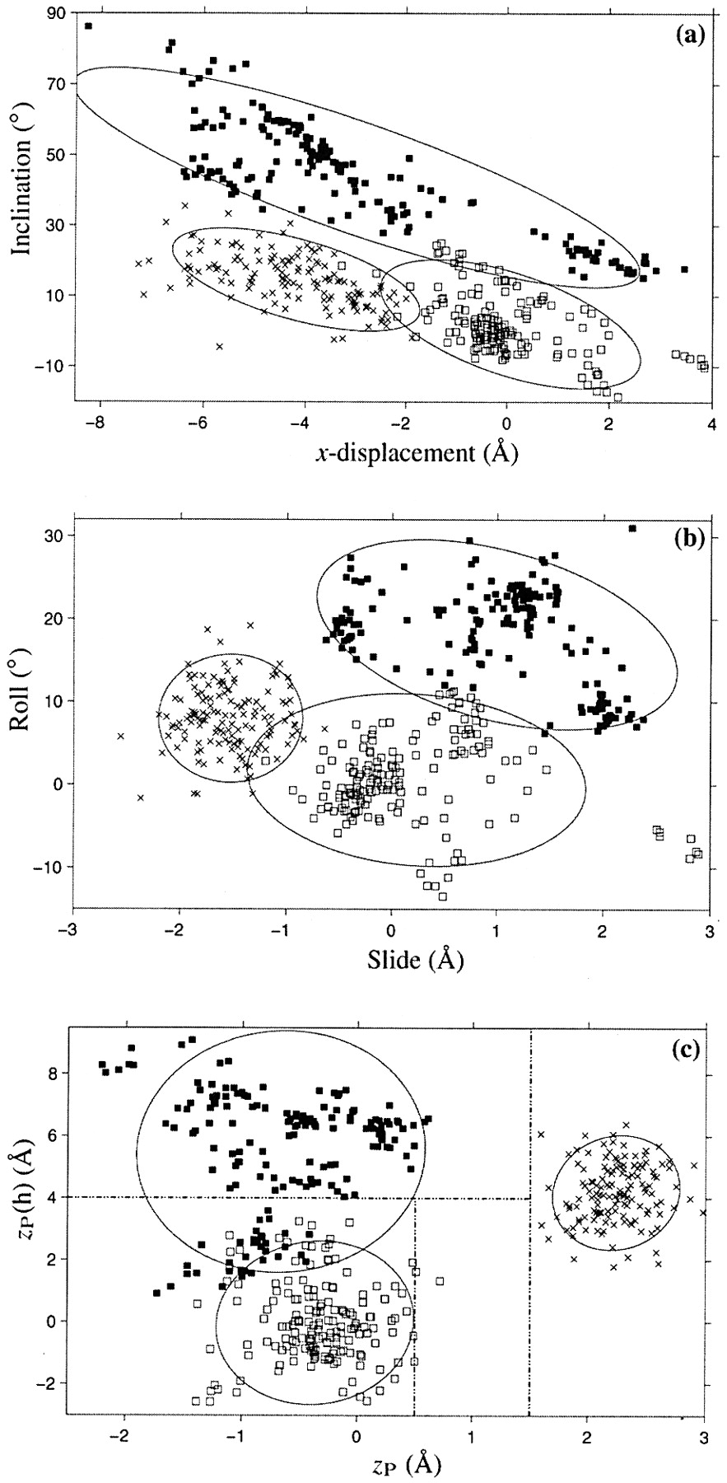
Figure 5. Scatter plots of selected conformational parameters showing the differences among A (× symbol), B ...
Notes:
Figure 5. Scatter plots of selected conformational parameters showing the differences among A (× symbol), B (open squares) and TA DNA (filled squares) dinucleotide steps: (a) helical inclination and x‐displacement; (b) dimer step Roll and Slide; (c) projected phosphorus positions, zP and zP(h). The contours correspond to ‘energies’ of 2kBT, i.e.‘2Δθ’ ellipses (17). Dashed lines in (c) illustrate the criteria used in 3DNA to distinguish the three helical forms (see text for details).
Unless provided in the caption above, the following copyright applies to the content of this slide:

Slide 6
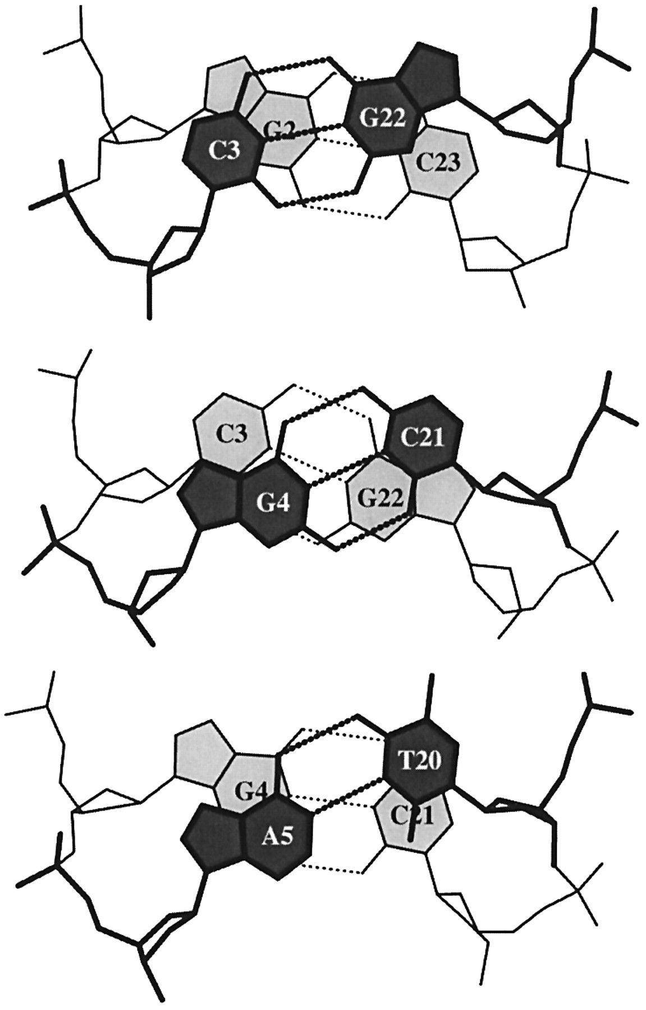
Figure 6. ‘Standardized’ base stacking diagrams of three consecutive dimer steps of the 1.4 Å B DNA ...
Notes:
Figure 6. ‘Standardized’ base stacking diagrams of three consecutive dimer steps of the 1.4 Å B DNA structure, d(CGCGAATTCGCG)2 (NDB_ID: bdl084) (87).
Unless provided in the caption above, the following copyright applies to the content of this slide:

Slide 7
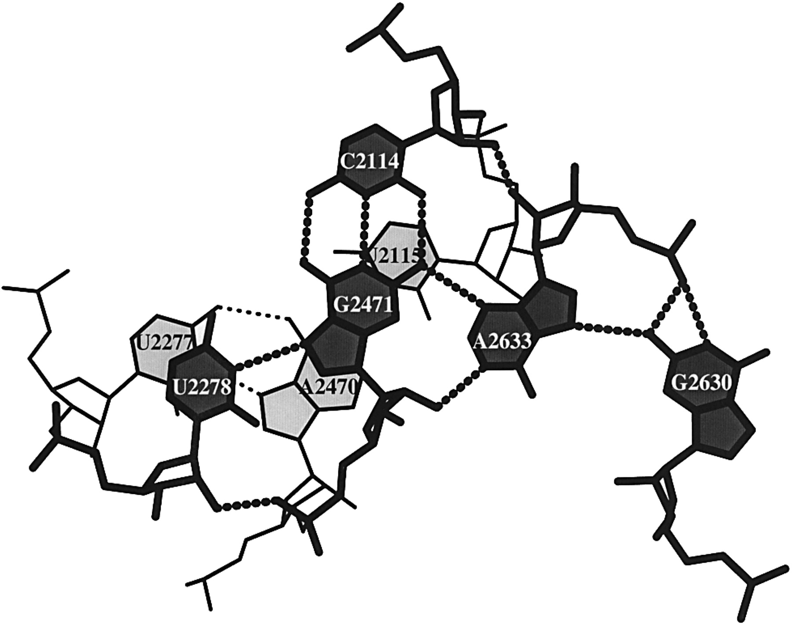
Figure 7. Stacking diagram of a U·G·C·A·G base pentad and a U·A·U triad in the refined structure of the large ...
Notes:
Figure 7. Stacking diagram of a U·G·C·A·G base pentad and a U·A·U triad in the refined structure of the large 50S ribosomal subunit (NDB_ID: rr0033) (3).
Unless provided in the caption above, the following copyright applies to the content of this slide:

Slide 8
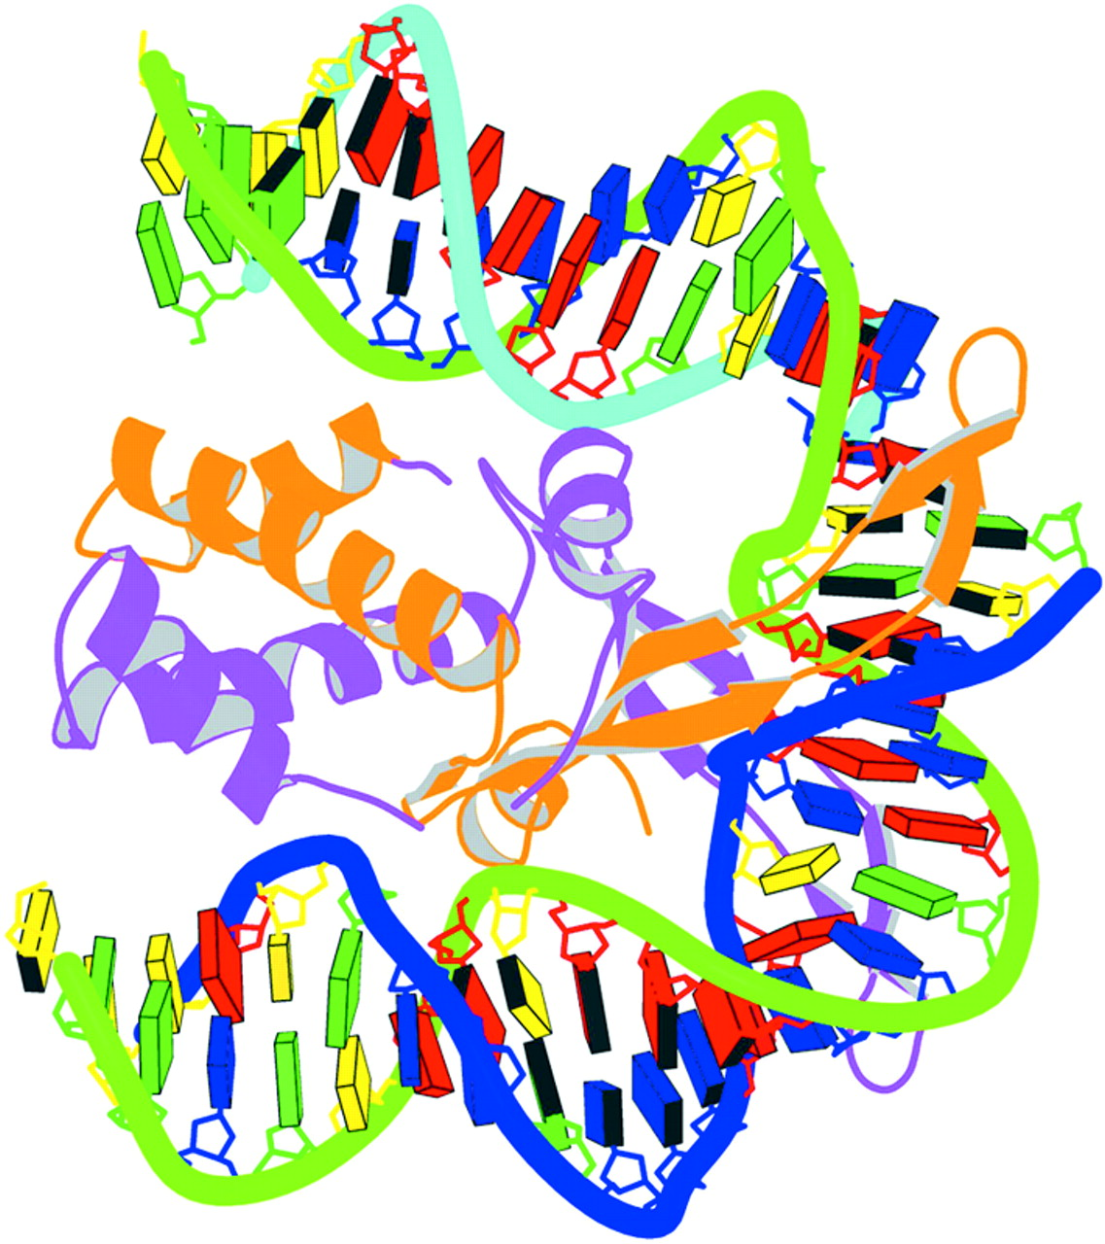
Figure 8. Schematic image of the IHF–DNA complex (NDB_ID: pdt040) (91) shown in the most extended view and ...
Notes:
Figure 8. Schematic image of the IHF–DNA complex (NDB_ID: pdt040) (91) shown in the most extended view and color coded according to chain identity and DNA residue type, with the minor groove edges of base pairs shaded.
Unless provided in the caption above, the following copyright applies to the content of this slide:

Slide 9
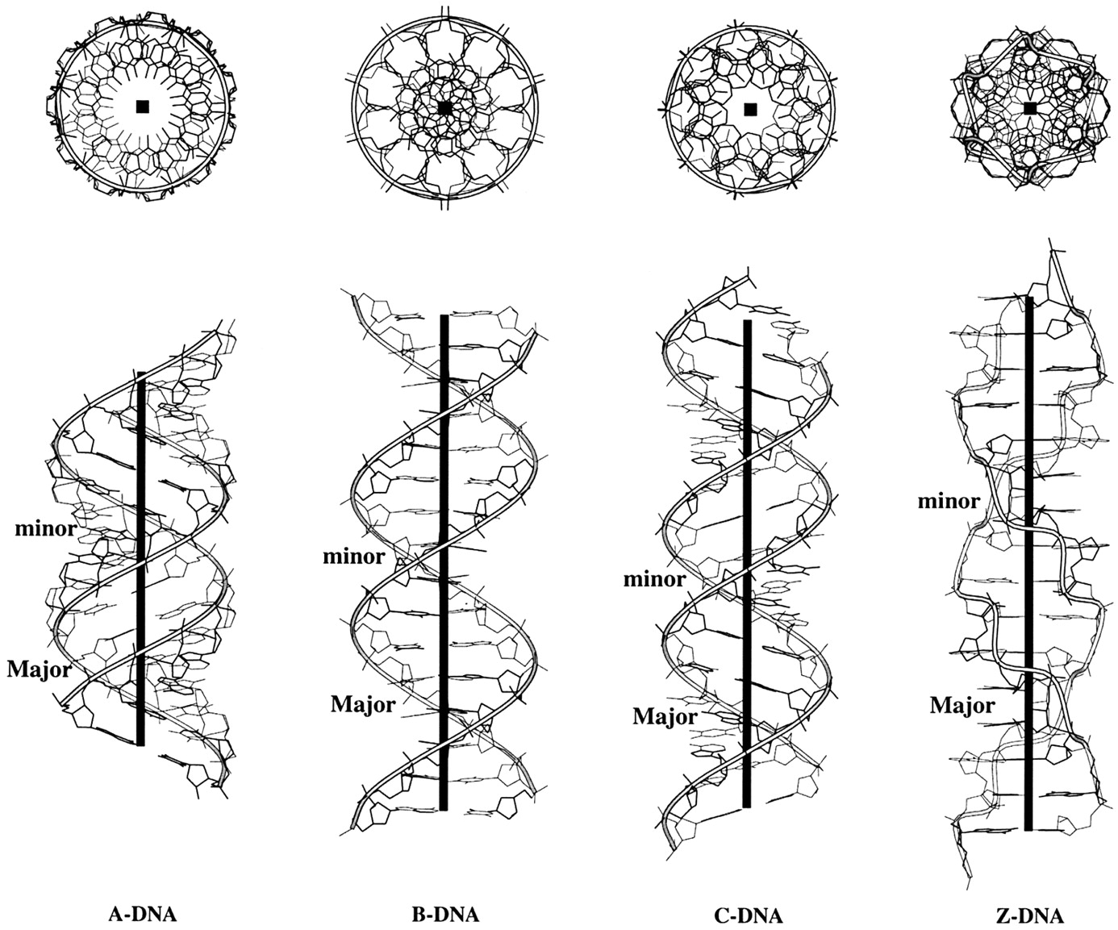
Figure 9. Top and side views illustrating the characteristic features of regular helical structures of A, B, ...
Notes:
Figure 9. Top and side views illustrating the characteristic features of regular helical structures of A, B, C and Z DNA deduced from representative X‐ray fiber diffraction models (44,46). Ribbons trace the progression of the backbone defined by the phosphorus atoms and the heavy black lines (boxes) represent the helical axes.
Unless provided in the caption above, the following copyright applies to the content of this slide:

