Slide 1
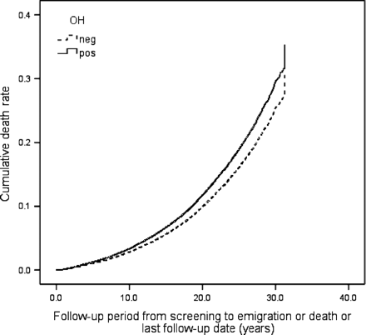
Figure 1 Orthostatic hypotension (OH) and all-cause mortality. One Minus Survival Function adjusted for age, gender, ...
Notes:
Figure 1 Orthostatic hypotension (OH) and all-cause mortality. One Minus Survival Function adjusted for age, gender, BMI, hypertension, diabetes, total cholesterol, smoking, and previous cancer.
Unless provided in the caption above, the following copyright applies to the content of this slide: Published on behalf of the European Society of Cardiology. All rights reserved. © The Author 2009. For permissions please email: journals.permissions@oxfordjournals.orgThe online version of this article has been published under an open access model. Users are entitled to use, reproduce, disseminate, or display the open access version of this article for non-commercial purposes provided that the original authorship is properly and fully attributed; the Journal, Learned Society and Oxford University Press are attributed as the original place of publication with correct citation details given; if an article is subsequently reproduced or disseminated not in its entirety but only in part or as a derivative work this must be clearly indicated. For commercial re-use, please contact journals.permissions@oxfordjournals.org

Slide 2
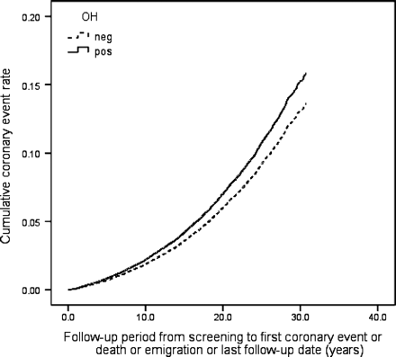
Figure 2 Orthostatic hypotension (OH) and coronary events. One Minus Coronary Event–Free Survival Function adjusted ...
Notes:
Figure 2 Orthostatic hypotension (OH) and coronary events. One Minus Coronary Event–Free Survival Function adjusted for age, gender, BMI, hypertension, diabetes, total cholesterol, and smoking.
Unless provided in the caption above, the following copyright applies to the content of this slide: Published on behalf of the European Society of Cardiology. All rights reserved. © The Author 2009. For permissions please email: journals.permissions@oxfordjournals.orgThe online version of this article has been published under an open access model. Users are entitled to use, reproduce, disseminate, or display the open access version of this article for non-commercial purposes provided that the original authorship is properly and fully attributed; the Journal, Learned Society and Oxford University Press are attributed as the original place of publication with correct citation details given; if an article is subsequently reproduced or disseminated not in its entirety but only in part or as a derivative work this must be clearly indicated. For commercial re-use, please contact journals.permissions@oxfordjournals.org

Slide 3
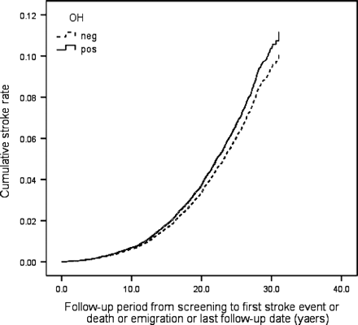
Figure 3 Orthostatic hypotension (OH) and stroke. One Minus Stroke Event–Free Survival Function adjusted for age, ...
Notes:
Figure 3 Orthostatic hypotension (OH) and stroke. One Minus Stroke Event–Free Survival Function adjusted for age, gender, BMI, hypertension, diabetes, total cholesterol, and smoking.
Unless provided in the caption above, the following copyright applies to the content of this slide: Published on behalf of the European Society of Cardiology. All rights reserved. © The Author 2009. For permissions please email: journals.permissions@oxfordjournals.orgThe online version of this article has been published under an open access model. Users are entitled to use, reproduce, disseminate, or display the open access version of this article for non-commercial purposes provided that the original authorship is properly and fully attributed; the Journal, Learned Society and Oxford University Press are attributed as the original place of publication with correct citation details given; if an article is subsequently reproduced or disseminated not in its entirety but only in part or as a derivative work this must be clearly indicated. For commercial re-use, please contact journals.permissions@oxfordjournals.org

Slide 4
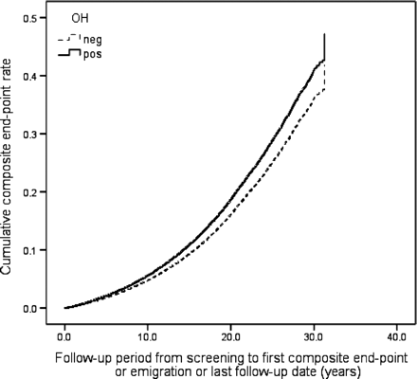
Figure 4 Orthostatic hypotension (OH) and composite endpoint (CE, stroke, and death). One Minus Event–Free Survival ...
Notes:
Figure 4 Orthostatic hypotension (OH) and composite endpoint (CE, stroke, and death). One Minus Event–Free Survival Function adjusted for age, gender, BMI, hypertension, diabetes, total cholesterol, and smoking.
Unless provided in the caption above, the following copyright applies to the content of this slide: Published on behalf of the European Society of Cardiology. All rights reserved. © The Author 2009. For permissions please email: journals.permissions@oxfordjournals.orgThe online version of this article has been published under an open access model. Users are entitled to use, reproduce, disseminate, or display the open access version of this article for non-commercial purposes provided that the original authorship is properly and fully attributed; the Journal, Learned Society and Oxford University Press are attributed as the original place of publication with correct citation details given; if an article is subsequently reproduced or disseminated not in its entirety but only in part or as a derivative work this must be clearly indicated. For commercial re-use, please contact journals.permissions@oxfordjournals.org

