Slide 1
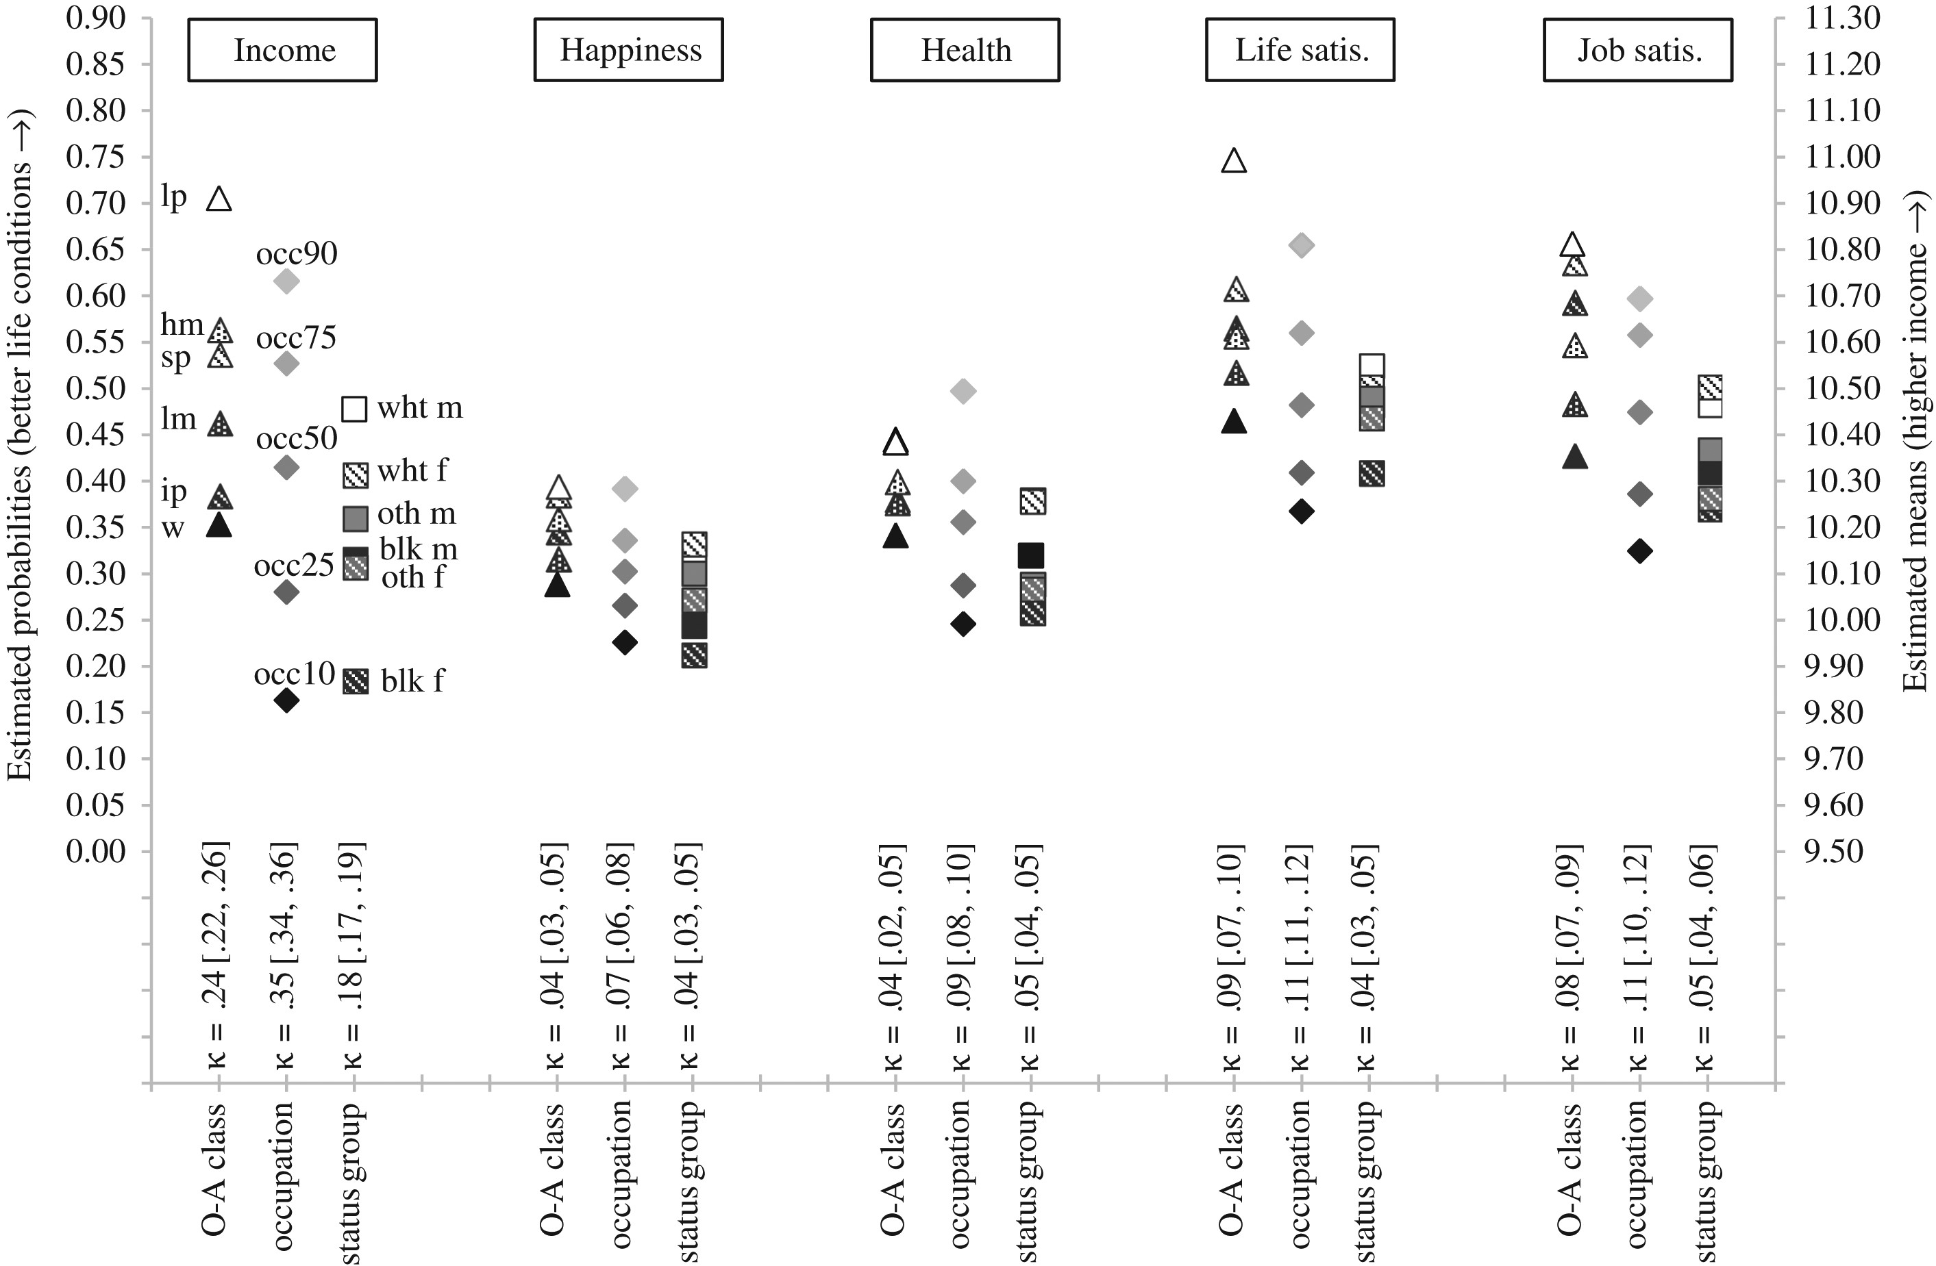
Figure 1. Aggregate ownership-and-authority class, disaggregate occupational class, and status group differences in ...
Notes:
Figure 1. Aggregate ownership-and-authority class, disaggregate occupational class, and status group differences in life conditions Note: Results are based on 100 multiple imputation datasets; 95 percent confidence intervals for the kappa statistics in brackets are based on the delta method. The estimated means (or probabilities) reported for disaggregate occupations are those at the 10th, 25th, 50th, 75th, and 90th percentiles.
Unless provided in the caption above, the following copyright applies to the content of this slide: © The Author 2017. Published by Oxford University Press on behalf of the University of North Carolina at Chapel Hill. All rights reserved. For permissions, please e-mail: journals.permissions@oup.com.

Slide 2
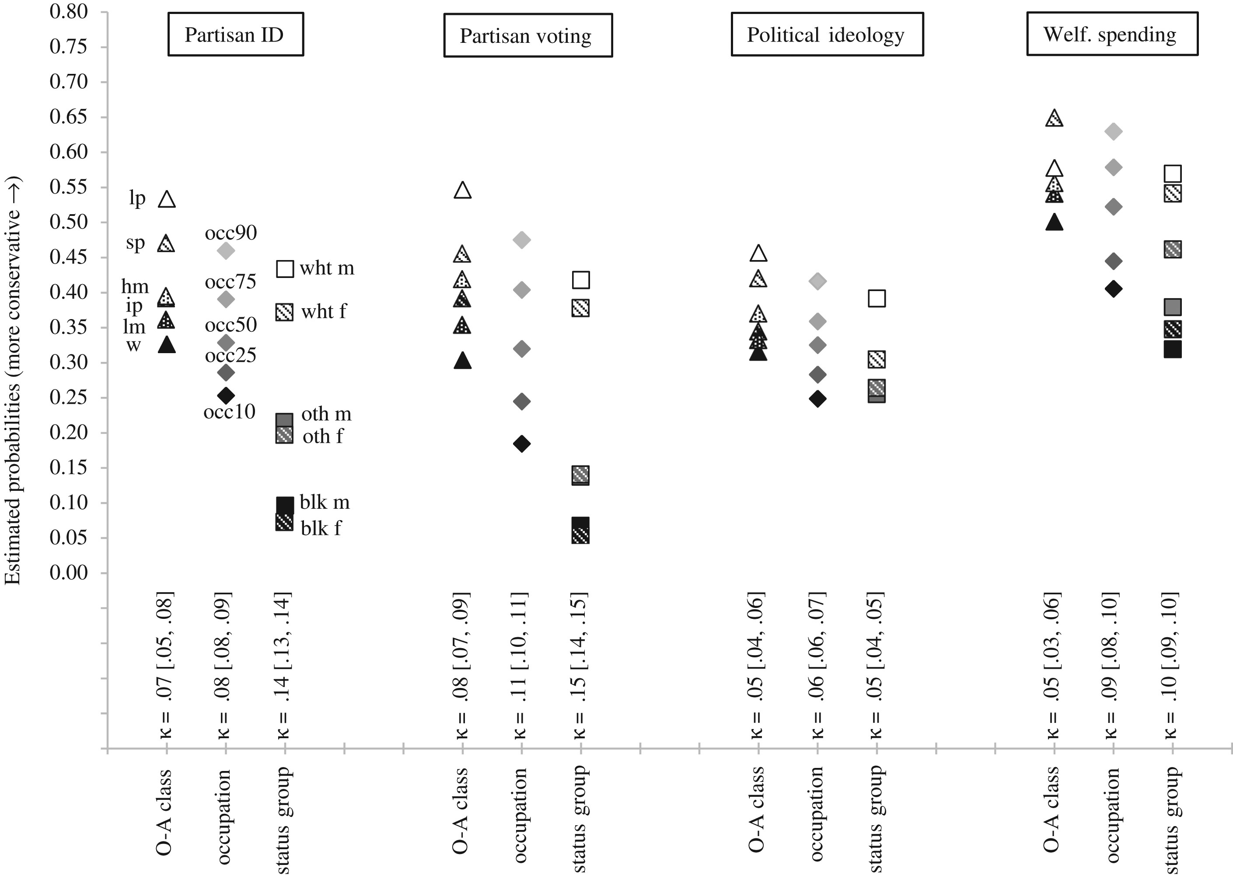
Figure 2. Aggregate ownership-and-authority class, disaggregate occupational class, and status group differences in ...
Notes:
Figure 2. Aggregate ownership-and-authority class, disaggregate occupational class, and status group differences in political attitudes Note: Results are based on 100 multiple imputation datasets; 95 percent confidence intervals for the kappa statistics in brackets are based on the delta method. The estimated probabilities reported for disaggregate occupations are those at the 10th, 25th, 50th, 75th, and 90th percentiles.
Unless provided in the caption above, the following copyright applies to the content of this slide: © The Author 2017. Published by Oxford University Press on behalf of the University of North Carolina at Chapel Hill. All rights reserved. For permissions, please e-mail: journals.permissions@oup.com.

Slide 3
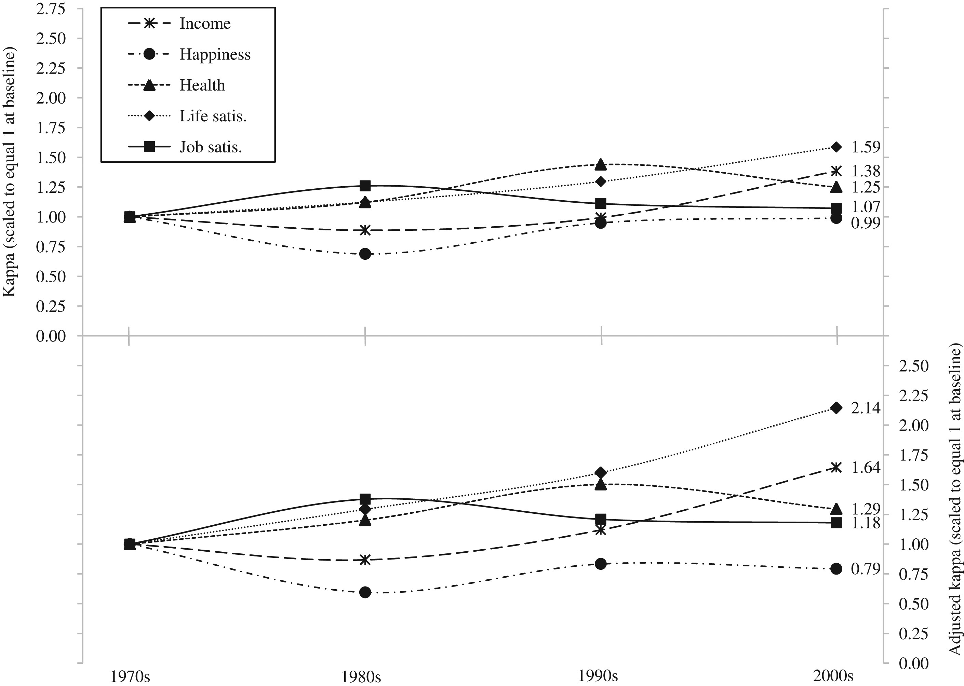
Figure 3. Trends in aggregate ownership-and-authority class differences in life conditions by decade
Notes:
Figure 3. Trends in aggregate ownership-and-authority class differences in life conditions by decade Note: Results are based on 100 multiple imputation datasets. The adjusted kappa statistics for aggregate ownership-and-authority class differences are based on average adjusted predictions from models that additionally include occupation fixed effects.
Unless provided in the caption above, the following copyright applies to the content of this slide: © The Author 2017. Published by Oxford University Press on behalf of the University of North Carolina at Chapel Hill. All rights reserved. For permissions, please e-mail: journals.permissions@oup.com.

Slide 4
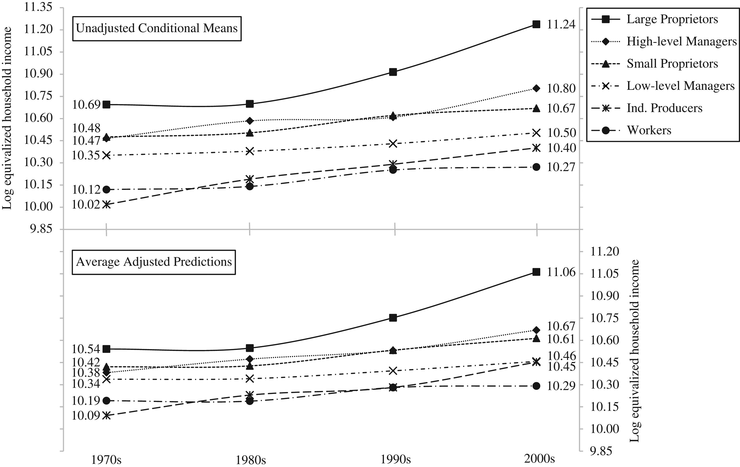
Figure 4. Trends in aggregate ownership-and-authority class differences in equivalized household income by decade
Notes:
Figure 4. Trends in aggregate ownership-and-authority class differences in equivalized household income by decade Note: Results are based on 100 multiple imputation datasets. The average adjusted predictions are computed from models that additionally include occupation fixed effects.
Unless provided in the caption above, the following copyright applies to the content of this slide: © The Author 2017. Published by Oxford University Press on behalf of the University of North Carolina at Chapel Hill. All rights reserved. For permissions, please e-mail: journals.permissions@oup.com.

Slide 5
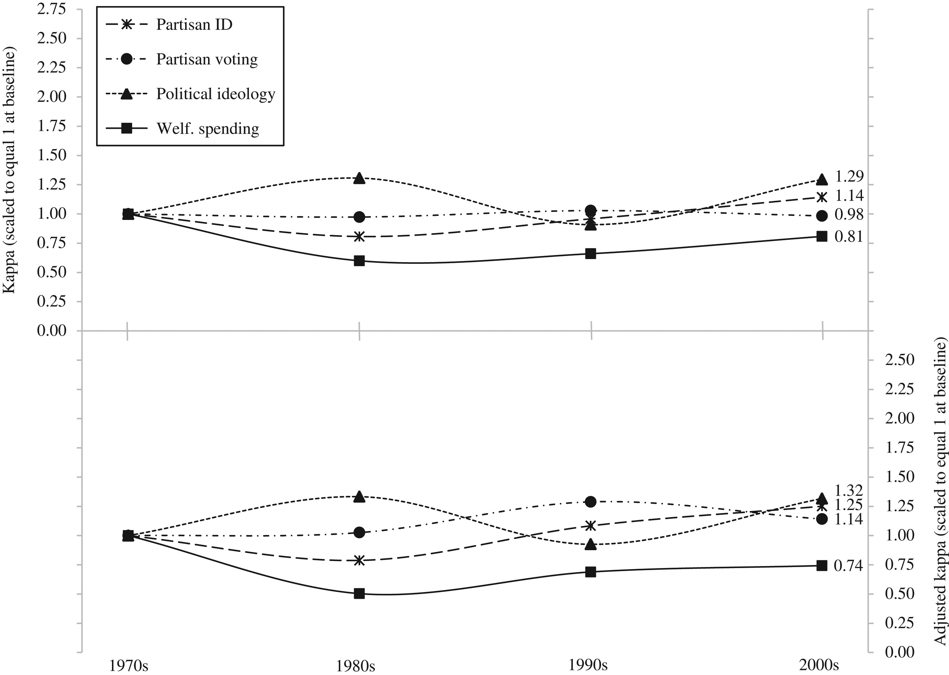
Figure 5. Trends in aggregate ownership-and-authority class differences in political attitudes by decade
Notes:
Figure 5. Trends in aggregate ownership-and-authority class differences in political attitudes by decade Note: Results are based on 100 multiple imputation datasets. The adjusted kappa statistics for aggregate ownership-and-authority class differences are based on average adjusted predictions from models that additionally include occupation fixed effects.
Unless provided in the caption above, the following copyright applies to the content of this slide: © The Author 2017. Published by Oxford University Press on behalf of the University of North Carolina at Chapel Hill. All rights reserved. For permissions, please e-mail: journals.permissions@oup.com.

