Slide 1
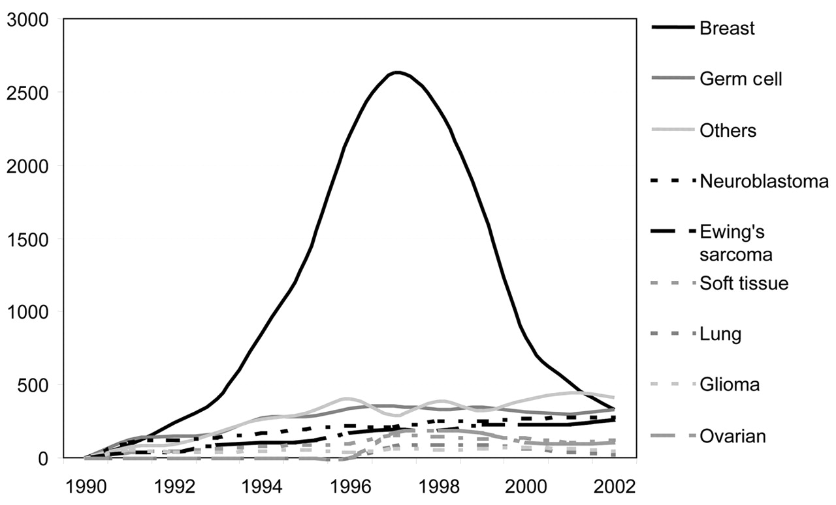
Figure 1. Numbers of hematopoetic stem cell transplants (HSCT) for solid tumors in Europe according to main ...
Notes:
Figure 1. Numbers of hematopoetic stem cell transplants (HSCT) for solid tumors in Europe according to main disease categories from 1991 to 2002. Allogeneic and autologous HSCT combined.
Unless provided in the caption above, the following copyright applies to the content of this slide: European Society for Medical Oncology

Slide 2
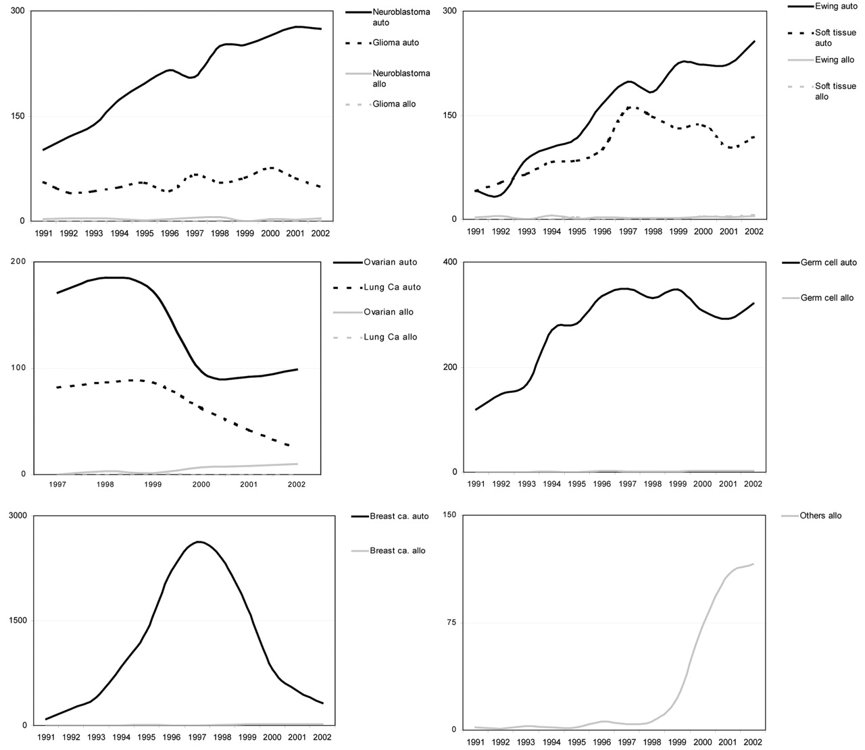
Figure 2. Transplant numbers for solid tumors in Europe for 1991–2002 according to disease and donor type. ...
Notes:
Figure 2. Transplant numbers for solid tumors in Europe for 1991–2002 according to disease and donor type. (A) Neuroblastoma and glioma. (B) Ewing’s sarcoma and soft tissue sarcoma. (C) Ovarian cancer and lung cancer. (D) Germ cell tumors. (E) Breast cancer. (F) ‘Other’ solid tumors.
Unless provided in the caption above, the following copyright applies to the content of this slide: European Society for Medical Oncology

Slide 3
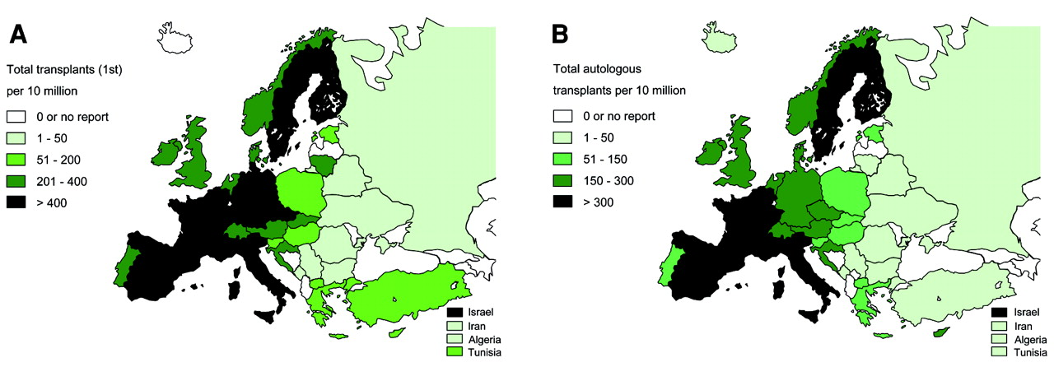
Figure 3. Transplant rates in European countries, 2002. Shades reflect numbers of hematopoetic stem cell ...
Notes:
Figure 3. Transplant rates in European countries, 2002. Shades reflect numbers of hematopoetic stem cell transplants (HSCT) per 10 million inhabitants. (A) All indications and all donor types. (B) Autologous HSCT.
Unless provided in the caption above, the following copyright applies to the content of this slide: European Society for Medical Oncology

Slide 4
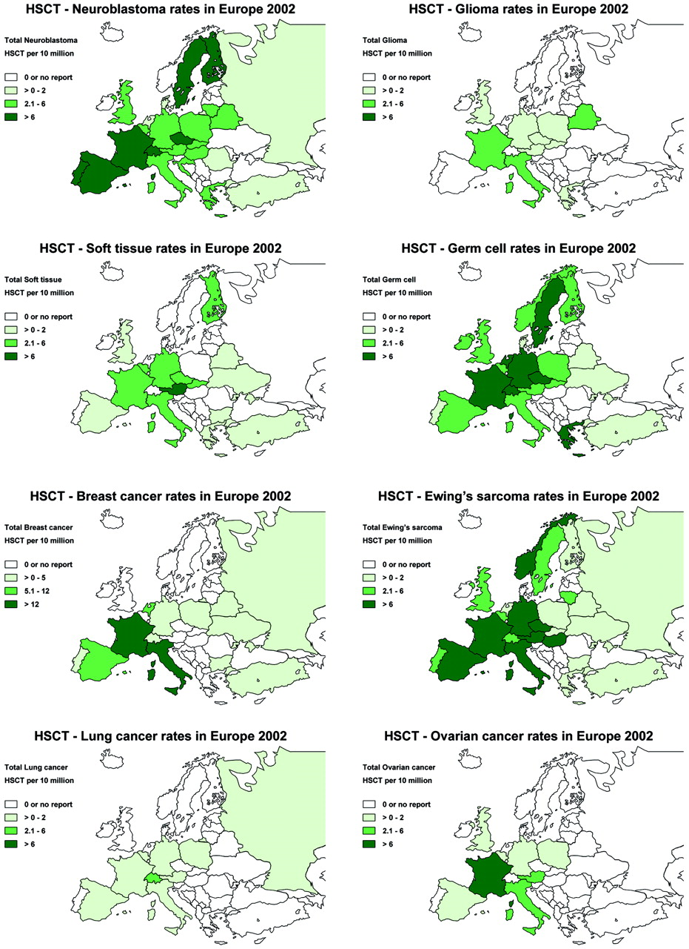
Figure 4. Transplant rates for solid tumors in Europe, 2002. Shades reflect numbers of transplants for ...
Notes:
Figure 4. Transplant rates for solid tumors in Europe, 2002. Shades reflect numbers of transplants for individual indications per 10 million inhabitants. Transplant rates for: (A) neuroblastoma; (B) glioma; (C) soft tissue; (D) germ cell cancer; (E) breast cancer; (F) Ewing’s sarcoma; (G) lung cancer; (H) ovarian cancer.
Unless provided in the caption above, the following copyright applies to the content of this slide: European Society for Medical Oncology

