Slide 1
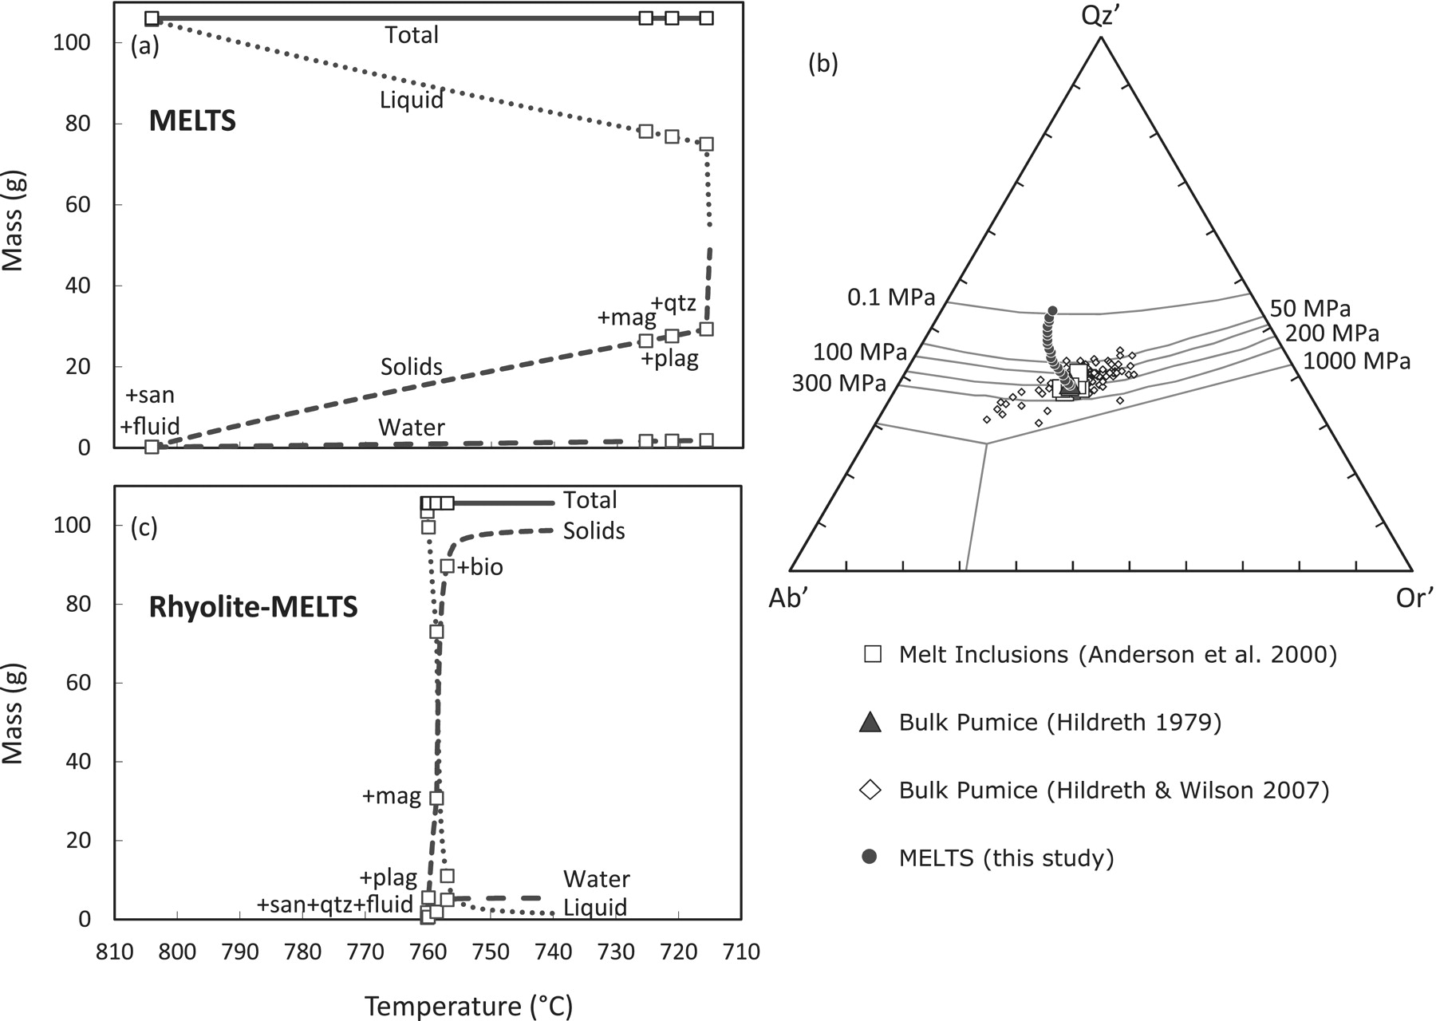
Fig. 1. Results of simulations using average early erupted melt inclusion compositions. (a) MELTS simulation at ...
Notes:
Fig. 1. Results of simulations using average early erupted melt inclusion compositions. (a) MELTS simulation at 200 MPa, 5·5 wt % water, oxygen fugacity buffered at Ni–NiO; it should be noted that saturation of sanidine is at ∼90°C higher than the onset of nearly invariant crystallization. (b) Qz'–Ab'–Or' diagram showing relevant compositions for early erupted pumice, melt inclusions, and melt compositions calculated by MELTS; projection of An-bearing compositions into the ternary follows the scheme of Blundy & Cashman (2001), which is appropriate for metaluminous compositions. It should be noted that melt compositions calculated by MELTS are excessively silicic owing to the large temperature interval between sanidine and quartz saturation. (c) Results of rhyolite-MELTS simulation under 175 MPa, oxygen fugacity buffered at Ni–NiO, water-saturated conditions, which show distinct nearly invariant behavior marked by co-crystallization of quartz, sanidine and plagioclase in the presence of a fluid phase.
Unless provided in the caption above, the following copyright applies to the content of this slide: © The Author 2012. Published by Oxford University Press. All rights reserved. For Permissions, please e-mail: journals.permissions@oup.com

Slide 2
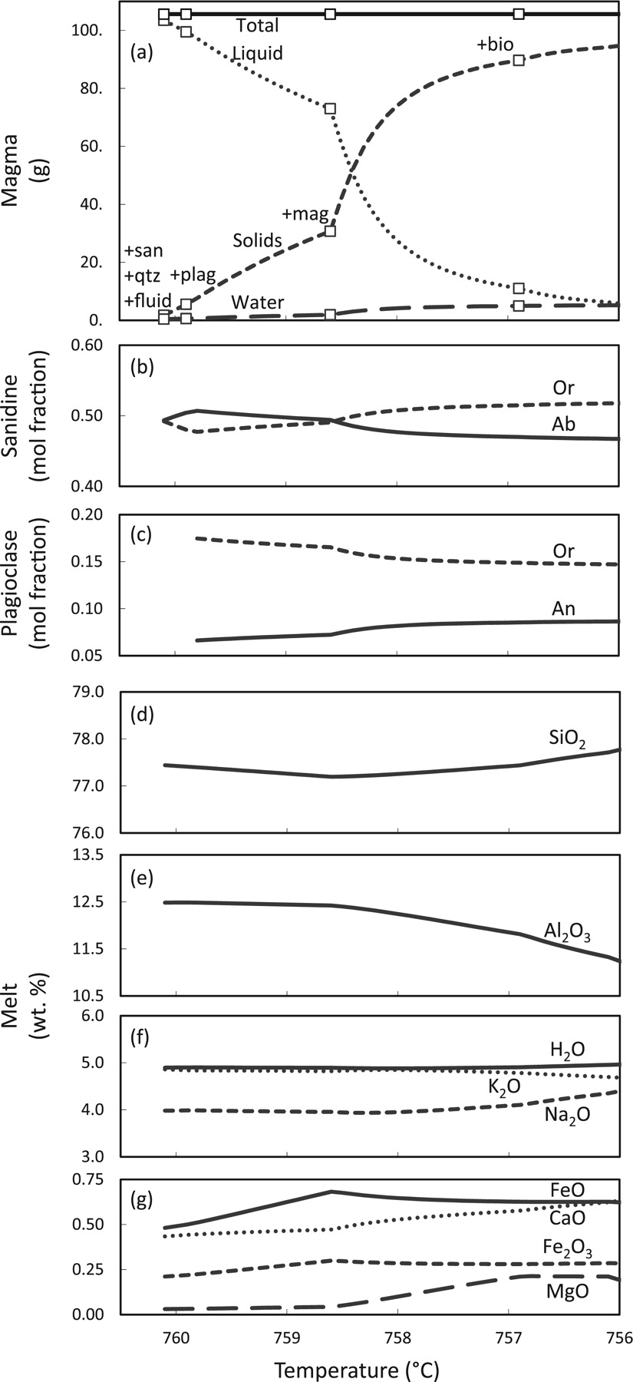
Fig. 2. Results of rhyolite-MELTS simulation for early erupted Bishop Tuff average melt inclusion composition; ...
Notes:
Fig. 2. Results of rhyolite-MELTS simulation for early erupted Bishop Tuff average melt inclusion composition; 175 MPa, oxygen fugacity buffered at Ni–NiO, water-saturated conditions. Phase proportions (a) and compositions of (b) sanidine, (c) plagioclase, and (d–g) melt as a function of temperature. (Note the relative homogeneity in the calculated compositions, consistent with the small temperature interval.)
Unless provided in the caption above, the following copyright applies to the content of this slide: © The Author 2012. Published by Oxford University Press. All rights reserved. For Permissions, please e-mail: journals.permissions@oup.com

Slide 3
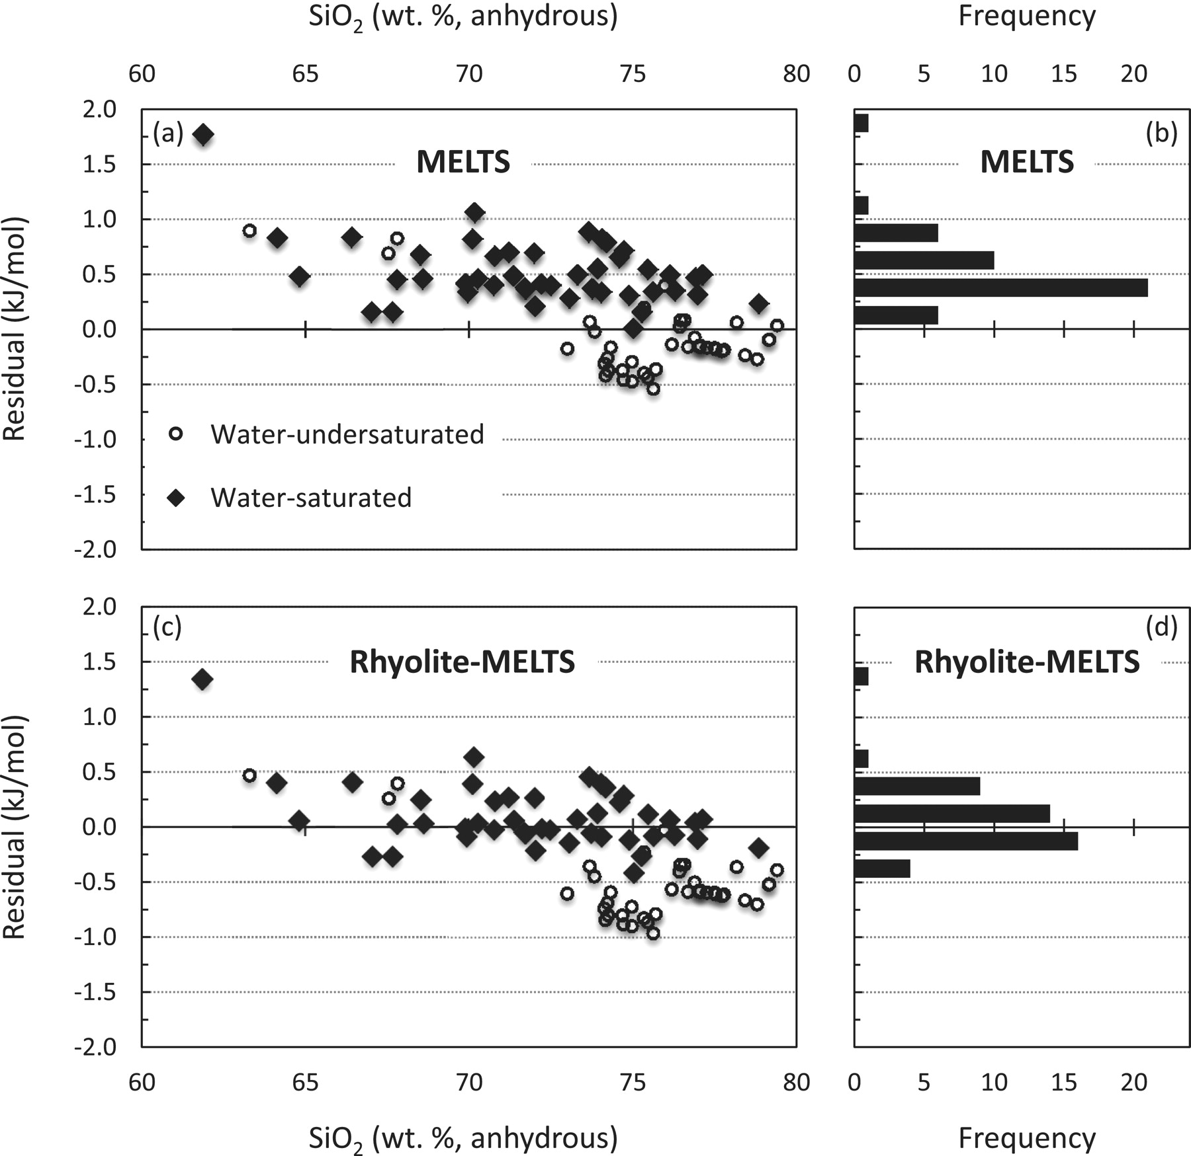
Fig. 3. Comparison of silica chemical potential residuals for MELTS and rhyolite-MELTS. Data displayed are retrieved ...
Notes:
Fig. 3. Comparison of silica chemical potential residuals for MELTS and rhyolite-MELTS. Data displayed are retrieved from the LEPR database (Hirschmann et al., 2008) and correspond to entries characterized by quartz saturation and melt compositions from dacite to rhyolite (see text for details). Residuals are the difference between the chemical potential of silica in quartz and melt; positive residuals correspond to quartz undersaturation, whereas residuals of zero correspond to quartz saturation. It should be noted that whereas residuals calculated with MELTS (a, b) are mostly positive, residuals calculated with rhyolite-MELTS (c, d) cluster around zero irrespective of melt composition; this is particularly true for water-saturated experiments (b, d).
Unless provided in the caption above, the following copyright applies to the content of this slide: © The Author 2012. Published by Oxford University Press. All rights reserved. For Permissions, please e-mail: journals.permissions@oup.com

Slide 4
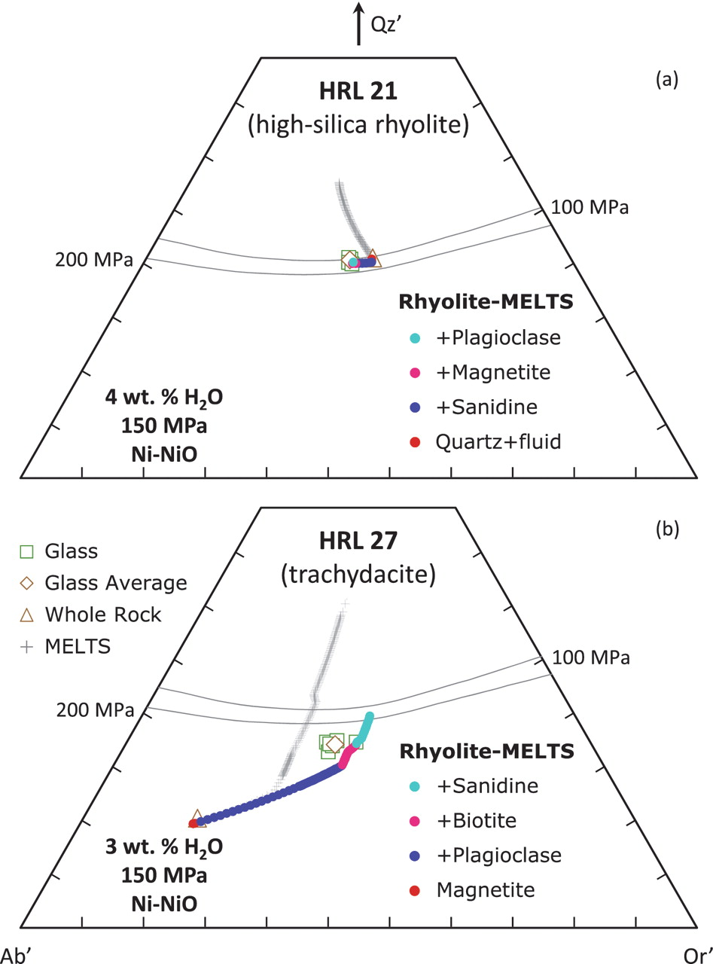
Fig. 4. Results of MELTS and rhyolite-MELTS simulations for compositions representative of the Highland Range ...
Notes:
Fig. 4. Results of MELTS and rhyolite-MELTS simulations for compositions representative of the Highland Range Volcanic Sequence (Nevada); conditions as shown. (a) Simulations with high-silica rhyolite composition show that quartz saturation is underestimated by MELTS, but appropriately calculated by rhyolite-MELTS. (b) Simulations with trachydacite composition suggest that MELTS overestimates sanidine saturation, causing the melt composition to diverge from observed glass compositions; melt composition trajectories calculated by rhyolite-MELTS are consistent with observed glass compositions and with the lack of quartz in the crystallizing assemblage.
Unless provided in the caption above, the following copyright applies to the content of this slide: © The Author 2012. Published by Oxford University Press. All rights reserved. For Permissions, please e-mail: journals.permissions@oup.com

Slide 5
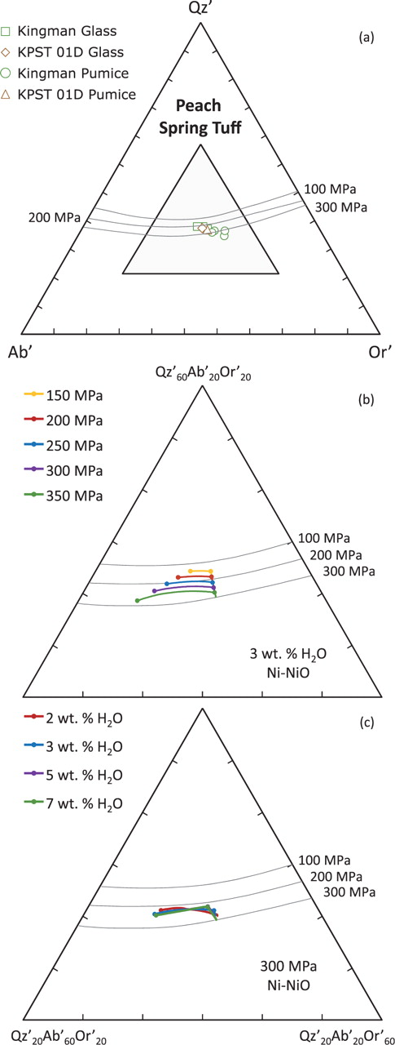
Fig. 5. Results of rhyolite-MELTS simulations for compositions representative of the Peach Spring Tuff (AZ–NV–CA). ...
Notes:
Fig. 5. Results of rhyolite-MELTS simulations for compositions representative of the Peach Spring Tuff (AZ–NV–CA). (a) Compositions of relevant bulk-pumice and glass; simulations were run with compositions from sample KPST 01D; shaded portion of the ternary is shown in (b) and (c). (b) Crystallization paths as a function of pressure for 3 wt % initial water; rhyolite-MELTS correctly captures the shift of the quartz + feldspar saturation surface toward more silicic compositions with decreasing pressure; the agreement between the experimental cotectic curves and the calculated position is very good for pressures of ∼200 MPa or lower, but they differ for higher pressures. (c) Crystallization paths as a function of water content for 300 MPa pressure; the position of the quartz + feldspar saturation surface is independent of water content, as expected.
Unless provided in the caption above, the following copyright applies to the content of this slide: © The Author 2012. Published by Oxford University Press. All rights reserved. For Permissions, please e-mail: journals.permissions@oup.com

Slide 6
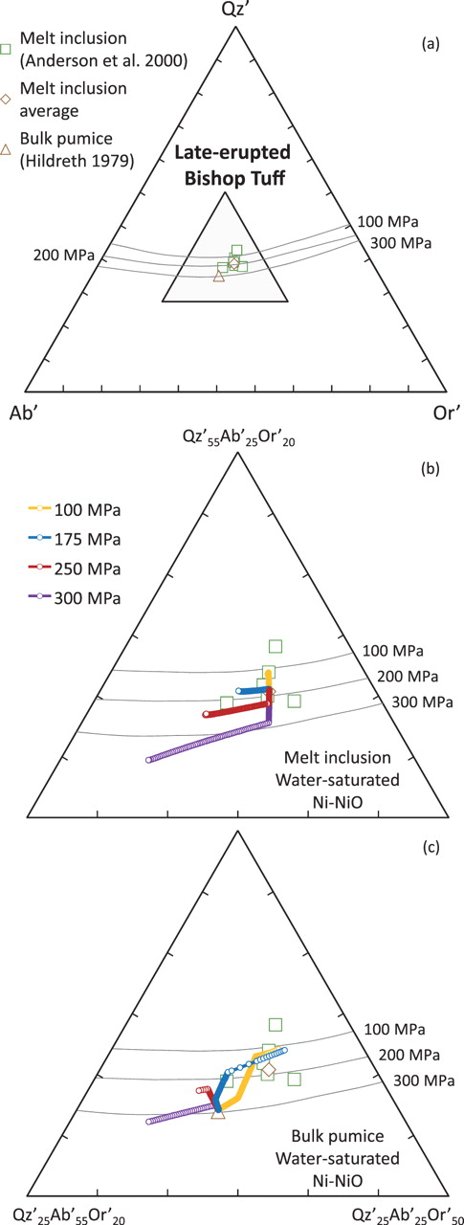
Fig. 6. Results of rhyolite-MELTS simulations for compositions representative of the late-erupted Bishop Tuff (CA). ...
Notes:
Fig. 6. Results of rhyolite-MELTS simulations for compositions representative of the late-erupted Bishop Tuff (CA). (a) Compositions of relevant bulk-pumice and melt inclusions; simulations were run with bulk-pumice and average melt inclusion compositions; shaded portion of the ternary is shown in (b) and (c). (b) Simulations using average melt inclusion composition under varying pressure; calculations are consistent with the 100 and 200 MPa cotectics, showing initial quartz crystallization for 250 and 350 MPa, initial sanidine crystallization for 100 MPa, and simultaneous saturation in quartz and sanidine for 175 MPa; crystallization follows paths subparallel to the cotectic curves, with good agreement between calculated paths and cotectic curves for 200 MPa or lower; results suggest that melt inclusions equilibrated at ∼175 MPa. (c) Simulations using bulk-pumice compositions under varying pressure; crystallization paths are contrasted, owing to the different sequence of saturation of quartz, sanidine and plagioclase as a function of pressure; results for 100 and 175 MPa show trajectories that converge towards the melt inclusion compositions, whereas results for 250 and 350 MPa diverge from the melt inclusion compositions, suggesting crystallization under <200 MPa for the late-erupted pumice.
Unless provided in the caption above, the following copyright applies to the content of this slide: © The Author 2012. Published by Oxford University Press. All rights reserved. For Permissions, please e-mail: journals.permissions@oup.com

Slide 7
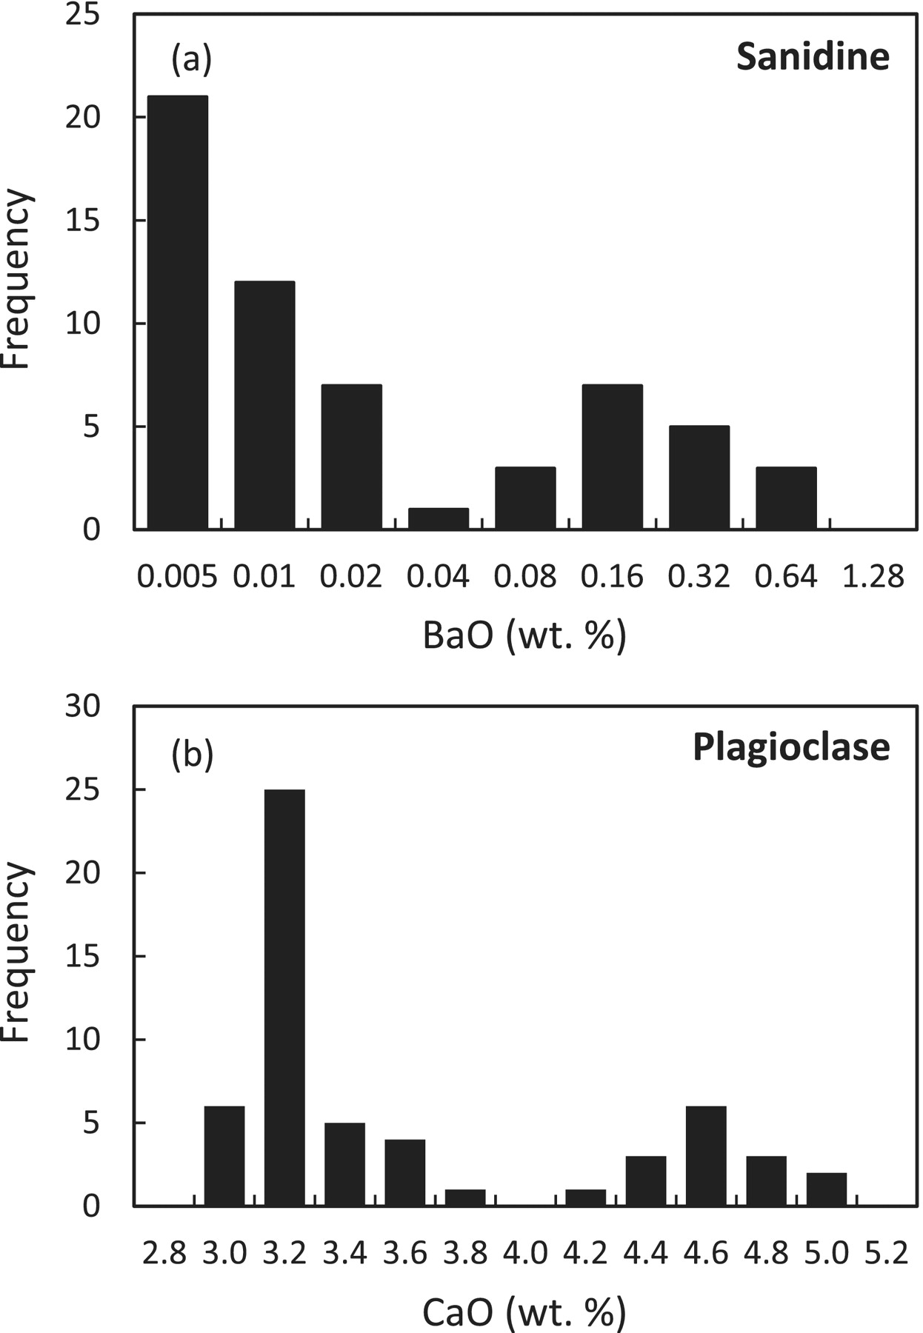
Fig. 10. Histograms of Bishop Tuff phenocryst compositions (data from Hildreth, 1979). (a) BaO in sanidine ...
Notes:
Fig. 10. Histograms of Bishop Tuff phenocryst compositions (data from Hildreth, 1979). (a) BaO in sanidine (logarithmic bin sizes), (b) CaO in plagioclase, showing bimodal distributions of phenocryst compositions, suggesting discrete magma compositions for the early and late-erupted magmas.
Unless provided in the caption above, the following copyright applies to the content of this slide: © The Author 2012. Published by Oxford University Press. All rights reserved. For Permissions, please e-mail: journals.permissions@oup.com

Slide 8
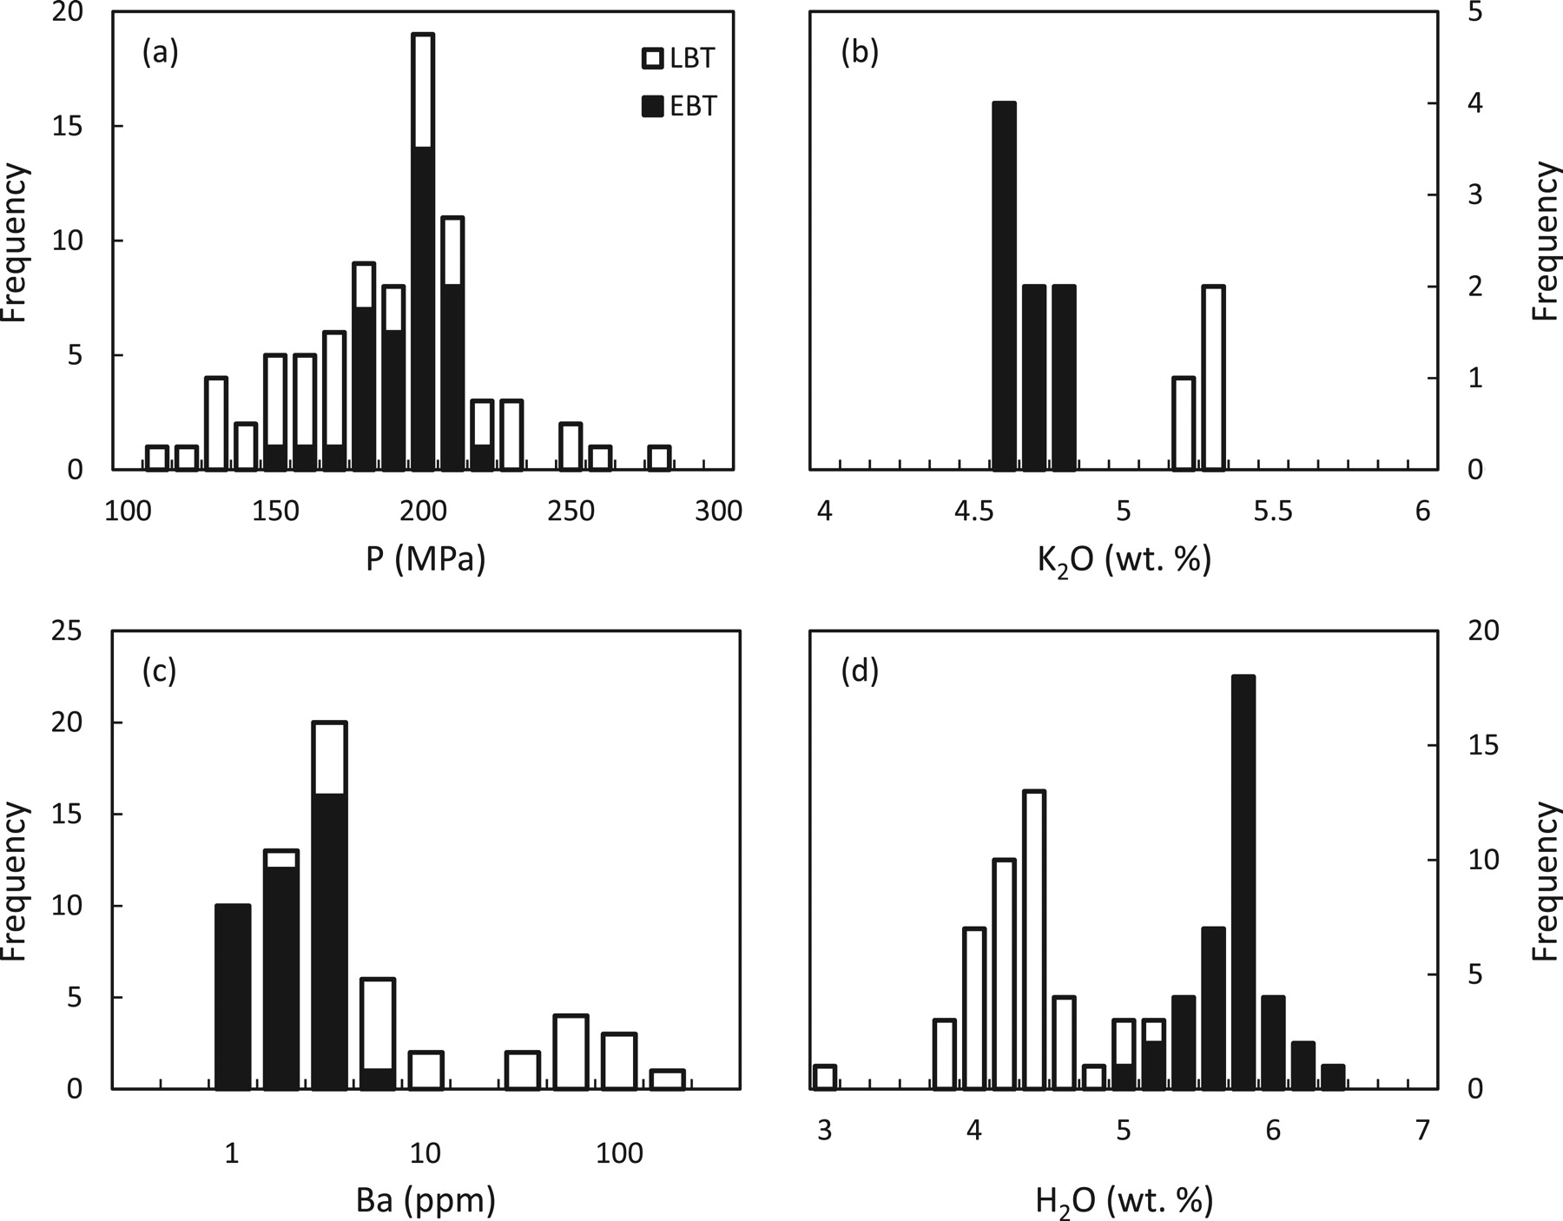
Fig. 9. Histograms of melt inclusion compositions for early erupted (EBT) and late-erupted (LBT) Bishop Tuff (data ...
Notes:
Fig. 9. Histograms of melt inclusion compositions for early erupted (EBT) and late-erupted (LBT) Bishop Tuff (data from Wallace et al., 1999). (a) H2O–CO2 saturation pressure, showing overlap between calculated pressure for early and late-erupted melt inclusions, both with average equilibration pressures <200 MPa. (b) K2O, (c) Ba (note logarithmic bin sizes), and (d) H2O distributions, clearly bimodal, suggest that early and late-erupted magmas were rather discrete compositionally.
Unless provided in the caption above, the following copyright applies to the content of this slide: © The Author 2012. Published by Oxford University Press. All rights reserved. For Permissions, please e-mail: journals.permissions@oup.com

Slide 9
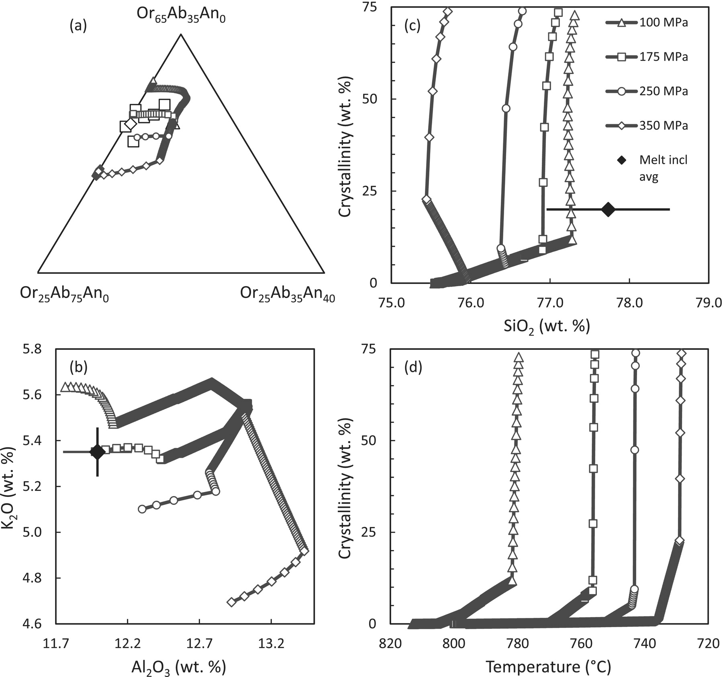
Fig. 8. Comparison of melt evolution trajectories with melt inclusion data for rhyolite-MELTS simulations using ...
Notes:
Fig. 8. Comparison of melt evolution trajectories with melt inclusion data for rhyolite-MELTS simulations using late-erupted Bishop Tuff bulk-pumice compositions. (a) Or–Ab–An ternary, showing that evolution under 175 MPa leads to a trajectory that intersects most melt inclusion compositions. (b) K2O vs Al2O3 plot showing remarkable agreement between calculated melt and melt inclusion compositions; error bar is 2% of value for both oxides. (c) Crystallinity (wt % crystals) vs SiO2 plot showing the strong dependence of the maximum SiO2 value attained by the melt as a function of pressure; error bar corresponds to 1% of value, showing that deviations from observed value are small. (d) Crystallinity (wt % crystals) vs temperature plot showing the marked dependence of the nearly invariant temperature on pressure; as expected for hydrous melts, invariant temperature decreases with increasing pressure. In combination, these results suggest crystallization of the late-erupted magma at ∼175 MPa, a value that is lower than the usually inferred 250 MPa, at temperatures substantially lower than ∼780°C inferred from thermometry.
Unless provided in the caption above, the following copyright applies to the content of this slide: © The Author 2012. Published by Oxford University Press. All rights reserved. For Permissions, please e-mail: journals.permissions@oup.com

Slide 10
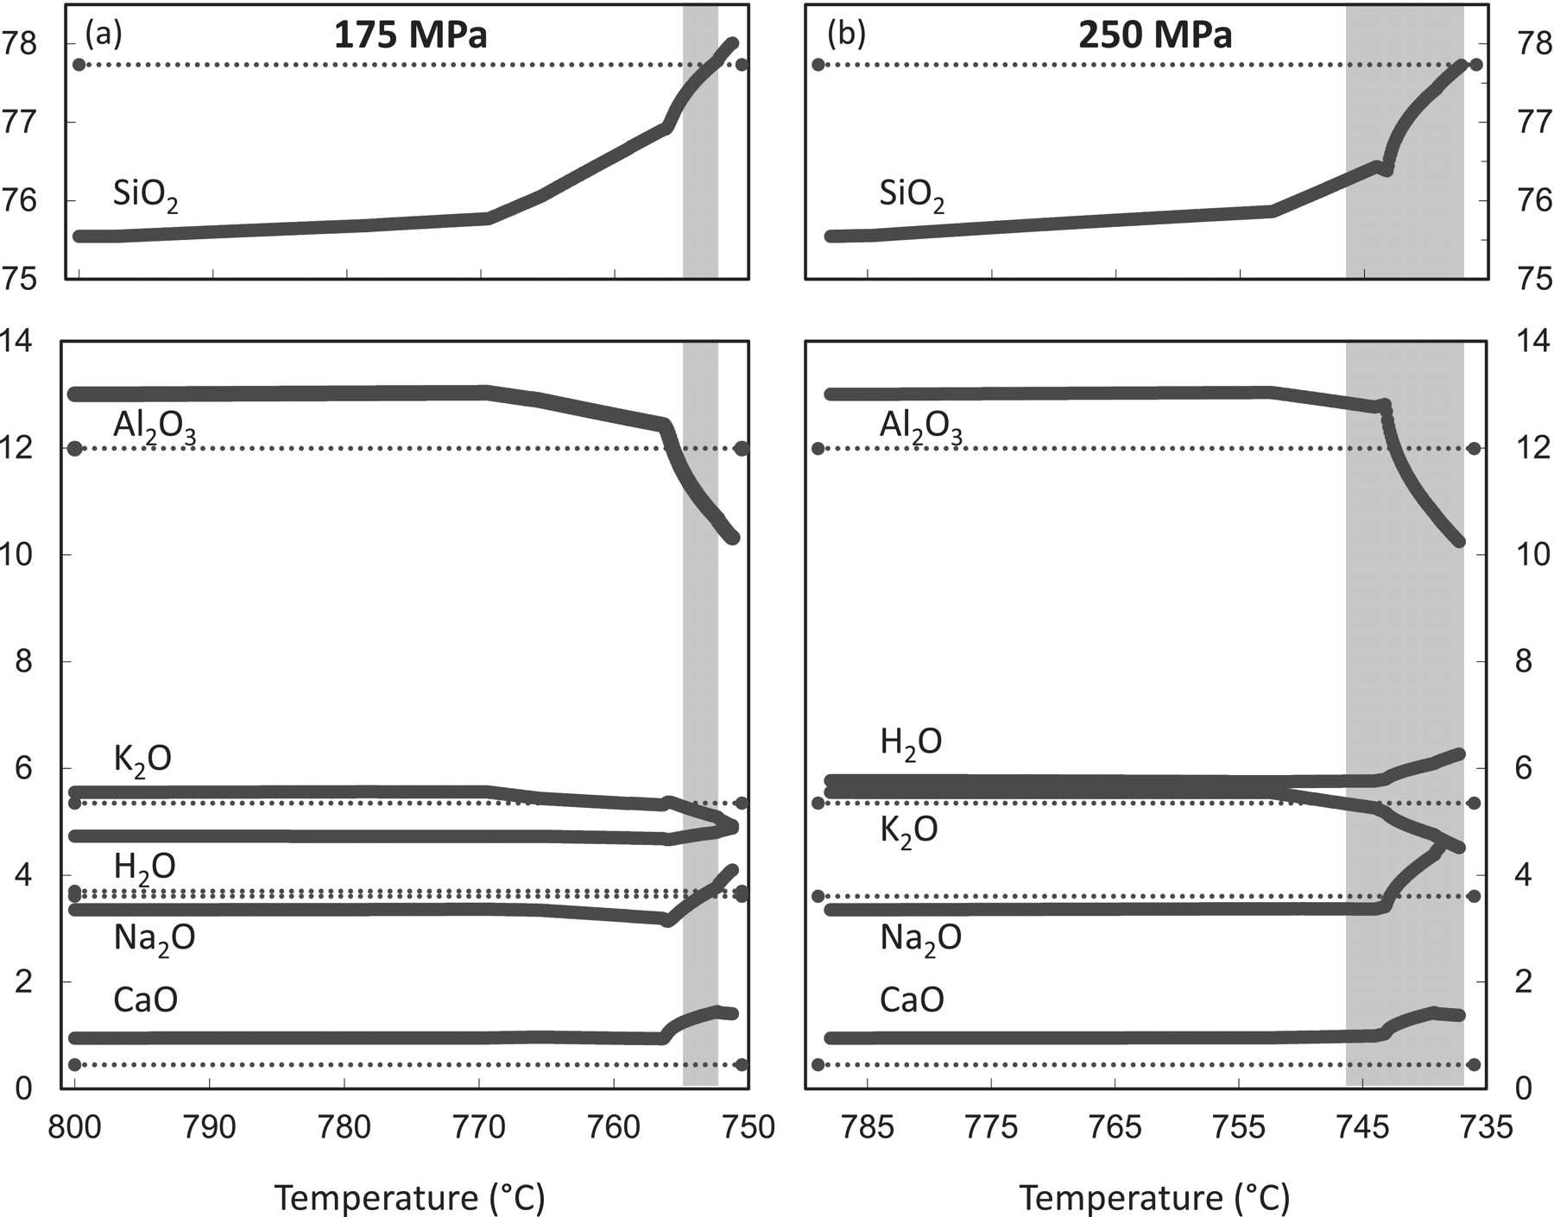
Fig. 7. Evolution of melt composition with temperature for rhyolite-MELTS simulations using late-erupted Bishop Tuff ...
Notes:
Fig. 7. Evolution of melt composition with temperature for rhyolite-MELTS simulations using late-erupted Bishop Tuff bulk-pumice composition. (a) Results for 175 MPa pressure; melt inclusion and calculated melt compositions agree reasonably well, even though the match for SiO2 and Na2O takes place at lower temperature than for Al2O3 and K2O. (b) Results for 250 MPa pressure. In both cases, the horizontal dotted lines correspond to melt inclusion compositions. The vertical gray bars correspond to the minimum range of temperatures required to match expected and simulated compositions for the main oxides: SiO2, Al2O3, K2O, Na2O; the narrower shaded region for 175 MPa shows that the agreement between observed and simulated compositions is superior over the 250 MPa case.
Unless provided in the caption above, the following copyright applies to the content of this slide: © The Author 2012. Published by Oxford University Press. All rights reserved. For Permissions, please e-mail: journals.permissions@oup.com

