Slide 1
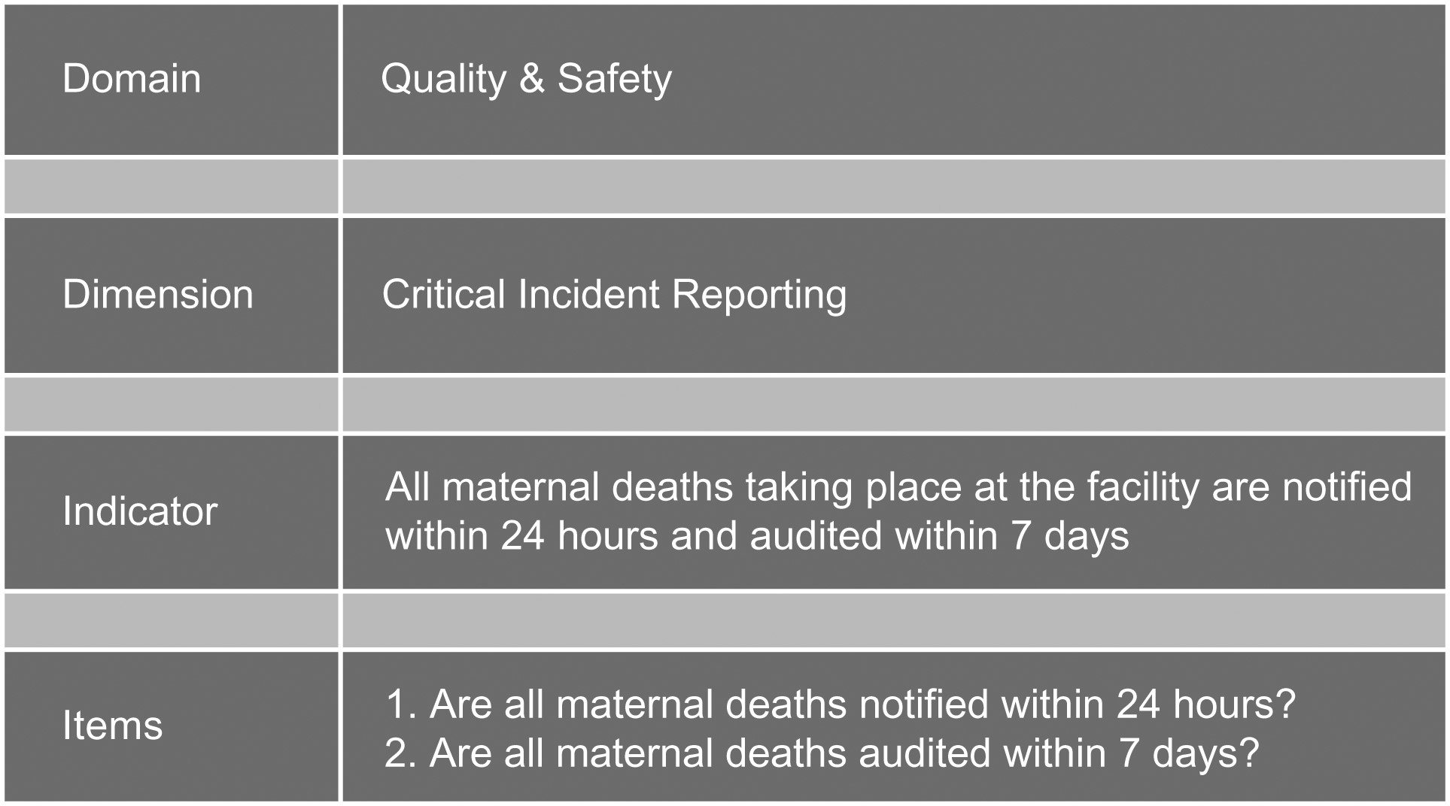
Figure 1 Overview of the different levels of the IQMS.
Notes:
Figure 1 Overview of the different levels of the IQMS.
Unless provided in the caption above, the following copyright applies to the content of this slide: © The Author 2016. Published by Oxford University Press in association with the International Society for Quality in Health Care.This is an Open Access article distributed under the terms of the Creative Commons Attribution License (http://creativecommons.org/licenses/by/4.0/), which permits unrestricted reuse, distribution, and reproduction in any medium, provided the original work is properly cited.

Slide 2
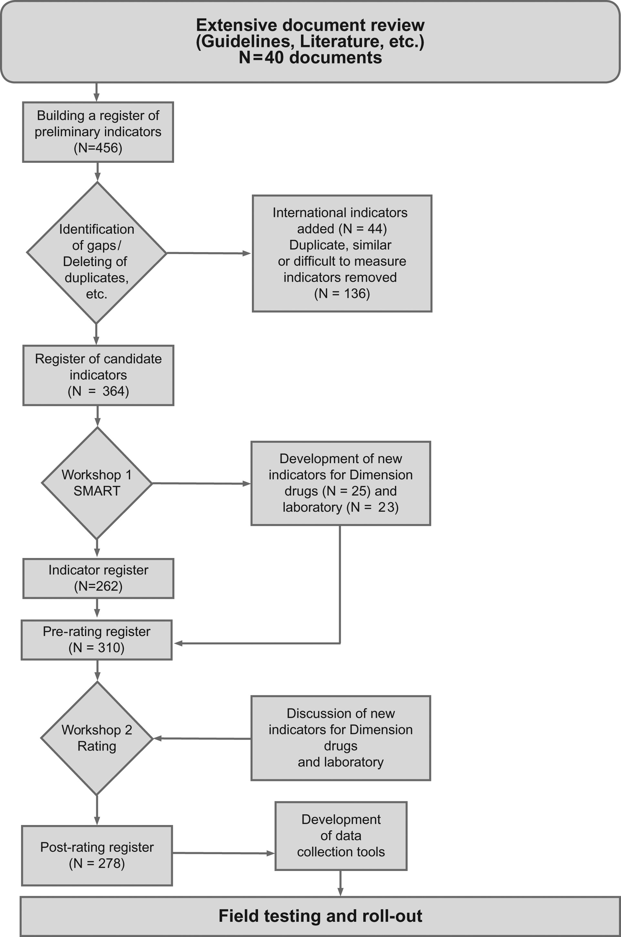
Figure 2 Overview of the process of establishing the indicators for use in the IQMS.
Notes:
Figure 2 Overview of the process of establishing the indicators for use in the IQMS.
Unless provided in the caption above, the following copyright applies to the content of this slide: © The Author 2016. Published by Oxford University Press in association with the International Society for Quality in Health Care.This is an Open Access article distributed under the terms of the Creative Commons Attribution License (http://creativecommons.org/licenses/by/4.0/), which permits unrestricted reuse, distribution, and reproduction in any medium, provided the original work is properly cited.

