Slide 1
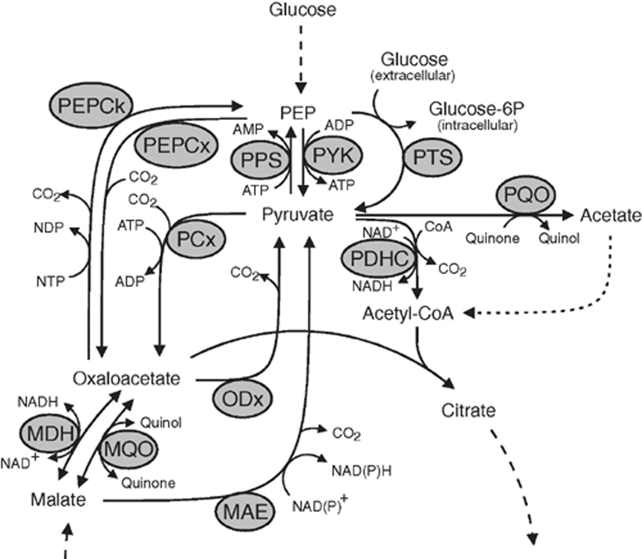
1 The enzymes at the PEP–pyruvate–oxaloacetate node in aerobic bacteria. Abbreviations: MAE, malic enzyme; MDH, ...
Notes:
1 The enzymes at the PEP–pyruvate–oxaloacetate node in aerobic bacteria. Abbreviations: MAE, malic enzyme; MDH, malate dehydrogenase; MQO, malate: quinone oxidoreductase; ODx, oxaloacetate decarboxylase; PCx, pyruvate carboxylase; PDHC, pyruvate dehydrogenase complex; PEPCk, PEP carboxykinase; PEPCx, PEP carboxylase; PPS, PEP synthetase; PQO, pyruvate: quinone oxidoreductase; PTS, phosphotransferase system; PYK, pyruvate kinase.
Unless provided in the caption above, the following copyright applies to the content of this slide: © 2004 Federation of European Microbiological Societies. Published by Elsevier B.V. All rights reserved.

Slide 2
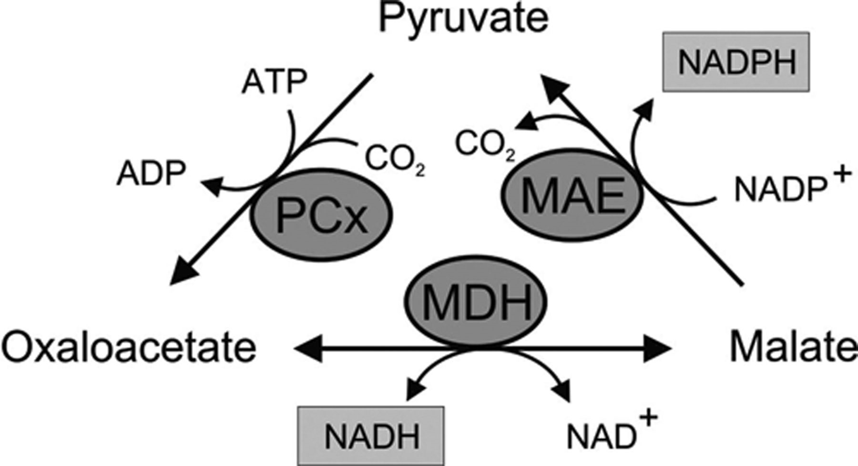
2 NADPH formation from NADH in a cycle including the reactions of pyruvate carboxylase (PCx), malate ...
Notes:
2 NADPH formation from NADH in a cycle including the reactions of pyruvate carboxylase (PCx), malate dehydrogenase (MDH) and malic enzyme (MAE).
Unless provided in the caption above, the following copyright applies to the content of this slide: © 2004 Federation of European Microbiological Societies. Published by Elsevier B.V. All rights reserved.

Slide 3
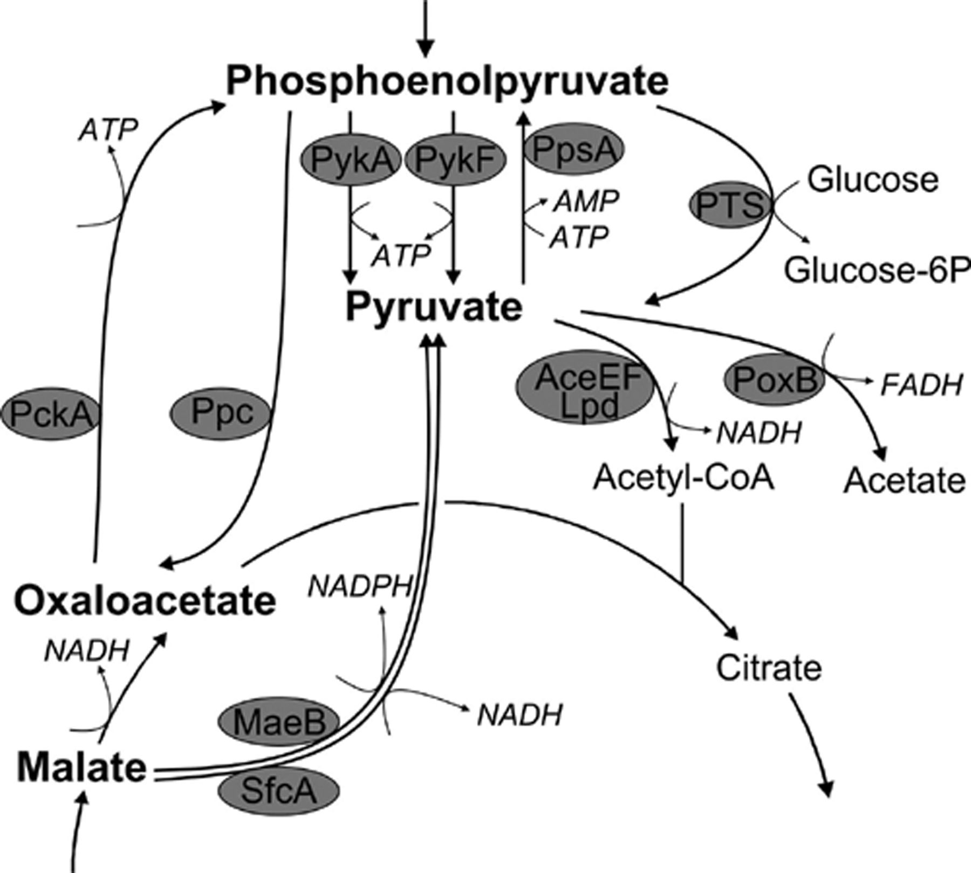
3 The PEP–pyruvate–oxaloacetate node in aerobic E. coli. The reaction arrows point into the normal ...
Notes:
3 The PEP–pyruvate–oxaloacetate node in aerobic E. coli. The reaction arrows point into the normal physiological direction. Abbreviations denote the gene products that catalyze a given reaction: PykA(F), pyruvate kinase(s); PpsA, PEP synthetase; PTS, phosphotransferase system (for glucose uptake); AceEF and Lpd, pyruvate dehydrogenase; PoxB, pyruvate oxidase; Ppc, PEP carboxylase; PckA, PEP carboxykinase; MaeB and SfcA, malic enzyme(s).
Unless provided in the caption above, the following copyright applies to the content of this slide: © 2004 Federation of European Microbiological Societies. Published by Elsevier B.V. All rights reserved.

Slide 4
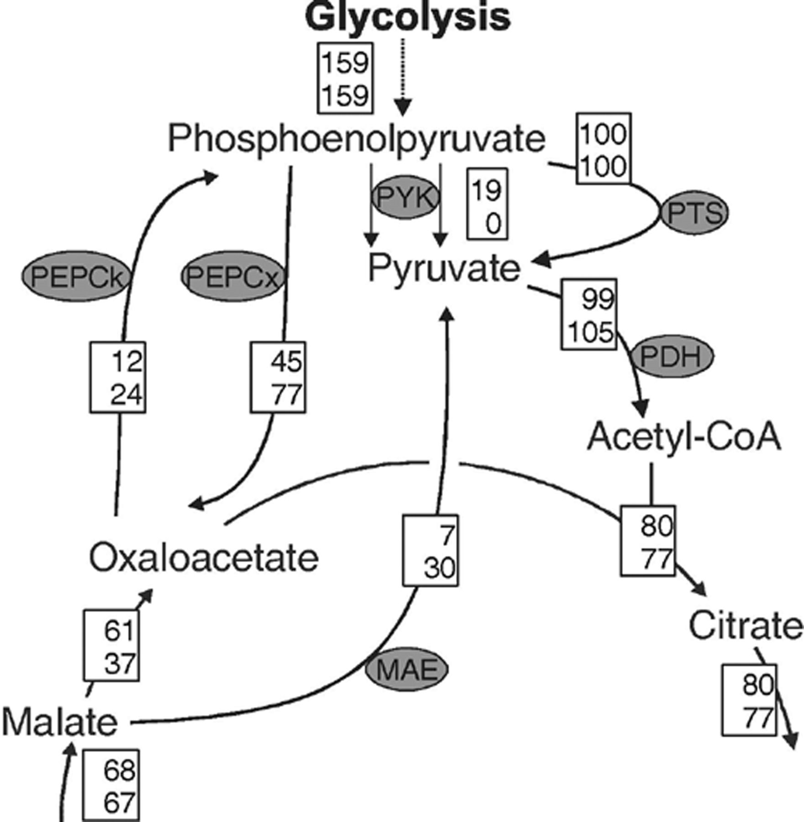
4 Distribution of metabolic fluxes at the glycolysis-Krebs cycle interface in wild-type E. coli (top entry in ...
Notes:
4 Distribution of metabolic fluxes at the glycolysis-Krebs cycle interface in wild-type E. coli (top entry in the boxes) and a knockout mutant of both pyruvate kinase isoenzymes (bottom entry). Flux values are relative to the specific glucose uptake rate and were obtained from glucose-limited continuous cultures at a growth rate of 0.4 h−1[144]. Note the local bypass of pyruvate kinase via malic enzyme and PEP carboxylase. Abbreviations: see legend to Fig. 2.
Unless provided in the caption above, the following copyright applies to the content of this slide: © 2004 Federation of European Microbiological Societies. Published by Elsevier B.V. All rights reserved.

Slide 5
5 Stoichiometry of the TCA cycle (a) and the PEP–glyoxylate cycle (b) in E. coli[11]. Solid arrows indicate ...
Notes:
5 Stoichiometry of the TCA cycle (a) and the PEP–glyoxylate cycle (b) in E. coli[11]. Solid arrows indicate reactions that are required twice per cycle.
Unless provided in the caption above, the following copyright applies to the content of this slide: © 2004 Federation of European Microbiological Societies. Published by Elsevier B.V. All rights reserved.

Slide 6
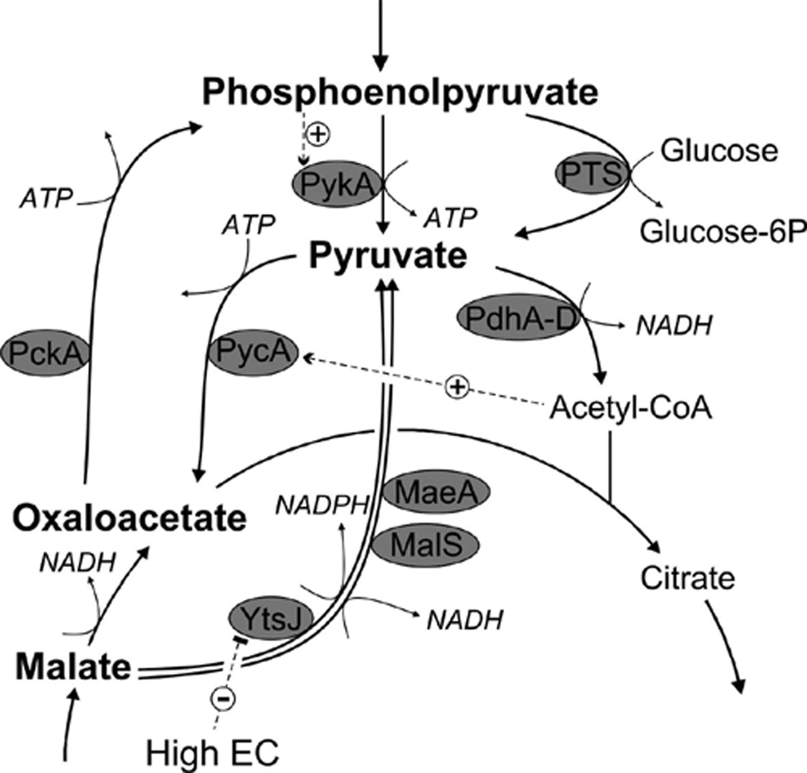
6 The PEP–pyruvate–oxaloacetate node in B. subtilis. The reaction arrows point into the normal physiological ...
Notes:
6 The PEP–pyruvate–oxaloacetate node in B. subtilis. The reaction arrows point into the normal physiological direction. Allosteric regulation is indicated by thin, hatched arrows. Abbreviations (gene products that catalyze a given reaction): PykA, pyruvate kinase; PTS, phosphotransferase systems (for glucose uptake); PdhABCD, pyruvate dehydrogenase complex; PycA, pyruvate carboxylase; PckA, PEP carboxykinase; MaeA, MalS, and YtsJ, malic enzyme(s); EC, energy charge.
Unless provided in the caption above, the following copyright applies to the content of this slide: © 2004 Federation of European Microbiological Societies. Published by Elsevier B.V. All rights reserved.

Slide 7
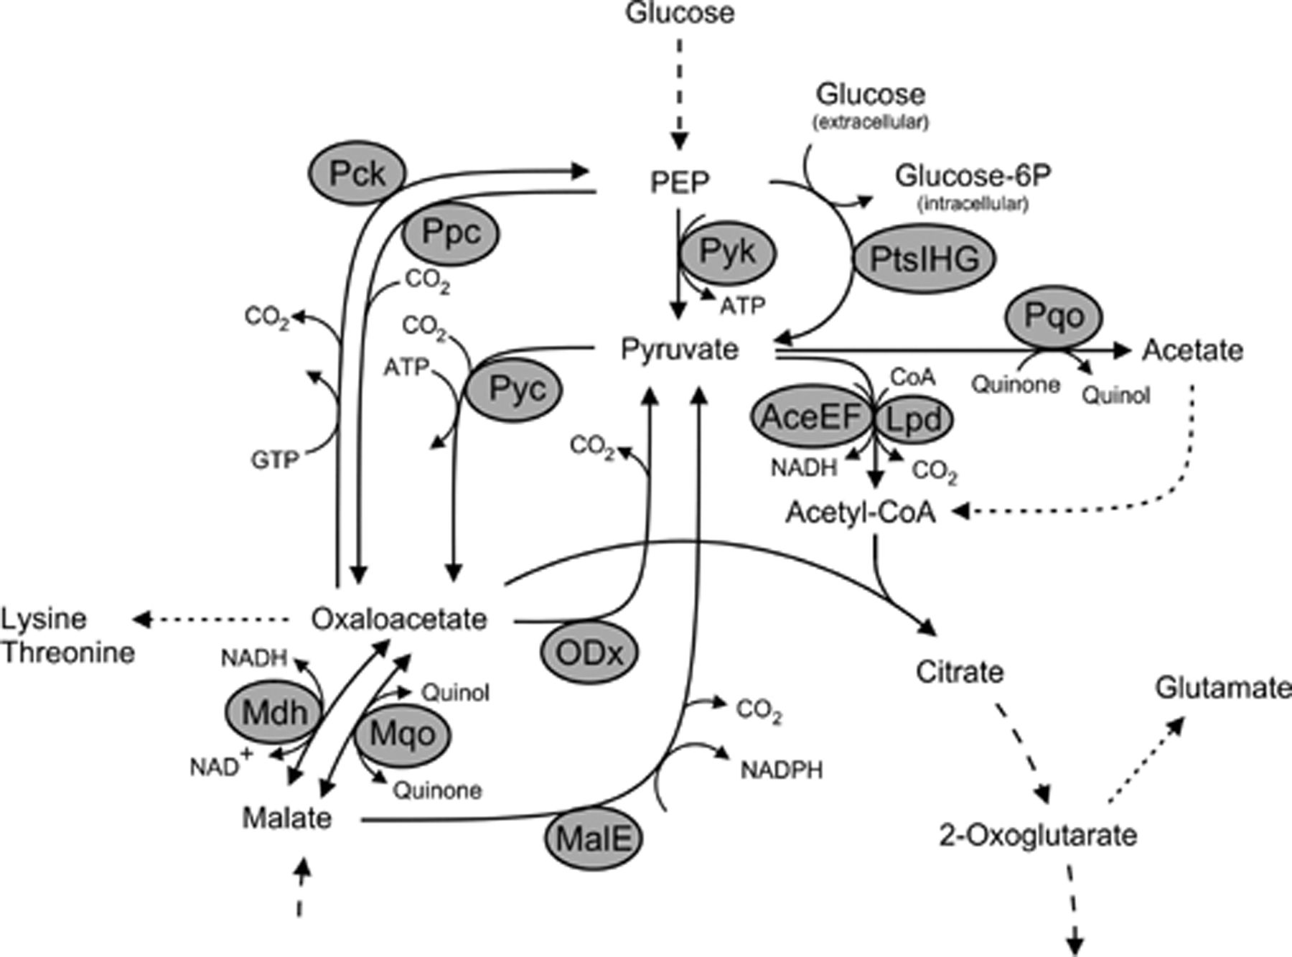
7 The PEP–pyruvate–oxaloacetate node in C. glutamicum. Abbreviations denote the gene products that catalyze a ...
Notes:
7 The PEP–pyruvate–oxaloacetate node in C. glutamicum. Abbreviations denote the gene products that catalyze a given reaction: AceEF, subunits E1 and E2 of the pyruvate dehydrogenase complex; Lpd, subunit E3 of the pyruvate dehydrogenase complex; MalE, malic enzyme; Mdh, malate dehydrogenase; Mqo, malate: quinone oxidoreductase; ODx, oxaloacetate decarboxylase (gene not annotated); Pck, PEP carboxykinase; PtsIHG, phosphotransferase system; Pqo, pyruvate: quinone oxidoreductase; Pyc, pyruvate carboxylase; Pyk, pyruvate kinase.
Unless provided in the caption above, the following copyright applies to the content of this slide: © 2004 Federation of European Microbiological Societies. Published by Elsevier B.V. All rights reserved.

Slide 8
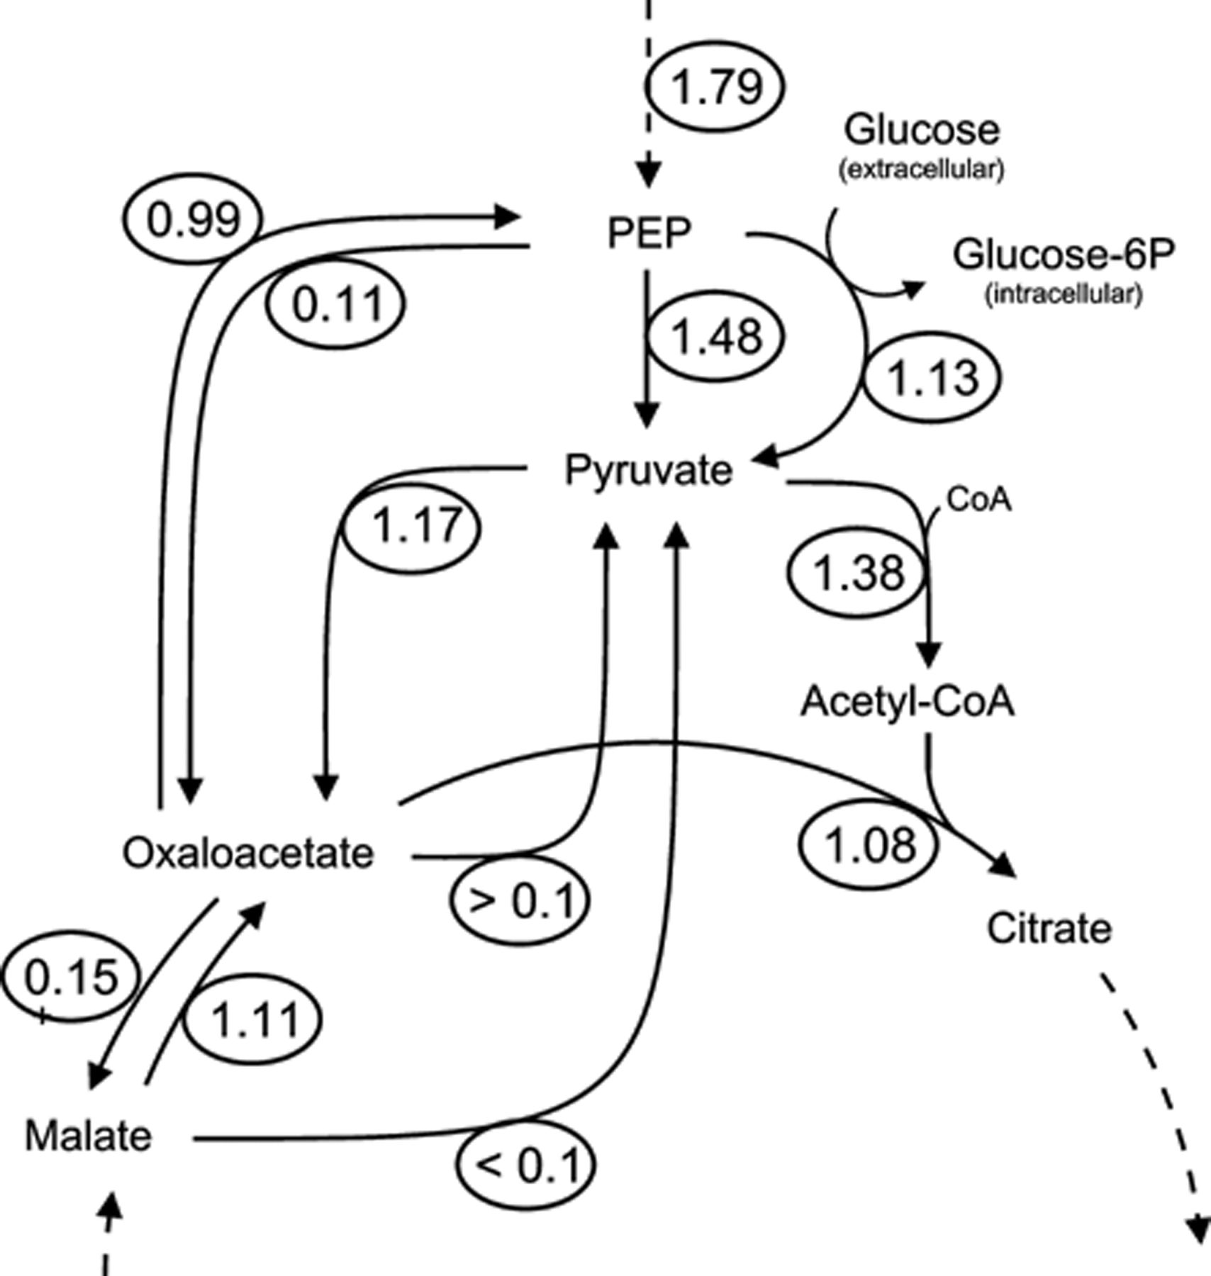
8 Distribution of metabolic fluxes at the PEP–pyruvate–oxaloacetate node in C. glutamicum. All fluxes are given ...
Notes:
8 Distribution of metabolic fluxes at the PEP–pyruvate–oxaloacetate node in C. glutamicum. All fluxes are given in mmol/g dry weight/h and were obtained from carbon-limited continuous cultures at a growth rate of 0.1 h−1[10].
Unless provided in the caption above, the following copyright applies to the content of this slide: © 2004 Federation of European Microbiological Societies. Published by Elsevier B.V. All rights reserved.

