Slide 1
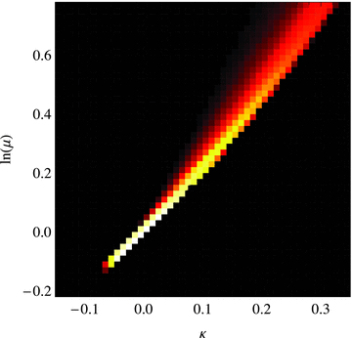
Figure 1 The joint distribution of the logarithmic magnification λ = ln (μ) and the convergence κ for sources at ...
Notes:
Figure 1 The joint distribution of the logarithmic magnification λ = ln (μ) and the convergence κ for sources at redshift zS = 1.5 (lighter areas correspond to higher probability densities on a logarithmic scale).
Unless provided in the caption above, the following copyright applies to the content of this slide: © 2010 The Authors Monthly Notices of the Royal Astronomical Society © 2010 RAS

Slide 2
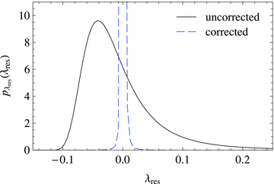
Figure 2 The probability distribution of the residual logarithmic magnification λ_{res}=λ−λ_{est} for ...
Notes:
Figure 2 The probability distribution of the residual logarithmic magnification λres=λ−λest for sources at redshift zS = 1.5. The residual distribution for the optimal estimate (25) with the convergence to the same source redshift (dashed line) is compared to the case without correction (i.e. λest = 0, solid line).
Unless provided in the caption above, the following copyright applies to the content of this slide: © 2010 The Authors Monthly Notices of the Royal Astronomical Society © 2010 RAS

Slide 3
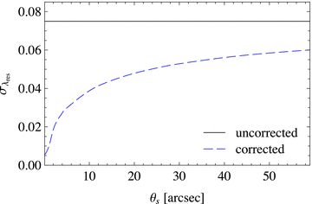
Figure 3 The dispersion of the residual λ_{res} (dashed line) for sources at redshift z_{S} = 1.5 as ...
Notes:
Figure 3 The dispersion of the residual λres (dashed line) for sources at redshift zS = 1.5 as a function of the filter scale θs used to generate the convergence estimate κest by convolving the convergence κ(zS) with a Gaussian filter. The solid horizontal line marks the magnification dispersion λres=λ without correction.
Unless provided in the caption above, the following copyright applies to the content of this slide: © 2010 The Authors Monthly Notices of the Royal Astronomical Society © 2010 RAS

Slide 4
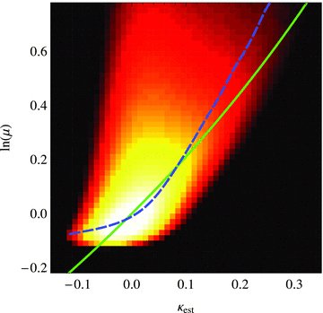
Figure 4 The joint distribution of the logarithmic magnification λ for sources at redshift z_{S} = 1.5 and ...
Notes:
Figure 4 The joint distribution of the logarithmic magnification λ for sources at redshift zS = 1.5 and the convergence κest reconstructed from the shear of galaxy images in a survey with galaxy density ngal = 100 arcmin−2, median redshift zmedian = 1.5 and a Gaussian smoothing with filter scale θs = 20 arcsec (lighter areas correspond to higher probability densities on a logarithmic scale). Also shown are the relation λ=−2 ln (1 −κest) (solid line) and the relation (dashed line).
Unless provided in the caption above, the following copyright applies to the content of this slide: © 2010 The Authors Monthly Notices of the Royal Astronomical Society © 2010 RAS

Slide 5
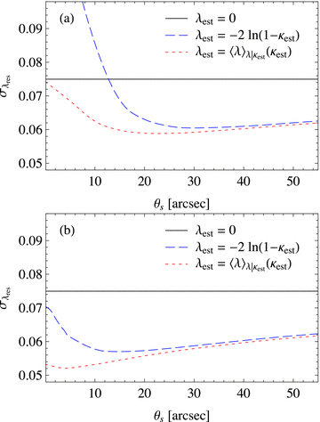
Figure 5 The dispersion of the residual logarithmic magnification λ_{res}=λ−λ_{est} of sources at ...
Notes:
Figure 5 The dispersion of the residual logarithmic magnification λres=λ−λest of sources at redshift zS = 1.5 as a function of the filter scale θs used to reconstruct the convergence κest from an advanced survey with ngal = 100 arcmin−2. Results are shown for the simple estimate (24) (dashed lines) and for the optimal estimate (25) (dotted lines) with convergence reconstructed from shear (a) and from shear and flexion (b). The solid horizontal line indicates the dispersion λres=λ without correction.
Unless provided in the caption above, the following copyright applies to the content of this slide: © 2010 The Authors Monthly Notices of the Royal Astronomical Society © 2010 RAS

Slide 6
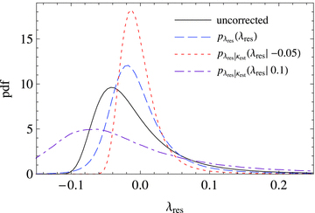
Figure 6 The probability distribution of the residual magnification λ_{res}=λ−λ_{est} for sources at ...
Notes:
Figure 6 The probability distribution of the residual magnification λres=λ−λest for sources at redshift zS = 1.5. Compared are the distribution for λest = 0 (solid line), the distribution for the optimal estimate (25) with κest reconstructed using the shear from an advanced survey with ngal = 100 arcmin−2 and a filter scale θs = 25 arcsec (dashed line), and the conditional distribution for κest=−0.05 (dotted line) and κest = 0.1 (dash–dotted line).
Unless provided in the caption above, the following copyright applies to the content of this slide: © 2010 The Authors Monthly Notices of the Royal Astronomical Society © 2010 RAS

Slide 7
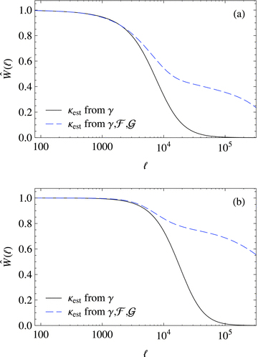
Figure 15 Wiener filters in Fourier space for standard candles/sirens at redshift z_{S} = 1.5 and convergence ...
Notes:
Figure 15 Wiener filters in Fourier space for standard candles/sirens at redshift zS = 1.5 and convergence reconstructed from the shear (solid line) or the shear and flexion (dashed line) from an advanced survey with galaxy density ngal = 100 arcmin−2 and median redshift zmedian = 1.5 (a) and a futuristic survey with ngal = 500 arcmin−2 and zmedian = 1.8 (b).
Unless provided in the caption above, the following copyright applies to the content of this slide: © 2010 The Authors Monthly Notices of the Royal Astronomical Society © 2010 RAS

Slide 8
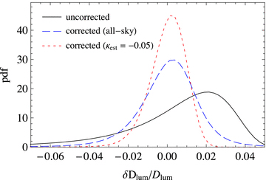
Figure 14 The probability distribution of the magnification-induced distance error δD_{lum} (relative to the ...
Notes:
Figure 14 The probability distribution of the magnification-induced distance error δDlum (relative to the true distance Dlum) for sources at redshift zS = 1.5. Compared are the distribution without correction (solid line), the all-sky distribution for the corrected distance using the optimal estimate (25) with κest reconstructed using the shear and flexion from a futuristic survey with ngal = 500 arcmin−2 and a filter scale θs = 3 arcsec (dashed line), and the distribution for sources in regions with estimated convergence κest=−0.05.
Unless provided in the caption above, the following copyright applies to the content of this slide: © 2010 The Authors Monthly Notices of the Royal Astronomical Society © 2010 RAS

Slide 9
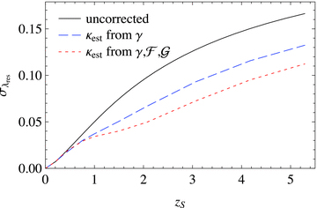
Figure 13 The dispersion of the residual magnification as a function of the source redshift z_{S}. The ...
Notes:
Figure 13 The dispersion of the residual magnification as a function of the source redshift zS. The dispersion without correction (λest = 0, solid line) is compared to the residual dispersion with convergence reconstructed from the shear (dashed line) and shear and flexion of a futuristic weak-lensing survey with galaxy number density ngal = 500 arcmin−2 and median redshift zmedian = 1.8.
Unless provided in the caption above, the following copyright applies to the content of this slide: © 2010 The Authors Monthly Notices of the Royal Astronomical Society © 2010 RAS

Slide 10
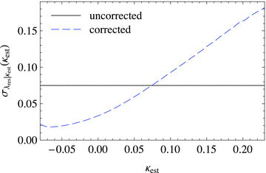
Figure 12 Dispersion of the conditional probability distribution of the residual magnification ...
Notes:
Figure 12 Dispersion of the conditional probability distribution of the residual magnification λres=λ−λest for sources at redshift zS = 1.5 using the optimal estimate (25) and convergence κest reconstructed using the shear and flexion from a futuristic survey with ngal = 500 arcmin−2 and a filter scale θs = 3 arcsec (dashed line). The solid line indicates the dispersion of the uncorrected magnification.
Unless provided in the caption above, the following copyright applies to the content of this slide: © 2010 The Authors Monthly Notices of the Royal Astronomical Society © 2010 RAS

Slide 11
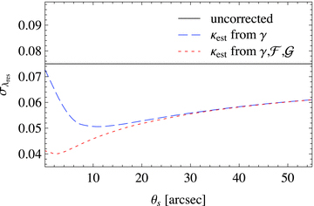
Figure 11 The dispersion of the residual logarithmic magnification λ_{res}=λ−λ_{est} of sources at ...
Notes:
Figure 11 The dispersion of the residual logarithmic magnification λres=λ−λest of sources at redshift zS = 1.5 as a function of the filter scale θs used to reconstruct the convergence κest from a futuristic survey with ngal = 500 arcmin−2. Results are shown for the optimal estimate (25) with convergence reconstructed from shear (dashed line) and from shear and flexion (dotted line). The solid horizontal line indicates the dispersion of λres=λ without correction.
Unless provided in the caption above, the following copyright applies to the content of this slide: © 2010 The Authors Monthly Notices of the Royal Astronomical Society © 2010 RAS

Slide 12
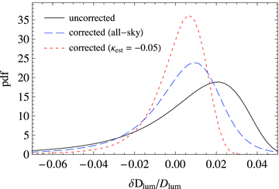
Figure 10 The probability distribution of the magnification-induced distance error δD_{lum} relative to the ...
Notes:
Figure 10 The probability distribution of the magnification-induced distance error δDlum relative to the true distance Dlum for sources at redshift zS = 1.5. Compared are the distribution without correction (solid line), the all-sky distribution for the corrected distance using the optimal estimate (25) with κest reconstructed using the shear from an advanced survey with ngal = 100 arcmin−2 and a filter scale θs = 25 arcsec (dashed line), and the distribution for sources in regions with estimated convergence κest=−0.05 (dotted line).
Unless provided in the caption above, the following copyright applies to the content of this slide: © 2010 The Authors Monthly Notices of the Royal Astronomical Society © 2010 RAS

Slide 13
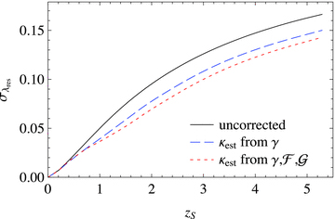
Figure 9 The dispersion of the residual magnification as a function of the source redshift z_{S}. The ...
Notes:
Figure 9 The dispersion of the residual magnification as a function of the source redshift zS. The dispersion without correction (λest = 0, solid line) is compared to the residual dispersion with convergence reconstructed from the shear (dashed line) and shear and flexion of an advanced weak-lensing survey with galaxy number density ngal = 100 arcmin−2 and median redshift zmedian = 1.5.
Unless provided in the caption above, the following copyright applies to the content of this slide: © 2010 The Authors Monthly Notices of the Royal Astronomical Society © 2010 RAS

Slide 14
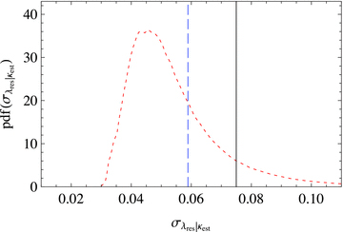
Figure 8 The probability distribution of the conditional residual dispersion for sources at redshift z_{S} = ...
Notes:
Figure 8 The probability distribution of the conditional residual dispersion for sources at redshift zS = 1.5 for an advanced survey with shear (dashed line). The vertical solid line indicates the value of the uncorrected magnification dispersion σλ, and the vertical dotted line marks the all-sky average of the residual dispersion.
Unless provided in the caption above, the following copyright applies to the content of this slide: © 2010 The Authors Monthly Notices of the Royal Astronomical Society © 2010 RAS

Slide 15
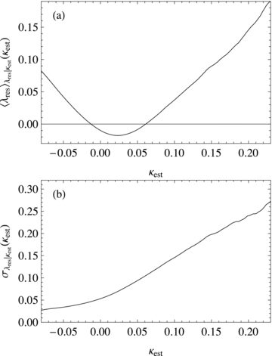
Figure 7 Bias and dispersion of the conditional probability distribution of the residual magnification ...
Notes:
Figure 7 Bias and dispersion of the conditional probability distribution of the residual magnification λres=λ−λest for sources at redshift zS = 1.5 as a function of the estimated convergence κest. Shown are the conditional bias and dispersion for the simple estimate (24) with the convergence κest reconstructed using the shear from an advanced survey with ngal = 100 arcmin−2 and a filter scale θs = 25 arcsec. Note that the conditional bias of the optimal estimate (25) vanishes by construction, while its conditional dispersion is equal to that of the simple estimate.
Unless provided in the caption above, the following copyright applies to the content of this slide: © 2010 The Authors Monthly Notices of the Royal Astronomical Society © 2010 RAS

Slide 16
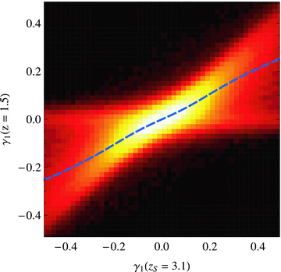
Figure 16 The joint distribution of the shear component γ₁ at redshift z = 1.8 and redshift z_{S} = ...
Notes:
Figure 16 The joint distribution of the shear component γ1 at redshift z = 1.8 and redshift zS = 3.1 at the same sky position (lighter areas correspond to higher probability densities on a logarithmic scale). The dashed line marks the mean shear as a function of γ1(zS). Note that the joint distribution for the second shear components γ2(z) and γ2(zS) is the same as for the first shear components.
Unless provided in the caption above, the following copyright applies to the content of this slide: © 2010 The Authors Monthly Notices of the Royal Astronomical Society © 2010 RAS

Slide 17
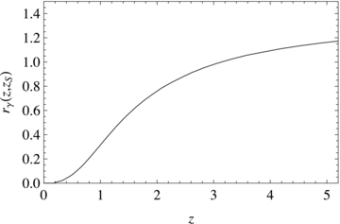
Figure 17 The ratio r_{γ}(z, z_{S}) between the mean shear at redshift z and the shear at redshift ...
Notes:
Figure 17 The ratio rγ(z, zS) between the mean shear at redshift z and the shear at redshift zS = 3.1. The ratio has been calculated by fitting the relation (29a) to the shear data from the ray-tracing simulations.
Unless provided in the caption above, the following copyright applies to the content of this slide: © 2010 The Authors Monthly Notices of the Royal Astronomical Society © 2010 RAS

Slide 18
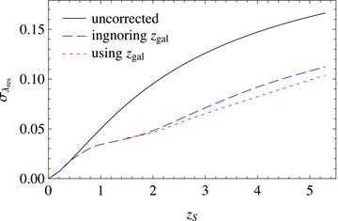
Figure 18 The dispersion of the residual magnification as a function of the source redshift z_{S}. The ...
Notes:
Figure 18 The dispersion of the residual magnification as a function of the source redshift zS. The dispersion without correction (λest = 0, solid line) is compared to the residual dispersion with convergence reconstructed from the shear and flexion of a futuristic weak-lensing survey with galaxy number density ngal = 500 arcmin−2 and median redshift zmedian = 1.8, when ignoring (dashed line) or using the individual galaxy redshifts (dotted line).
Unless provided in the caption above, the following copyright applies to the content of this slide: © 2010 The Authors Monthly Notices of the Royal Astronomical Society © 2010 RAS

