Slide 1
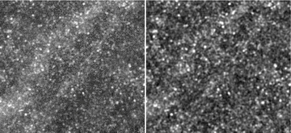
Figure 1 Part of the 350-μm map from FLS, covering an area of approximately 36 × 33 arcmin, before (left) and after ...
Notes:
Figure 1 Part of the 350-μm map from FLS, covering an area of approximately 36 × 33 arcmin, before (left) and after (right) applying the Wiener filter. The point sources are significantly emphasized by the Wiener filter, thus diminishing the effects of the large-scale diffuse cirrus.
Unless provided in the caption above, the following copyright applies to the content of this slide: © 2011 The Authors Monthly Notices of the Royal Astronomical Society © 2011 RAS

Slide 2
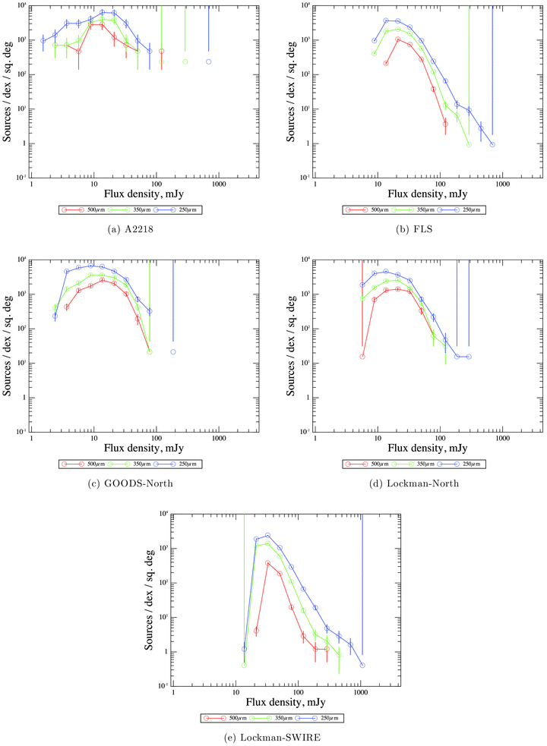
Figure 2 Raw source counts for the five fields, showing the number of sources per unit area per log₁₀ ...
Notes:
Figure 2 Raw source counts for the five fields, showing the number of sources per unit area per log10 interval in the central region. No corrections have been applied for incompleteness or flux boosting. Error bars are the counts in that bin divided by the square root of the number of sources in the bin. Each plot shows the results for 250 μm (blue), 350 μm (green) and 500 μm (red).
Unless provided in the caption above, the following copyright applies to the content of this slide: © 2011 The Authors Monthly Notices of the Royal Astronomical Society © 2011 RAS

Slide 3
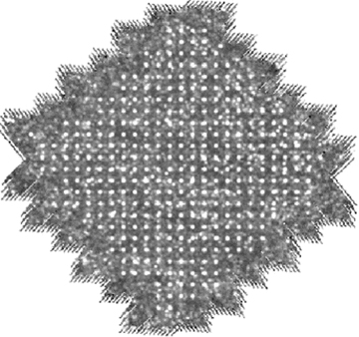
Figure 3 The 350-μm map from GOODS-North, with a grid of 100 mJy sources injected.
Notes:
Figure 3 The 350-μm map from GOODS-North, with a grid of 100 mJy sources injected.
Unless provided in the caption above, the following copyright applies to the content of this slide: © 2011 The Authors Monthly Notices of the Royal Astronomical Society © 2011 RAS

Slide 4
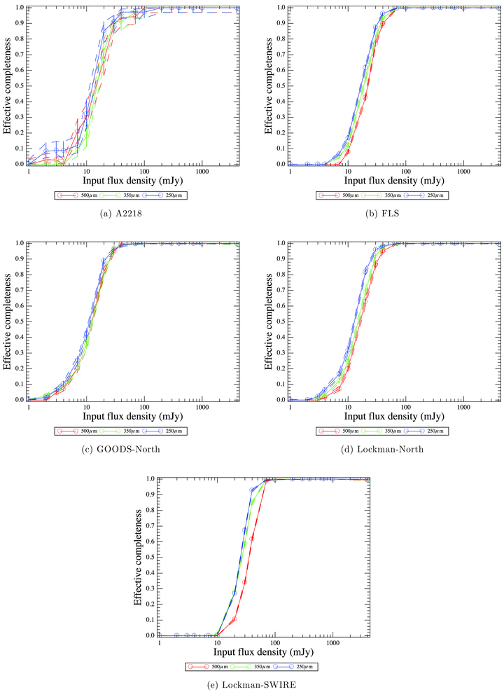
Figure 4 Completeness, for the five fields, as in Fig. 2. The flux density corresponding to 50 per cent completeness ...
Notes:
Figure 4 Completeness, for the five fields, as in Fig. 2. The flux density corresponding to 50 per cent completeness is given in Table 5. Error bars and dashed lines are the lower and upper bounds, respectively, of the posterior probability distribution for the completeness, chosen such that the probabilities at the bounds are equal, and so that the integrated probability between the bounds is 68 per cent.
Unless provided in the caption above, the following copyright applies to the content of this slide: © 2011 The Authors Monthly Notices of the Royal Astronomical Society © 2011 RAS

Slide 5
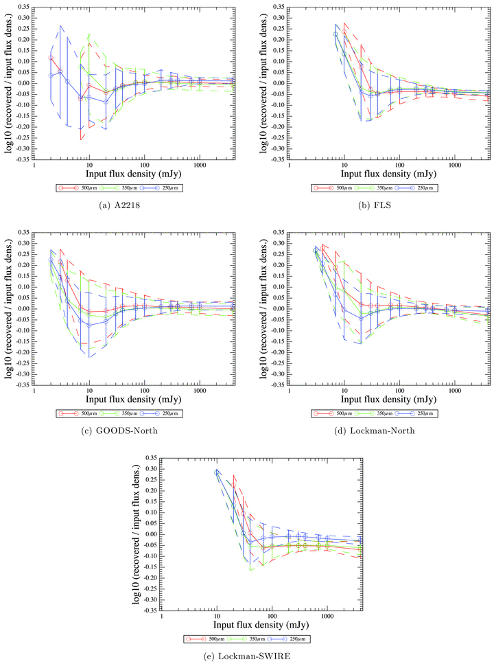
Figure 5 Flux-density accuracy, for the five fields, as in Fig. 2. Error bars are the rms of the log₁₀ ...
Notes:
Figure 5 Flux-density accuracy, for the five fields, as in Fig. 2. Error bars are the rms of the log10 (recovered flux density/input flux density) at that flux density.
Unless provided in the caption above, the following copyright applies to the content of this slide: © 2011 The Authors Monthly Notices of the Royal Astronomical Society © 2011 RAS

Slide 6
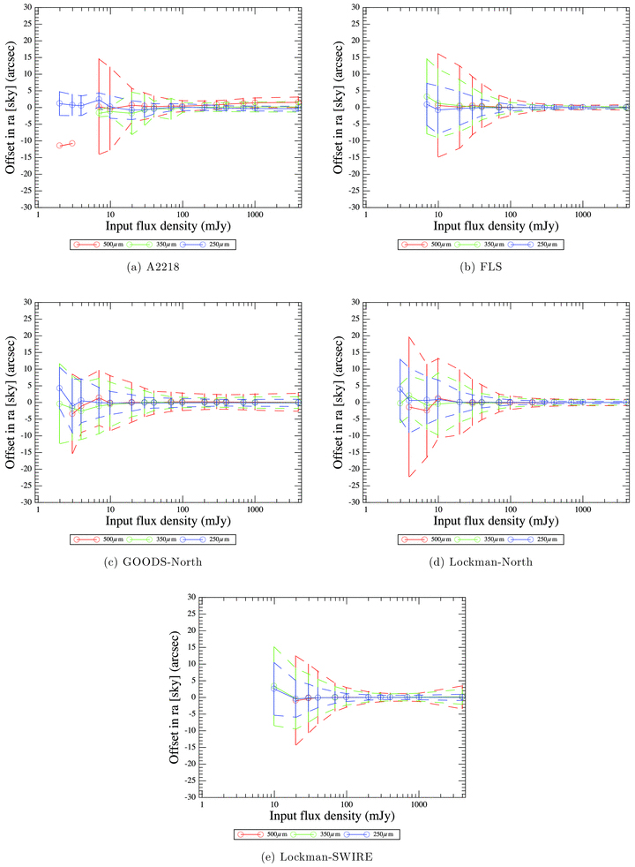
Figure 6 Positional accuracy in RA (offset to the east, in arcsec), for the five fields, as in Fig. 2. Error bars are ...
Notes:
Figure 6 Positional accuracy in RA (offset to the east, in arcsec), for the five fields, as in Fig. 2. Error bars are the rms of the positional error at that flux density. Similar results are found for the offset in declination.
Unless provided in the caption above, the following copyright applies to the content of this slide: © 2011 The Authors Monthly Notices of the Royal Astronomical Society © 2011 RAS

