Slide 1
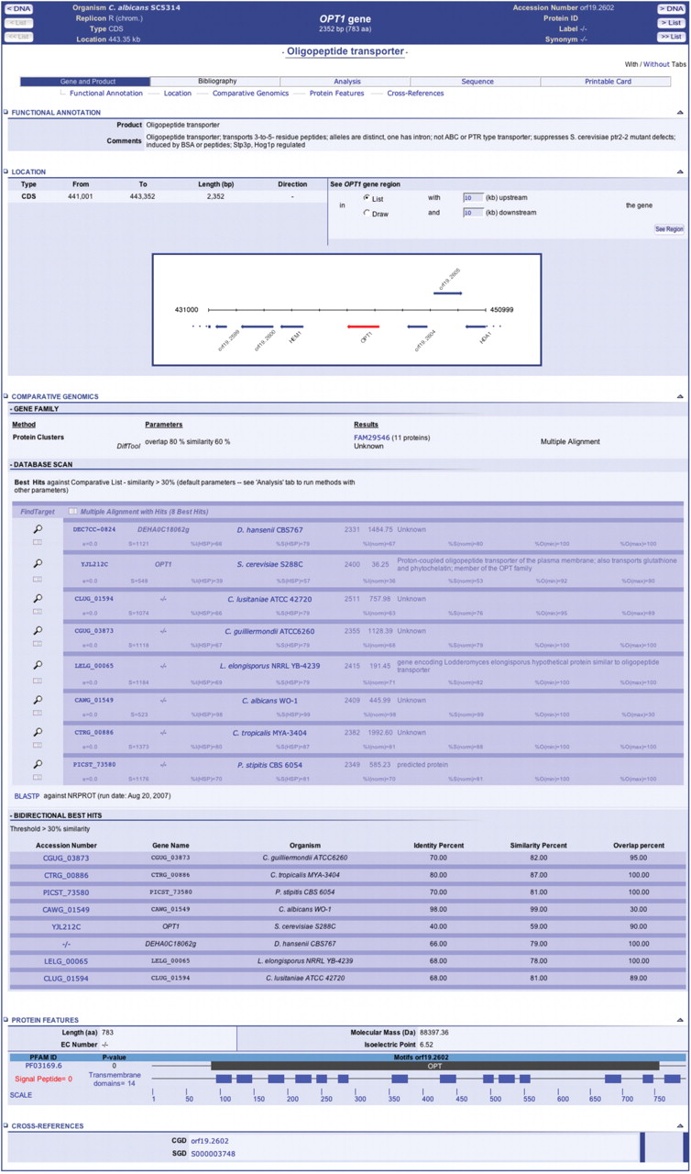
Figure 1. Snapshot of a gene window for the C. albicans OPT1 gene. The gene window displays annotation data, a dynamic ...
Notes:
Figure 1. Snapshot of a gene window for the C. albicans OPT1 gene. The gene window displays annotation data, a dynamic map of the genomic region surrounding the OPT1 gene, access to a protein cluster including the Opt1 protein, a list of best hits identified in genomes of the comparative list with links to pairwise and multiple ClustalW alignments, a list of bi-directional best hits in other genomes available in CandidaDB, a graphical representation of predicted signal peptide, transmembrane domains and PFAM domains, and links to relevant pages in other databases. Other tabs in the gene window allow access to dynamic analysis tools and tools for sequence retrieval.
Unless provided in the caption above, the following copyright applies to the content of this slide: © 2007 The Author(s)This is an Open Access article distributed under the terms of the Creative Commons Attribution Non-Commercial License (http://creativecommons.org/licenses/by-nc/2.0/uk/) which permits unrestricted non-commercial use, distribution, and reproduction in any medium, provided the original work is properly cited.

