Slide 1
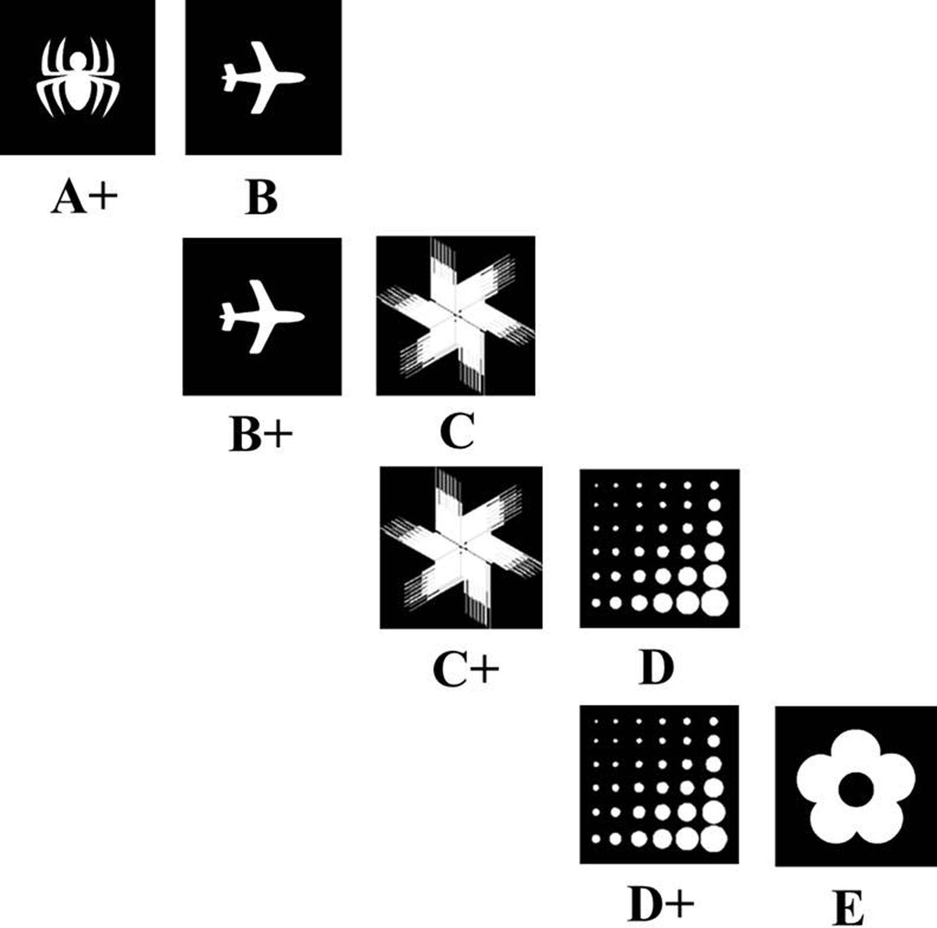
Figure 1. Schematic of the visual stimuli used for the transitive inference hierarchy. This visual task was modified ...
Notes:
Figure 1. Schematic of the visual stimuli used for the transitive inference hierarchy. This visual task was modified from a nonoperant olfactory version in rats (Dusek and Eichenbaum 1997).
Unless provided in the caption above, the following copyright applies to the content of this slide: © The Author 2013. Published by Oxford University Press. All rights reserved. For Permissions, please e-mail: journals.permissions@oup.com

Slide 2
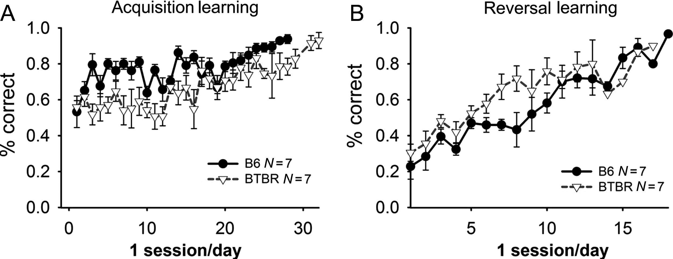
Figure 2. Percentages of choice accuracy for discrimination and reversal learning across training session days in B6 ...
Notes:
Figure 2. Percentages of choice accuracy for discrimination and reversal learning across training session days in B6 and BTBR. Acquisition of visual discrimination of luminescent-balanced stimuli in B6 and BTBR inbred strains of mice. (A) Simple discrimination learning and (B) simple reversal learning were normal in both strains, as demonstrated by similar accuracy in the percent correct responses in B6 and BTBR. Both strains reached the stringent criteria of 90% choice accuracy discrimination and 80% choice accuracy for reversal. Both strains exhibited normal acquisition curves, that is, increased correct responses across training sessions. Data are mean ± standard error of the mean. N = 7 per strain.
Unless provided in the caption above, the following copyright applies to the content of this slide: © The Author 2013. Published by Oxford University Press. All rights reserved. For Permissions, please e-mail: journals.permissions@oup.com

Slide 3
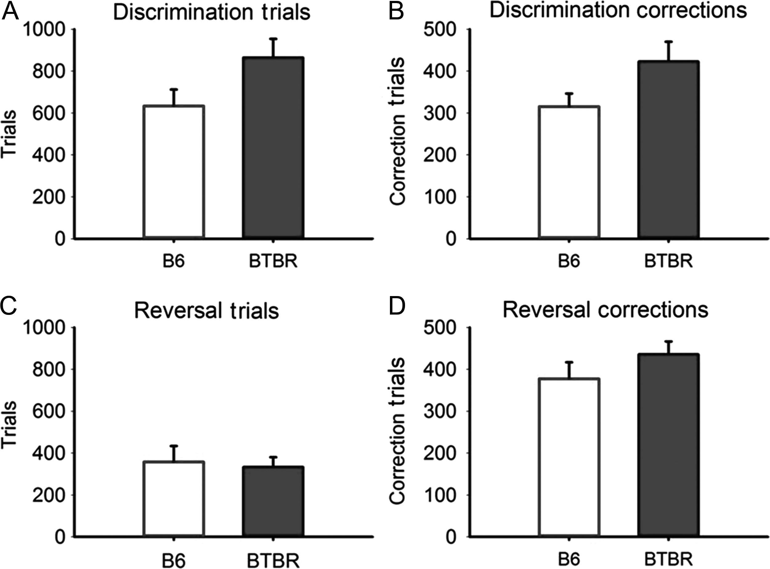
Figure 3. Trials to criterion and correction errors for pairwise discrimination and reversal learning in B6 and BTBR. ...
Notes:
Figure 3. Trials to criterion and correction errors for pairwise discrimination and reversal learning in B6 and BTBR. Visual discrimination acquisition and reversal learning were normal in both B6 and BTBR mice. (A) Total number of trials completed demonstrated a trend for more trials required by BTBR when compared with B6; however, this trend failed to reach statistical significance (P = 0.08), when summed to reach a stringent 90% criterion of correct responses. (B) Number of correction error trials did not differ between B6 and BTBR. (C) Total number of trials for reversal learning did not differ between BTBR and B6, when summed to reach the 80% criterion of correct responses for reversal. (D) Number of correction error trials during reversal did not differ between B6 and BTBR. Data are mean ± standard error of the mean. N = 7 per strain.
Unless provided in the caption above, the following copyright applies to the content of this slide: © The Author 2013. Published by Oxford University Press. All rights reserved. For Permissions, please e-mail: journals.permissions@oup.com

Slide 4
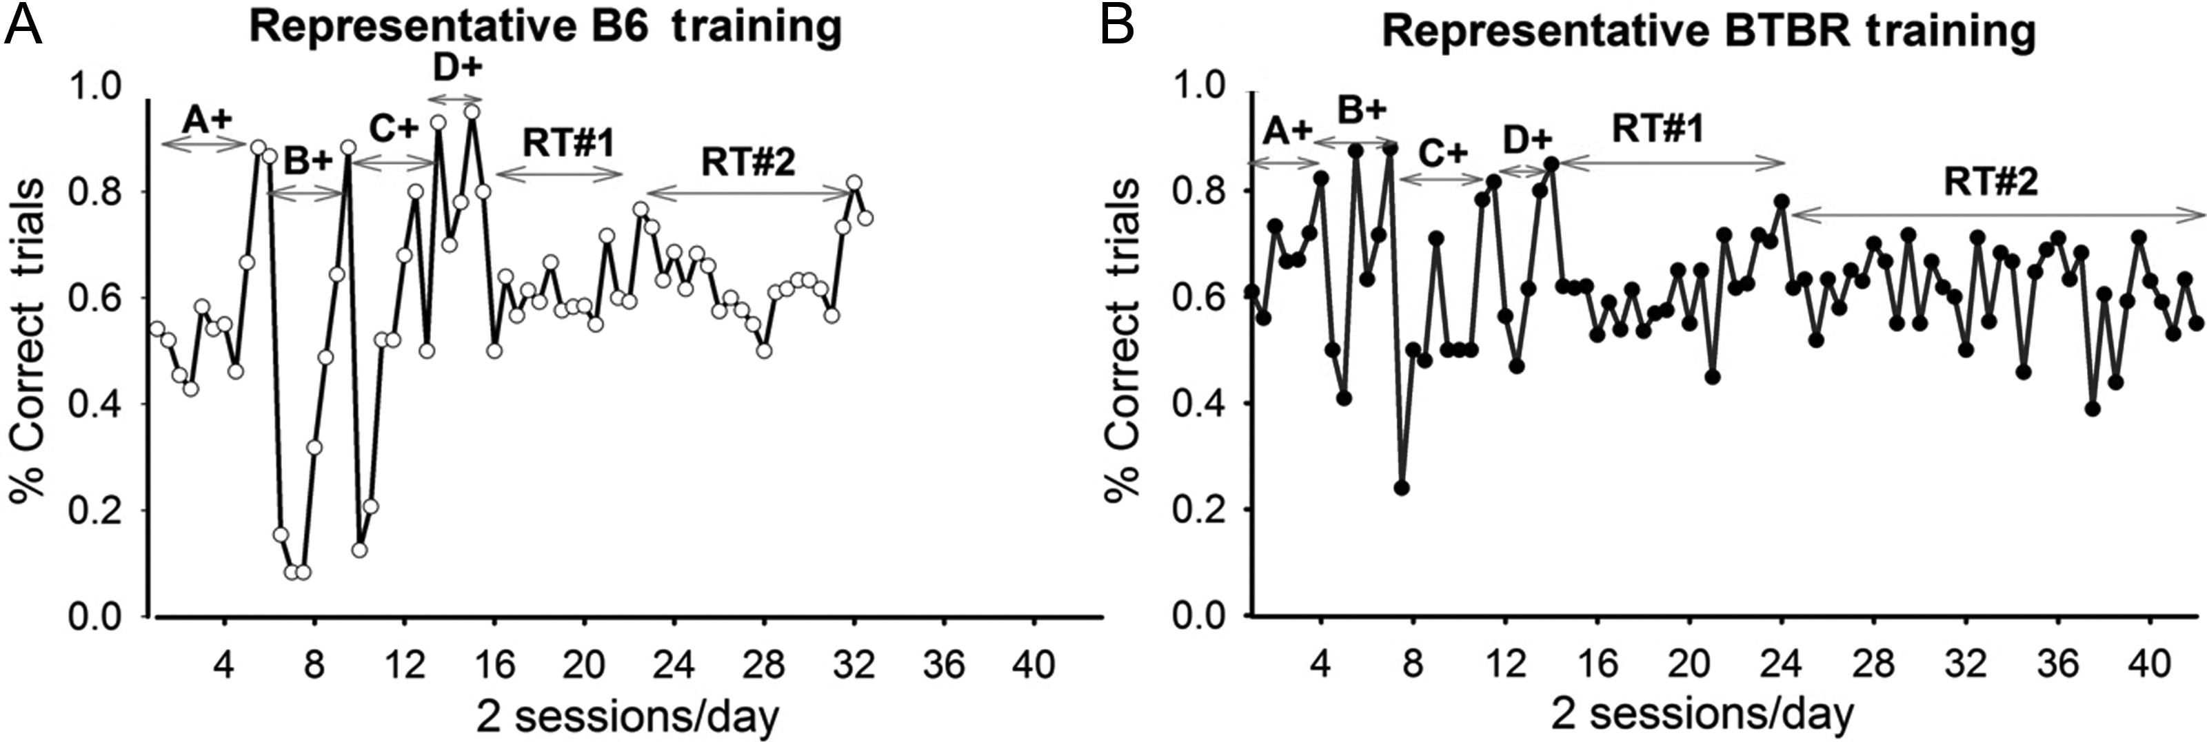
Figure 4. Representative image stimuli and representative transitive inference training learning curves in B6 and BTBR. ...
Notes:
Figure 4. Representative image stimuli and representative transitive inference training learning curves in B6 and BTBR. Mice were trained on a sequence of premise image pair discriminations in which the + sign indicated the rewarded image. Representative training progression of (A) B6 mouse and of (B) a BTBR mouse, in learning the series of premise pairs (early session numbers, illustrated on the left of each graph, A+, B+, C+, D+) and reaching criterion on 2 retention tests (later session numbers, illustrated on the right of each graph, ordered RT#1, pseudorandom RT#2). BTBR acquired premise pair discriminations at a rate similar to B6, but required more sessions to reach criterion during integrated retention tests.
Unless provided in the caption above, the following copyright applies to the content of this slide: © The Author 2013. Published by Oxford University Press. All rights reserved. For Permissions, please e-mail: journals.permissions@oup.com

Slide 5
Figure 5. Performance on the relational premise pairs (A > B, B > C, C > D, D > E) in B6 and BTBR mice. The criterion ...
Notes:
Figure 5. Performance on the relational premise pairs (A > B, B > C, C > D, D > E) in B6 and BTBR mice. The criterion for progression to the next training stage was an average of 75% or greater correct responses over 2 consecutive sessions. (A) Total number of days to criterion across stages of training in B6 mice. Higher number of days to criterion was observed for the more complex ordered RT#1 and pseudorandom RT#2 stages when compared with performance on the last premise pair DE. (B) Total number of days to criterion across all stages of training in BTBR mice. Similar numbers of sessions were needed to acquire the premise training pairs, when compared with B6. BTBR also required significantly more sessions to reach criterion on the 2 retention tests, when compared with performance on the premise pair DE. BTBR required more days to reach criterion than B6 on both ordered RT#1 and pseudorandom RT#2. Data are mean ± standard error of the mean. N = 6 per strain. *P < 0.05, days to reach criterion in BTBR versus B6. (C) Percentages of B6 and BTBR that completed each stage of training. Mice were given up to 40 sessions to reach criterion on each training stage. Mice that did not reach criterion by the end of 40 sessions were assigned a 40 session maximum and advanced to the next training stage.
Unless provided in the caption above, the following copyright applies to the content of this slide: © The Author 2013. Published by Oxford University Press. All rights reserved. For Permissions, please e-mail: journals.permissions@oup.com

Slide 6
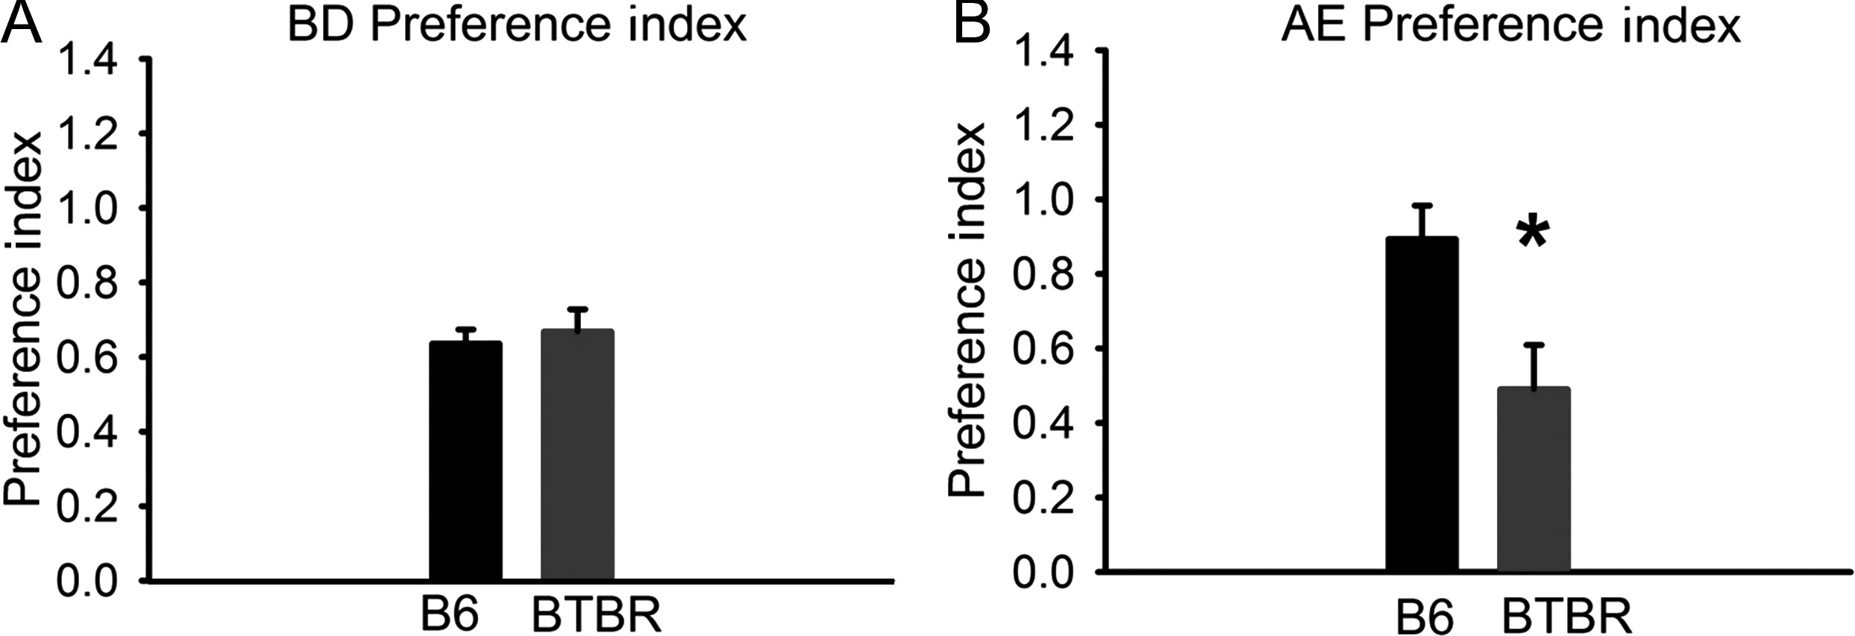
Figure 6. Performance on the transitive pair BD and the end pair simple inference AE in B6 and BTBR mice. An index of ...
Notes:
Figure 6. Performance on the transitive pair BD and the end pair simple inference AE in B6 and BTBR mice. An index of preference was calculated as described in the Materials and Methods. (A) Comparable strain performance was exhibited on the transitive intermediate pair B > D preference index, which requires a high level of inferential judgment. (B) Strain comparisons using the preference index revealed impaired performance in BTBR on the anchored end pair A > E. *P < 0.05, lower preference index for A versus E in BTBR versus B6. N = 6 per strain.
Unless provided in the caption above, the following copyright applies to the content of this slide: © The Author 2013. Published by Oxford University Press. All rights reserved. For Permissions, please e-mail: journals.permissions@oup.com

