Slide 1
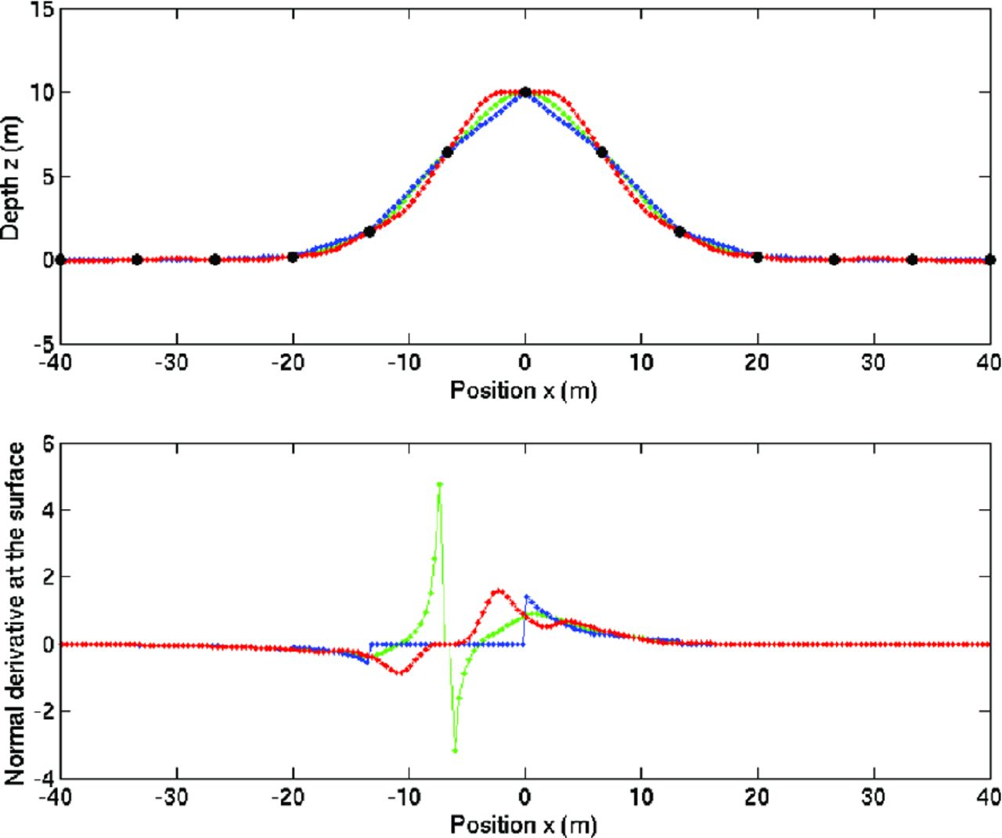
Figure 1. Shapes of the interpolated topography (green: after cubic interpolation, blue: after linear interpolation, ...
Notes:
Figure 1. Shapes of the interpolated topography (green: after cubic interpolation, blue: after linear interpolation, red: after imposing a small curvature at the electrode positions) (top panel), and associated Neumann values ∂nVs for an electrode position at x = −8 m (bottom panel). The black points (top panel) indicate all fixed electrode positions.
Unless provided in the caption above, the following copyright applies to the content of this slide: © The Authors 2013. Published by Oxford University Press on behalf of The Royal Astronomical Society.

Slide 2
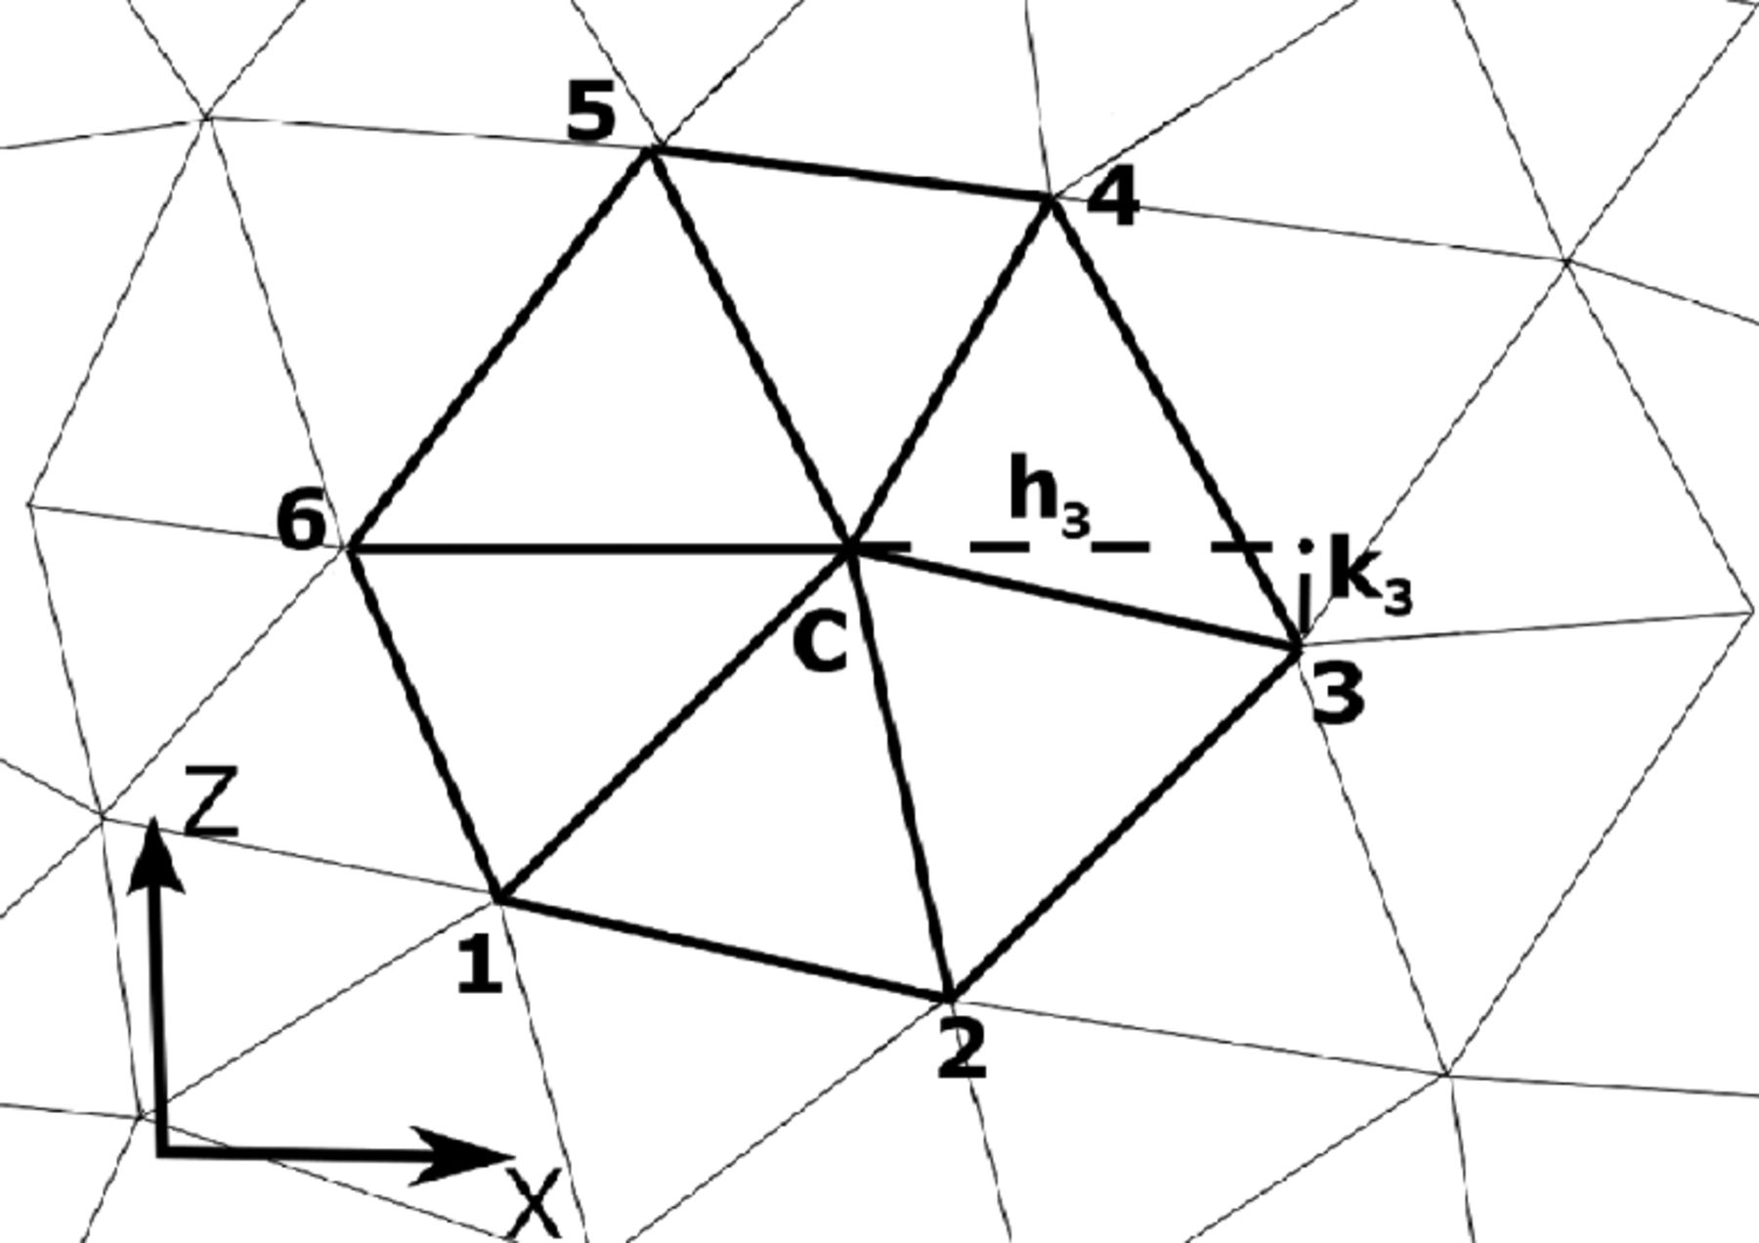
Figure 2. Selected points within a mesh for the estimation of the derivatives at the central point c.
Notes:
Figure 2. Selected points within a mesh for the estimation of the derivatives at the central point c.
Unless provided in the caption above, the following copyright applies to the content of this slide: © The Authors 2013. Published by Oxford University Press on behalf of The Royal Astronomical Society.

Slide 3
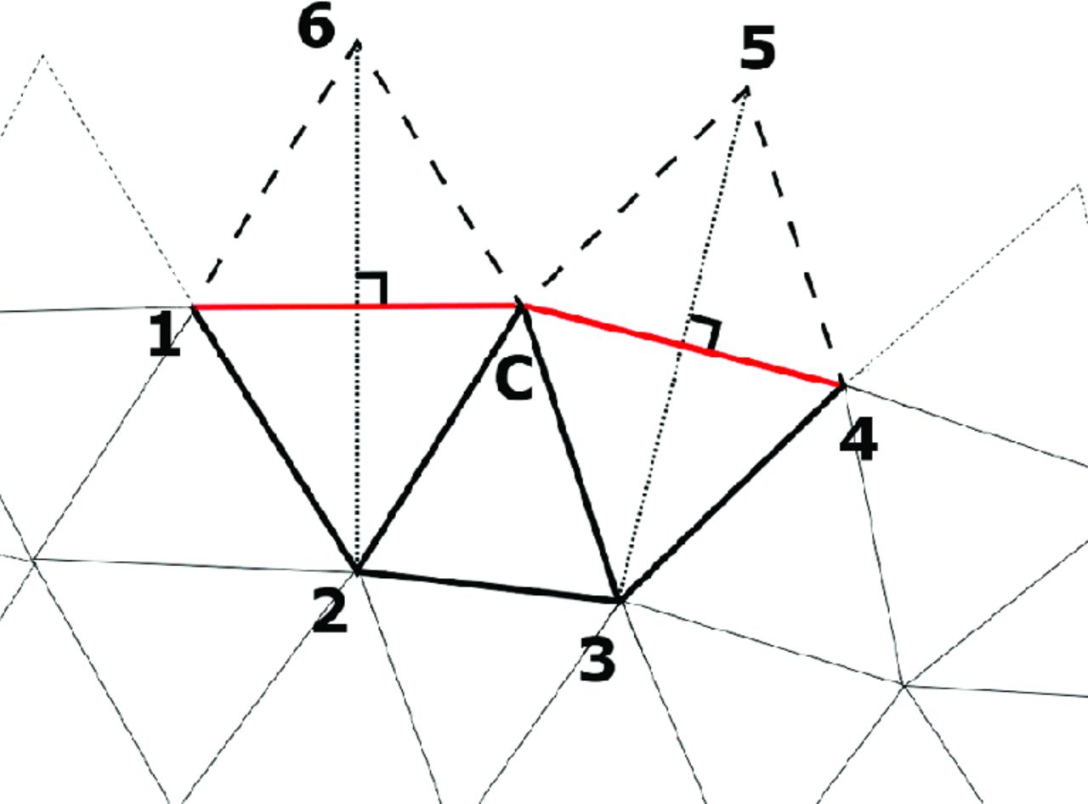
Figure 3. Selected points for the estimation of the derivatives when the central points belong to the free surface.
Notes:
Figure 3. Selected points for the estimation of the derivatives when the central points belong to the free surface.
Unless provided in the caption above, the following copyright applies to the content of this slide: © The Authors 2013. Published by Oxford University Press on behalf of The Royal Astronomical Society.

Slide 4
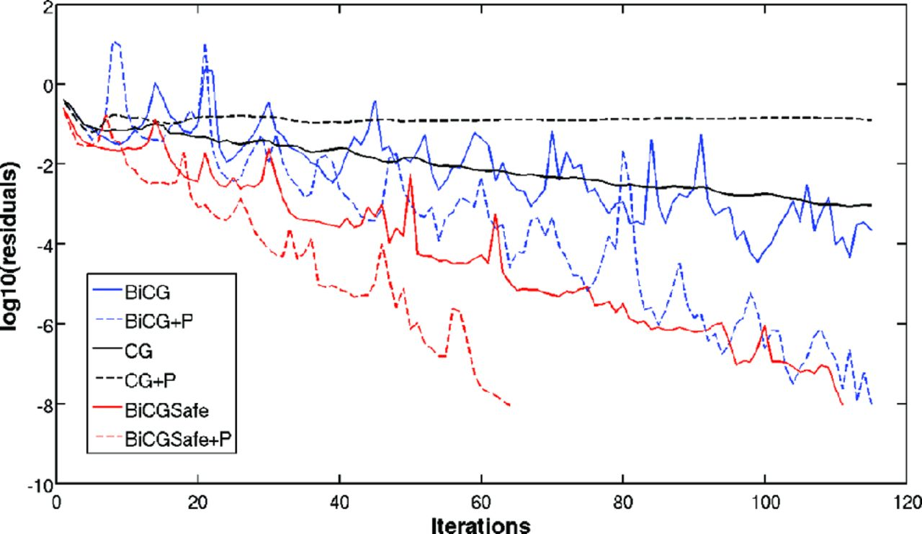
Figure 4. Convergence rates for different iterative solvers: Bi-Conjugate Gradient (BiCG), Conjudate-Gradient (CG) and ...
Notes:
Figure 4. Convergence rates for different iterative solvers: Bi-Conjugate Gradient (BiCG), Conjudate-Gradient (CG) and a safe variant of the BiCG (BiCGSafe). The solid lines are without pre-conditioner and the dashed lines with a Jacobi pre-conditioner. The number of mesh nodes is 1386.
Unless provided in the caption above, the following copyright applies to the content of this slide: © The Authors 2013. Published by Oxford University Press on behalf of The Royal Astronomical Society.

Slide 5
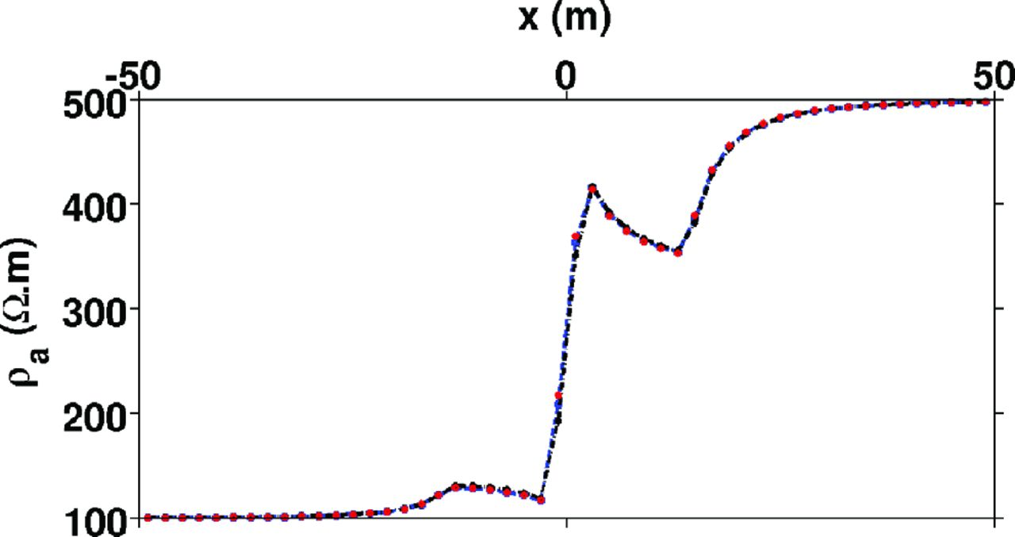
Figure 5. Apparent resistivity curves for a Schlumberger array over a vertical contact located at x = 0 m (dashed line: ...
Notes:
Figure 5. Apparent resistivity curves for a Schlumberger array over a vertical contact located at x = 0 m (dashed line: 2.5-D computation, solid line: 3-D computation and dotted line: analytic solution).
Unless provided in the caption above, the following copyright applies to the content of this slide: © The Authors 2013. Published by Oxford University Press on behalf of The Royal Astronomical Society.

Slide 6
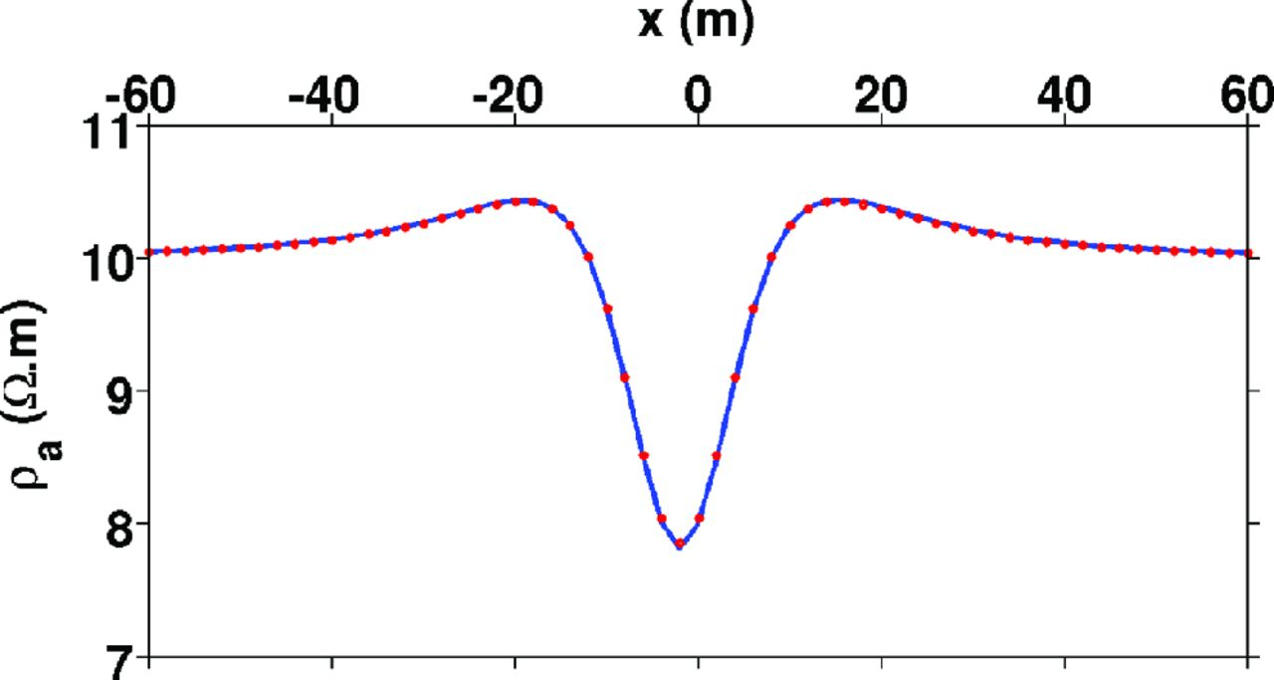
Figure 6. Apparent resistivity curves for a buried conductive sphere. The solid line corresponds to a 3-D computation ...
Notes:
Figure 6. Apparent resistivity curves for a buried conductive sphere. The solid line corresponds to a 3-D computation and the dotted line denotes the analytic solution.
Unless provided in the caption above, the following copyright applies to the content of this slide: © The Authors 2013. Published by Oxford University Press on behalf of The Royal Astronomical Society.

Slide 7
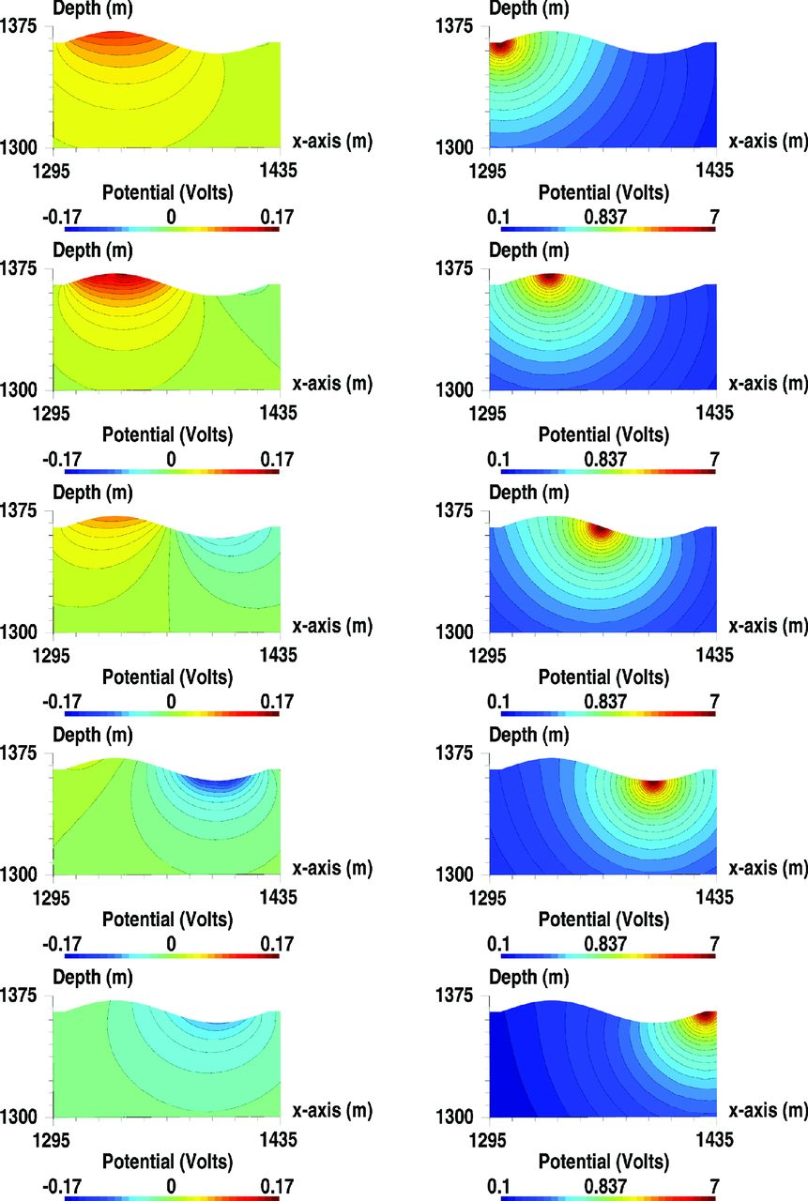
Figure 7. Secondary potential in a linear scale (left-hand side) and total potential in a logarithm scale (right-hand ...
Notes:
Figure 7. Secondary potential in a linear scale (left-hand side) and total potential in a logarithm scale (right-hand side) for several source locations, with the 2.5-D code. The model is homogeneous at 100 Ωm.
Unless provided in the caption above, the following copyright applies to the content of this slide: © The Authors 2013. Published by Oxford University Press on behalf of The Royal Astronomical Society.

Slide 8
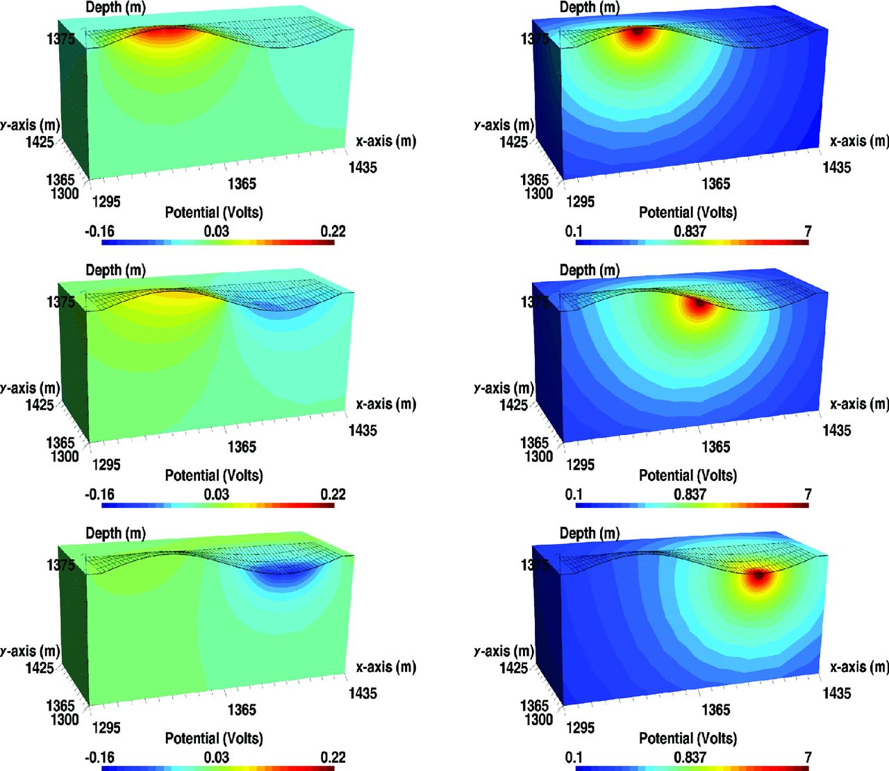
Figure 8. Secondary potential in a linear scale (left-hand side) and total potential in a logarithm scale (right-hand ...
Notes:
Figure 8. Secondary potential in a linear scale (left-hand side) and total potential in a logarithm scale (right-hand side) for several source locations, with the 3-D code. The model is homogeneous at 100 Ωm.
Unless provided in the caption above, the following copyright applies to the content of this slide: © The Authors 2013. Published by Oxford University Press on behalf of The Royal Astronomical Society.

Slide 9
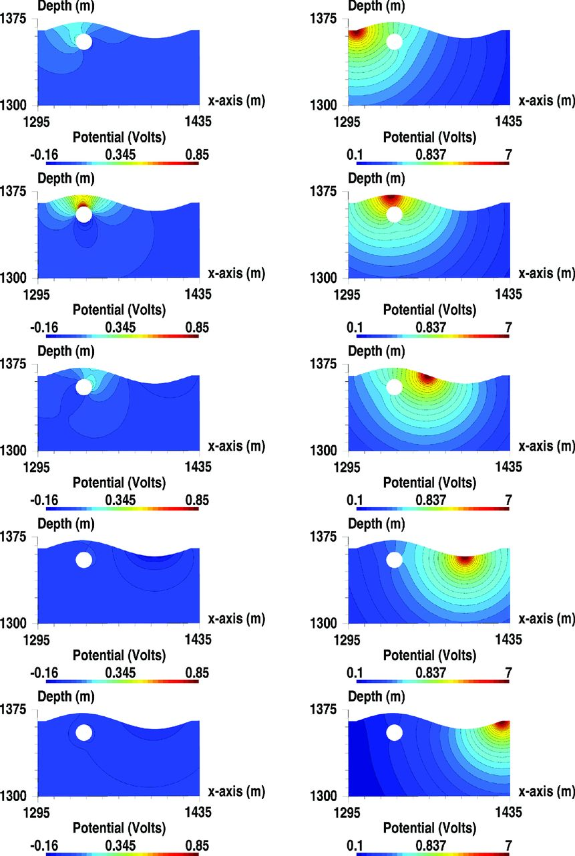
Figure 9. Secondary potential in a linear scale (left-hand side) and total potential in a logarithm scale (right-hand ...
Notes:
Figure 9. Secondary potential in a linear scale (left-hand side) and total potential in a logarithm scale (right-hand side) for several source locations, with the 2.5-D code. The model is homogeneous at 100 Ωm.
Unless provided in the caption above, the following copyright applies to the content of this slide: © The Authors 2013. Published by Oxford University Press on behalf of The Royal Astronomical Society.

Slide 10
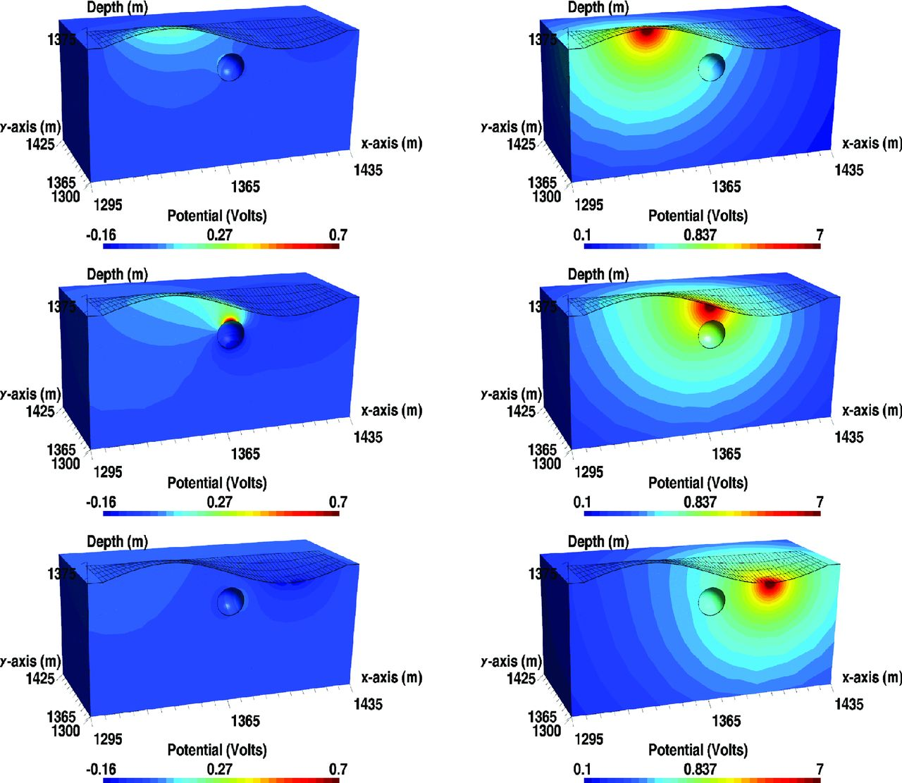
Figure 10. Secondary potential in a linear scale (left-hand side) and total potential in a logarithm scale (right-hand ...
Notes:
Figure 10. Secondary potential in a linear scale (left-hand side) and total potential in a logarithm scale (right-hand side) for several source locations, with the 3-D code. The model is homogeneous at 100 Ωm.
Unless provided in the caption above, the following copyright applies to the content of this slide: © The Authors 2013. Published by Oxford University Press on behalf of The Royal Astronomical Society.

Slide 11
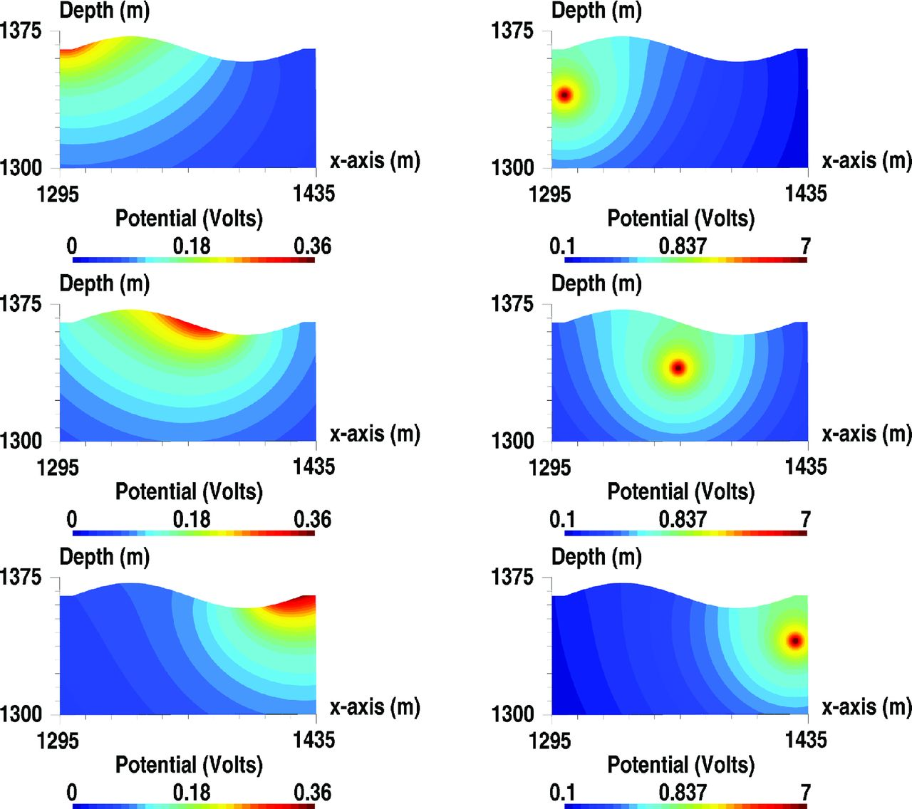
Figure 11. Secondary potential in a linear scale (left-hand side) and total potential in a logarithm scale (right-hand ...
Notes:
Figure 11. Secondary potential in a linear scale (left-hand side) and total potential in a logarithm scale (right-hand side) for several buried source locations, with the 2.5-D code. The model is homogeneous at 100 Ωm.
Unless provided in the caption above, the following copyright applies to the content of this slide: © The Authors 2013. Published by Oxford University Press on behalf of The Royal Astronomical Society.

Slide 12
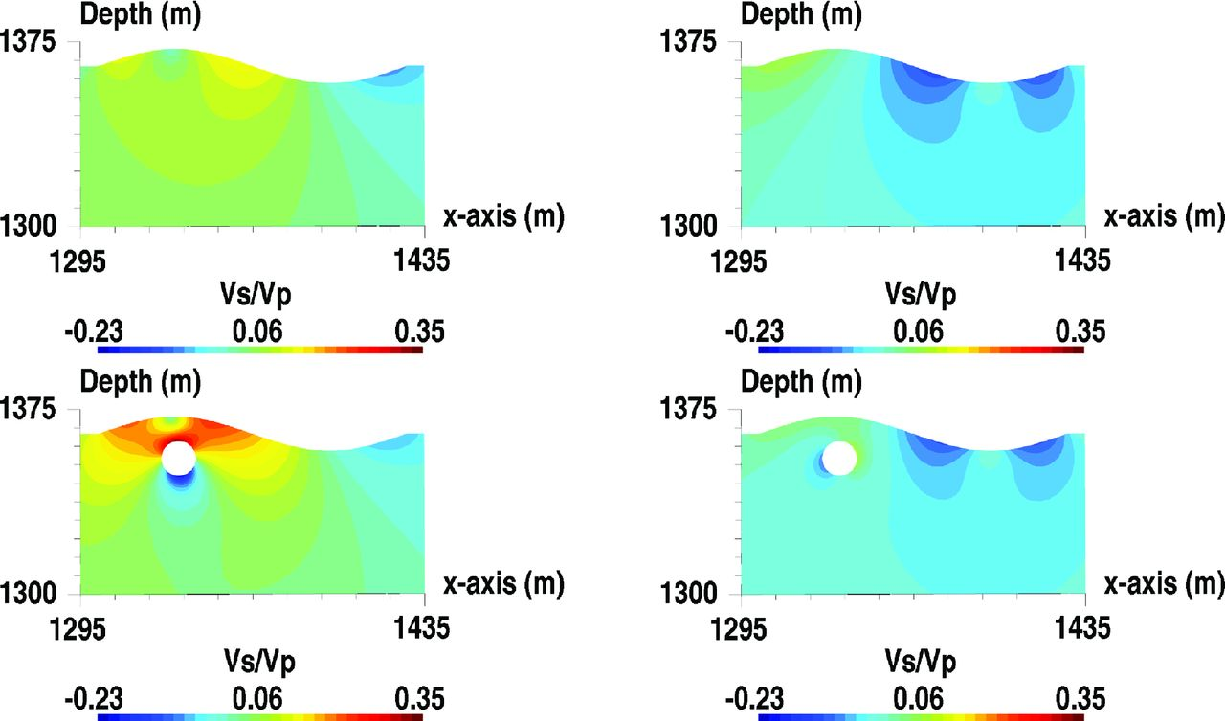
Figure 12. Ratios between the secondary potential V_{s} and the fixed primary potential V_{p} (top ...
Notes:
Figure 12. Ratios between the secondary potential Vs and the fixed primary potential Vp (top panel: from Fig. 7, lines 2 and 4, bottom panel: from Fig. 9, lines 2 and 4).
Unless provided in the caption above, the following copyright applies to the content of this slide: © The Authors 2013. Published by Oxford University Press on behalf of The Royal Astronomical Society.

Slide 13
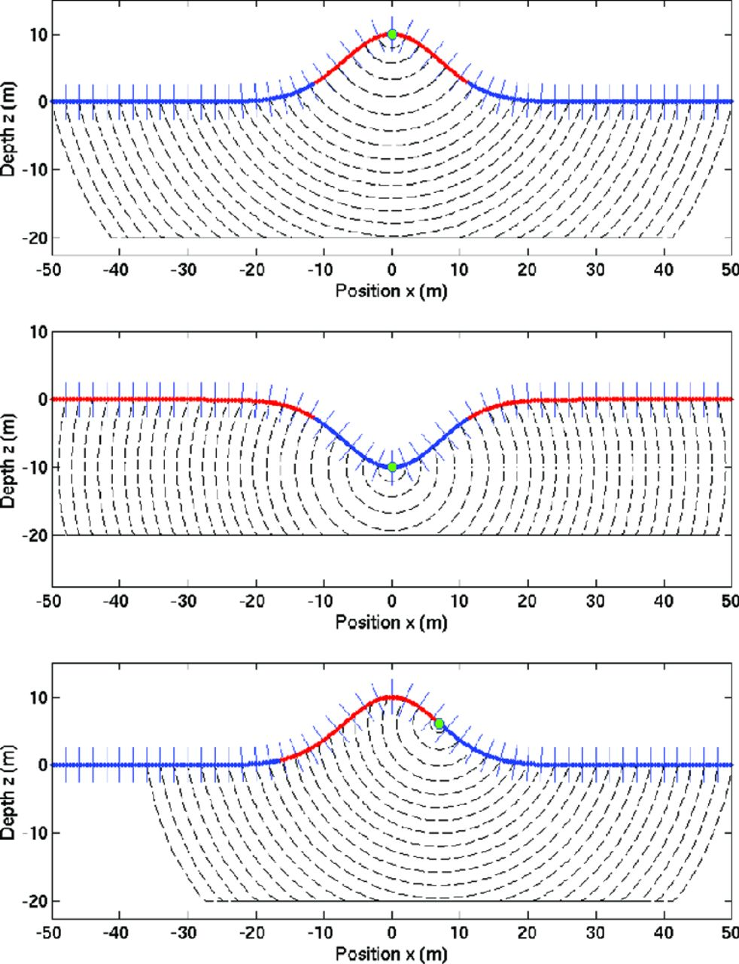
Figure 13. Sign of the Neumann conditions for simple topography shapes and different source positions indicated by the ...
Notes:
Figure 13. Sign of the Neumann conditions for simple topography shapes and different source positions indicated by the green point. The red values denote a positive sign and the blue value a negative sign.
Unless provided in the caption above, the following copyright applies to the content of this slide: © The Authors 2013. Published by Oxford University Press on behalf of The Royal Astronomical Society.

Slide 14
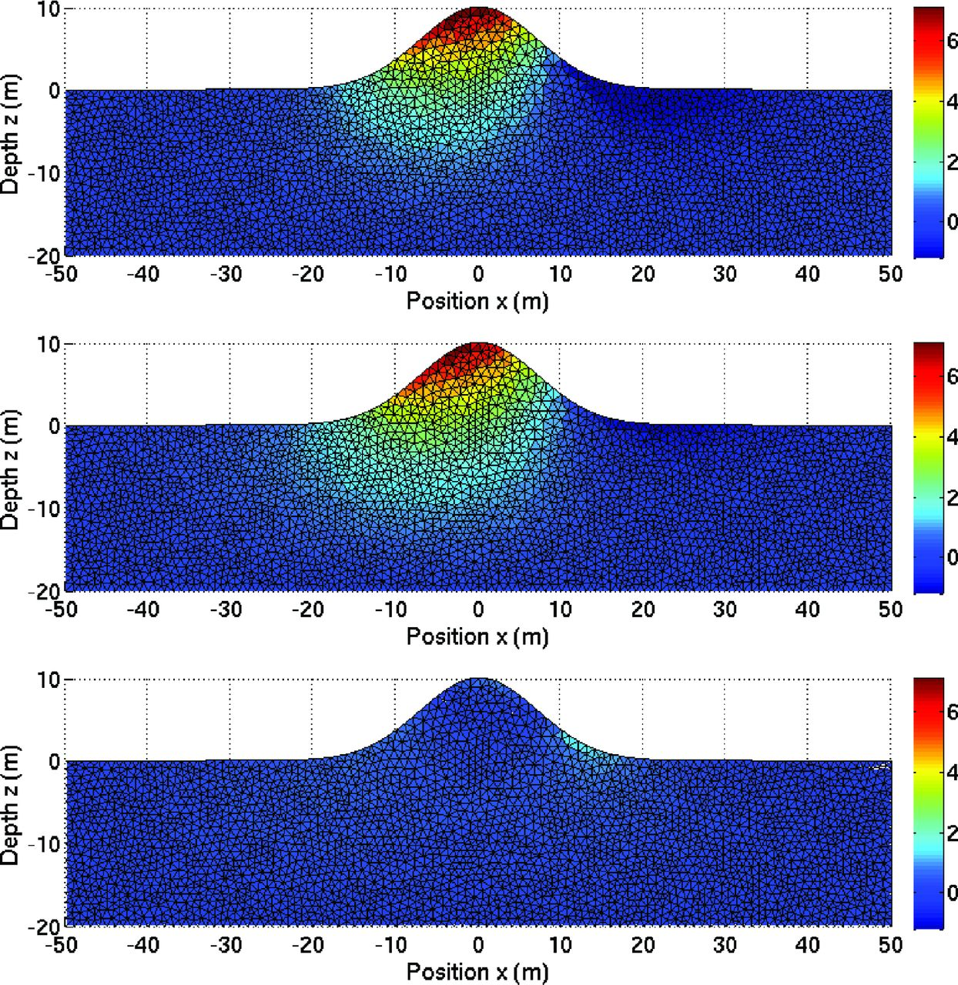
Figure 14. Numerical solutions obtained with the GFD method (top panel), with the FSM approach (middle panel) and ...
Notes:
Figure 14. Numerical solutions obtained with the GFD method (top panel), with the FSM approach (middle panel) and differences in absolute value (bottom panel). The secondary potential is expressed in mV. The source is positioned at xs = (8.0, 5.3) m.
Unless provided in the caption above, the following copyright applies to the content of this slide: © The Authors 2013. Published by Oxford University Press on behalf of The Royal Astronomical Society.

