Slide 1
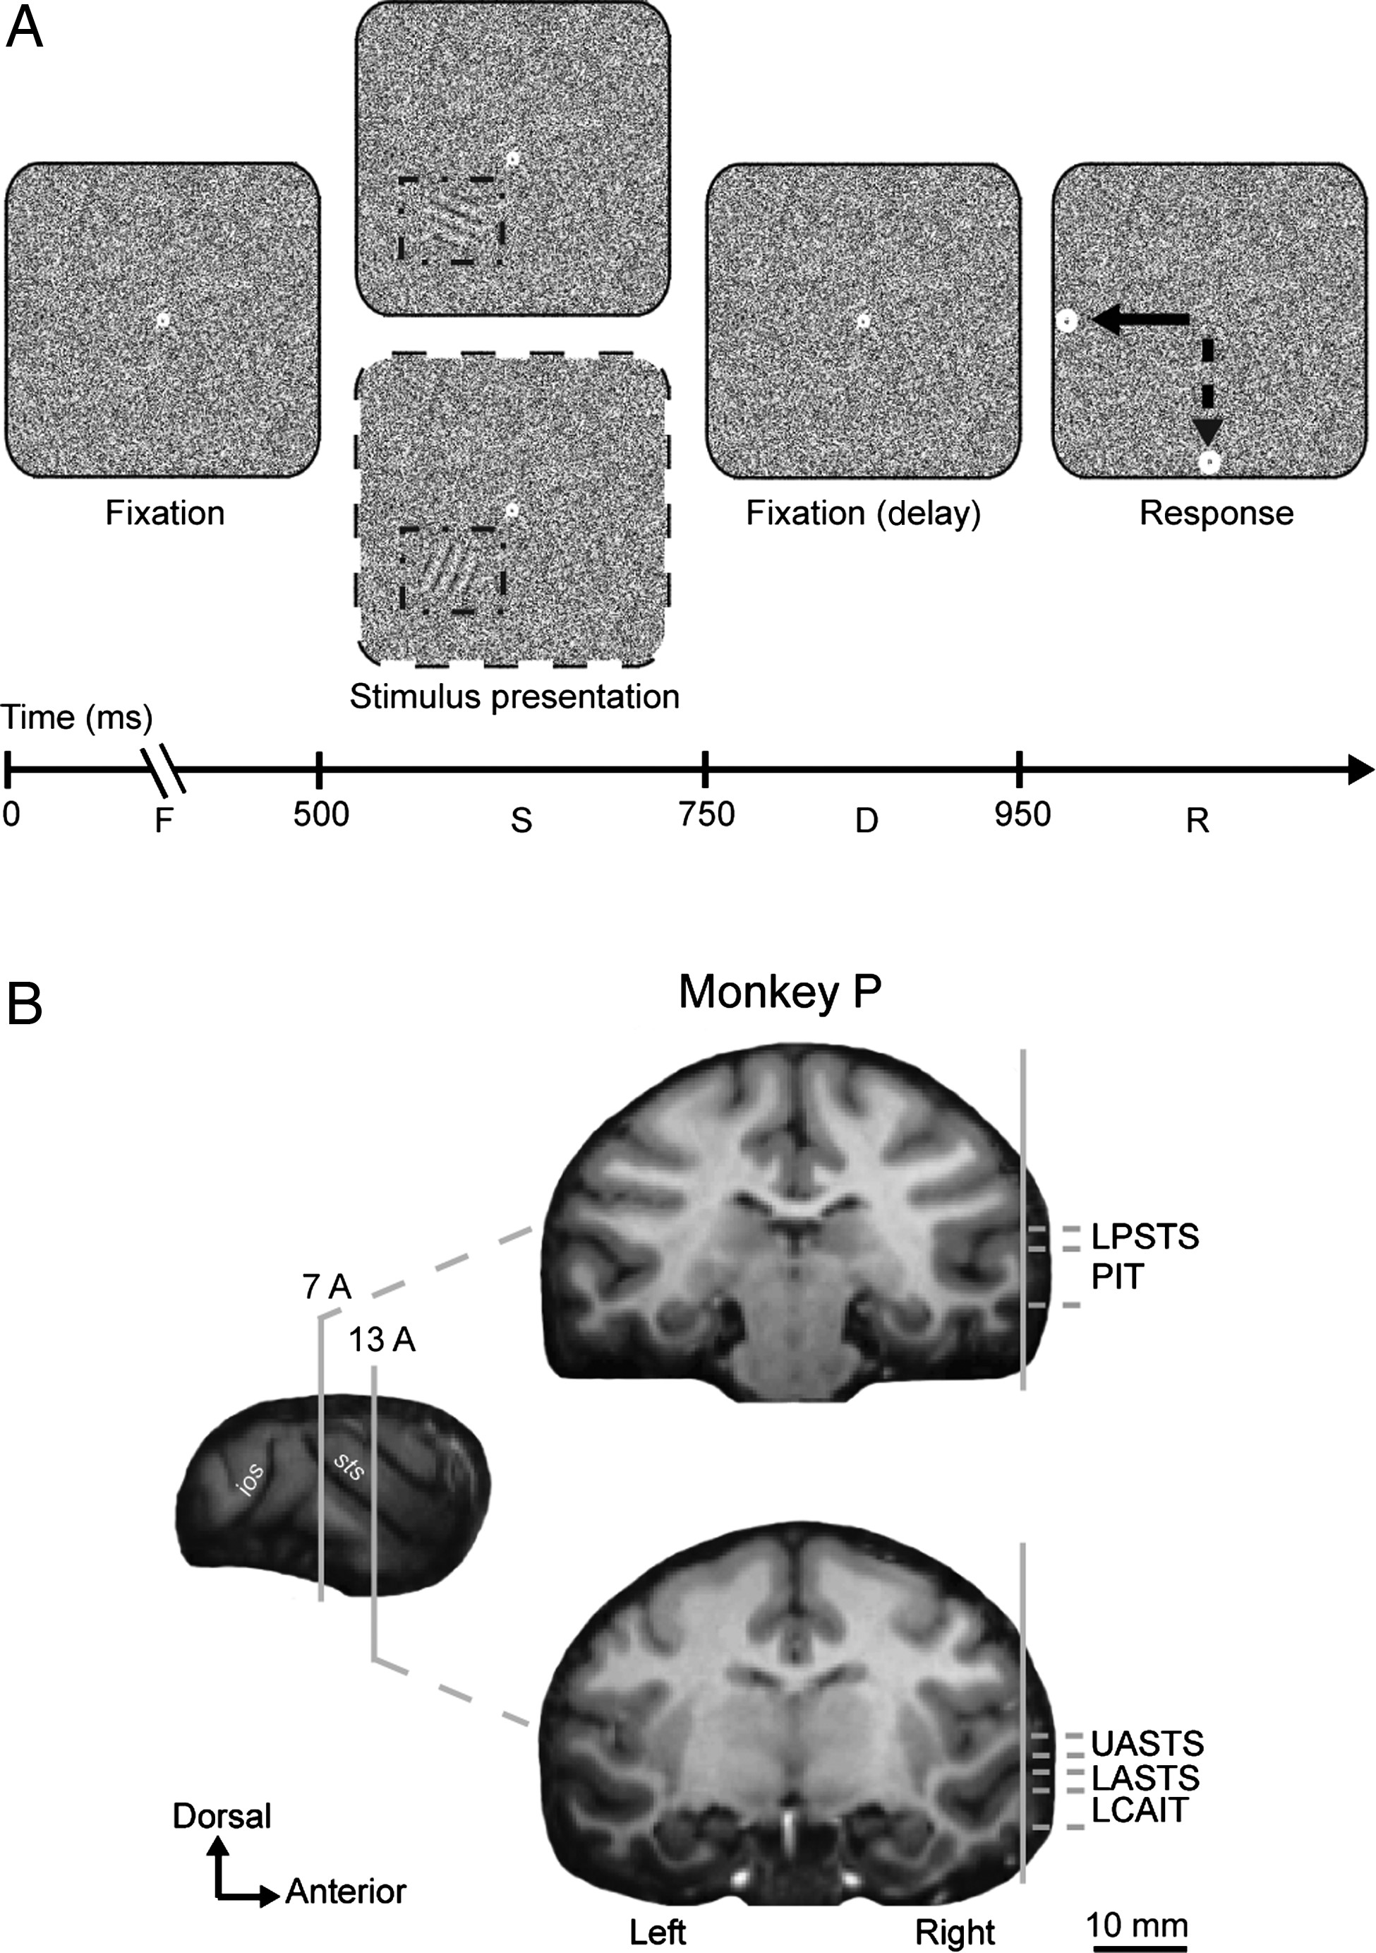
Figure 1. Coarse orientation discrimination task and cortical regions. (A) Coarse orientation discrimination task. ...
Notes:
Figure 1. Coarse orientation discrimination task and cortical regions. (A) Coarse orientation discrimination task. After an initial fixation period of 500 ms, a grating masked by noise was presented for 250 ms during continuous fixation. The grating was presented at 3° eccentricity in the lower left visual field on a noise background. The gratings could have 1 of 2 orthogonal orientations. After grating presentation, the monkey was required to continue fixating for another 200 ms (delay period) after which 2 targets appeared at fixed locations (5° left and down relative to the fixation point). The monkey then indicated the orientation by making a saccadic eye movement to 1 of the 2 associated targets (illustrated by arrows). A correct response was followed by a small liquid reward. The fixation and target points were red with an actual size of 0.26 and 0.57°, respectively. The SNR of the illustrated gratings is 40%. The dashed-dotted box around the grating was not shown during the experiment but is presented here for illustration purposes only. F, fixation period; S, visual stimulus presentation period; D, delay period; R, response period. (B) One lateral and 2 coronal sections in Monkey P showing the posterior (∼7 mm relative to auditory meatus) and anterior (∼13 mm) parts of the IT cortex that were electrically stimulated. STS, superior temporal sulcus; LPSTS, lower bank of posterior STS; the region ventral to LPSTS in the convexity is labeled here as PIT: posterior IT; UASTS, upper bank of anterior STS; LASTS, lower bank of anterior STS; LCAIT, lateral convexity of anterior IT; ios: inferior occipital sulcus.
Unless provided in the caption above, the following copyright applies to the content of this slide: © The Author 2015. Published by Oxford University Press. All rights reserved. For Permissions, please e-mail: journals.permissions@oup.com

Slide 2
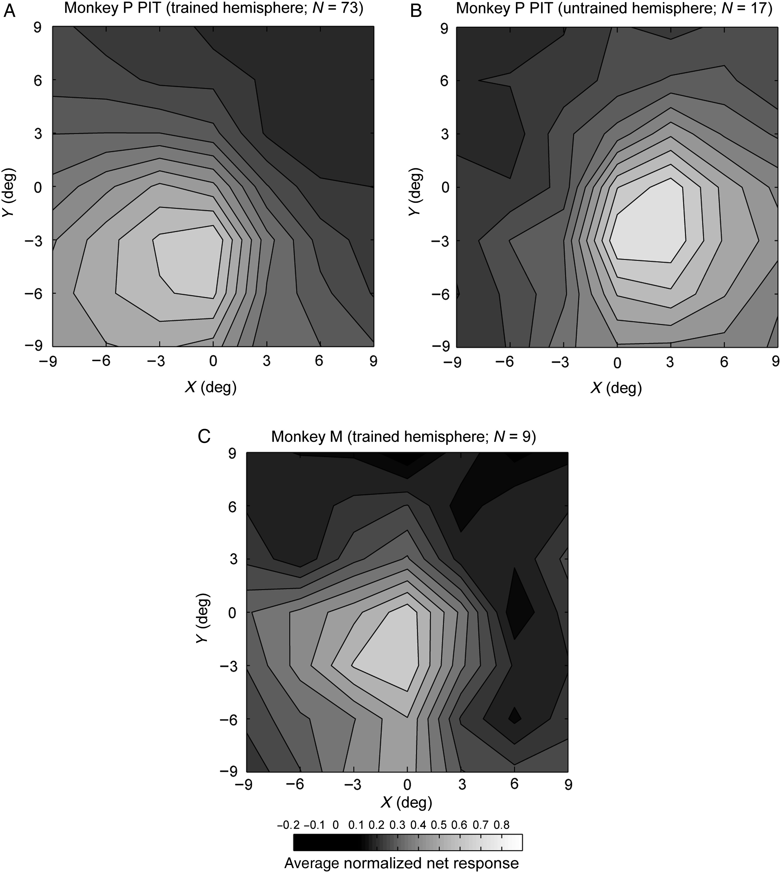
Figure 2. Population multiunit receptive fields in PIT. (A) Monkey P “trained” hemisphere, (B) Monkey P “untrained” ...
Notes:
Figure 2. Population multiunit receptive fields in PIT. (A) Monkey P “trained” hemisphere, (B) Monkey P “untrained” hemisphere, (C) Monkey M “trained” hemisphere. Monkey M was not stimulated in the “untrained” hemisphere. For each site, the baseline-subtracted, net multiunit firing rate was computed per stimulus location and then normalized by the maximum net firing rate of that site across the locations. The normalized net responses were then averaged across sites for PIT of each individual hemisphere. The averaged normalized responses were plotted as a function of location by interpolating the responses to the tested locations. (0,0) corresponds to the fovea. N indicates the number of sites. Only sites at which ES was applied are included.
Unless provided in the caption above, the following copyright applies to the content of this slide: © The Author 2015. Published by Oxford University Press. All rights reserved. For Permissions, please e-mail: journals.permissions@oup.com

Slide 3
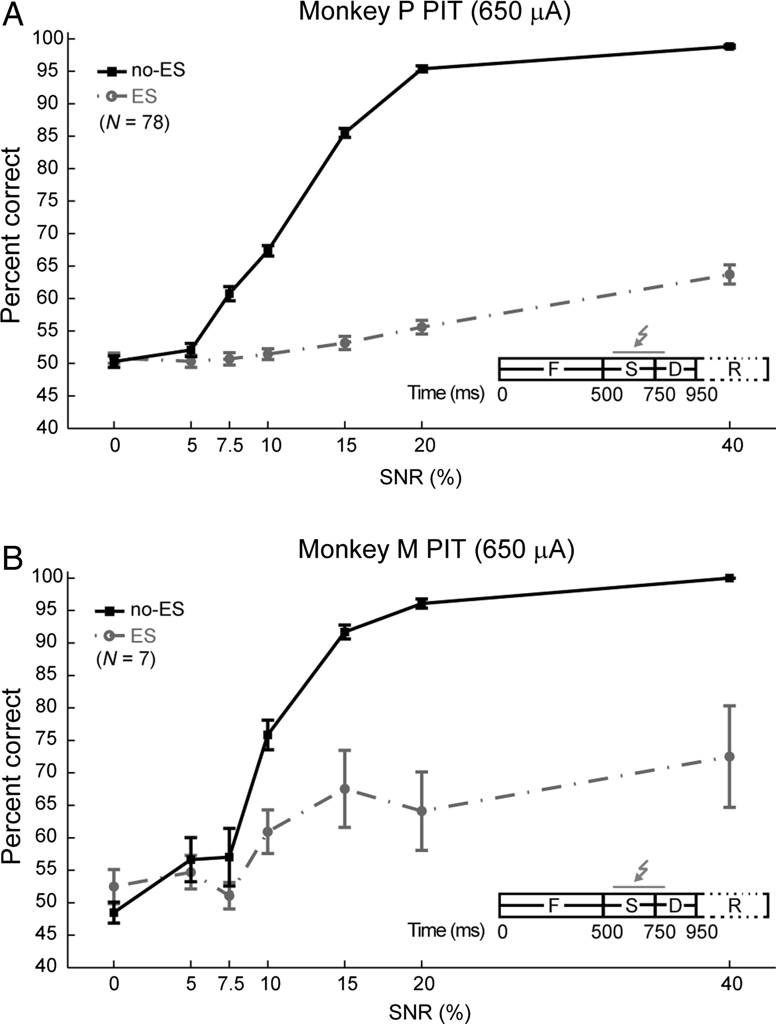
Figure 3. Effect of 650-μA ES in PIT on coarse orientation discrimination performance. Mean behavioral performance for ...
Notes:
Figure 3. Effect of 650-μA ES in PIT on coarse orientation discrimination performance. Mean behavioral performance for ES and no-ES trials is plotted as a function of SNR in Monkeys P (A) and M (B). Error bars denote standard errors of the mean. N indicates the number of experiments. The insets show the timing of the task and the ES onset and duration, which were in these cases 250 ms with a delay of 50 ms relative to visual stimulus onset. F, fixation; S, visual stimulus presentation; D, delay; R, response period.
Unless provided in the caption above, the following copyright applies to the content of this slide: © The Author 2015. Published by Oxford University Press. All rights reserved. For Permissions, please e-mail: journals.permissions@oup.com

Slide 4
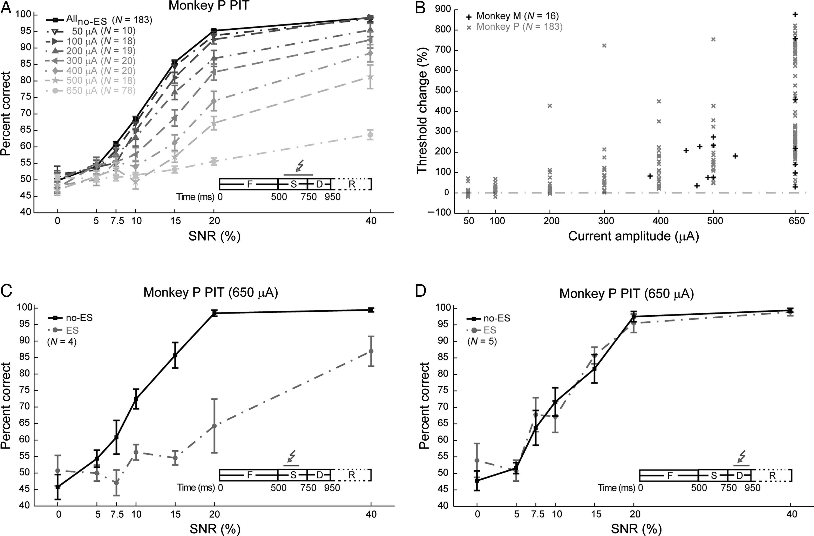
Figure 4. Effect of current strength and timing of the ES in PIT on coarse orientation discrimination performance. (A) ...
Notes:
Figure 4. Effect of current strength and timing of the ES in PIT on coarse orientation discrimination performance. (A) Mean behavioral performance for ES and no-ES trials (averaged across all experiments) is plotted as a function of SNR and current amplitude in Monkey P. The inset is the same as in Figure 3. (B) Percent change in the 75% threshold with ES is plotted as function of current amplitude for Monkeys M and P. A positive percent threshold change indicates an impairment to discriminate the orientation. Each point corresponds to a single experiment. (C) Mean behavioral performance for ES and no-ES trials is shown as a function of SNR for a shorter ES duration (133 ms) in PIT of Monkey P. The ES current amplitude was 650 μA. The impairment was still severe but less than when longer ES duration was employed (compare with Fig.3A). (D) Same as (C) except that the 650-μA short ES (133 ms duration) was delivered in the delay period (with a 50-ms delay relative to visual stimulus offset). There was no effect of ES when it was applied after visual stimulus presentation. The inset for (C,D) is the same as Figure 3 except for the ES onset and duration. Error bars in (A,C,D) denote standard errors of the mean. N indicates the number of experiments.
Unless provided in the caption above, the following copyright applies to the content of this slide: © The Author 2015. Published by Oxford University Press. All rights reserved. For Permissions, please e-mail: journals.permissions@oup.com

Slide 5
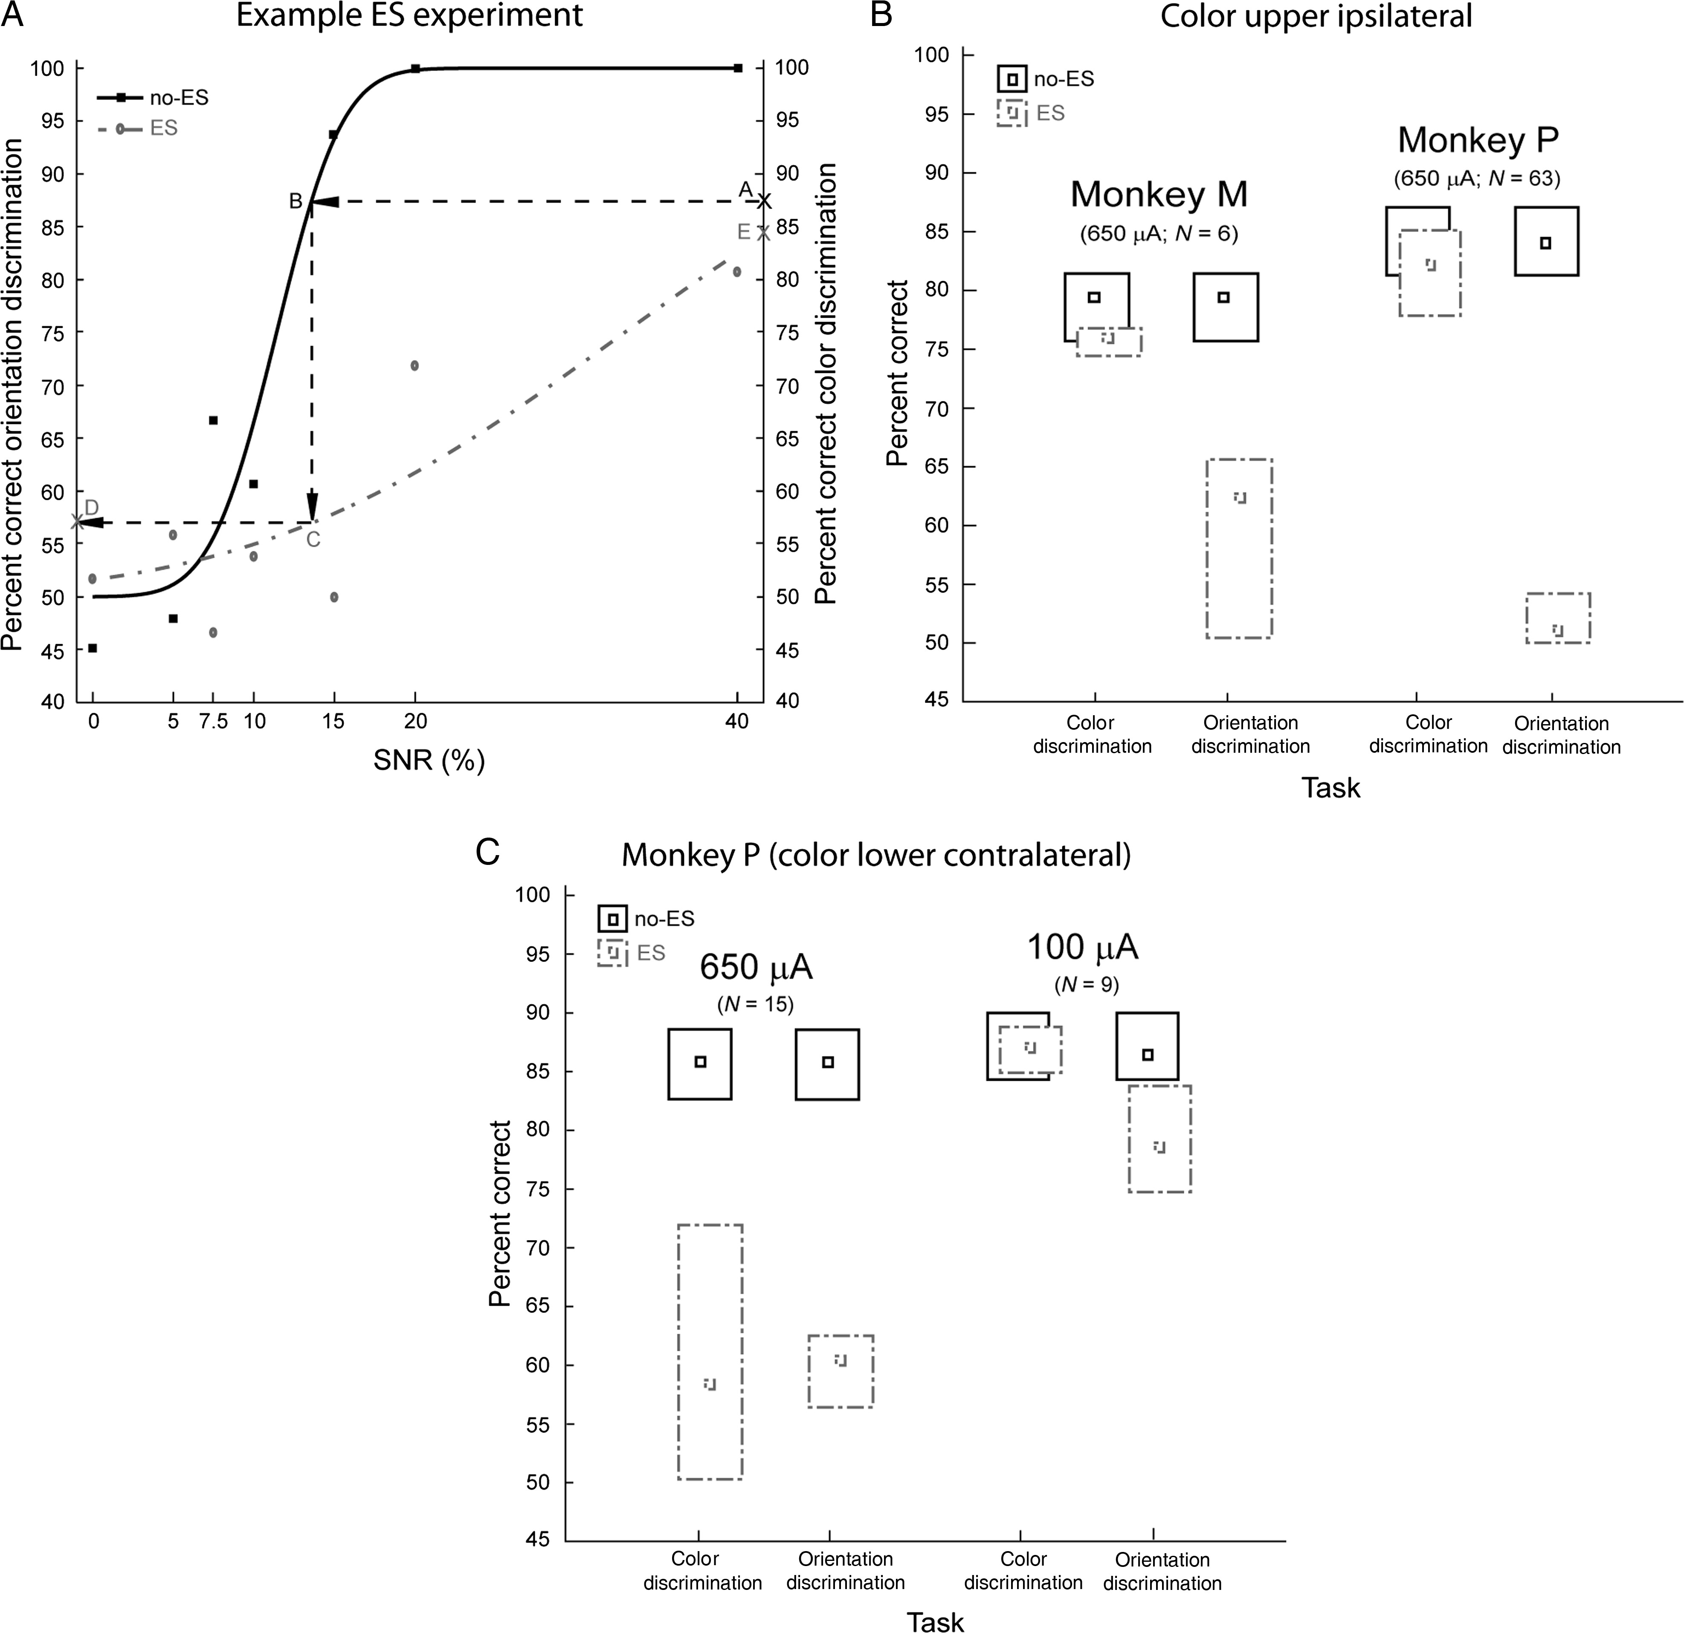
Figure 5. Effects of ES in the coarse orientation discrimination task and the fine color discrimination task compared. ...
Notes:
Figure 5. Effects of ES in the coarse orientation discrimination task and the fine color discrimination task compared. (A) An example of a 650-μA ES experiment in PIT of Monkey P. The performance was fitted with cumulative normal function for ES and no-ES trials. Then, the performance in no-ES trials of the color discrimination task in the same experiment (ordinate of point A) and the fitted curve in no-ES trials of the orientation discrimination task were used to estimate the SNR at which the performance in both tasks were equal (abscissa of point B). The performance for the ES trials (ordinate of D) in the orientation discrimination task then corresponded to the value of the fitted curve at the estimated SNR (abscissa of point C). By doing so, the same baseline (performance in no-ES trials) in the 2 tasks was obtained. For this particular experiment, performance dropped with ES from 87% to 84% and 54% in the color and orientation discrimination tasks, respectively. (B) The performance of Monkeys M and P is shown as a function of the task after equating for the performance in no-ES trials for the 2 tasks. The color patch was presented at 10° eccentricity in the ipsilateral upper visual field. The ES current strength was 650 µA. (C) Performance of Monkey P when the color patch for the fine color discrimination task was presented at the same location (3° eccentricity, contralateral lower visual field) as the grating pattern in the coarse orientation discrimination task. Two current strengths were applied for both tasks: 650 (left) and 100 µA (right). Only the 650 µA resulted in an ES effect for the fine color discrimination task, whereas the coarse orientation discrimination task was significantly affected at both current strengths. Note that the performance in the no-ES trials was equated for the 2 tasks. The small and big boxes in (B,C) indicate the median and the interquartile range, respectively. N indicates the number of experiments.
Unless provided in the caption above, the following copyright applies to the content of this slide: © The Author 2015. Published by Oxford University Press. All rights reserved. For Permissions, please e-mail: journals.permissions@oup.com

Slide 6
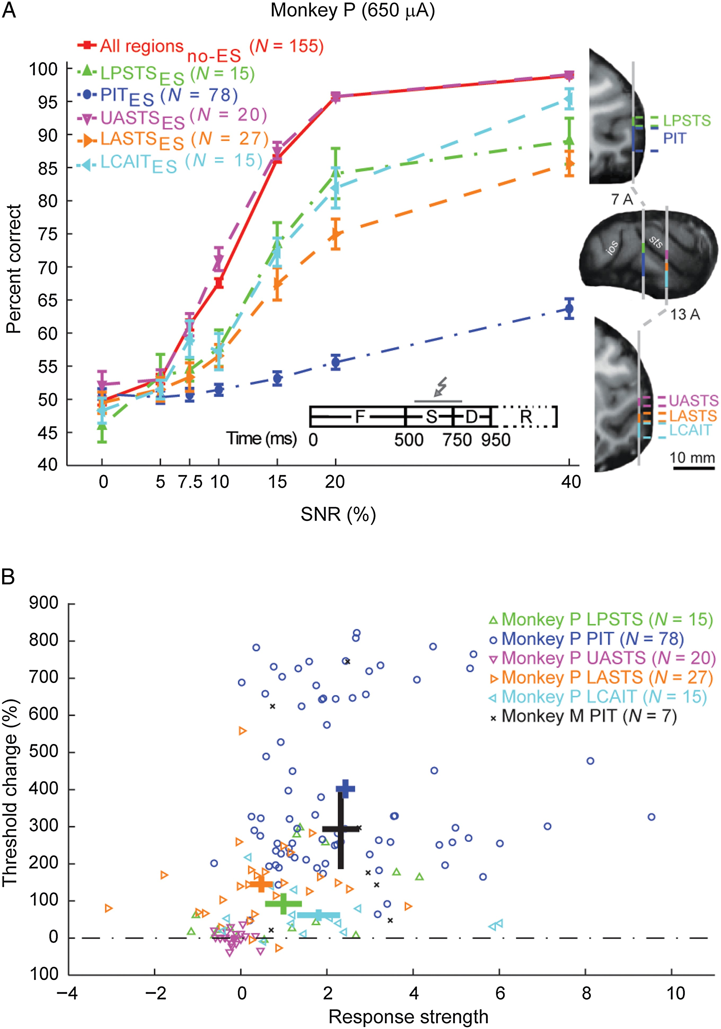
Figure 6. Degree of behavioral impairment depends on the ES site within the visual temporal cortex. (A) Mean ...
Notes:
Figure 6. Degree of behavioral impairment depends on the ES site within the visual temporal cortex. (A) Mean performance for ES and no-ES trials (averaged across all experiments) is plotted as a function of SNR and region in Monkey P. Performance dropped with ES in all regions except UASTS, and the impairment was the strongest in PIT. The ES current amplitude was 650 μA in all experiments. The inset is the same as Figure 3. For definitions of the cortical regions, see right side of the panel. (B) The percent threshold change is plotted as a function of response strength for different temporal cortical regions of Monkey P and PIT of Monkey M. The response strength was calculated for each site based on MUA responses to the 80% SNR gratings presented during the passive fixation task (see Materials and Methods). The crosses indicate the mean and their standard errors for both the threshold change and the response strength. N indicates the number of experiments.
Unless provided in the caption above, the following copyright applies to the content of this slide: © The Author 2015. Published by Oxford University Press. All rights reserved. For Permissions, please e-mail: journals.permissions@oup.com

Slide 7
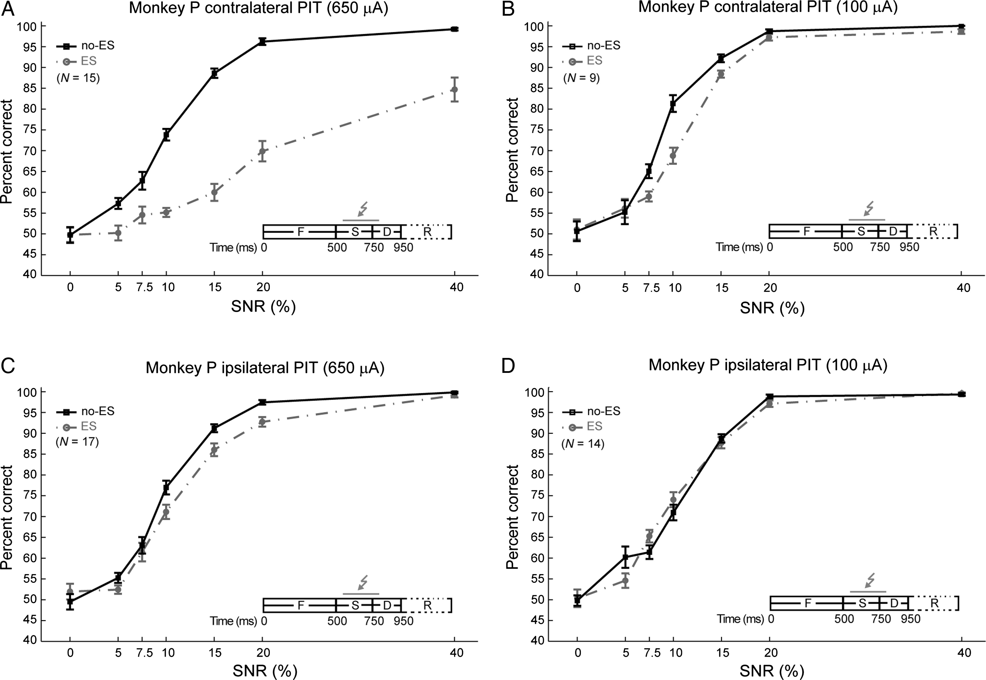
Figure 7. Comparison of ES in contralateral (“trained”; A,B) and ipsilateral (“untrained”; C,D) PIT of Monkey P, with ...
Notes:
Figure 7. Comparison of ES in contralateral (“trained”; A,B) and ipsilateral (“untrained”; C,D) PIT of Monkey P, with current strengths of 650 (A,C) and 100 µA (B,D). Same conventions as in Figure 3.
Unless provided in the caption above, the following copyright applies to the content of this slide: © The Author 2015. Published by Oxford University Press. All rights reserved. For Permissions, please e-mail: journals.permissions@oup.com

Slide 8
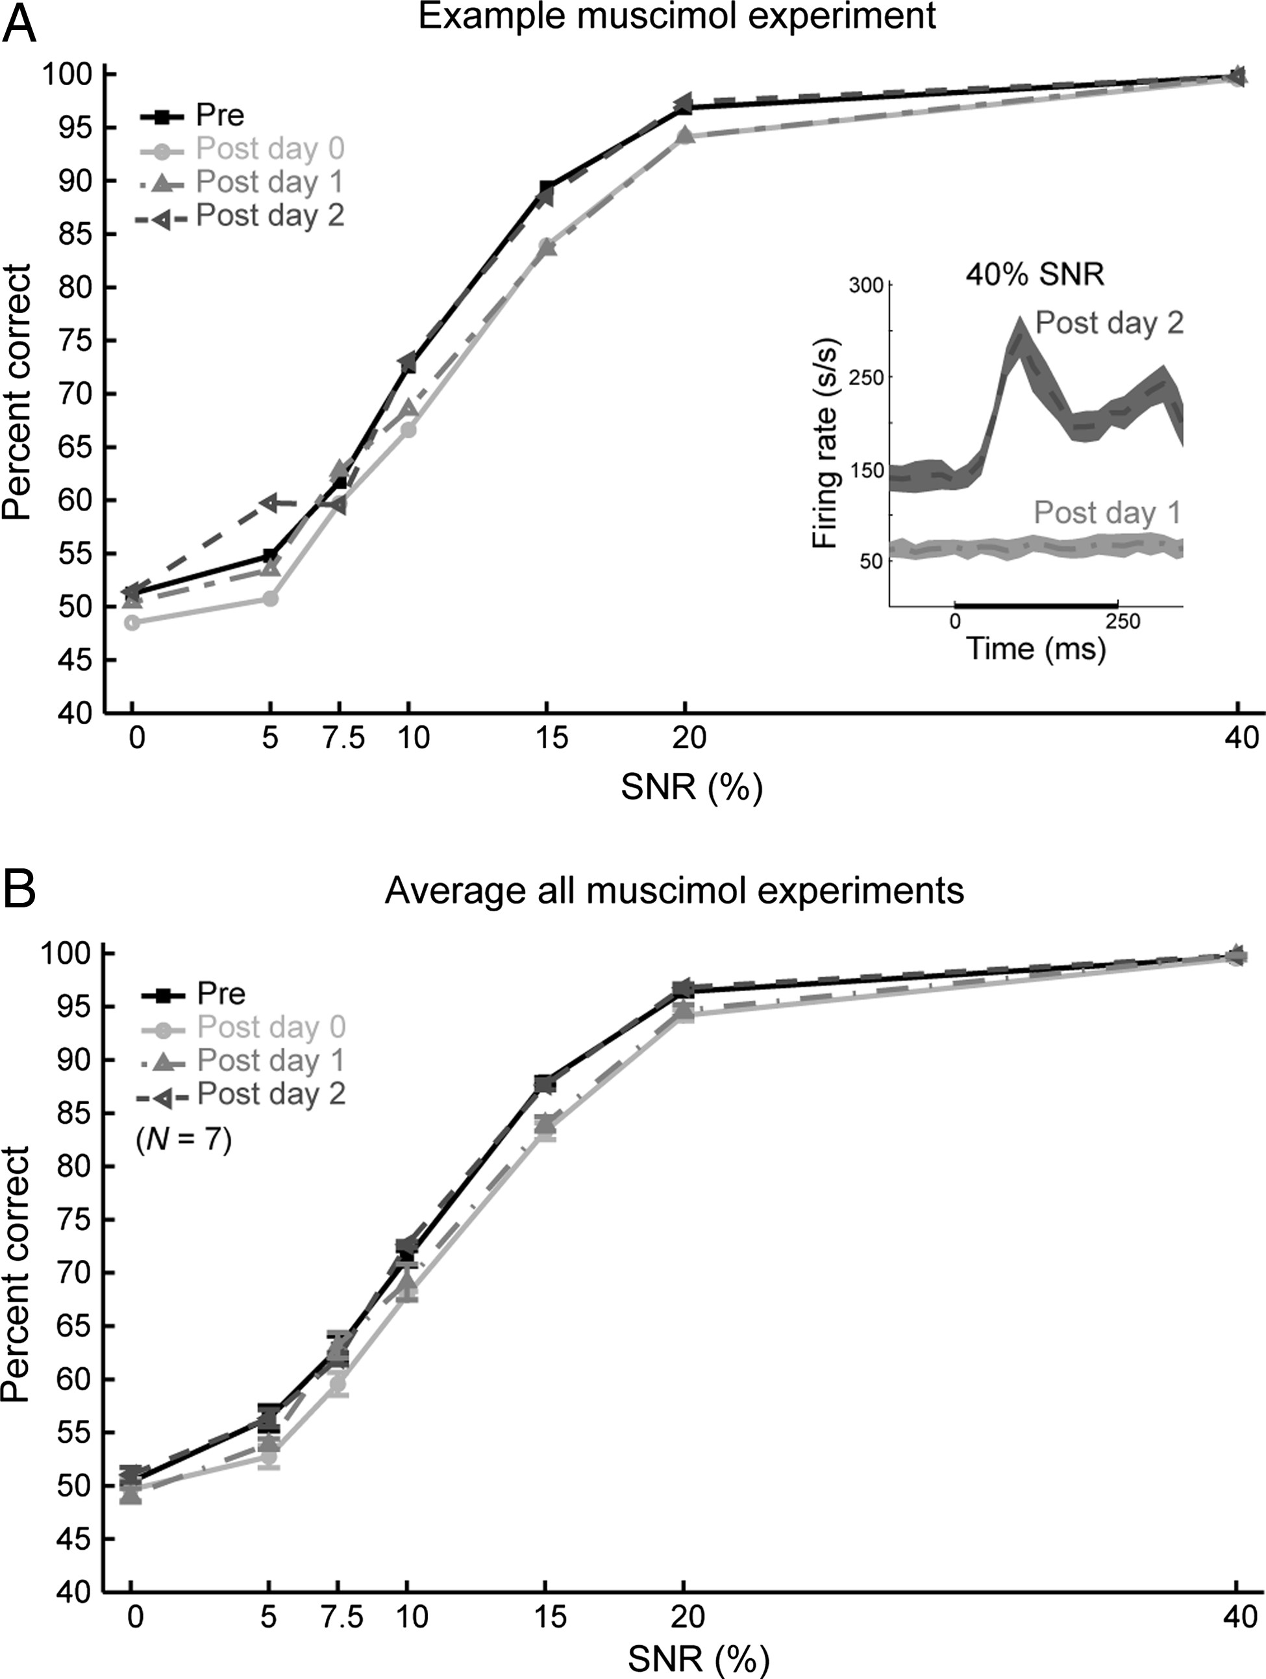
Figure 8. Muscimol inactivation in PIT impairs coarse orientation discrimination. (A) An example of a muscimol ...
Notes:
Figure 8. Muscimol inactivation in PIT impairs coarse orientation discrimination. (A) An example of a muscimol experiment in PIT of Monkey P. The behavioral performance is plotted as a function of SNR before injection (pre; n = 6455 trials), immediately (postday 0), 12–16 h (postday 1), and 36–40 h (postday 2) after injection of muscimol. The number of trials after the injection was equated (n = 3229 trials). Performance dropped in postday 0 and 1 and then recovered to that of the pre measurements in postday 2. The inset shows the averaged MUA responses to the 40% SNR gratings during the orientation discrimination task on postday 1 and 2. Bands indicate standard error of the mean. The thicker line on the x-axis shows the stimulus presentation period with 0 ms corresponding to stimulus onset. Comparison of the responses on postday 1 and 2 after injection shows that the responses were almost abolished due to muscimol. (B) Performance accuracy averaged across muscimol experiments shows similar results as the example experiment of (A). The number of trials was equated for the postday 0, 1, and 2. Similar results held when including all trials. N indicates the number of experiments.
Unless provided in the caption above, the following copyright applies to the content of this slide: © The Author 2015. Published by Oxford University Press. All rights reserved. For Permissions, please e-mail: journals.permissions@oup.com

