Slide 1
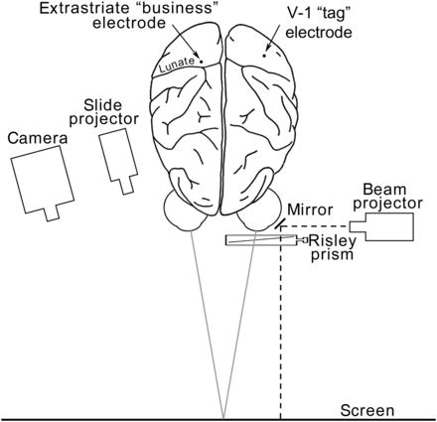
Figure 1. Bird's eye view of the recording set-up for measuring disparity tuning in macaque extrastriate cortex. See ...
Notes:
Figure 1. Bird's eye view of the recording set-up for measuring disparity tuning in macaque extrastriate cortex. See Results and Methods for details.
Unless provided in the caption above, the following copyright applies to the content of this slide: © The Author 2013. Published by Oxford University Press. All rights reserved. For Permissions, please e-mail: journals.permissions@oup.com

Slide 2
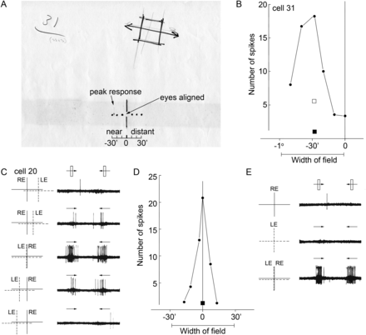
Figure 2. Responses of 2 disparity-tuned neurons recorded on 24 June 1969 in what is now known to be V-2 (see Fig. 3). ...
Notes:
Figure 2. Responses of 2 disparity-tuned neurons recorded on 24 June 1969 in what is now known to be V-2 (see Fig. 3). (A) Cell 31, receptive field map. Diagram at the bottom shows the laser beam coordinates of gaze directions indicating aligned eyes, near disparities, and far (distant) disparities. (The dark horizontal band across the page is an acid stain caused by 43-year-old masking tape.) The neuron's peak tuning is indicated in pencil. (B) Cell 31, disparity-tuning curve; squares show responses to single-eye stimulation (solid, right; open, left). (C) Cell 20, responses to horizontal disparities showing maximal activation to aligned LE and RE receptive fields. Dashed lines indicate receptive field for the left eye (LE); solid lines indicate receptive field for the right eye (RE). (D) Cell 20, disparity-tuning curve; single-eye response for each eye shown as a square symbol. Each point in the graph is the average of 10 back-and-forth passes of a computer-generated moving slit. (E) Cell 20, responses to stimulation of either eye alone (top panels), and to both eyes simultaneously (bottom panel). See Supplementary File 1; Supplementary Movies 1–6; Supplementary Figures 1 and 2.
Unless provided in the caption above, the following copyright applies to the content of this slide: © The Author 2013. Published by Oxford University Press. All rights reserved. For Permissions, please e-mail: journals.permissions@oup.com

Slide 3
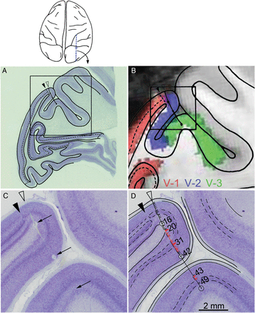
Figure 3. Reconstruction of electrode penetrations. (A) Low-power, Nissl-stained sagittal section from the experiment ...
Notes:
Figure 3. Reconstruction of electrode penetrations. (A) Low-power, Nissl-stained sagittal section from the experiment run on 24 June 1969. Black arrow shows the area 17/area 18 border. Electrode tract has been drawn on the tracing of the section. The tracing of the cortex within the boxed region of (A) is shown in (B), superimposed on the corresponding MRI macaque atlas section showing area designations. The MRI atlas was generated using different animals from those used in the physiology experiments; the atlas was made by conducting a functional scan of retinotopy to identify area borders (e.g., see Fize et al. 2003). (C) high-resolution Nissl-stained section corresponding to the boxed region in (B), containing the 3 electrolytic lesions made during the recording (arrows). (D) Cell identifications reconstructed on the electrode tract. Red dashes indicate disparity-tuned neurons.
Unless provided in the caption above, the following copyright applies to the content of this slide: © The Author 2013. Published by Oxford University Press. All rights reserved. For Permissions, please e-mail: journals.permissions@oup.com

Slide 4
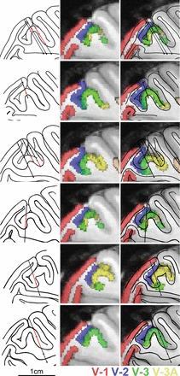
Figure 4. Reconstruction of the visual areas traversed during 6 experiments (each row from one experiment). Left panels ...
Notes:
Figure 4. Reconstruction of the visual areas traversed during 6 experiments (each row from one experiment). Left panels show tracings of the sagittal sections containing the electrode tracts. Regions along the electrode penetration in red are those in which disparity-tuned neurons were identified. Center panels show the matching slice from a monkey atlas of visual areas generated with fMRI. Right panels, overlay.
Unless provided in the caption above, the following copyright applies to the content of this slide: © The Author 2013. Published by Oxford University Press. All rights reserved. For Permissions, please e-mail: journals.permissions@oup.com

Slide 5
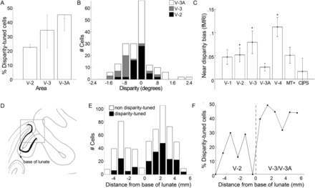
Figure 5. Quantification of single-cell results. (A) Proportion of neurons recorded in each visual area selective for ...
Notes:
Figure 5. Quantification of single-cell results. (A) Proportion of neurons recorded in each visual area selective for binocular disparity. Error bars show upper and lower estimates as predicted from the alignment of the electrode penetrations with the MRI atlas of visual areas. Some electrode penetrations glanced the predicted border between V-3 and V-3A. The upper estimate includes all neurons that could potentially have resided within the visual area; the lower estimate includes only those neurons that were very likely to have resided in the visual area. (B) Population distribution of disparity preferences among extrastriate disparity-tuned neurons. (C) fMRI response to near- versus far-disparity stimuli. Near-disparity bias index was calculated as [(Response to drifting random dot stereograms containing only near disparities − Response to drifting random dot stereograms containing only far disparities)/(Response to drifting random dot stereograms containing only near disparities + Response to drifting random dot stereograms containing only far disparities)]. Asterisk shows a significant bias for near disparities, P < 0.05 (unpaired 2-tailed t-test, N = 4 hemispheres). CIPS: caudal intraparietal sulcus. (D) Tracing of the sagittal section containing the electrode penetration (see Fig. 3B) showing layer 4 (black line) and the base of the lunate sulcus (dashed line), an anatomical landmark that coincides with the border between V-2 and V-3. (E) The total number of disparity-tuned and nondisparity-tuned neurons within 1 mm bins at various distances from the base of the lunate sulcus (negative numbers are within putative V-2; positive numbers are within putative V-3/V-3A). (F) The proportion of neurons that showed disparity tuning recorded at various distances from the base of the lunate sulcus (compare with A).
Unless provided in the caption above, the following copyright applies to the content of this slide: © The Author 2013. Published by Oxford University Press. All rights reserved. For Permissions, please e-mail: journals.permissions@oup.com

Slide 6
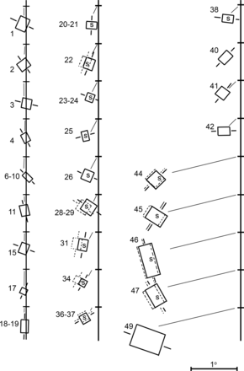
Figure 6. Reconstruction of the receptive-field maps for all the neurons encountered on the experiment conducted on 24 ...
Notes:
Figure 6. Reconstruction of the receptive-field maps for all the neurons encountered on the experiment conducted on 24 June 1969 (see Figs 2 and 3). “S” indicates disparity-tuned (“stereo”) neurons. The horizontal tick marks along the vertical line show the center of gaze. The receptive fields have been splayed out along the vertical axis, so that individual overlapping receptive fields can be easily discriminated. See also Supplementary Figures 3 and 4.
Unless provided in the caption above, the following copyright applies to the content of this slide: © The Author 2013. Published by Oxford University Press. All rights reserved. For Permissions, please e-mail: journals.permissions@oup.com

Slide 7
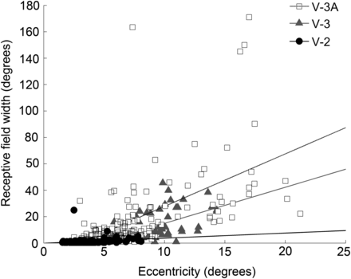
Figure 7. Receptive field width as a function of the eccentricity of the receptive field within the visual field for ...
Notes:
Figure 7. Receptive field width as a function of the eccentricity of the receptive field within the visual field for neurons recorded in V-2, V-3, and V-3A.
Unless provided in the caption above, the following copyright applies to the content of this slide: © The Author 2013. Published by Oxford University Press. All rights reserved. For Permissions, please e-mail: journals.permissions@oup.com

Slide 8
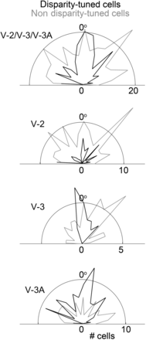
Figure 8. Orientation preferences for the population of disparity-tuned (black lines) and nondisparity-tuned (gray ...
Notes:
Figure 8. Orientation preferences for the population of disparity-tuned (black lines) and nondisparity-tuned (gray lines) neurons in V-2, V-3, V-3A, and combined. Neurons selective for vertical bars are plotted at 0°. Supplementary Figure 5 shows results for each cell separately. Supplementary Movie 4 shows tests of the orientation sensitivity of one example neuron.
Unless provided in the caption above, the following copyright applies to the content of this slide: © The Author 2013. Published by Oxford University Press. All rights reserved. For Permissions, please e-mail: journals.permissions@oup.com

Slide 9
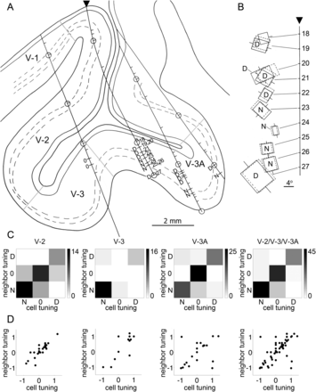
Figure 9. Clustering of disparity-tuned neurons by disparity preference (N = near; 0 = zero; D = distant). (A) Tracing ...
Notes:
Figure 9. Clustering of disparity-tuned neurons by disparity preference (N = near; 0 = zero; D = distant). (A) Tracing of the sagittal slice from an example experiment containing 4 penetrations. Area designations were obtained by aligning the slice with an atlas of visual areas obtained with fMRI. (B) Receptive field reconstructions for neurons 18 through 27 recorded in the second penetration, marked by an arrowhead in (A). The horizontal tick marks along the vertical line show the center of gaze. The receptive fields have been splayed out along the vertical axis, so that individual overlapping receptive fields can be easily discriminated. For cells preferring distant disparity, the cell peaked with the left eye's receptive field (solid line) deviated to the right of the right eye's receptive field (dashed line); for cells preferring near disparity, the optimal stimulus configuration required the left eye's receptive field displaced to the left of the right eye's receptive field. (C) Quantification of spatial clustering by visual area using values binned as either “near,” “distant,” or “zero” disparity preference, as done in the original analysis from around 1970 (see Supplementary Fig. 6). Scale bar shows the number of cells. Spatial clustering is evident in peaks along the y = x axis. (D) Quantification of spatial clustering by visual area. Note that near-disparity preferences are plotted at plus values, following contemporary conventions. Spatial clustering is evident in peaks along the y = x axis. For panels (left to right), the R2 values are 0.77, 0.78, 0.23, and 0.51.
Unless provided in the caption above, the following copyright applies to the content of this slide: © The Author 2013. Published by Oxford University Press. All rights reserved. For Permissions, please e-mail: journals.permissions@oup.com

Slide 10
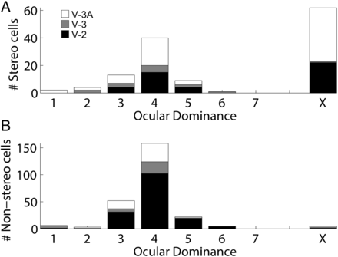
Figure 10. Responses to monocular versus binocular stimulation. (A) Population distribution of disparity-tuned neurons. ...
Notes:
Figure 10. Responses to monocular versus binocular stimulation. (A) Population distribution of disparity-tuned neurons. Values of “1” correspond to neurons whose responses were entirely driven by the left eye; “7,” correspond to neurons whose responses were entirely driven by the right eye; and “4,” by both eyes equally. Obligate binocular cells, which require simultaneous stimulation of both eyes, are shown in column “X.” (B) Distribution of nondisparity-tuned neurons.
Unless provided in the caption above, the following copyright applies to the content of this slide: © The Author 2013. Published by Oxford University Press. All rights reserved. For Permissions, please e-mail: journals.permissions@oup.com

