Slide 1
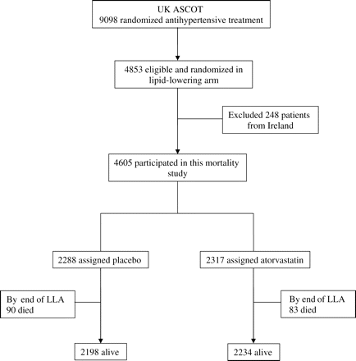
Figure 1 Study profile.
Notes:
Figure 1 Study profile.
Unless provided in the caption above, the following copyright applies to the content of this slide: Published on behalf of the European Society of Cardiology. All rights reserved. © The Author 2011. For permissions please email: journals.permissions@oup.com

Slide 2
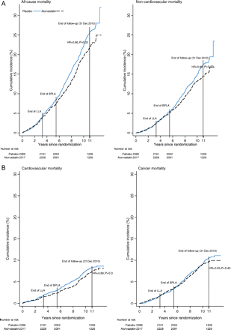
Figure 2 (A) Cumulative incidence of all-cause mortality and non-cardiovascular mortality. (B) Cumulative incidence of ...
Notes:
Figure 2 (A) Cumulative incidence of all-cause mortality and non-cardiovascular mortality. (B) Cumulative incidence of cardiovascular mortality and cancer mortality.
Unless provided in the caption above, the following copyright applies to the content of this slide: Published on behalf of the European Society of Cardiology. All rights reserved. © The Author 2011. For permissions please email: journals.permissions@oup.com

Slide 3
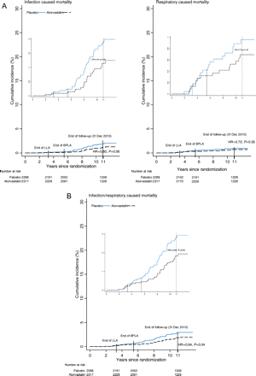
Figure 3 (A) Cumulative incidence of mortality due to infection and respiratory disease mortality. (B) Cumulative ...
Notes:
Figure 3 (A) Cumulative incidence of mortality due to infection and respiratory disease mortality. (B) Cumulative incidence of mortality due to combined infection and respiratory disease.
Unless provided in the caption above, the following copyright applies to the content of this slide: Published on behalf of the European Society of Cardiology. All rights reserved. © The Author 2011. For permissions please email: journals.permissions@oup.com

