Slide 1
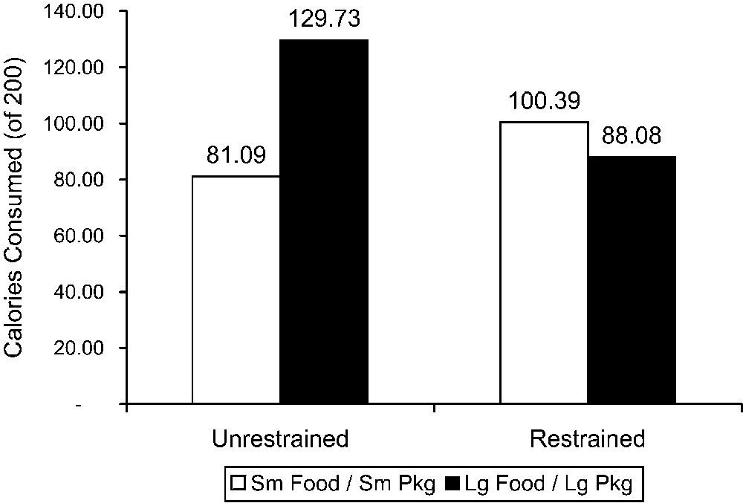
Figure 1 Study 2: Calories Consumed by Unrestrained Eaters and Restrained Eaters from Small Food in Small Packages ...
Notes:
Figure 1 Study 2: Calories Consumed by Unrestrained Eaters and Restrained Eaters from Small Food in Small Packages versus Large Food in Large Packages
Unless provided in the caption above, the following copyright applies to the content of this slide: © 2008 by JOURNAL OF CONSUMER RESEARCH, Inc.

Slide 2
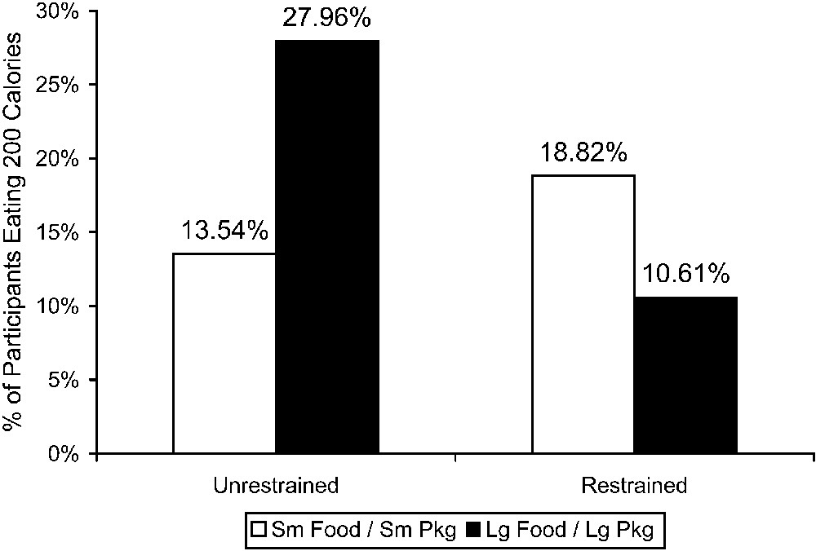
Figure 2 Study 2: Percentage of Participants Eating Entire 200 Calories
Notes:
Figure 2 Study 2: Percentage of Participants Eating Entire 200 Calories
Unless provided in the caption above, the following copyright applies to the content of this slide: © 2008 by JOURNAL OF CONSUMER RESEARCH, Inc.

Slide 3
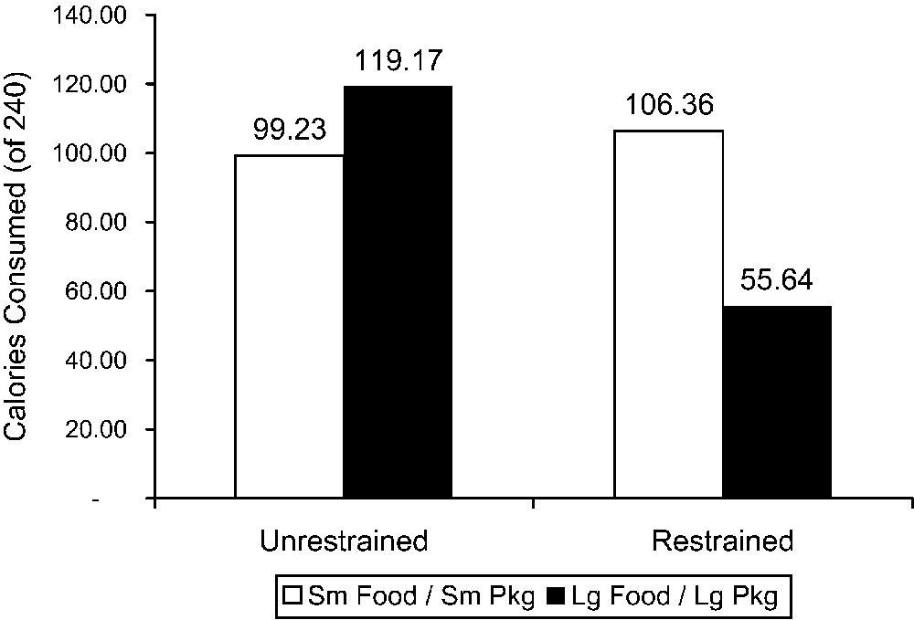
Figure 3 Study 3: Calories Consumed by Unrestrained Eaters and Restrained Eaters from Small Food in Small Packages ...
Notes:
Figure 3 Study 3: Calories Consumed by Unrestrained Eaters and Restrained Eaters from Small Food in Small Packages versus Large Food in Large Packages
Unless provided in the caption above, the following copyright applies to the content of this slide: © 2008 by JOURNAL OF CONSUMER RESEARCH, Inc.

Slide 4
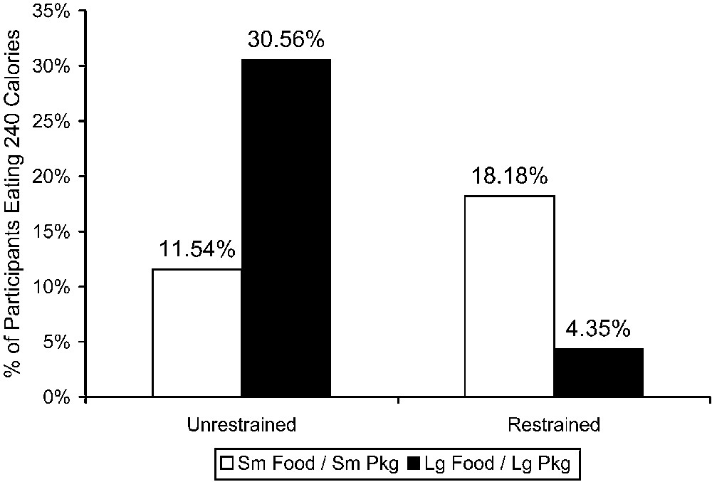
Figure 4 Study 3: Percentage of Participants Eating Entire 240 Calories
Notes:
Figure 4 Study 3: Percentage of Participants Eating Entire 240 Calories
Unless provided in the caption above, the following copyright applies to the content of this slide: © 2008 by JOURNAL OF CONSUMER RESEARCH, Inc.

Slide 5
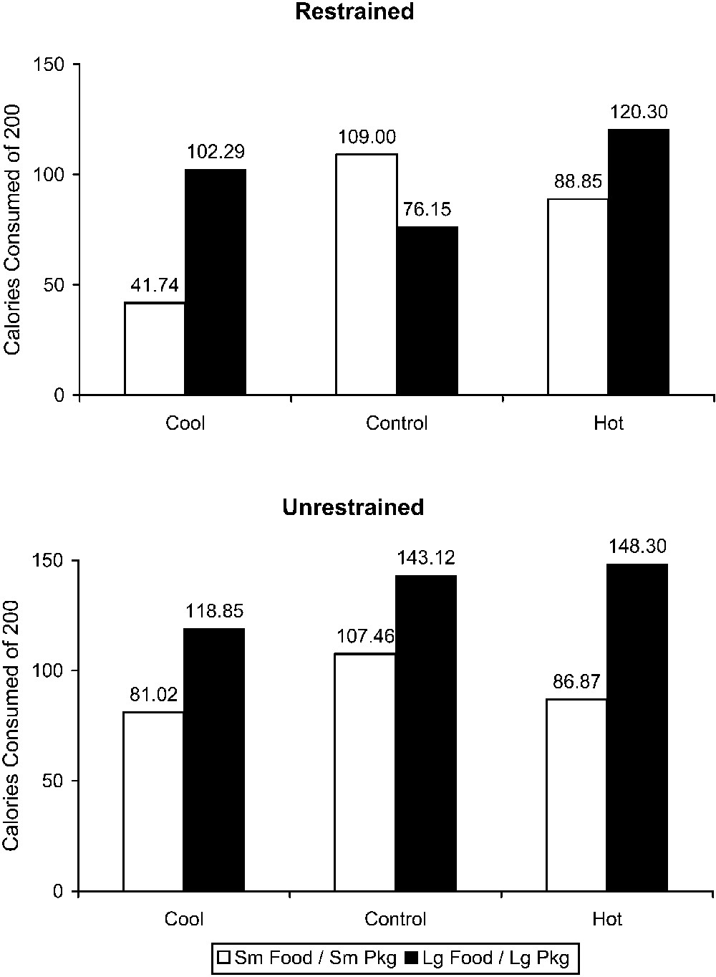
Figure 5 Study 4: Calories Consumed by Restrained Eaters and Unrestrained Eaters with Cool, Control, and Hot System ...
Notes:
Figure 5 Study 4: Calories Consumed by Restrained Eaters and Unrestrained Eaters with Cool, Control, and Hot System Focus
Unless provided in the caption above, the following copyright applies to the content of this slide: © 2008 by JOURNAL OF CONSUMER RESEARCH, Inc.

Slide 6
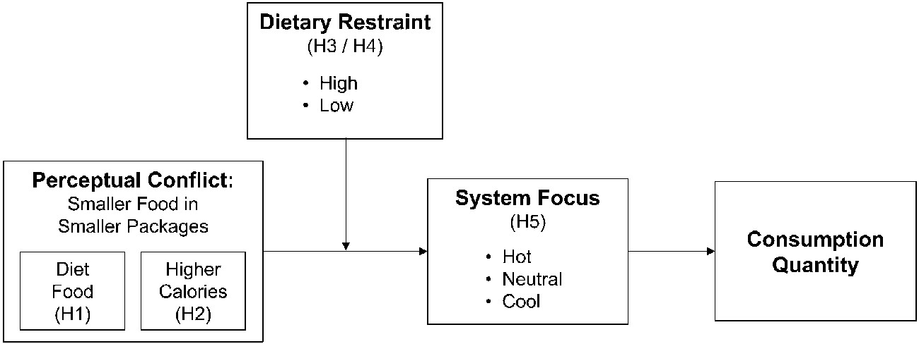
Figure 6 Conceptual Framework
Notes:
Figure 6 Conceptual Framework
Unless provided in the caption above, the following copyright applies to the content of this slide: © 2008 by JOURNAL OF CONSUMER RESEARCH, Inc.

Slide 7
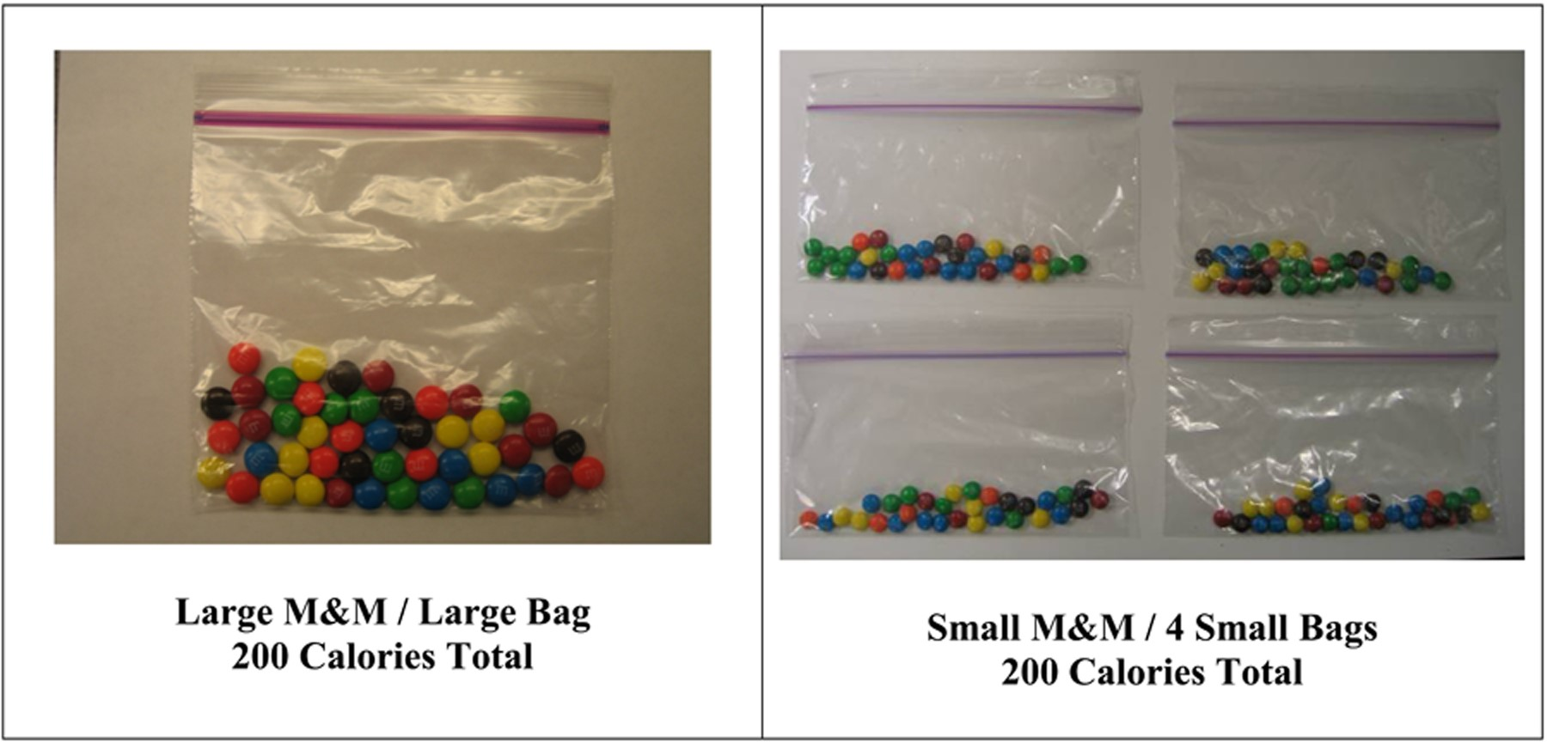
Figure A1 Photographs of Food Given to Participants to Eat
Notes:
Figure A1 Photographs of Food Given to Participants to Eat
Unless provided in the caption above, the following copyright applies to the content of this slide: © 2008 by JOURNAL OF CONSUMER RESEARCH, Inc.

