Slide 1
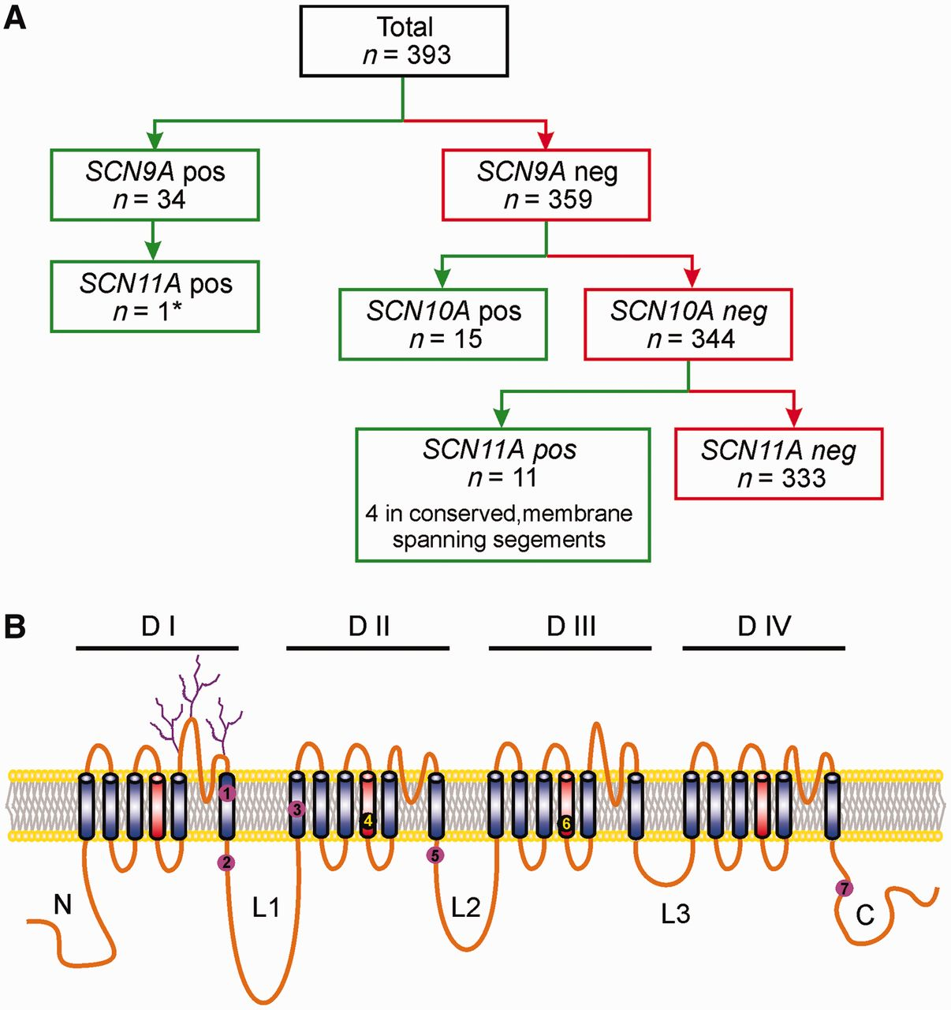
Figure 1 Scheme for patient selection and localization of Na_{v}1.9 variants. (A) Scheme for selecting ...
Notes:
Figure 1 Scheme for patient selection and localization of Nav1.9 variants. (A) Scheme for selecting patients with small fibre neuropathy for SCN11A screening. *SCN9A variant c.3799C>G (p.Leu1267Val) did not show abnormalities in cell electrophysiology; therefore, SCN10A and SCN11A were tested. (B) Schematic of sodium channel polypeptide showing the locations of the missense mutations in Nav1.9 in individuals with painful peripheral neuropathy and no mutations in Nav1.7 or Nav1.8. The mutations are: (1) I381T; (2) K419N; (3) A582T; (4) A681D; (5) A842P; (6) L1158P; and (7) F1689L. The mutations I381T and L1158P, which were profiled in this study, were each present in two patients. One additional mutation was found at the 3’ acceptor splice site in intron 24.
Unless provided in the caption above, the following copyright applies to the content of this slide: © The Author (2014). Published by Oxford University Press on behalf of the Guarantors of Brain. All rights reserved. For Permissions, please email: journals.permissions@oup.com

Slide 2
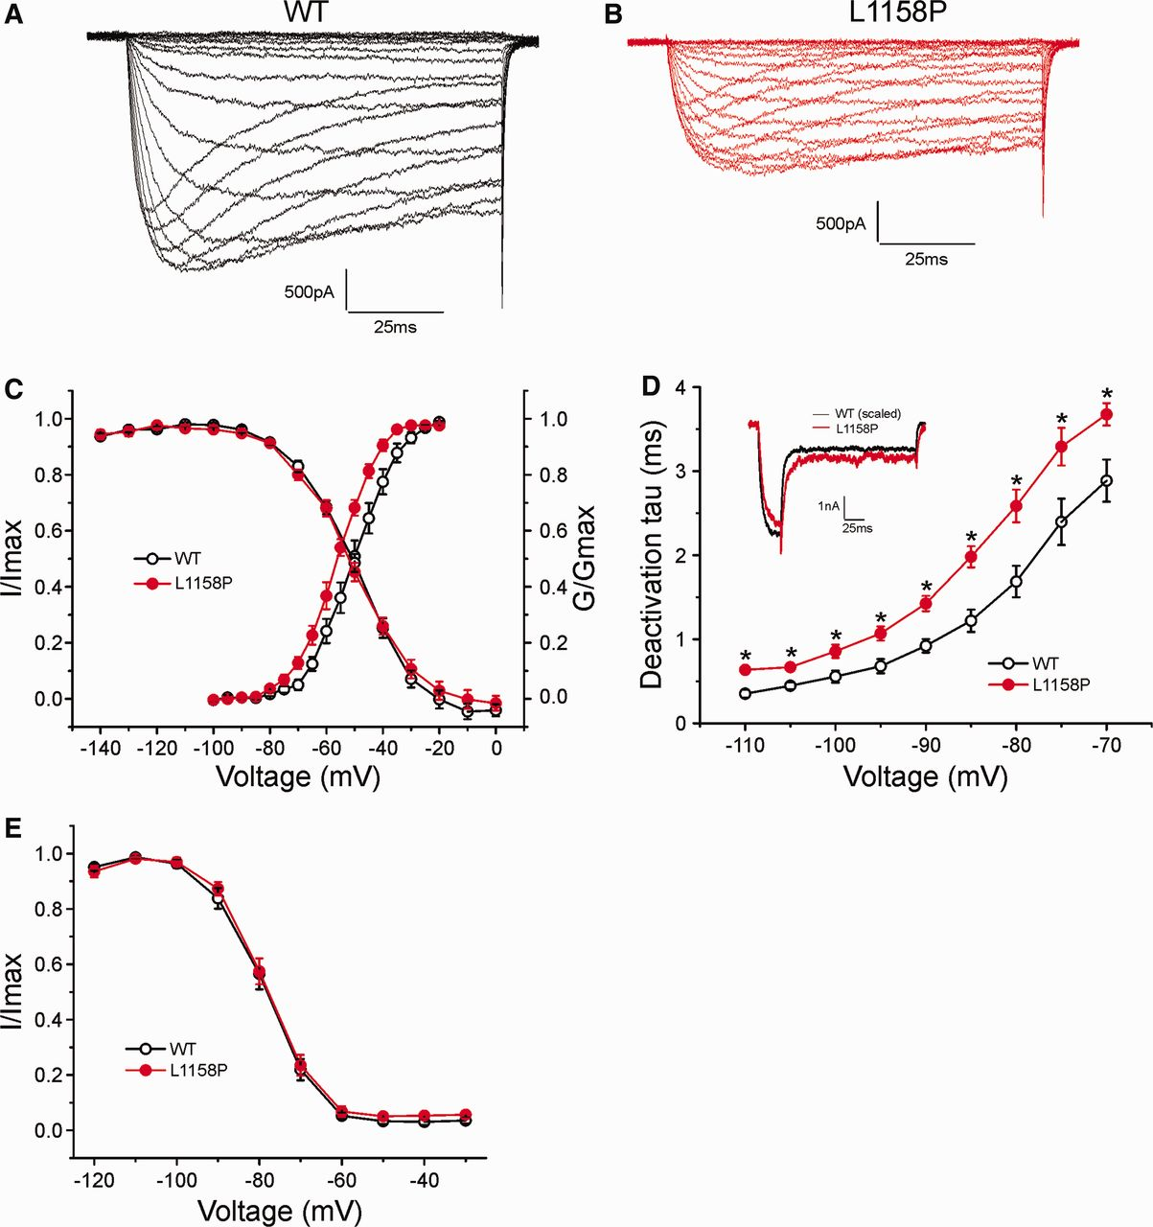
Figure 2 Voltage-clamp analysis of L1158P mutant channels. (A and B) Representative current traces recorded from DRG ...
Notes:
Figure 2 Voltage-clamp analysis of L1158P mutant channels. (A and B) Representative current traces recorded from DRG neurons expressing wild-type (A) or L1158P (B) mutant channels. (C) Comparison of activation for wild-type (WT) and L1158P mutant channels. L1158P shifts activation by −6.7 mV (wild-type: −49.6 ± 2.0 mV, n = 12; L1158P: −56.3 ± 1.1 mV, n = 10; P 0.05). (D) Comparison of deactivation time constants. L1158P (n = 15) deactivates significantly slower than wild-type (n = 12), *P 0.05).
Unless provided in the caption above, the following copyright applies to the content of this slide: © The Author (2014). Published by Oxford University Press on behalf of the Guarantors of Brain. All rights reserved. For Permissions, please email: journals.permissions@oup.com

Slide 3
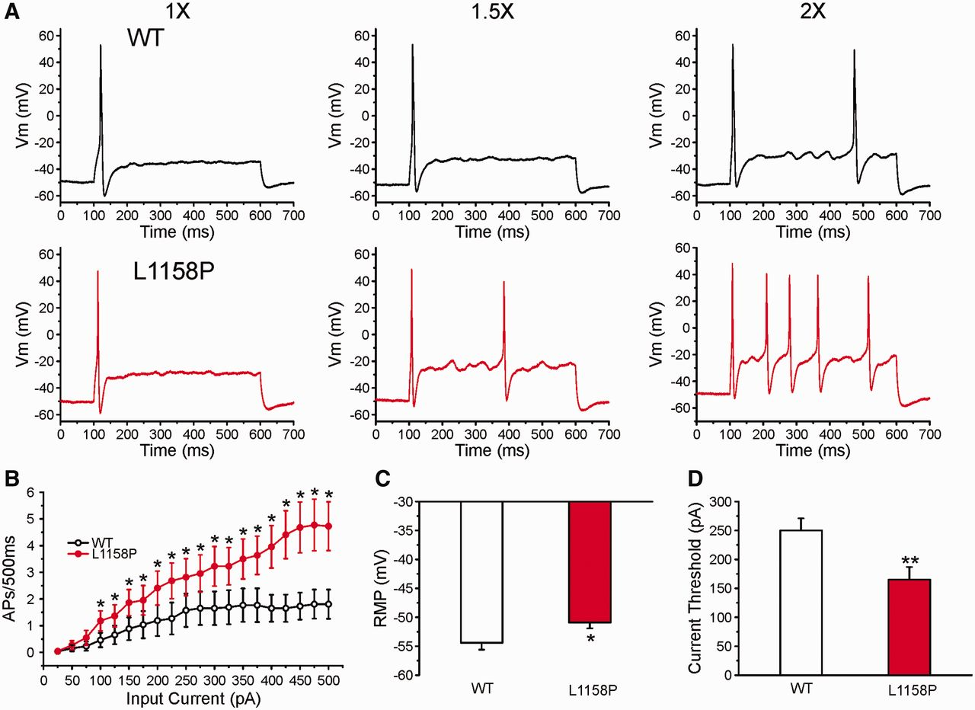
Figure 3 Current-clamp analysis of L1158P mutation. (A) Responses of representative DRG neurons expressing wild-type ...
Notes:
Figure 3 Current-clamp analysis of L1158P mutation. (A) Responses of representative DRG neurons expressing wild-type (upper) and L1158P (lower) channels, respectively, to 500 ms depolarization current steps which are 1×, 1.5× and 2× (left, centre and right traces, respectively) the current threshold for action potential generation. (B) Comparison of repetitive action potential firing spike number between DRG neurons expressing wild-type (n = 26) and L1158P (n = 22) across a range of 500 ms step current injections from 25 to 500 pA; *P < 0.05. (C) L1158P significantly depolarized resting membrane potential by 3.5 mV compared with wild-type channels (wild-type: −54.4 ± 1.2 mV, n = 26; L1158P: −50.9 ± 1.0 mV, n = 22; *P < 0.05). (D) Current threshold was reduced significantly after expression of L1158P (165 ± 22 pA, n = 22), compared with wild-type (250 ± 21 pA, n = 26; **P < 0.01). AP = action potential.
Unless provided in the caption above, the following copyright applies to the content of this slide: © The Author (2014). Published by Oxford University Press on behalf of the Guarantors of Brain. All rights reserved. For Permissions, please email: journals.permissions@oup.com

Slide 4
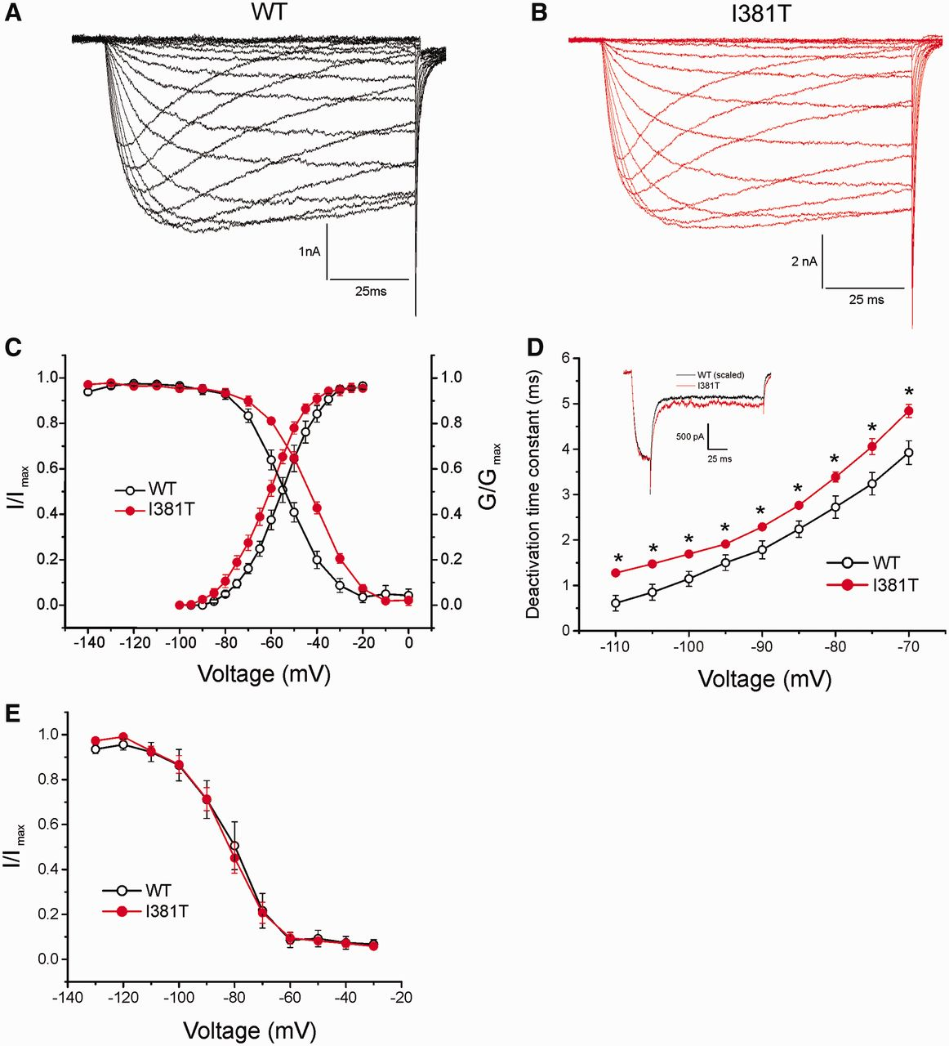
Figure 4 Voltage-clamp analysis of I381T mutant channels. Inward currents recorded from a small-diameter DRG neuron ...
Notes:
Figure 4 Voltage-clamp analysis of I381T mutant channels. Inward currents recorded from a small-diameter DRG neuron expressing wild-type Nav1.9 (A) or I381T mutant (B) sodium channels. (C) Comparison of the voltage dependence of activation (wild-type, −55.3 ± 1.8 mV, n = 12; I381T, −62.2 ± 1.4 mV, n = 10; P < 0.01) and steady-state fast-inactivation (wild-type, −53.3 ± 1.7 mV, n = 11; I381T, −40.0 ± 1.6 mV, n = 14; P 0.05).
Unless provided in the caption above, the following copyright applies to the content of this slide: © The Author (2014). Published by Oxford University Press on behalf of the Guarantors of Brain. All rights reserved. For Permissions, please email: journals.permissions@oup.com

Slide 5
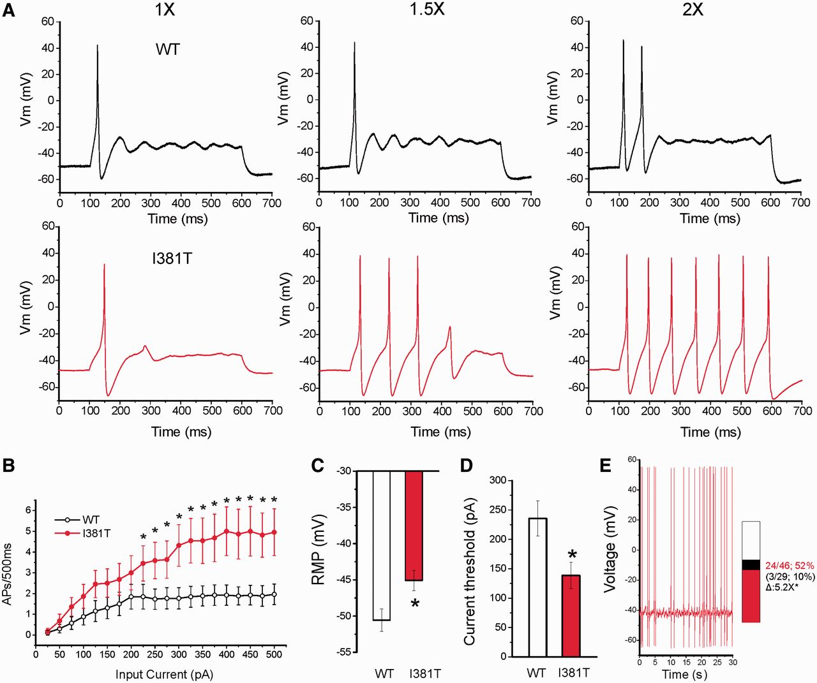
Figure 5 Current-clamp analysis of I381T mutation. (A) Responses of a neuron expressing wild-type or I381T channels to ...
Notes:
Figure 5 Current-clamp analysis of I381T mutation. (A) Responses of a neuron expressing wild-type or I381T channels to 500 ms depolarizing current steps that are 1×, 1.5× and 2× of the current threshold. (B) Summary of firing frequency data. The total number of action potentials (APs) elicited by the indicated depolarizing current steps from 25 to 500 pA in 25 pA increments was compared between two groups of neurons expressing wild-type (n = 26) or I381T (n = 22) channels. (C) RMP of neurons expressing I381T (−45.1 ± 1.4 mV) was depolarized by 5.5 mV as compared to that of wild-type channels (−50.6 ± 1.6 mV, P < 0.05). (D) Current threshold was significantly reduced after expressing I381T channels (wild-type, 236 ± 30 pA; I381T, 138 ± 23 pA; P 5-fold compared to that of wild-type (black); numbers to the right of the bar graph show values for wild-type (10%, lower value in parentheses) and I381T (52%, upper value). *P < 0.001 z-test.
Unless provided in the caption above, the following copyright applies to the content of this slide: © The Author (2014). Published by Oxford University Press on behalf of the Guarantors of Brain. All rights reserved. For Permissions, please email: journals.permissions@oup.com

Slide 6
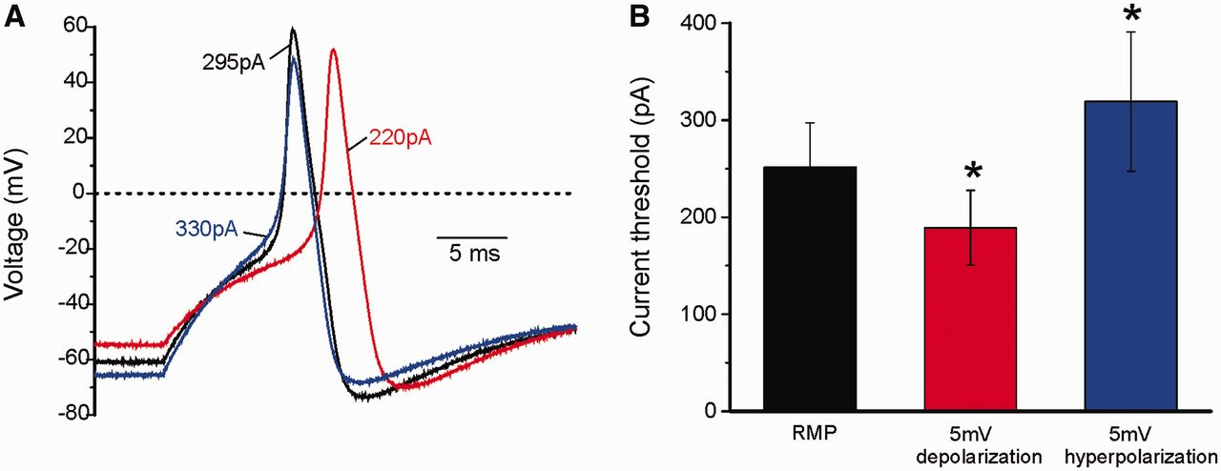
Figure 6 Depolarization of RMP of DRG neurons by 5 mV reduces current threshold for action potential. (A) ...
Notes:
Figure 6 Depolarization of RMP of DRG neurons by 5 mV reduces current threshold for action potential. (A) Representative action potentials recorded from a native adult rat DRG neuron at its RMP (black), at membrane potential depolarized by current injection 5 mV (red) or hyperpolarized by 5 mV (blue). Arrows and numbers indicate current thresholds at different membrane potentials. (B) The current threshold was reduced when the neurons were held at membrane potentials 5 mV depolarized compared to RMP and increased when they were held at membrane potentials 5 mV hyperpolarized compared to RMP. *P < 0.001, paired t-test.
Unless provided in the caption above, the following copyright applies to the content of this slide: © The Author (2014). Published by Oxford University Press on behalf of the Guarantors of Brain. All rights reserved. For Permissions, please email: journals.permissions@oup.com

Slide 7
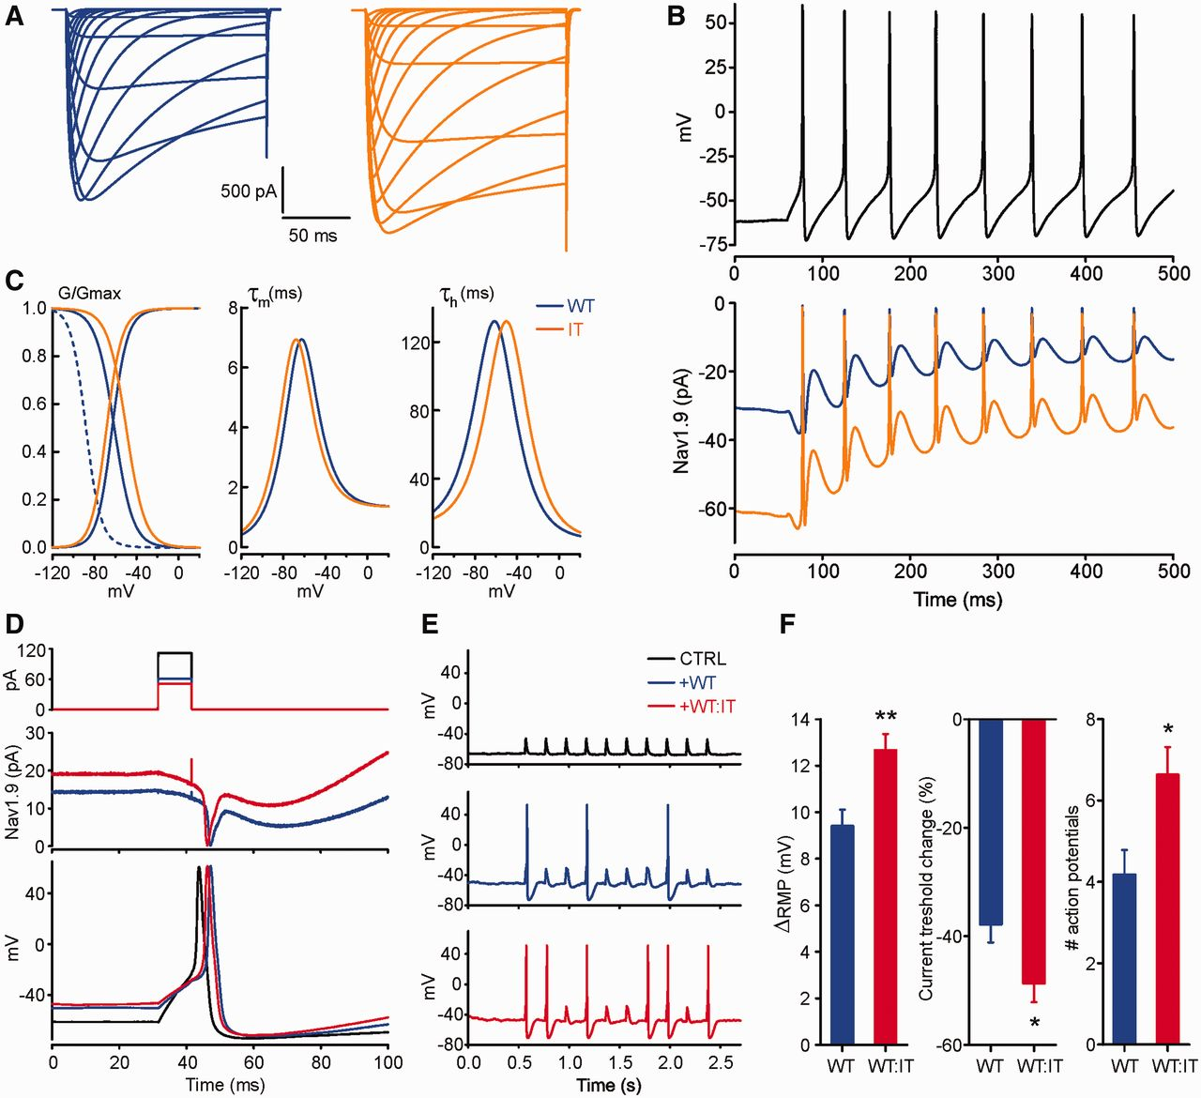
Figure 7 Dynamic clamp recording of DRG neuron firing using physiological levels of wild-type or mutant ...
Notes:
Figure 7 Dynamic clamp recording of DRG neuron firing using physiological levels of wild-type or mutant Nav1.9 currents. (A) Current traces obtained from wild-type (blue) and I381T (orange) Nav1.9 channel model INa = gmax × m × h × s × (Vm − ENa). Currents were evoked by voltage steps ranged from −90 mV to 60 mV (in 10 mV increment) applied from −110 mV holding potential. The model cell was equipotential 15 pF sphere with 0.0018 S/cm2 current density. (B, top) Repetitive firing of a spontaneously active small DRG neuron. (B, bottom) Modelled wild-type (blue) and I381T (orange) Nav1.9 currents obtained in response to the voltage command shaped in the form of the action potential shown in B (top). (C) Nav1.9 kinetic model steady-state fast inactivation (solid), steady-state activation (solid) and steady-state slow inactivation (dashed) are presented on the left panel; activation time constant and inactivation time constant are shown on the middle and right panel, respectively. Wild-type model is shown in blue and I381T is shown in orange. (D) Dynamic-clamp recordings of action potentials evoked by current pulses of threshold intensity in control (black), after dynamic-clamp addition of 100% wild-type conductance (blue) and (50% wild-type + 50% I381T) conductance (red). Stimulation current pulses are shown on top panel, dynamic-clamp currents are shown on the middle panel and action potentials are presented on the bottom panel. (E) Action potential repetitive firing evoked by a 5 Hz train of current pulses in control (top, black) and after dynamic-clamp addition of 100% wild-type (middle, blue) and (50% wild-type + 50% I381T) conductance (bottom, red). (F) ΔRMP: 9.4 mV ± 0.7 mV (wild-type); 12.7 mV ± 0.7 mV (WT:IT) (P < 0.01, t-test, n = 13). RMP: −61.7 mV ± 0.7 mV (control); −52.3 mV ± 0.8 (wild-type); −49.1 mV ± 0.7 mV (WT:IT); −62.1 mV ± 0.8 mV (control). Wild-type versus WT:IT (P < 0.01, t-test, n = 13). Current threshold change: −37.8% ± 3.3% (wild-type); −48.7% ± 3.5% (WT:IT) (P 0.05, t-test, n = 13). Number of action potentials: 4.2 ± 0.6 (wild-type); 6.6 ± 0.7 (WT:IT) (P < 0.05, Mann-Whitney, n = 11).
Unless provided in the caption above, the following copyright applies to the content of this slide: © The Author (2014). Published by Oxford University Press on behalf of the Guarantors of Brain. All rights reserved. For Permissions, please email: journals.permissions@oup.com

