Slide 1
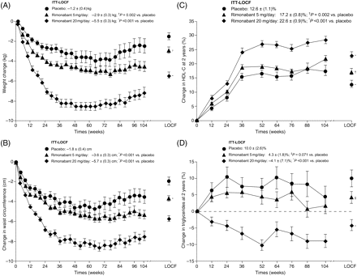
Figure 1 Change from baseline in (A) body weight and (B) waist circumference. Per cent change from baseline in (C) ...
Notes:
Figure 1 Change from baseline in (A) body weight and (B) waist circumference. Per cent change from baseline in (C) high-density lipoprotein cholesterol and (D) triglycerides. Data are mean (SE) values for patients completing each scheduled visit, with additional 2 year values for the intention-to-treat population with last observation carried forward. *P < 0.001 vs. placebo; †P = 0.002 vs. placebo; ‡P = 0.071 vs. placebo. HDL-C, high-density lipoprotein cholesterol; ITT, intention-to-treat; LOCF, last observation carried forward.
Unless provided in the caption above, the following copyright applies to the content of this slide: Published on behalf of the European Society of Cardiology. All rights reserved. © The Author 2008. For permissions please email: journals.permissions@oxfordjournals.org

Slide 2
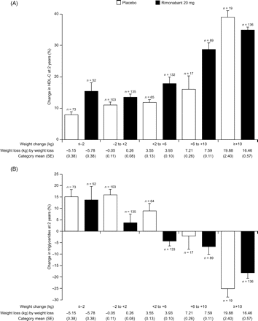
Figure 2 Relationship between (A) high-density lipoprotein cholesterol and weight loss; (B) triglycerides and weight ...
Notes:
Figure 2 Relationship between (A) high-density lipoprotein cholesterol and weight loss; (B) triglycerides and weight loss in the intention-to-treat population at 2 years. The selection of the weight loss categories was arbitrary since statistical modelling used to assess the relationships between weight loss and the secondary efficacy endpoints used continuous data. A weight loss of ±2 kg was chosen as being a reasonable level of no weight loss.
Unless provided in the caption above, the following copyright applies to the content of this slide: Published on behalf of the European Society of Cardiology. All rights reserved. © The Author 2008. For permissions please email: journals.permissions@oxfordjournals.org

