Slide 1
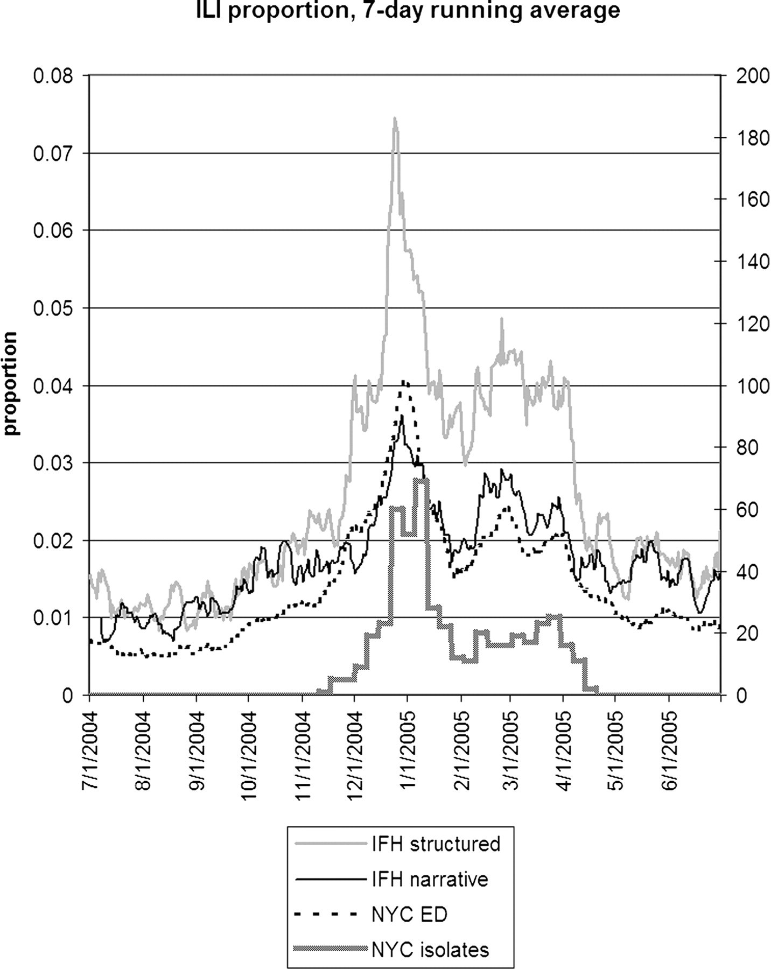
Figure 1 Seven-day running average of the proportion of visits (IFH structured data), proportion of notes (IFH ...
Notes:
Figure 1 Seven-day running average of the proportion of visits (IFH structured data), proportion of notes (IFH narrative data), and proportion of chief complaints (NYC emergency department data) that were positive for influenza-like illness. The NYC isolates shows the total number of influenza A and B isolates (right axis) that were obtained in New York City. IFH = Institute for Family Health; NYC = New York City.
Unless provided in the caption above, the following copyright applies to the content of this slide: American Medical Informatics Association

Slide 2
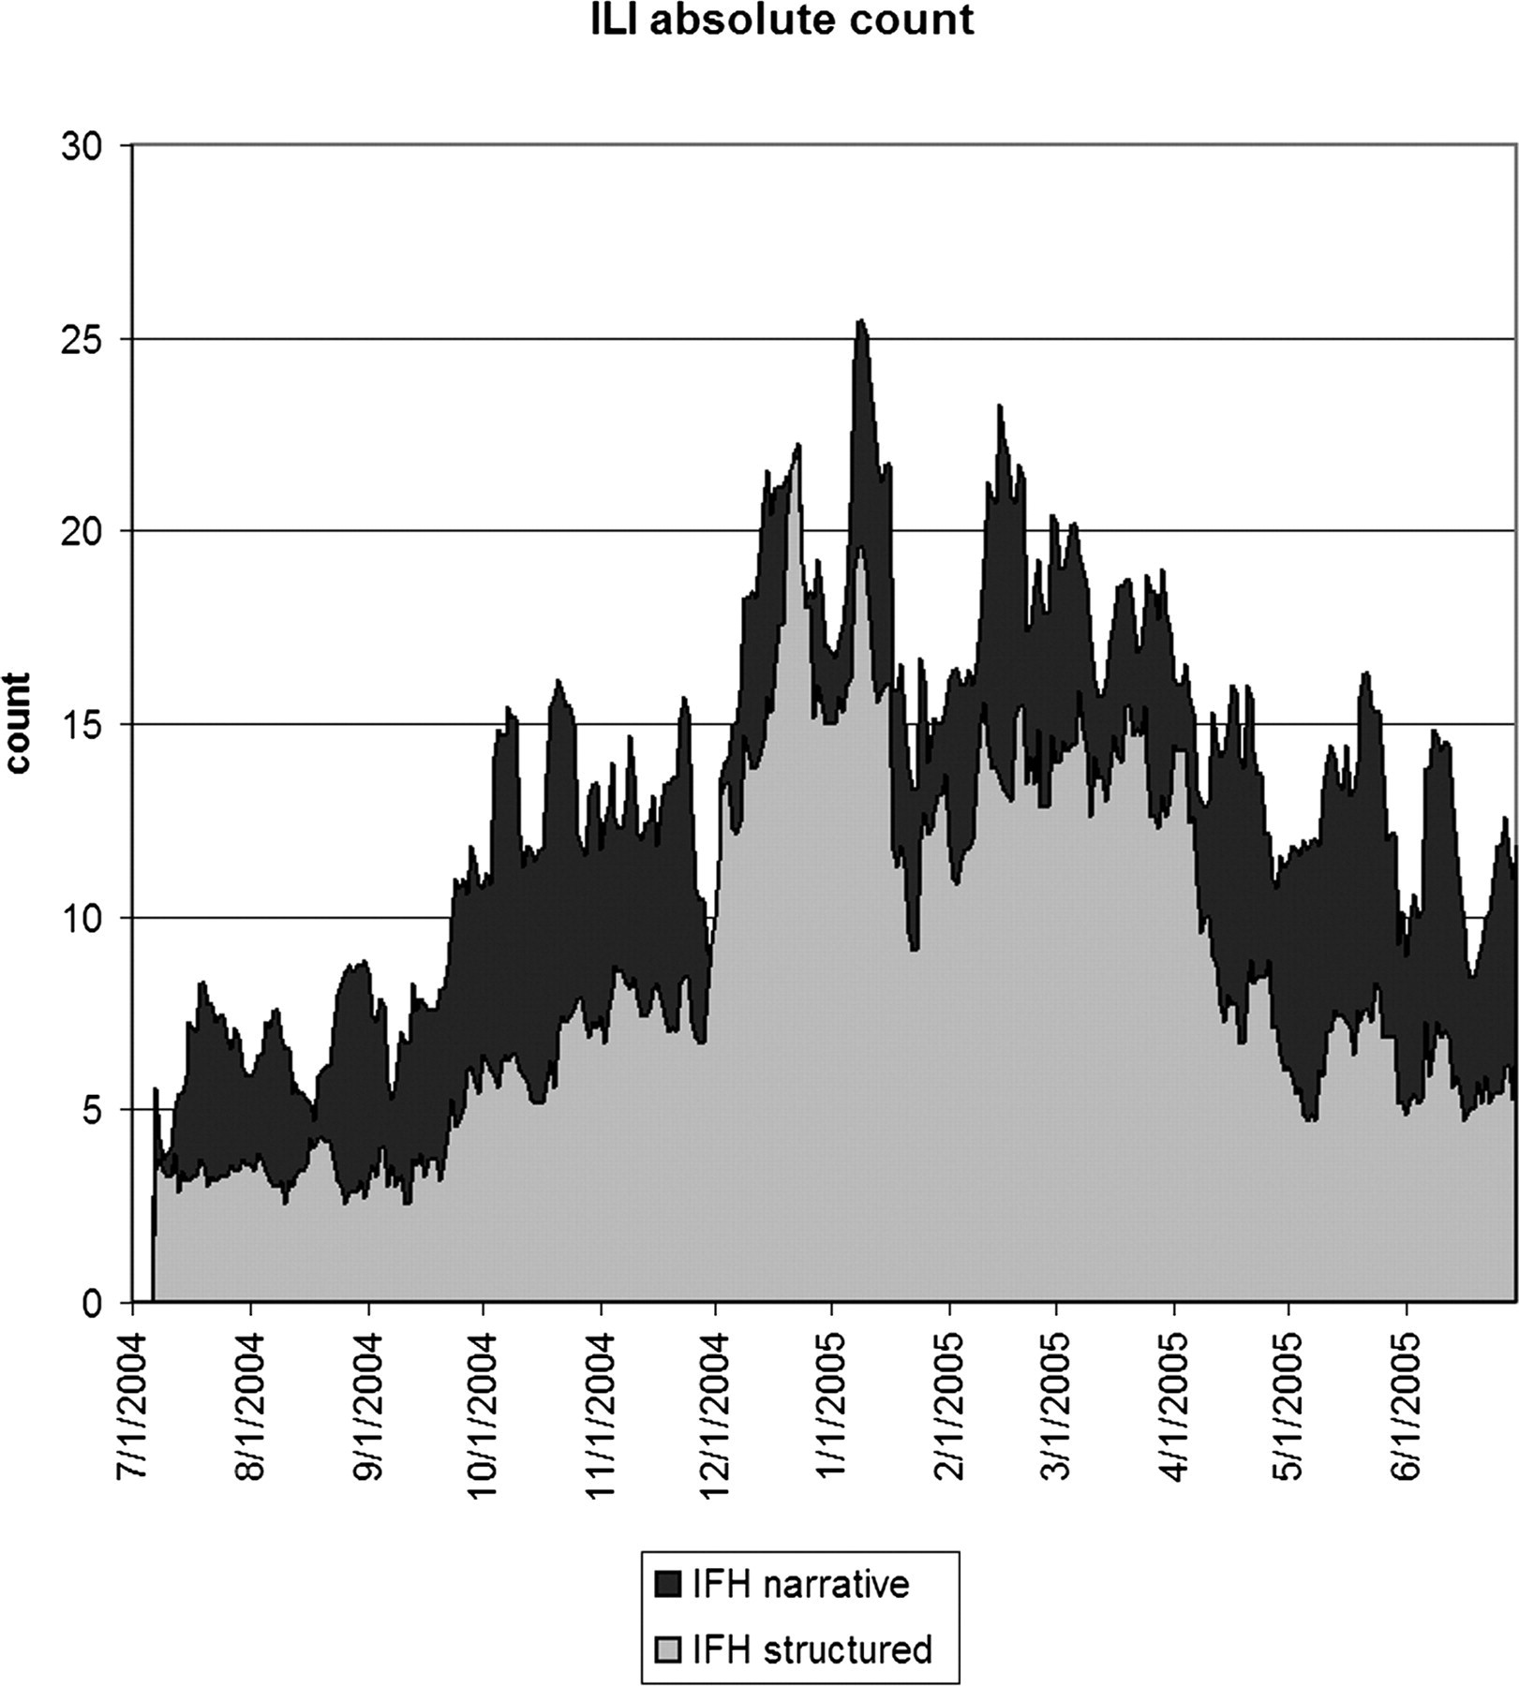
Figure 2 Seven-day running average of the absolute number of notes (IFH narrative) or visits (IFH structured) that ...
Notes:
Figure 2 Seven-day running average of the absolute number of notes (IFH narrative) or visits (IFH structured) that were positive for influenza-like illness. The narrative data appeared to have about five more positive instances per day than the structured data. IFH = Institute for Family Health.
Unless provided in the caption above, the following copyright applies to the content of this slide: American Medical Informatics Association

Slide 3
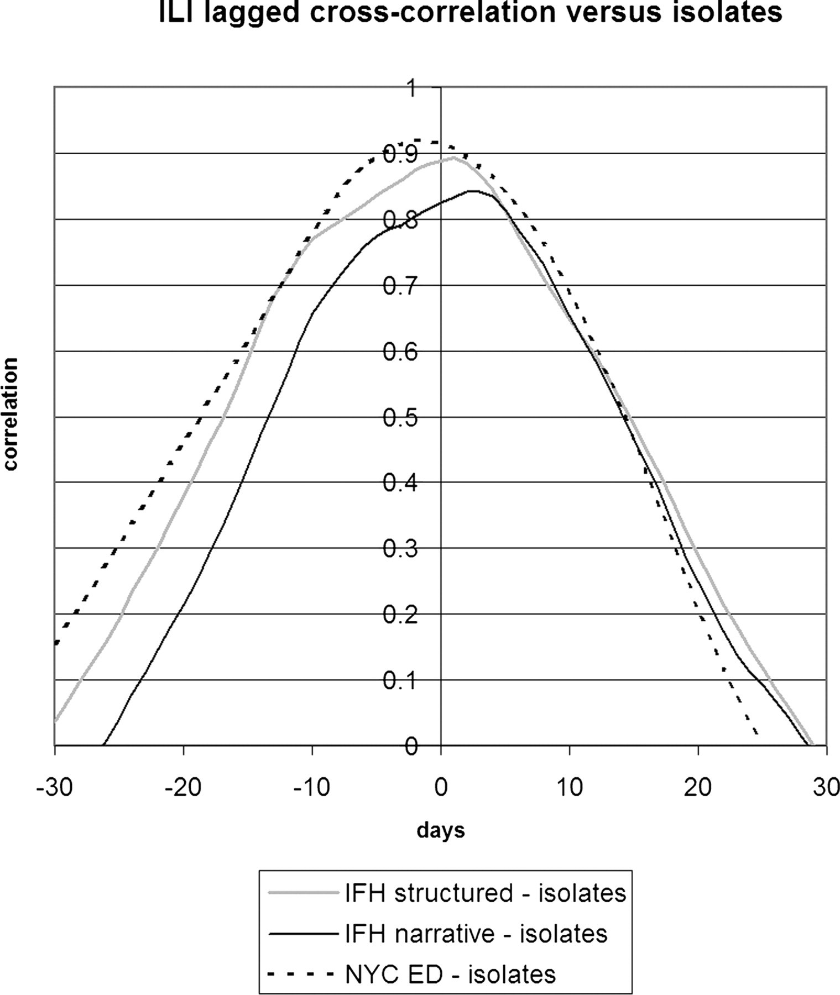
Figure 3 Lagged cross-correlation between the proportions of cases positive for influenza-like illness for IFH ...
Notes:
Figure 3 Lagged cross-correlation between the proportions of cases positive for influenza-like illness for IFH structured data, IFH narrative data, and NYC DOHMH emergency department chief complaint data versus NYC isolates. A peak to the left of 0 days implies that the left entity in the figure legend preceded the entity on the right. IFH = Institute for Family Health; NYC = New York City; DOHMH = Department of Health and Mental Hygiene.
Unless provided in the caption above, the following copyright applies to the content of this slide: American Medical Informatics Association

Slide 4
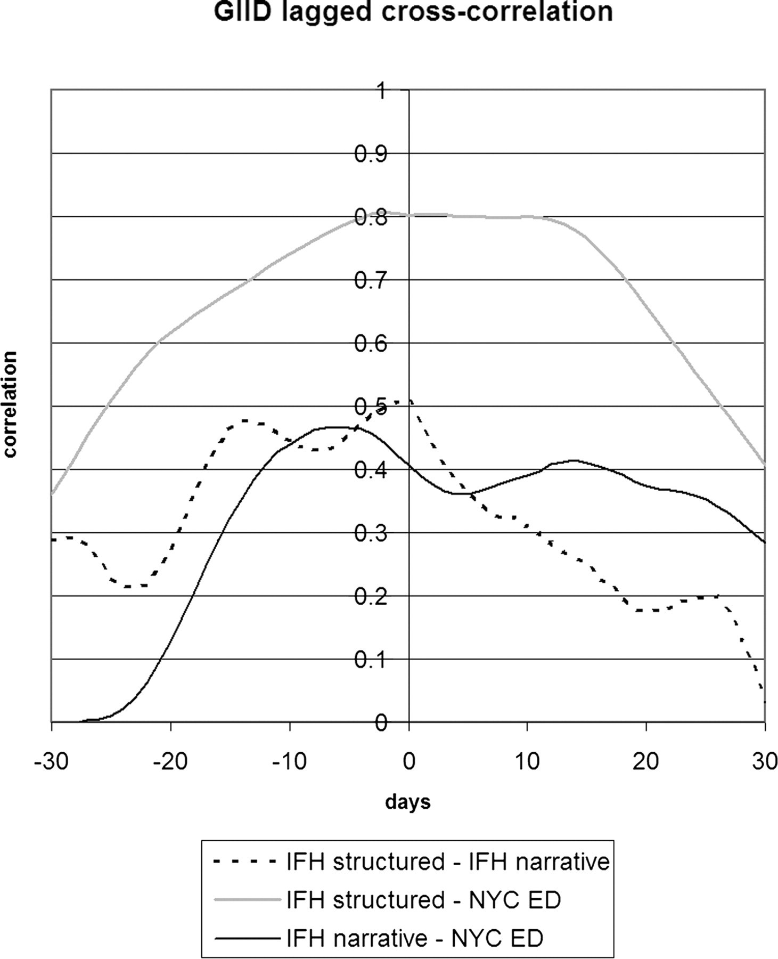
Figure 7 Lagged cross-correlation among the proportions of cases positive for gastrointestinal infectious disease for ...
Notes:
Figure 7 Lagged cross-correlation among the proportions of cases positive for gastrointestinal infectious disease for IFH structured data, IFH narrative data, and NYC DOHMH emergency department chief complaint data. A peak to the left of 0 days implies that the left entity in the figure legend preceded the entity on the right. IFH = Institute for Family Health; NYC = New York City; DOHMH = Department of Health and Mental Hygiene.
Unless provided in the caption above, the following copyright applies to the content of this slide: American Medical Informatics Association

Slide 5
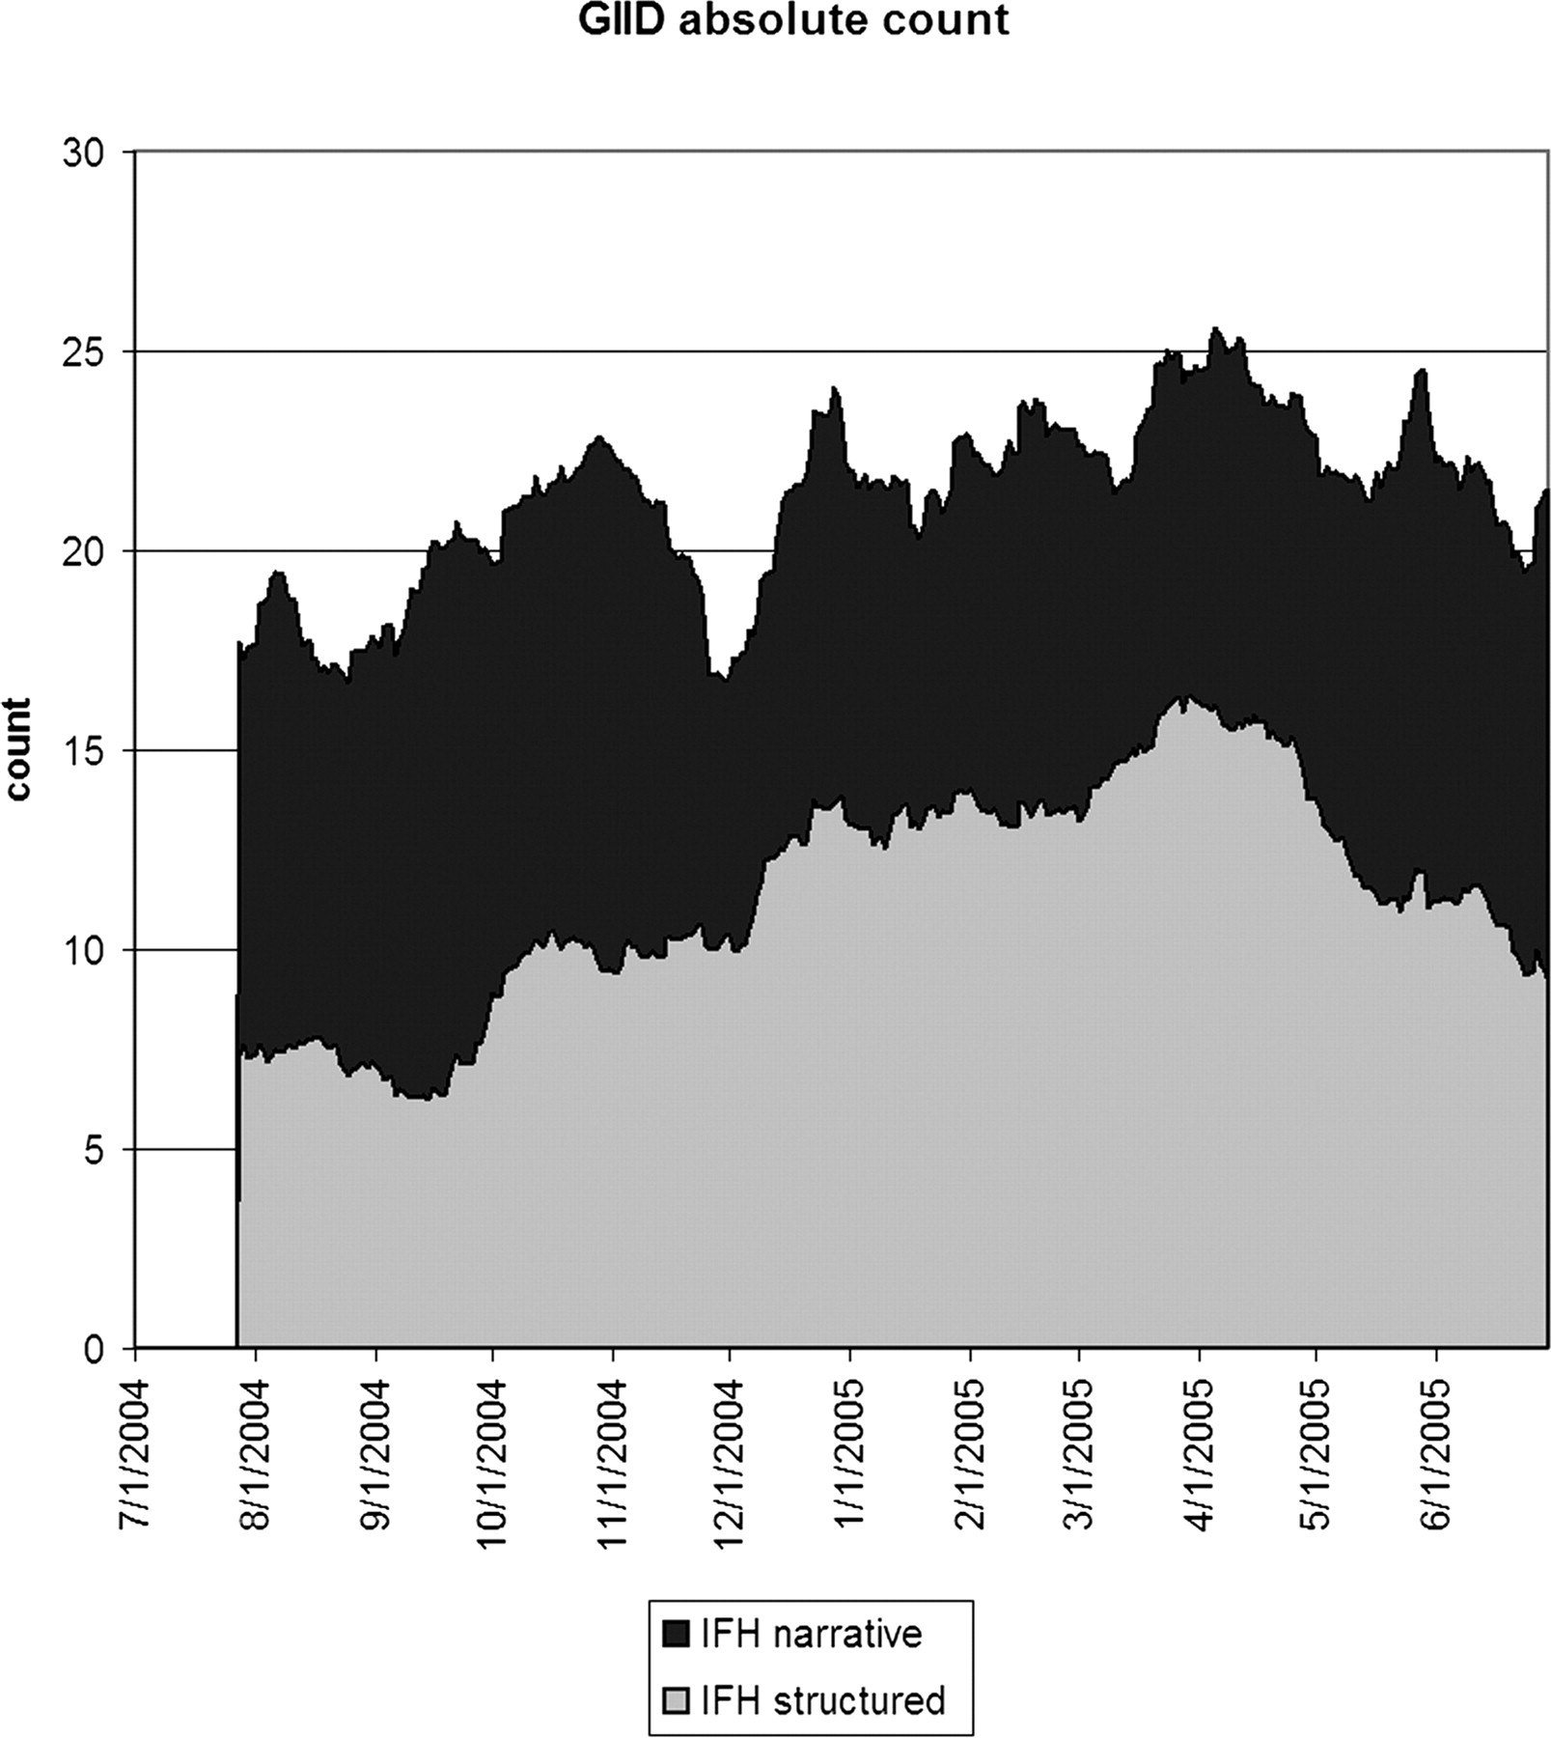
Figure 6 Twenty-eight-day running average of the absolute number of notes (IFH narrative) or visits (IFH structured) ...
Notes:
Figure 6 Twenty-eight-day running average of the absolute number of notes (IFH narrative) or visits (IFH structured) that were positive for gastrointestinal infectious disease. The narrative data appeared to have about ten more positive instances per day than the structured data. IFH = Institute for Family Health.
Unless provided in the caption above, the following copyright applies to the content of this slide: American Medical Informatics Association

Slide 6
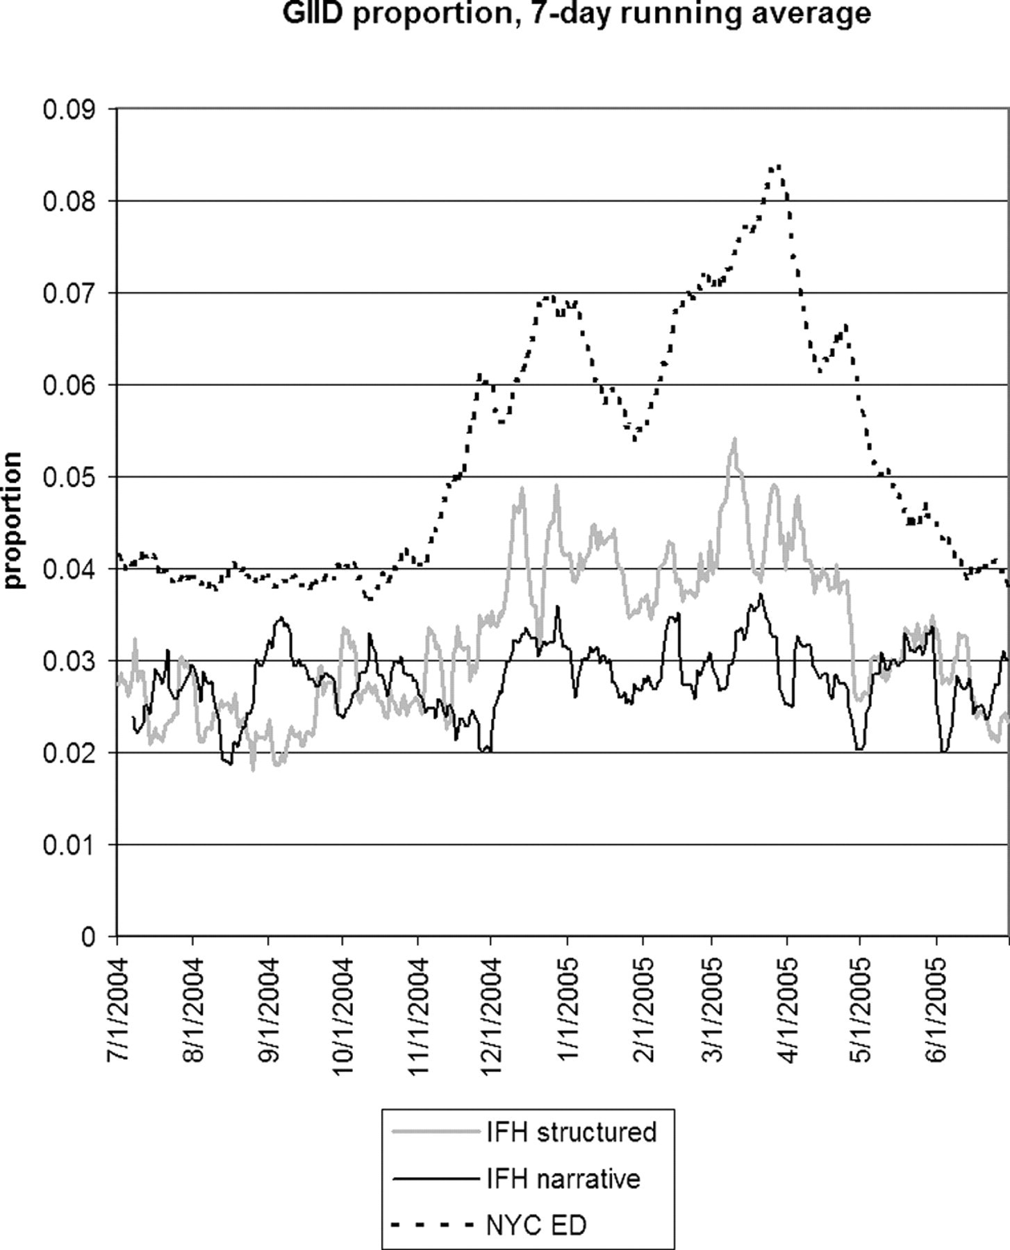
Figure 5 Seven-day running average of the proportion of visits (IFH structured data), proportion of notes (IFH ...
Notes:
Figure 5 Seven-day running average of the proportion of visits (IFH structured data), proportion of notes (IFH narrative data), and proportion of chief complaints (NYC emergency department data) that were positive for gastrointestinal infectious disease. IFH = Institute for Family Health; NYC = New York City.
Unless provided in the caption above, the following copyright applies to the content of this slide: American Medical Informatics Association

Slide 7
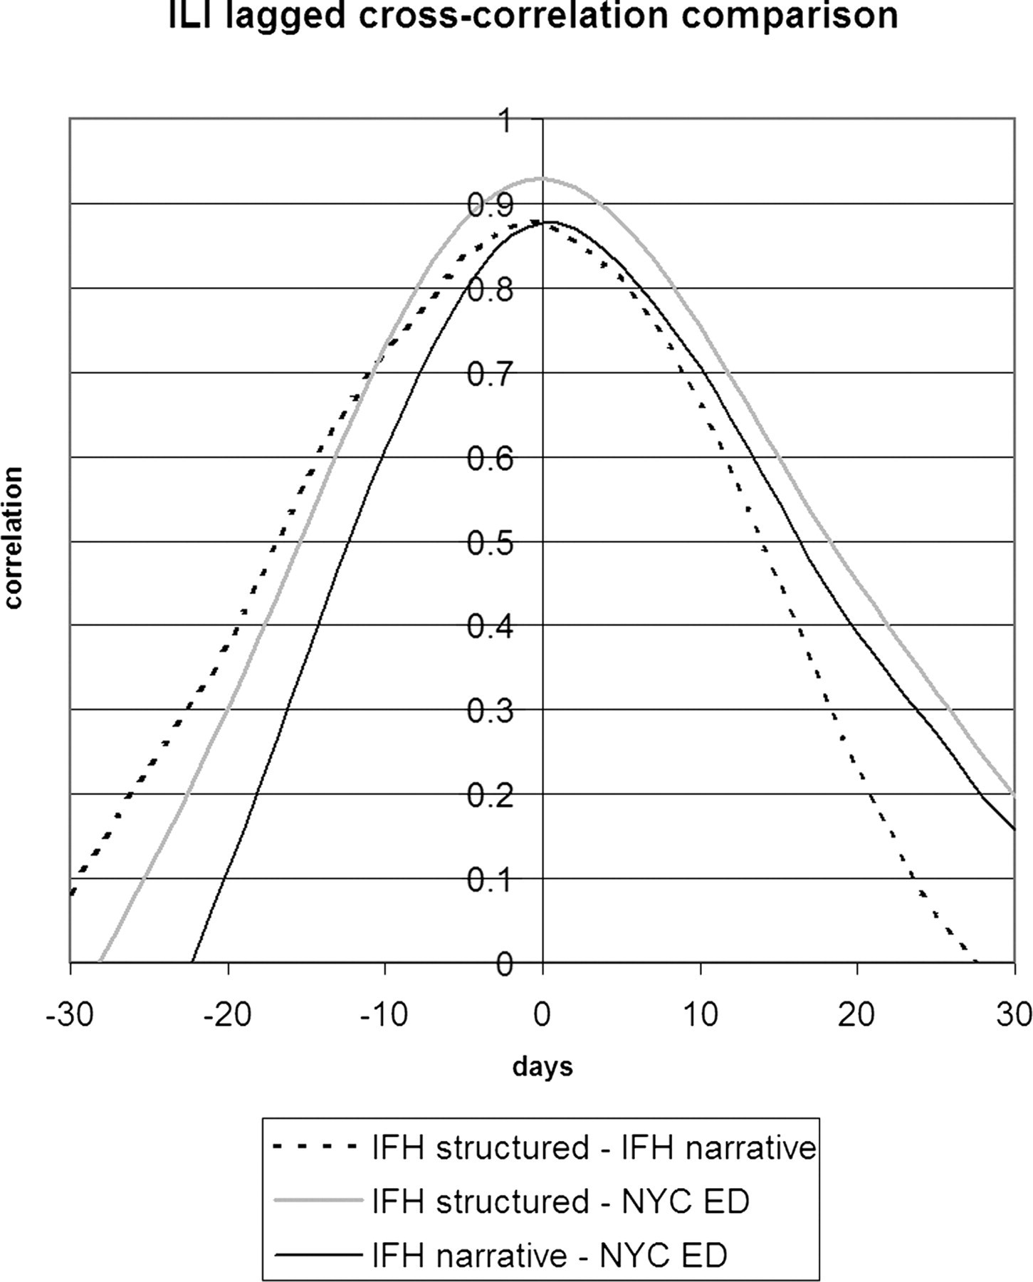
Figure 4 Lagged cross-correlation among the proportions of cases positive for influenza-like illness for IFH ...
Notes:
Figure 4 Lagged cross-correlation among the proportions of cases positive for influenza-like illness for IFH structured data, IFH narrative data, and NYC DOHMH emergency department chief complaint data. A peak to the left of 0 days implies that the left entity in the figure legend preceded the entity on the right. IFH = Institute for Family Health; NYC = New York City; DOHMH = Department of Health and Mental Hygiene.
Unless provided in the caption above, the following copyright applies to the content of this slide: American Medical Informatics Association

