Slide 1
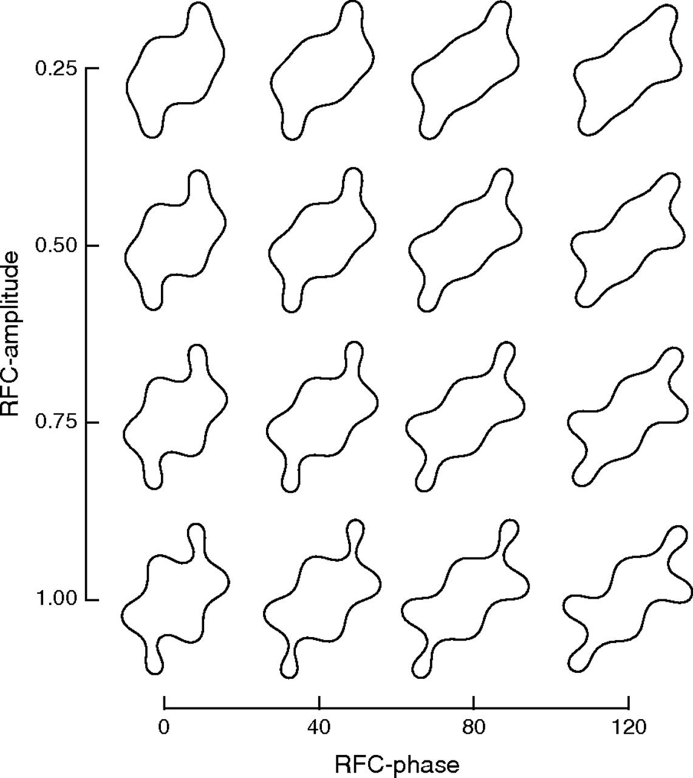
Figure 1. Stimuli. Sixteen unfilled, closed contours, constructed from RFCs. The amplitude and phase of frequency 6 was ...
Notes:
Figure 1. Stimuli. Sixteen unfilled, closed contours, constructed from RFCs. The amplitude and phase of frequency 6 was varied; the amplitude and phase of frequencies 2 and 4 were held constant at 0.50 radians and 0 degrees. All other frequency components were zero.
Unless provided in the caption above, the following copyright applies to the content of this slide: © The Author 2009. Published by Oxford University Press. All rights reserved. For permissions, please e-mail: journals.permissions@oxfordjournals.org

Slide 2
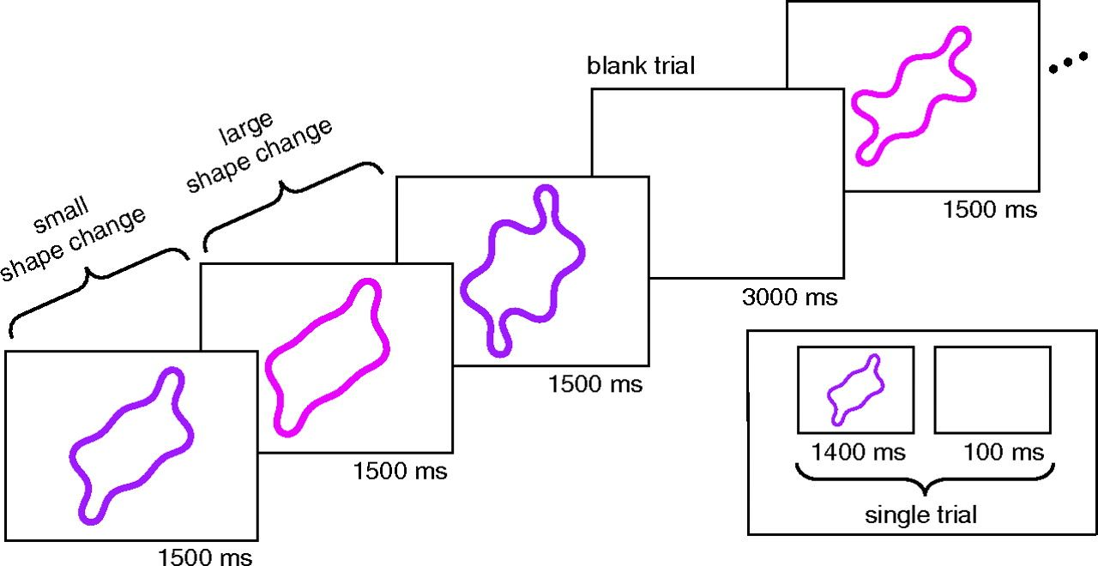
Figure 2. Stimulus presentation. A sequence of contours and blank trials were shown for 1400 ms each, separated by 100 ...
Notes:
Figure 2. Stimulus presentation. A sequence of contours and blank trials were shown for 1400 ms each, separated by 100 ms intertrial intervals. The stimulus on each trial was randomized to appear in either a red or purple hue on a gray background. The subject was instructed to indicate on each trial, by button press, the color of the stimulus.
Unless provided in the caption above, the following copyright applies to the content of this slide: © The Author 2009. Published by Oxford University Press. All rights reserved. For permissions, please e-mail: journals.permissions@oxfordjournals.org

Slide 3
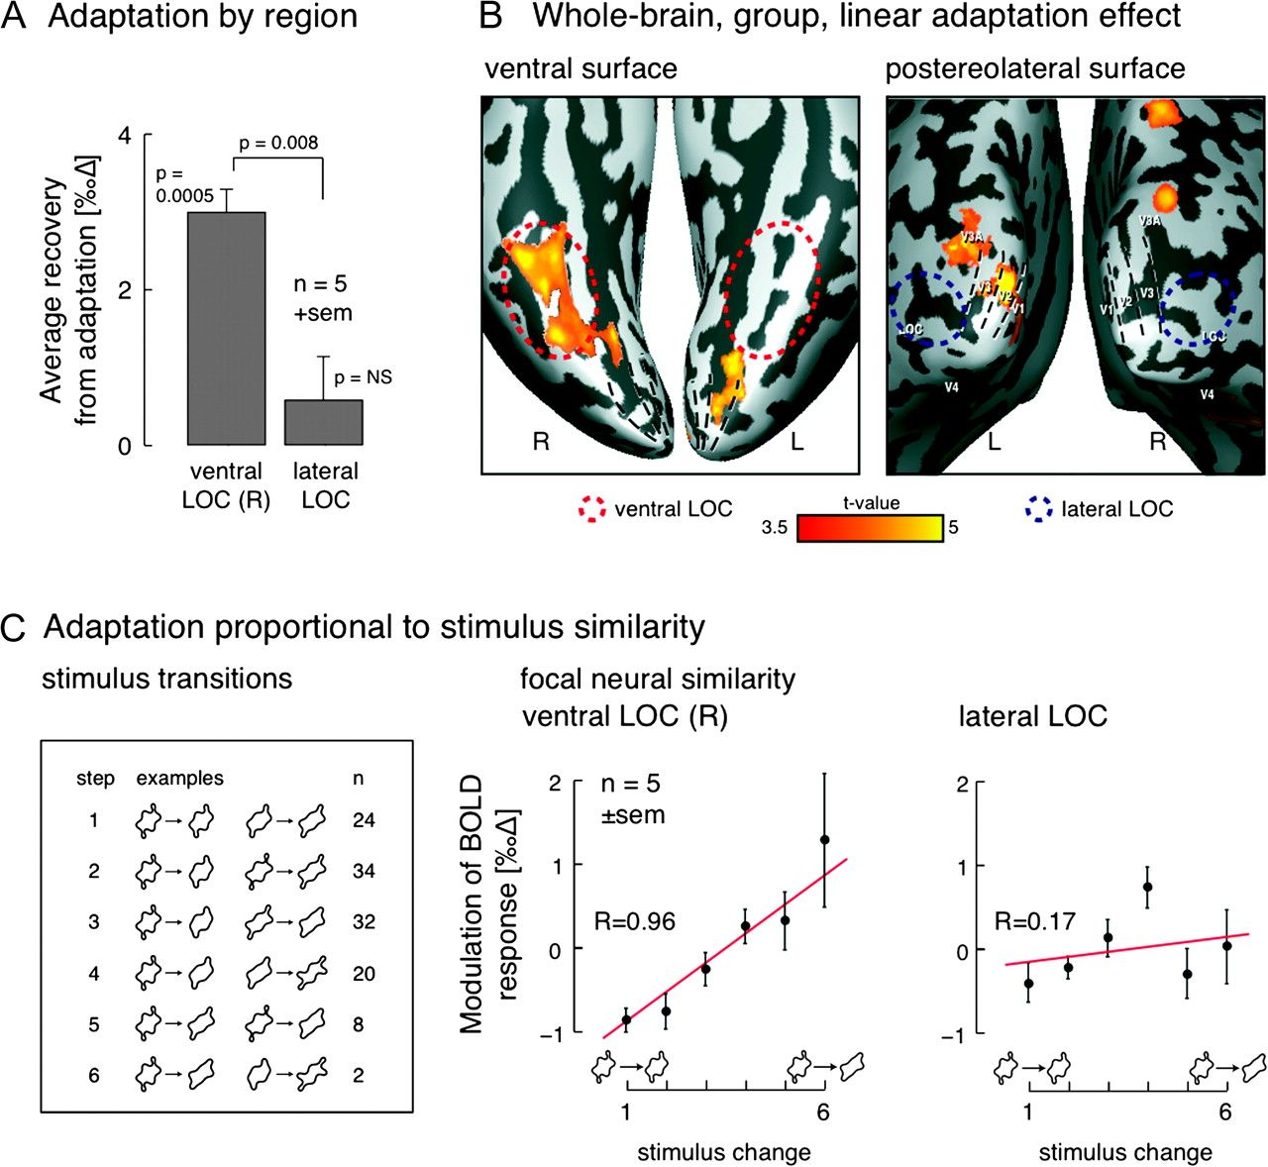
Figure 3. Focal pattern similarity. (A) The average across subjects of the amplitude of linear recovery from adaptation ...
Notes:
Figure 3. Focal pattern similarity. (A) The average across subjects of the amplitude of linear recovery from adaptation associated with stimulus transitions in ventral and lateral LOC. (B) Random-effects analysis of recovery from adaptation, linearly related to perceptual shape similarity. Warm colors indicate significant recovery from adaptation associated with stimulus change. (C) In a 4 by 4 configuration of stimuli, 6 (city block) step sizes are possible. In ventral but not lateral LOC, increasing step sizes are associated with increasing BOLD response (zero on the y-axis corresponds to the average response across all stimulus transitions). Greater error in higher step sizes is due to fewer possible exemplars of those changes. Error bars reflect variability across subjects. The R value of the best linear fit is given for each region.
Unless provided in the caption above, the following copyright applies to the content of this slide: © The Author 2009. Published by Oxford University Press. All rights reserved. For permissions, please e-mail: journals.permissions@oxfordjournals.org

Slide 4
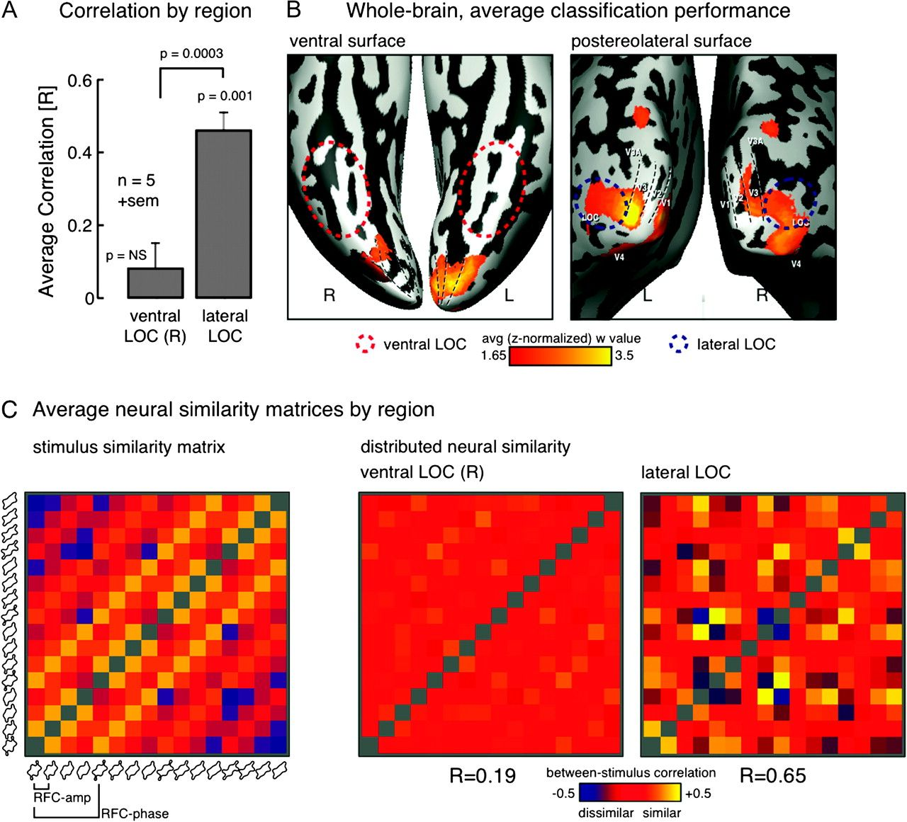
Figure 4. Distributed pattern similarity. (A) The average across subjects of the correlation of the distributed neural ...
Notes:
Figure 4. Distributed pattern similarity. (A) The average across subjects of the correlation of the distributed neural similarity matrix with the stimulus similarity matrix is shown. The distributed pattern within lateral LOC was significantly more correlated than in ventral LOC. (B) Average w-map indicating the amount of variation (informativeness) in each voxel's activity due to change in stimulus. The map from each subject was z-transformed across voxels, spatially smoothed, and then the average across subjects obtained. (C) Shown are stimulus and neural similarity matrices. The color of each cell reflects how similar a given pair of stimuli are as measured by behavioral responses (left) or distributed neural codes (right). The diagonal of the matrix is undefined for identical pairs of stimuli. Shown below the 2 neural similarity matrices is the correlation of the entire neural matrix with the stimulus similarity matrix. Ventral LOC carries little information about similarity in the distributed pattern and is therefore weakly correlated with the perceptual matrix. By contrast, in lateral LOC, the similarity of the distributed patterns associated with each stimulus pair is strongly and linearly related to their perceptual similarity, yielding strong correlation with the perceptual matrix. The diagonal symmetry of the matrices is enforced by the nature of their construction.
Unless provided in the caption above, the following copyright applies to the content of this slide: © The Author 2009. Published by Oxford University Press. All rights reserved. For permissions, please e-mail: journals.permissions@oxfordjournals.org

Slide 5
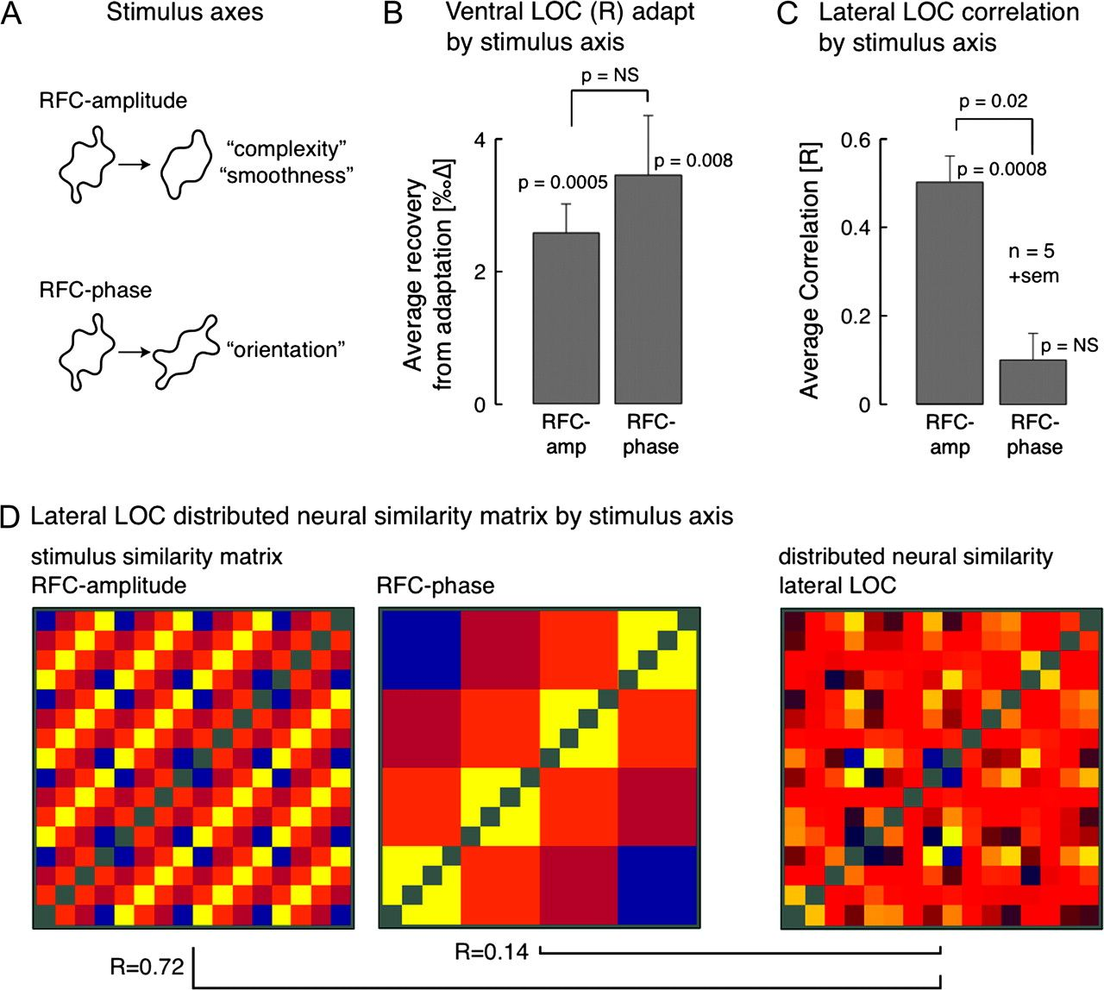
Figure 5. Similarity by stimulus axis. (A) The studied shapes were defined along 2 axes. Variations in RFC-amplitude ...
Notes:
Figure 5. Similarity by stimulus axis. (A) The studied shapes were defined along 2 axes. Variations in RFC-amplitude were perceived as changes in complexity or smoothness; variations in RFC-phase were perceived as changes in orientation (Cortese and Dyre 1996). (B) RFC-amplitude and RFC-phase are equally responsible for the adaptation effect in ventral LOC. (C) In lateral LOC, RFC-amplitude is primarily responsible for the distributed pattern. (D) The stimulus similarity matrix can be decomposed into the portion of similarity measured along the RFC-amplitude axis and the RFC-phase axis. The sum of the 2 stimulus similarity matrices shown on the left is equal to the complete stimulus similarity matrix shown in Figure 4C. The stimulus RFC-amplitude matrix is highly correlated with distributed neural similarity in lateral LOC, whereas there is only a weak relationship with RFC-phase.
Unless provided in the caption above, the following copyright applies to the content of this slide: © The Author 2009. Published by Oxford University Press. All rights reserved. For permissions, please e-mail: journals.permissions@oxfordjournals.org

Slide 6
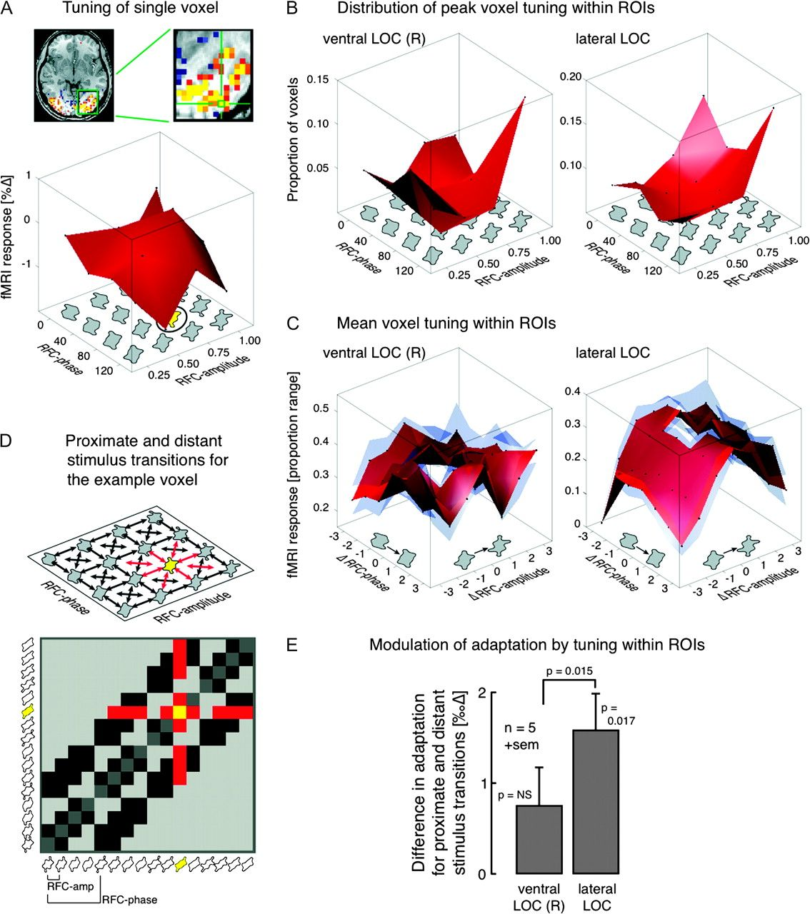
Figure 6. Voxel tuning and proximate versus distant adaptation. (A) The average BOLD fMRI response in a single voxel ...
Notes:
Figure 6. Voxel tuning and proximate versus distant adaptation. (A) The average BOLD fMRI response in a single voxel (shown inset) to each of the 16 stimuli. Data points are indicated by black dots and connected by a red surface. The shape that elicited the largest response is indicated in yellow. (B) The proportion of voxels within each ROI that responded maximally to each of the 16 different shapes. (C) The average response of voxels to stimuli that differ from the stimulus that elicited the largest response, expressed as a proportion of the range of response. Black data points and the red surface are the average across subjects, and the transparent blue surfaces are ±standard error of the mean across subjects. The x-axis and y-axis are expressed in units of steps along the stimulus axes away from the maximum stimulus. The central value is omitted and had an obligatory value of unity. (D) For the response profile shown in panel (A), the stimulus indicated in yellow elicited the maximum response on average across all presentations. We might consider that the neural adaptation associated with small stimulus transitions that involve this stimulus (red) will differ from that measured for stimulus transitions that do not include this stimulus (black). The top figure illustrates these different transitions in the stimulus space, whereas the bottom figure shows the transitions in the context of a similarity matrix. (E) The neural adaptation associated with small stimulus transitions was measured in the lateral and ventral LOC. Shown is the across subject average difference in adaptation between transitions that were proximate to, or distant from (red and black in panel D, respectively), the center of tuning for each voxel.
Unless provided in the caption above, the following copyright applies to the content of this slide: © The Author 2009. Published by Oxford University Press. All rights reserved. For permissions, please e-mail: journals.permissions@oxfordjournals.org

