Slide 1
Figure 1. Tested models of basal ganglia function in top–down attention. Three alternative models of basal ganglia (BG) ...
Notes:
Figure 1. Tested models of basal ganglia function in top–down attention. Three alternative models of basal ganglia (BG) function were tested. BG activity could 1) increase connectivity between the prefrontal cortex (PFC) and the attended hemifield, 2) decrease connectivity between the prefrontal cortex and the unattended hemifield, or 3) selectively gate prefrontal top–down signals through a combination of these mechanisms.
Unless provided in the caption above, the following copyright applies to the content of this slide: © The Author 2013. Published by Oxford University Press. All rights reserved. For Permissions, please e-mail: journals.permissions@oup.com

Slide 2
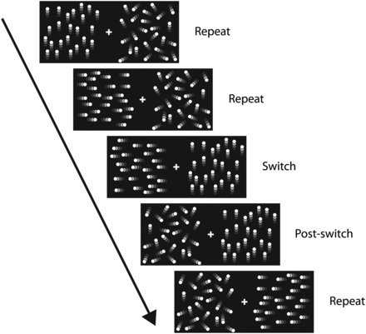
Figure 2. Attention-switching paradigm. Subjects were instructed to covertly attend to the left or right visual ...
Notes:
Figure 2. Attention-switching paradigm. Subjects were instructed to covertly attend to the left or right visual hemifield. On each trial (repeat trials), they had to discriminate the direction of a moving dot pattern at the attended side, while ignoring the unattended side (random noise). On switch trials, a moving dot pattern at the unattended side triggered a switch in attention. Subjects then continued performing the task at the opposite visual hemifield. Postswitch events (on which no response was required) were excluded from the analyses.
Unless provided in the caption above, the following copyright applies to the content of this slide: © The Author 2013. Published by Oxford University Press. All rights reserved. For Permissions, please e-mail: journals.permissions@oup.com

Slide 3
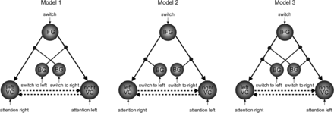
Figure 3. Tested dynamic causal models of BG function in top–down attention. All models included the right IFG, left ...
Notes:
Figure 3. Tested dynamic causal models of BG function in top–down attention. All models included the right IFG, left and right visual cortex nodes (VC) and BG. Note that the BG node was divided into 2 time series that included variance related to left-attended versus right-attended trials, respectively. Hence, the models do not test for left versus right BG function. Top–down connections from the IFG were modulated by BG activity during switch-to-left and switch-to-right trials. We tested 3 alternative models of BG function. BG activity could modulate fronto-posterior connectivity on the visual cortex contralateral (model 1) or ipsilateral (model 2) to the side attention was being switched to, or both (model 3). Model 1 assesses excitatory modulation of fronto-posterior connections to the visual hemisphere that processes the newly attended visual hemifield. Model 2 assesses inhibitory modulation of fronto-posterior connections to the visual hemisphere that processes the now unattended visual hemifield. Model 3 embodies both these effects. These 3 models of BG function were constructed with and without reciprocal connections between the left and right visual cortex (dashed lines). Thus, the final model space included 6 models.
Unless provided in the caption above, the following copyright applies to the content of this slide: © The Author 2013. Published by Oxford University Press. All rights reserved. For Permissions, please e-mail: journals.permissions@oup.com

Slide 4
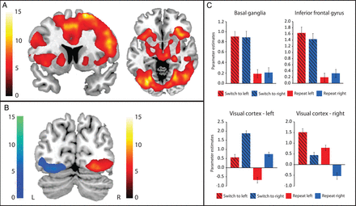
Figure 4. Univariate fMRI results (A) Main effect on BOLD signal for the attention-switching contrast (switch trials ...
Notes:
Figure 4. Univariate fMRI results (A) Main effect on BOLD signal for the attention-switching contrast (switch trials vs. repeat trials). (B) Switching to the left visual hemifield compared with switching to the right visual hemifield increased BOLD signal in the right visual cortex (red). The opposite contrast showed increased BOLD signal in the left visual cortex (blue). Bars indicate t-values, and maps are thresholded for a t-value of 3.68, corresponding to a P-value of 0.001 uncorrected for multiple comparisons. Maps were superimposed on a skull-stripped template in MNI space and displayed using MRIcroN (Rorden et al. 2007). (C) Graphs show the pattern of activation for the 4 different trial types in the BG, IFG, and the left and right visual cortex. Plotted data were extracted from the peak voxels from the contrast of interest, as described in the subsection “time series extraction” in the Materials and Methods section.
Unless provided in the caption above, the following copyright applies to the content of this slide: © The Author 2013. Published by Oxford University Press. All rights reserved. For Permissions, please e-mail: journals.permissions@oup.com

Slide 5
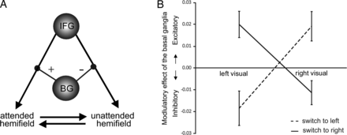
Figure 5. Results from Bayesian model averaging. (A) The average model showed that the BG both suppress previously ...
Notes:
Figure 5. Results from Bayesian model averaging. (A) The average model showed that the BG both suppress previously attended visual information and enhance the newly attended visual information, via modulation of frontal top–down connections. (B) In line with this model, the BG inhibited connection strength with the left visual cortex when subjects switched attention to the left visual hemifield, but enhanced connection strength with the left visual cortex when subjects switched attention to the right visual hemifield. The opposite pattern was observed in the right visual cortex.
Unless provided in the caption above, the following copyright applies to the content of this slide: © The Author 2013. Published by Oxford University Press. All rights reserved. For Permissions, please e-mail: journals.permissions@oup.com

