Slide 1
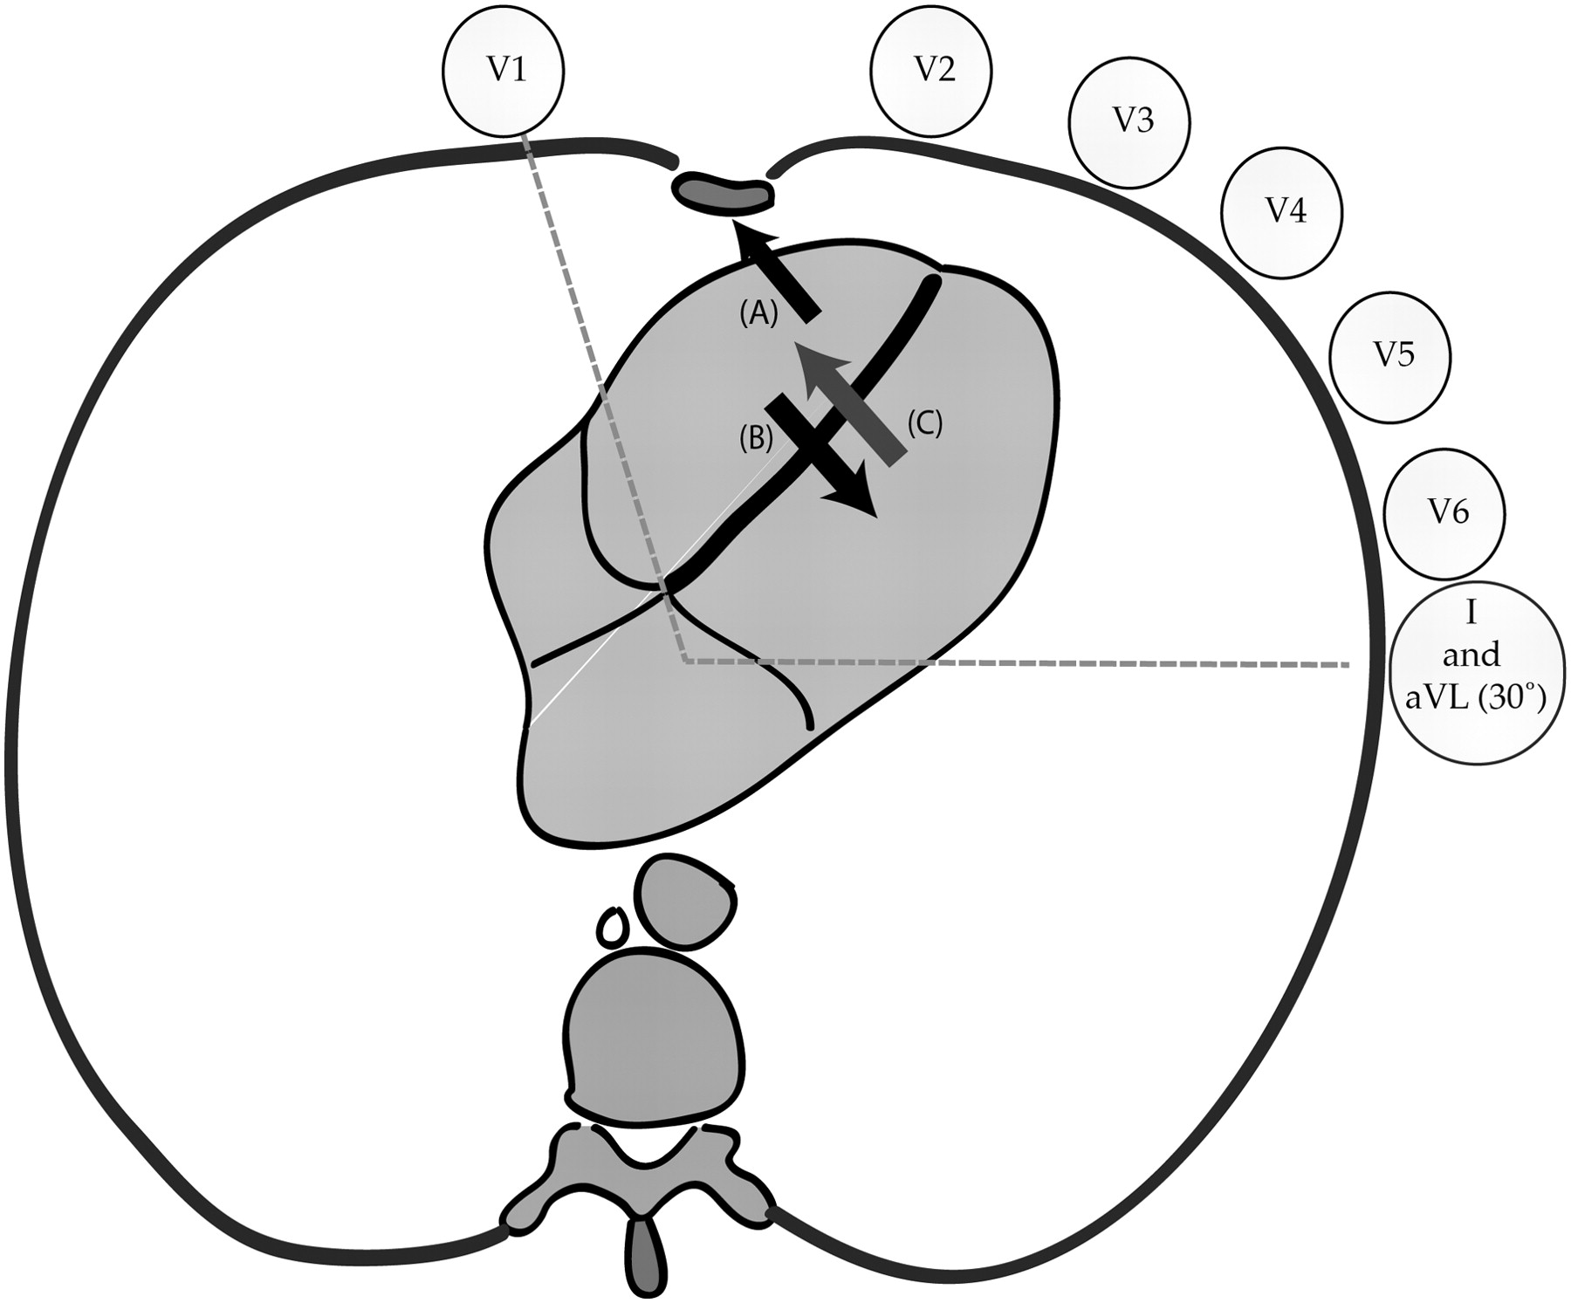
Figure 1 Hypothesized early ventricular activation in complete left bundle branch block and ‘left bundle branch block’ ...
Notes:
Figure 1 Hypothesized early ventricular activation in complete left bundle branch block and ‘left bundle branch block’ with residual left bundle conduction. Note that V1 is in close proximity and near perpendicular to the interventricular septum. Lead V6, I, and aVL are approximately in the same coronal plane but en face to different surfaces of the heart—V6 lower than I and aVL. In complete left bundle branch block the septum is activated from right to left (B) and opposed by endocardial to epicardial activation of the right ventricular free wall (A); this composite activation results in a q wave in V1 and/or an r wave <1 mm. When residual left-sided conduction remains, septal activation is left to right (C) and summed with right ventricular free wall activation (A) resulting in an r wave in V1 ≥1 mm.
Unless provided in the caption above, the following copyright applies to the content of this slide: Published on behalf of the European Society of Cardiology. All rights reserved. © The Author 2011. For permissions please email: journals.permissions@oup.com

Slide 2
Figure 2 Example tracings of complete left bundle branch block (cLBBB), left bundle branch block with residual left ...
Notes:
Figure 2 Example tracings of complete left bundle branch block (cLBBB), left bundle branch block with residual left bundle conduction (rLBBB), and intraventricular conduction delay (IVCD). Note in complete left bundle branch block, the absence of an r wave in V1 or q wave in I, V6 and aVL. Left bundle branch block with residual left bundle conduction displays an r wave in V1 >1 mm, and a small q wave in aVL. The diagnosis of intraventricular conduction delay is made by the presence of a q wave in lead V6; note also the small r wave in V1.
Unless provided in the caption above, the following copyright applies to the content of this slide: Published on behalf of the European Society of Cardiology. All rights reserved. © The Author 2011. For permissions please email: journals.permissions@oup.com

