Slide 1
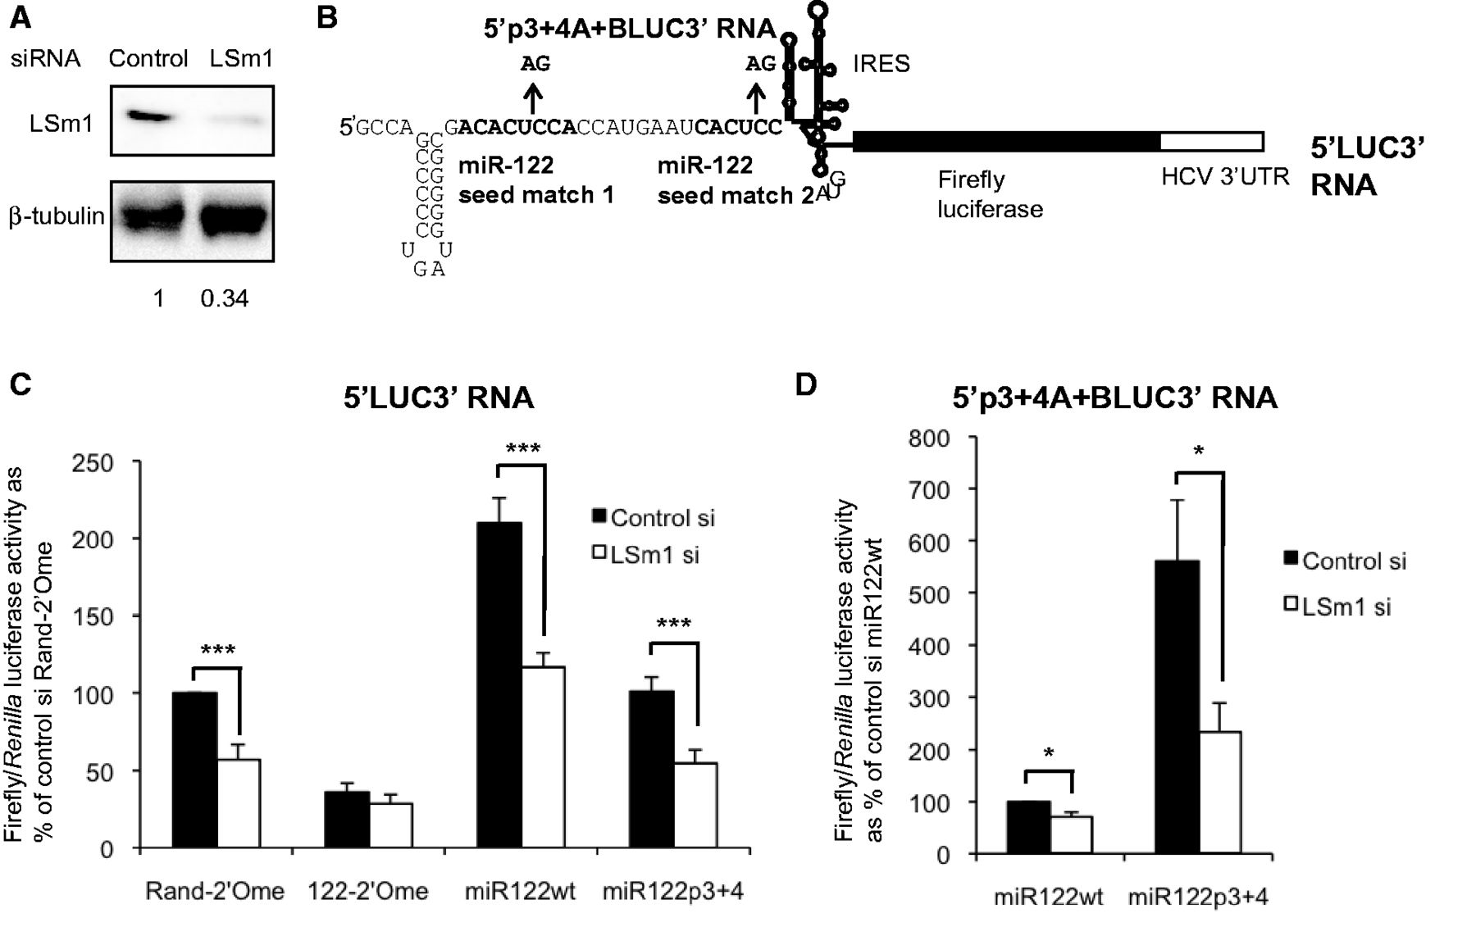
Figure 1. LSm1 contributes to miR-122 activation of HCV IRES-driven translation. (A) Western blot showing effective ...
Notes:
Figure 1. LSm1 contributes to miR-122 activation of HCV IRES-driven translation. (A) Western blot showing effective depletion of LSm1 by siRNA transfection in Huh7 cells. LSm1 level relative to β-tubulin is quantified below the image. (B) Schematic diagram of the 5′LUC3′ reporter RNA. The miR-122 seed matches in the HCV 5′UTR are mutated at positions 3 and 4 in 5′p3+4A+BLUC3′ RNA. (C) Following LSm1 depletion, Huh7 cells were transfected with 5′LUC3′ RNA and a capped polyadenylated Renilla luciferase transfection control, in combination with a randomized control 2′O-methylated oligonucleotide (Rand-2′Ome), a 2′O-methylated oligonucleotide that sequesters miR-122 (122-2′Ome), a wild-type miR-122 duplex (miR122wt) or a control duplex with two mutations in the miR-122 seed to abolish target binding (miR122p3+4). LSm1 depletion significantly reduced firefly/Renilla luciferase activity in the presence of endogenous miR-122 (Rand-2′Ome, miR122p3+4) or following miR-122 overexpression (miR122wt), but did not significantly affect luciferase production when miR-122 was inhibited (122-2′Ome). (D) As (C), except that 5′p3+4A+BLUC3′ RNA was used in place of 5′LUC3′ RNA. The RNA was delivered into cells with the miR122wt duplex, which does not bind to the mutant target sites, or miR122p3+4, which binds and activates translation. Basal luciferase activity in the presence of miR122wt decreased when LSm1 was depleted, but activation by miR122p3+4 decreased further. All data are the mean of at least three independent experiments, +SD. *P < 0.05, ***P < 0.0005.
Unless provided in the caption above, the following copyright applies to the content of this slide: © The Author(s) 2013. Published by Oxford University Press.This is an Open Access article distributed under the terms of the Creative Commons Attribution License (http://creativecommons.org/licenses/by/3.0/), which permits unrestricted reuse, distribution, and reproduction in any medium, provided the original work is properly cited.

Slide 2
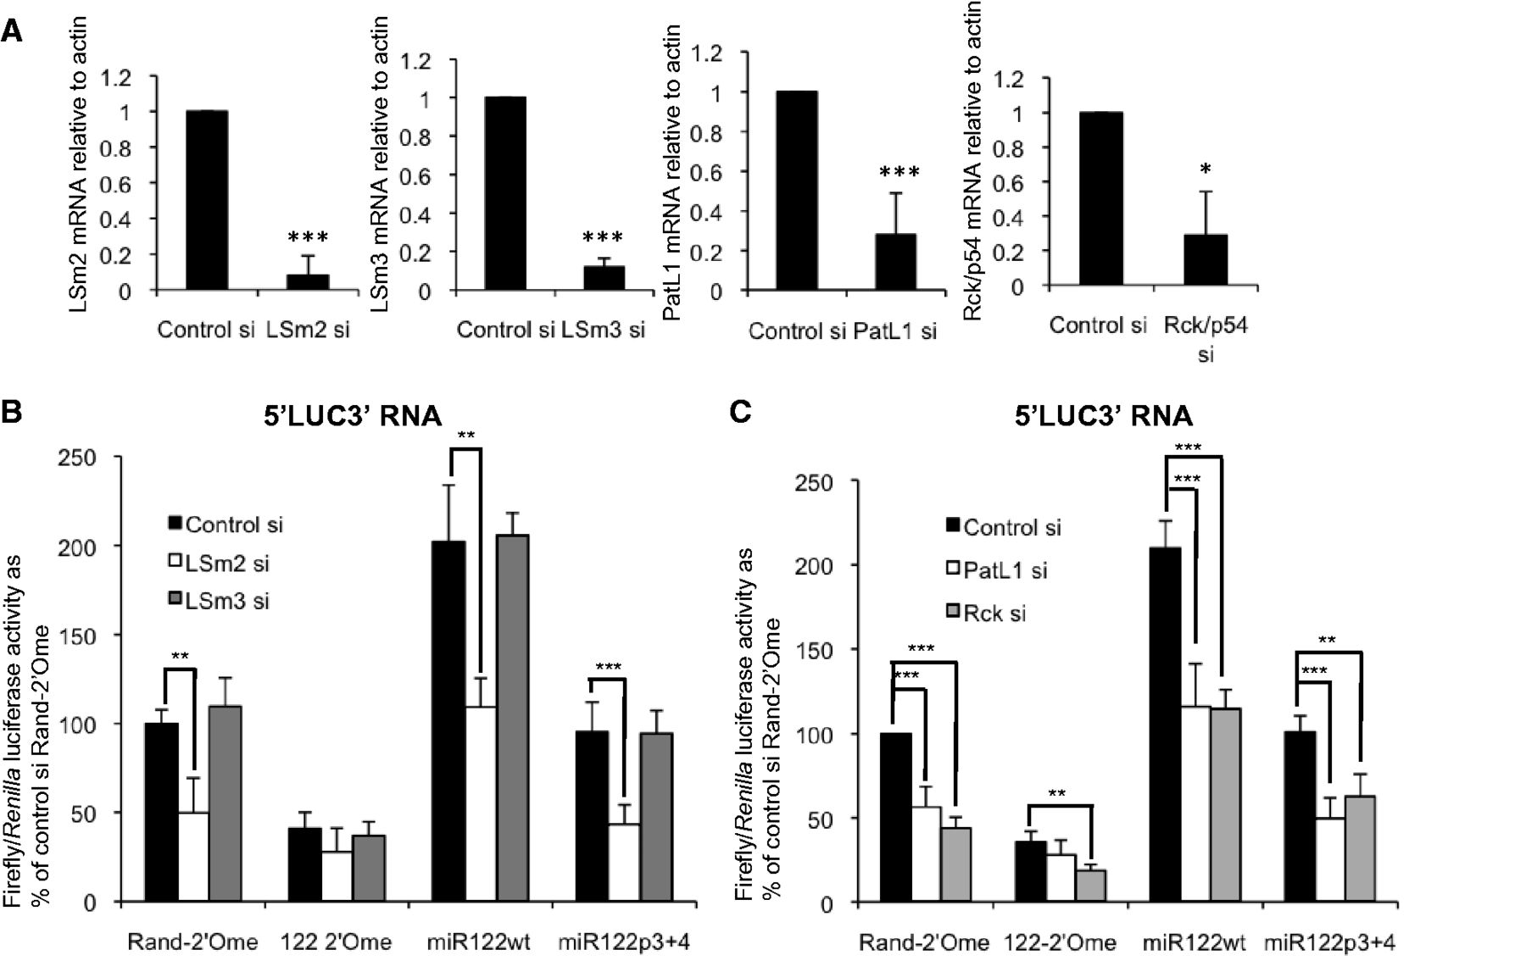
Figure 2. Different P body proteins make different contributions to miR-122–mediated activation of HCV IRES-driven ...
Notes:
Figure 2. Different P body proteins make different contributions to miR-122–mediated activation of HCV IRES-driven translation. (A) qPCR showing effective depletion of LSm2, LSm3, PatL1 and Rck/p54 by transfection of the respective siRNAs. Levels of each mRNA are shown relative to actin mRNA. (B) Huh7 cells treated with siRNAs to deplete LSm2 or 3 were transfected with 5′LUC3′ RNA and Rand-2′Ome or 122-2′Ome oligonucleotides, or miR122wt or miR122p3+4 duplexes. LSm2 depletion strongly reduced luciferase activity in the presence of endogenous (Rand-2′Ome, miR122p3+4) or overexpressed (miR122wt) miR-122, with less effect when miR-122 was inhibited (122-2′Ome), whereas LSm3 depletion did not affect reporter translation or its regulation by miR-122. Firefly luciferase activity is shown relative to a Renilla luciferase transfection control as a percentage of control siRNA+Rand-2′Ome. (C) As (B), except that Huh7 cells were treated with siRNAs to deplete PatL1 or Rck/p54. PatL1 depletion strongly reduced luciferase activity in the presence of endogenous (Rand-2′Ome, miR122p3+4) or overexpressed (miR122wt) miR-122, with less effect when miR-122 was inhibited (122-2′Ome). Rck/p54 knockdown repressed 5′LUC3′ translation to a similar extent irrespective of whether miR-122 was inhibited or overexpressed. All data are an average of at least three independent experiments, +SD. *P < 0.05, **P < 0.005, ***P < 0.0005.
Unless provided in the caption above, the following copyright applies to the content of this slide: © The Author(s) 2013. Published by Oxford University Press.This is an Open Access article distributed under the terms of the Creative Commons Attribution License (http://creativecommons.org/licenses/by/3.0/), which permits unrestricted reuse, distribution, and reproduction in any medium, provided the original work is properly cited.

Slide 3
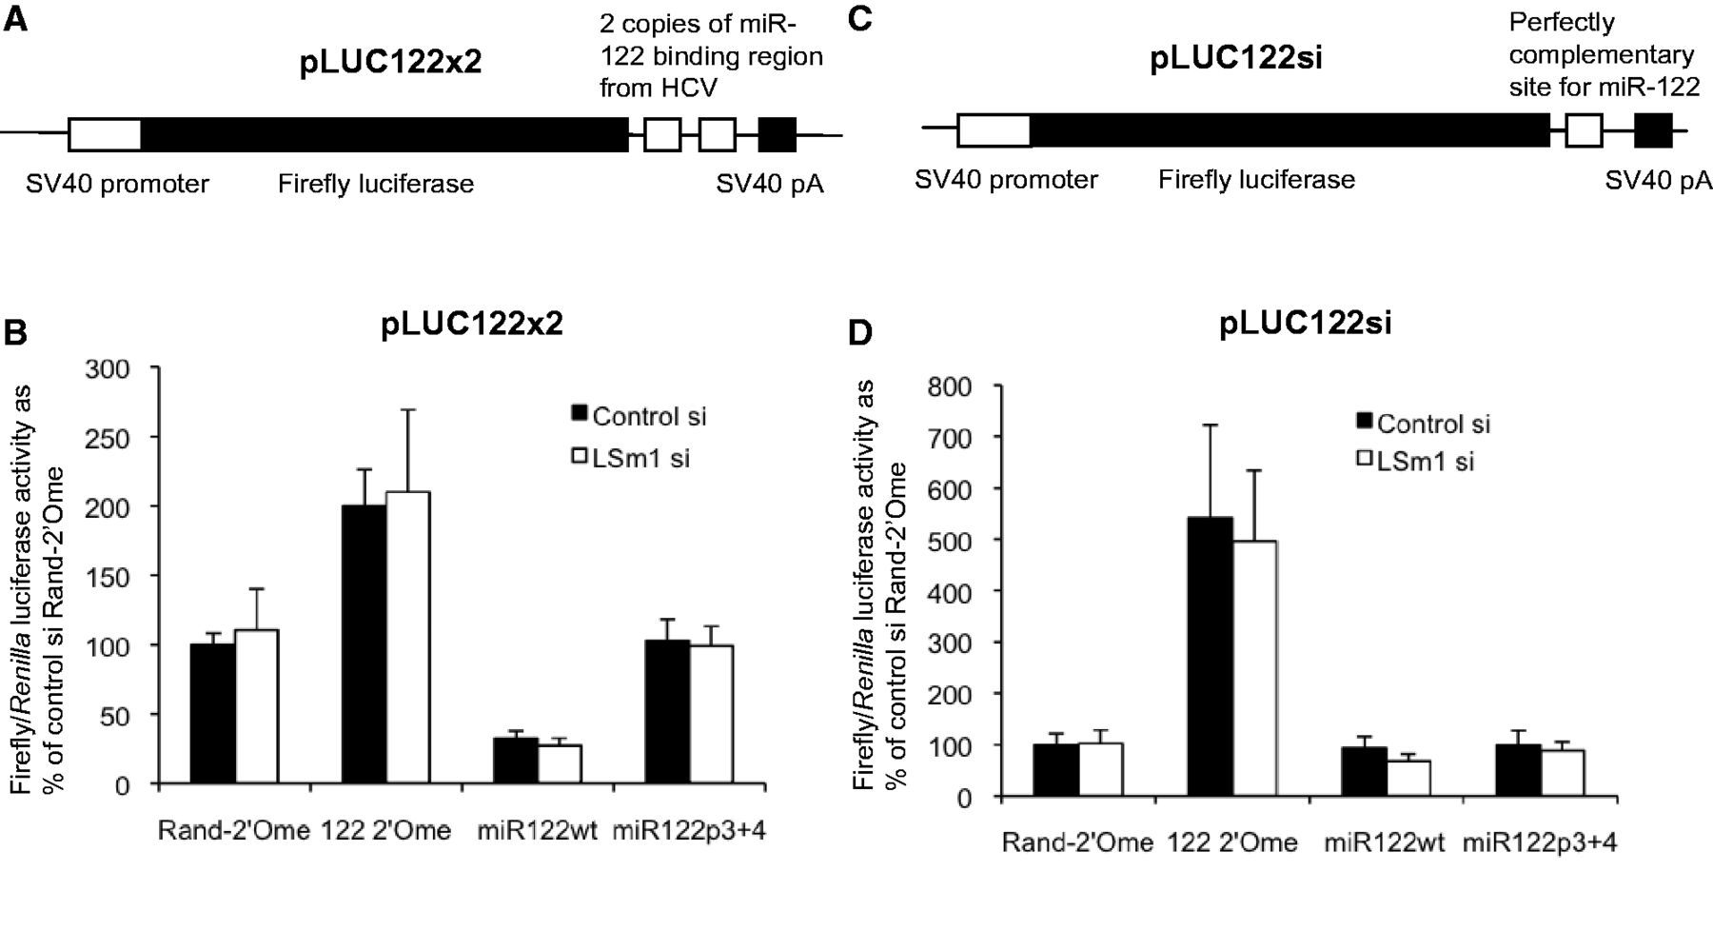
Figure 3. LSm1 does not affect miR-122–mediated repression via 3′UTR sites or RNA cleavage at a perfectly complementary ...
Notes:
Figure 3. LSm1 does not affect miR-122–mediated repression via 3′UTR sites or RNA cleavage at a perfectly complementary site. (A) The pLUC122x2 plasmid, containing two copies of the miR-122 binding region from HCV in the firefly luciferase 3′UTR. (B) Huh7 cells treated with control or LSm1 siRNA were transfected with pLUC122x2 together with Rand-2′Ome or 122-2′Ome oligonucleotides, or miR122wt or miR122p3+4 duplexes. The reduction in luciferase activity when miR-122 was overexpressed (miR122wt) or relief of inhibition when miR-122 was sequestered (122-2′Ome) were both unaffected by LSm1 depletion. (C) The pLUC122si plasmid, containing a single perfectly complementary site for miR-122 in the 3′UTR. (D) pLUC122si was introduced into cells as in (B). Relief of inhibition when miR-122 was sequestered (122-2′Ome) was unaffected by LSm1 depletion. All data are mean firefly luciferase activity relative to a Renilla luciferase transfection control in at least three independent experiments, +SD.
Unless provided in the caption above, the following copyright applies to the content of this slide: © The Author(s) 2013. Published by Oxford University Press.This is an Open Access article distributed under the terms of the Creative Commons Attribution License (http://creativecommons.org/licenses/by/3.0/), which permits unrestricted reuse, distribution, and reproduction in any medium, provided the original work is properly cited.

Slide 4
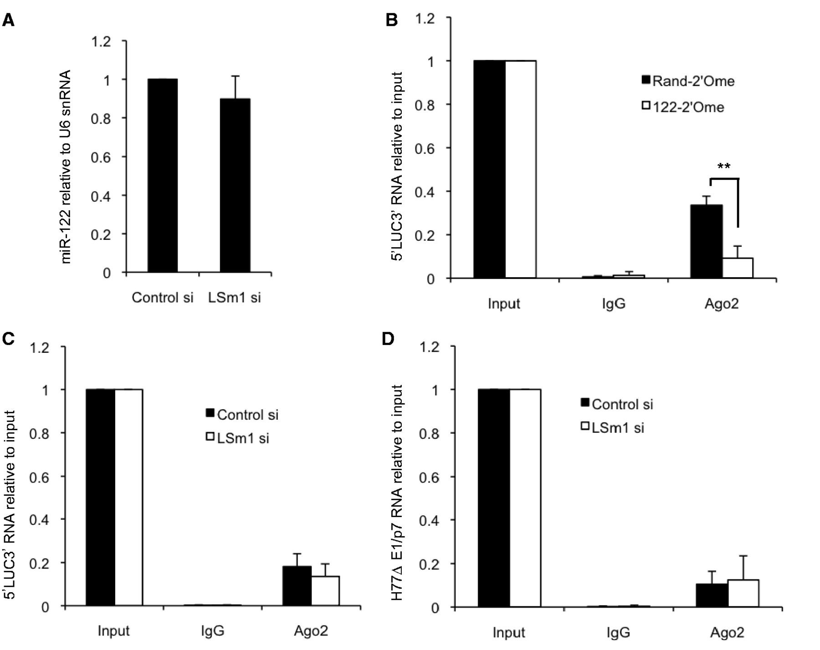
Figure 4. LSm1 does not affect miR-122-RISC association with the HCV 5′UTR. (A) miR-122 levels determined by qPCR ...
Notes:
Figure 4. LSm1 does not affect miR-122-RISC association with the HCV 5′UTR. (A) miR-122 levels determined by qPCR relative to U6 snRNA in Huh7 cells did not change significantly following LSm1 depletion. (B) Huh7 cells were treated with an antisense oligonucleotide to sequester miR-122 (122-2′Ome) or a randomized control (Rand-2′Ome) for 48 h before electroporation with 5′LUC3 RNA. Six hours after electroporation, cell lysates were immunoprecipitated with an anti-Ago2 monoclonal antibody or a normal rat IgG control. Immunoprecipitated RNA levels relative to input were determined by qPCR, and demonstrate that the association of Ago2 with 5′LUC3′ RNA is miR-122-dependent. (C) As (B), except that cells were treated with an siRNA specific to LSm1, or a control nontargeting siRNA, instead of the oligonucleotides in (B). LSm1 depletion did not significantly affect Ago2 association with 5′LUC3′ RNA. (D) As (C), except that cells were electroporated with H77ΔE1/p7 RNA instead of 5′LUC3′ RNA. All data represent an average of three independent experiments, +SD. **P < 0.005.
Unless provided in the caption above, the following copyright applies to the content of this slide: © The Author(s) 2013. Published by Oxford University Press.This is an Open Access article distributed under the terms of the Creative Commons Attribution License (http://creativecommons.org/licenses/by/3.0/), which permits unrestricted reuse, distribution, and reproduction in any medium, provided the original work is properly cited.

Slide 5
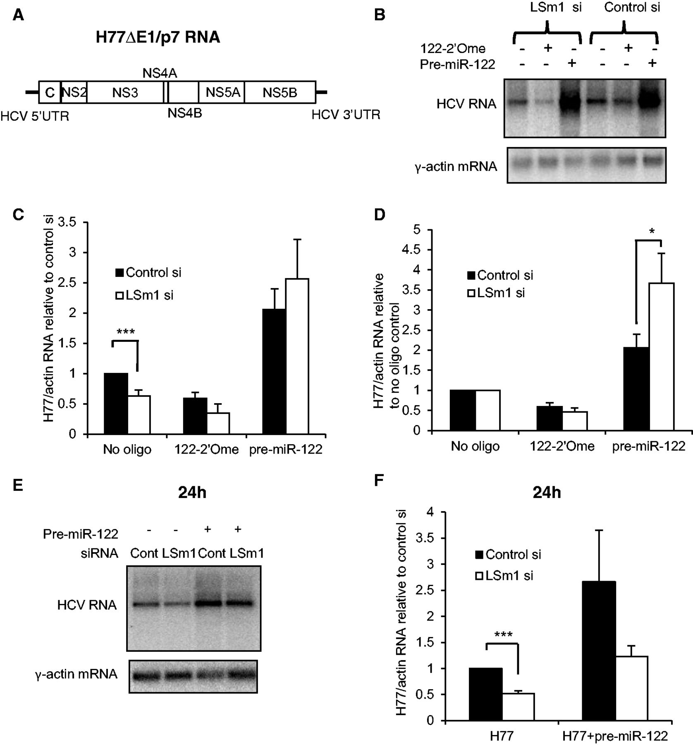
Figure 5. LSm1 is not required for endogenous or overexpressed miR-122 to regulate HCV replication. (A) Structure of ...
Notes:
Figure 5. LSm1 is not required for endogenous or overexpressed miR-122 to regulate HCV replication. (A) Structure of H77ΔE1/p7 RNA. (B) Huh7 cells were electroporated with H77ΔE1/p7 RNA, cultured for 24 h, then transfected with a control siRNA or an siRNA targeting LSm1, with or without cotransfection of 122-2′Ome or synthetic pre-miR-122. HCV and actin RNA were detected by northern blotting. (C) As (B), except that HCV RNA levels were determined relative to actin mRNA by qPCR. miR-122 overexpression overcame inhibition of HCV replication by LSm1 knockdown. (D) The data shown in (C) replotted relative to the no oligonucleotide control for each siRNA. (E) Following LSm1 depletion, Huh7 cells were electroporated with H77ΔE1/p7 RNA, with or without synthetic pre-miR-122. Total RNA was harvested at 24 h after electroporation and analyzed by northern blotting. Pre-miR-122 overexpression increased the level of HCV RNA in both control and LSm1 siRNA-transfected cells. (F) As (E), except that HCV RNA levels were determined relative to actin mRNA by qPCR. qPCR data represent an average of three independent experiments, +SD. *P < 0.05, ***P < 0.0005.
Unless provided in the caption above, the following copyright applies to the content of this slide: © The Author(s) 2013. Published by Oxford University Press.This is an Open Access article distributed under the terms of the Creative Commons Attribution License (http://creativecommons.org/licenses/by/3.0/), which permits unrestricted reuse, distribution, and reproduction in any medium, provided the original work is properly cited.

Slide 6
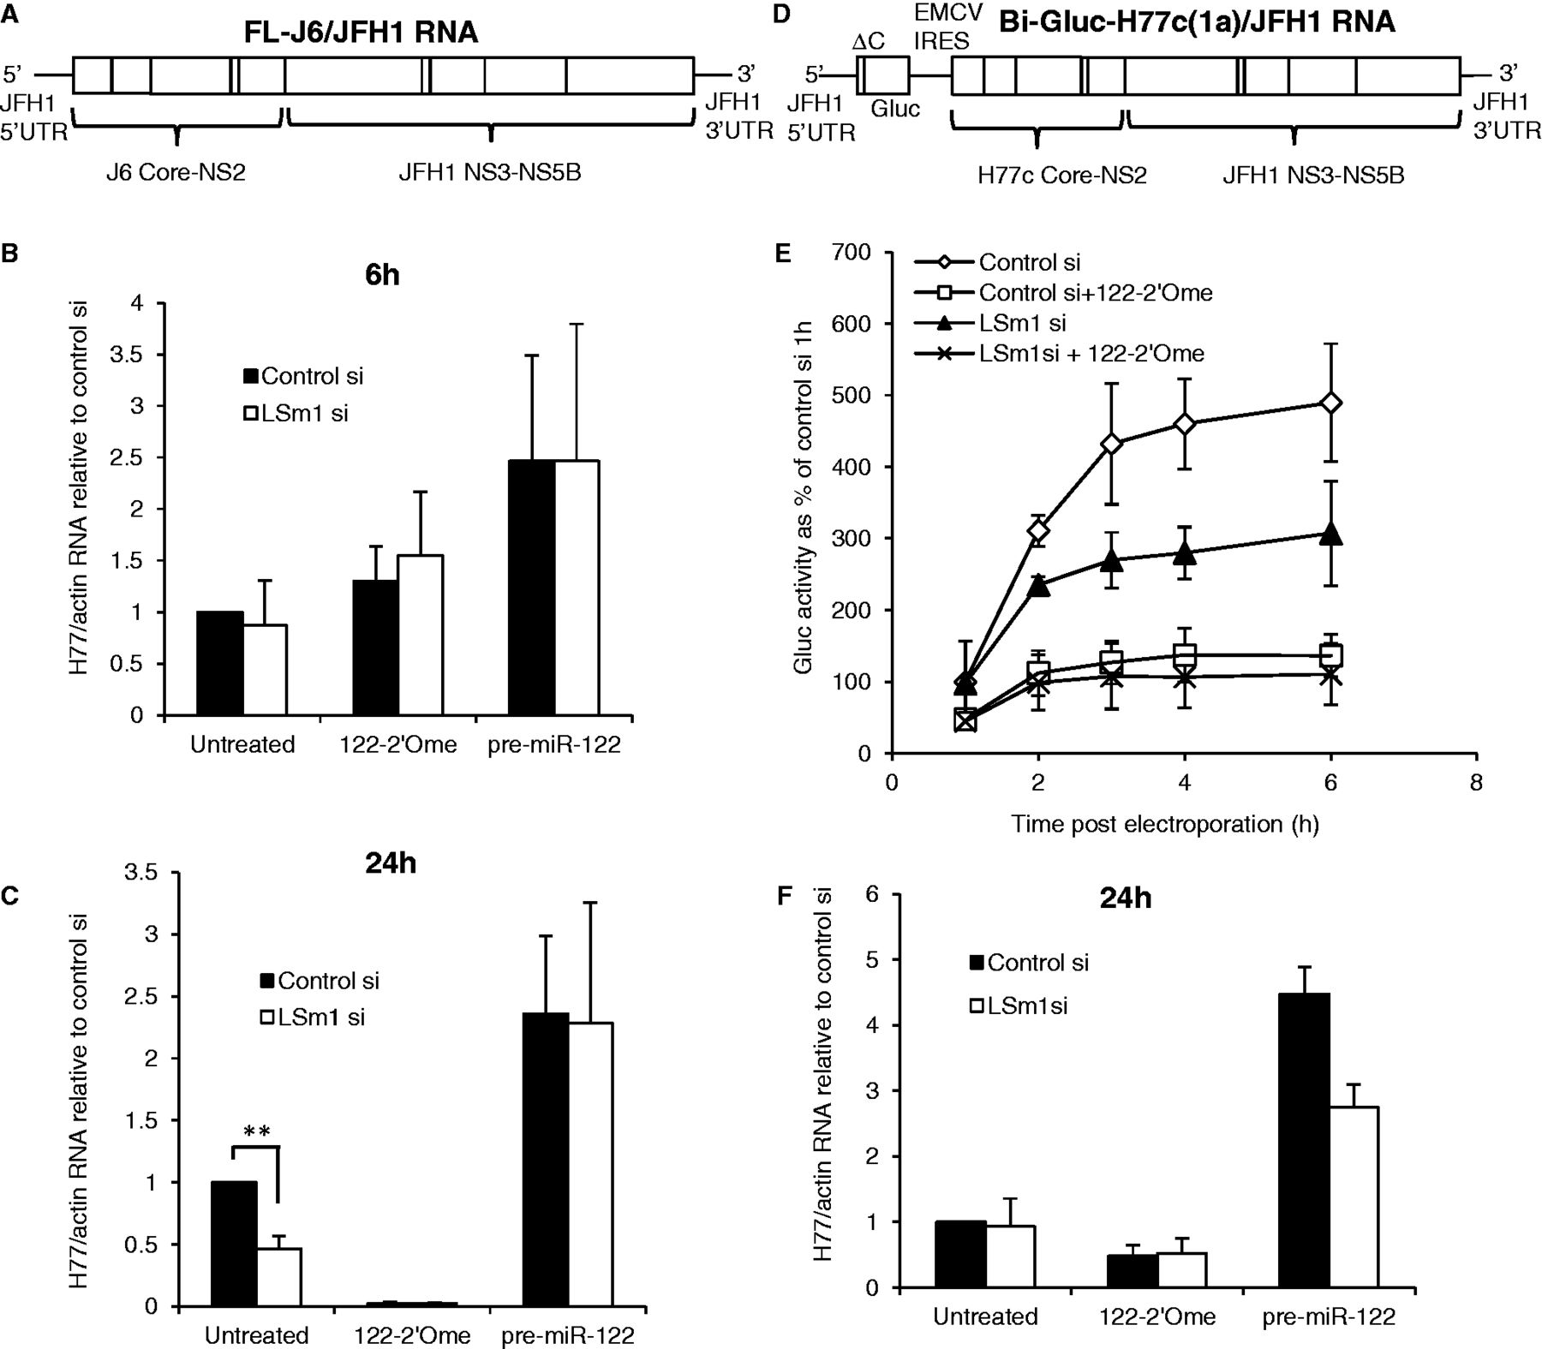
Figure 6. LSm1 contributes to miR-122–mediated regulation of infectious HCV translation. (A) Schematic diagram of the ...
Notes:
Figure 6. LSm1 contributes to miR-122–mediated regulation of infectious HCV translation. (A) Schematic diagram of the infectious FL-J6/JFH1 RNA. (B) Following treatment with an siRNA to deplete LSm1 or a nontargeting control, Huh7 cells were electroporated with FL-J6/JFH1 RNA with or without the 122-2′Ome oligonucleotide to sequester miR-122, or synthetic pre-miR-122. Total RNA was harvested at 6 h after electroporation and analyzed by qPCR. HCV RNA relative to actin mRNA was determined relative to control siRNA-treated cells without oligonucleotide. (C) As (B), except that RNA was harvested at 24 h after electroporation. Pre-miR-122 overexpression overcame the repressive effects of LSm1 depletion. (D) The Bi-Gluc-H77C(1a)/JFH1 infectious RNA, in which Gaussia luciferase translation is driven by the JFH1 5′UTR. (E) Huh7 cells with or without LSm1 depletion were electroporated with Bi-Gluc-H77C(1a)/JFH1 RNA, with or without 122-2′Ome to sequester miR-122. Cell supernatants harvested over a time course after electroporation were assayed for Gluc activity, which is shown as a percentage of the control siRNA 1 h value. miR-122 inhibition reduced translation to a similar extent with or without LSm1 depletion. (F) As (E), except that total RNA was extracted from the cells at 24 h after electroporation and analyzed by qPCR as in (B). LSm1 inhibited replication when pre-miR-122 was overexpressed. All data are an average of at least three independent experiments, +SD. **P < 0.005.
Unless provided in the caption above, the following copyright applies to the content of this slide: © The Author(s) 2013. Published by Oxford University Press.This is an Open Access article distributed under the terms of the Creative Commons Attribution License (http://creativecommons.org/licenses/by/3.0/), which permits unrestricted reuse, distribution, and reproduction in any medium, provided the original work is properly cited.

