Slide 1
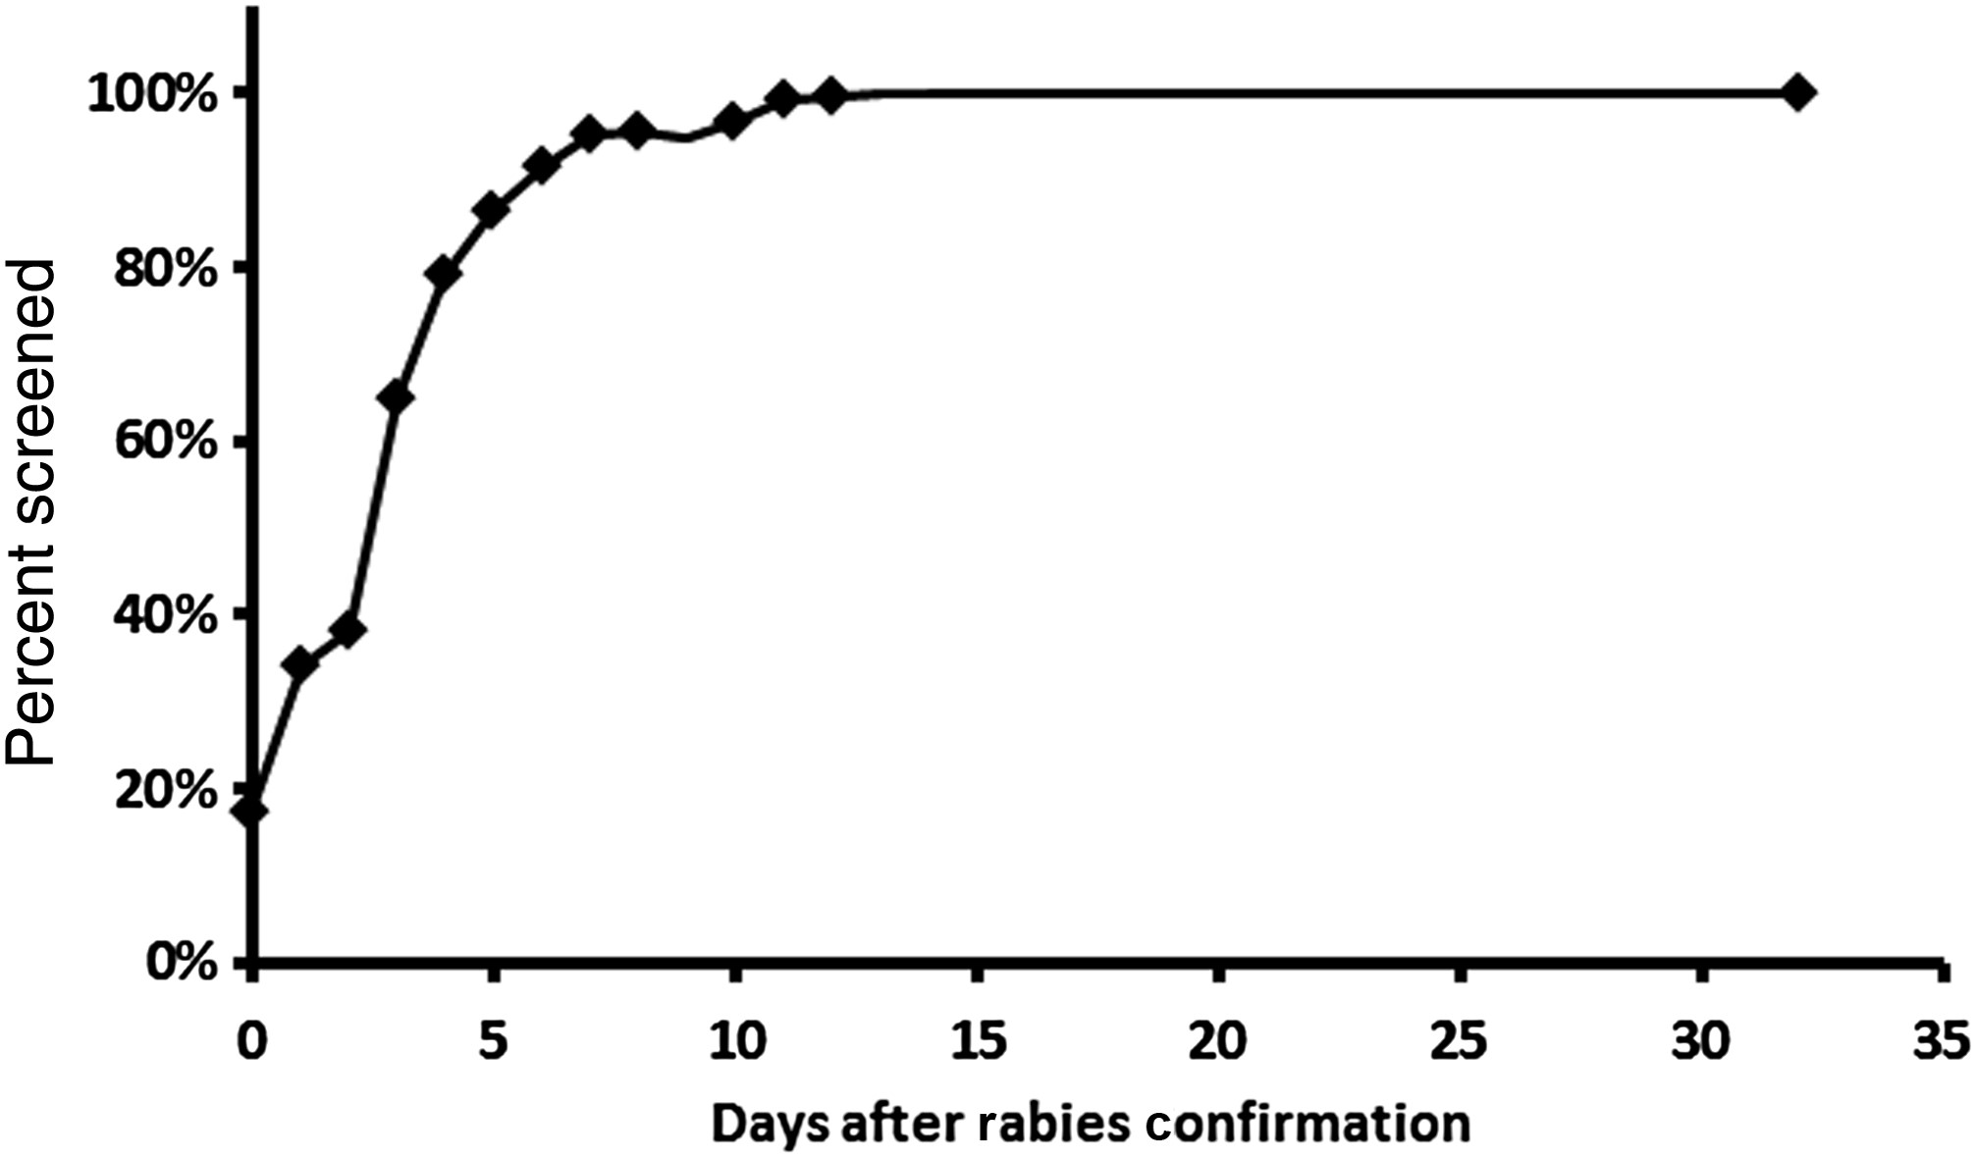
Figure 1. Time to completion of rabies risk screening for all exposed healthcare workers.
Notes:
Figure 1. Time to completion of rabies risk screening for all exposed healthcare workers.
Unless provided in the caption above, the following copyright applies to the content of this slide: Published by Oxford University Press on behalf of the Infectious Diseases Society of America 2014. This work is written by (a) US Government employee(s) and is in the public domain in the US

