Slide 1
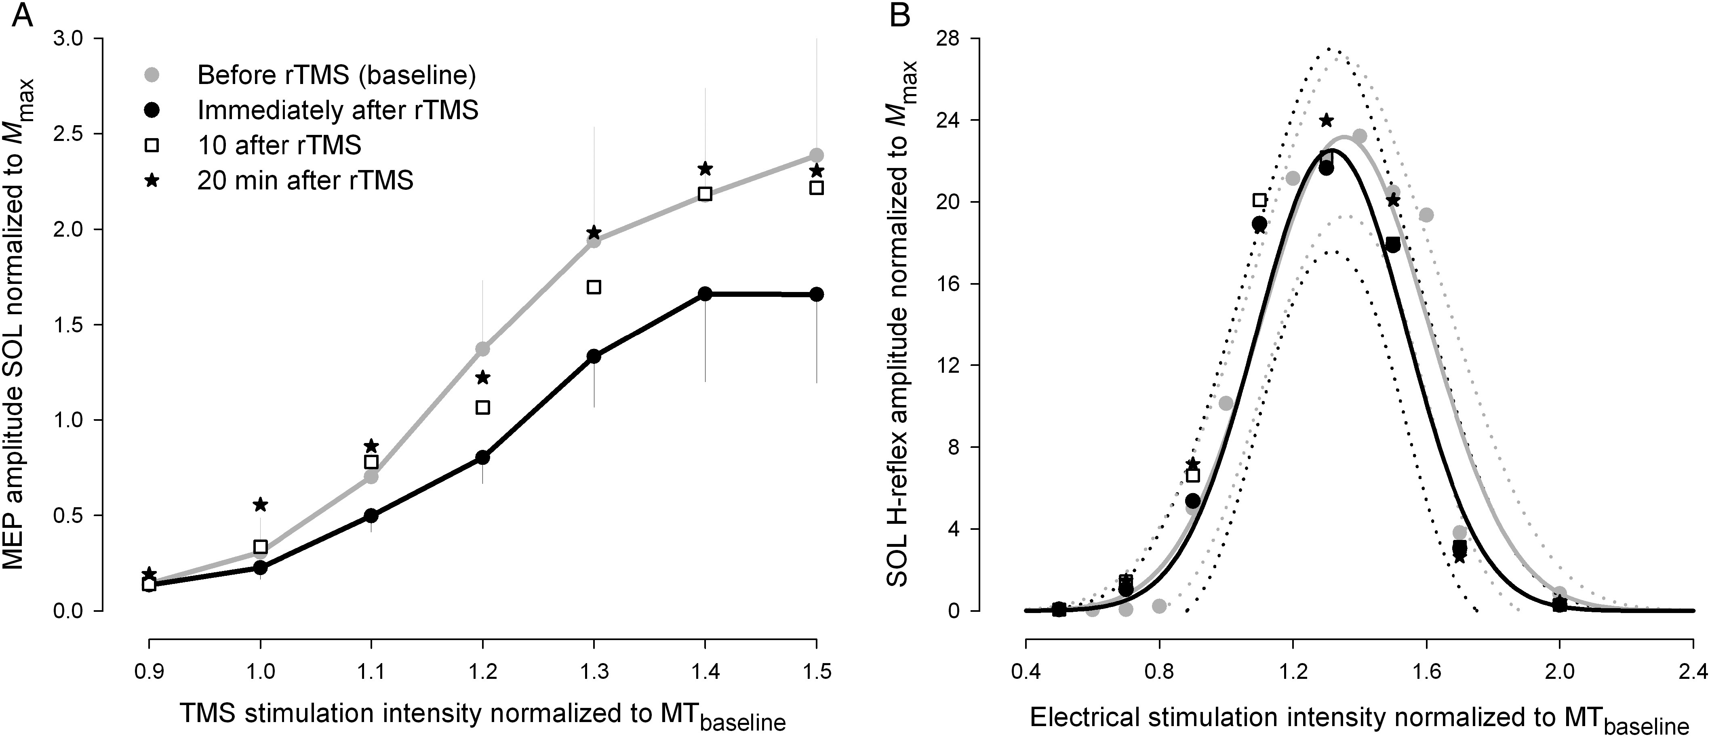
Figure 1. Results from Experiment I. (A) TMS stimulus-response curves obtained from SOL motor-evoked potentials evoked ...
Notes:
Figure 1. Results from Experiment I. (A) TMS stimulus-response curves obtained from SOL motor-evoked potentials evoked before, immediately after, 10, and 20 min after 20 min of 1-Hz rTMS at 1.2 MT. Stimulation intensities are normalized to the individual motor threshold and MEP amplitudes are normalized to Mmax. Data are presented as group mean ± SEM, *P < 0.05. (B) H-reflex recruitment curves obtained from SOL EMG at identical times. Data are presented as group mean. Recruitment curves are presented ± confidence bands.
Unless provided in the caption above, the following copyright applies to the content of this slide: © The Author 2014. Published by Oxford University Press. All rights reserved. For Permissions, please e-mail: journals.permissions@oup.com

Slide 2
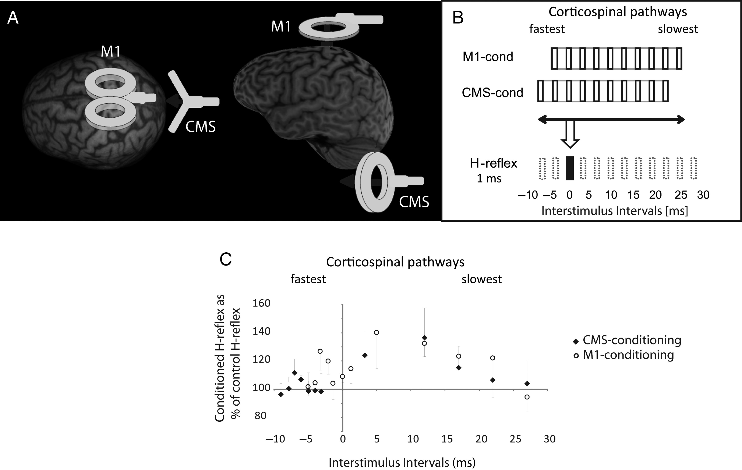
Figure 2. Procedure of M1- and CMS-conditioning. (A) Schematic drawing of M1- and CMS-conditioning procedure. One coil ...
Notes:
Figure 2. Procedure of M1- and CMS-conditioning. (A) Schematic drawing of M1- and CMS-conditioning procedure. One coil was placed over M1 (M1) and the other over the cervicomedullary junction (CMS). Conditioning of the SOL H-reflex by magnetic stimulation of the motor cortex (M1-conditioning) and by magnetic cervicomedullary stimulation (CMS-conditioning) was applied in a random order during the same measurement. (B) Descending volleys after magnetic stimulation of the motor cortex (M1-cond.) and the cervicomedullary junction (CMS-cond.) are dispersed for some milliseconds. In contrast, the peripheral nerve stimulation (H-reflex) produces a short effect. The H-reflex can be shifted forward in relation to the descending volley so that it collides with the fast(est) fraction(s) of the descending corticospinal volley (early facilitation) or it can be shifted backward so that slower corticospinal pathways can be tested (late facilitation). In the present study, interstimulus intervals (ISIs) from −9 to +1 were tested; the later ISIs are only displayed to complete the picture. (C) H-reflex conditioning curves after M1- and CMS-conditioning. The same ISIs are displayed as in (B), and it can be seen that the early facilitation occurs between ISI −7 and ISI −2 followed by a late facilitation starting around ISI +5. The conditioned H-reflexes were expressed as percentage of the control (unconditioned) H-reflexes. The first positive deflection from the baseline (100%) was taken to indicate the start of the early facilitation. In most subjects, the early facilitation after CMS-conditioning started 3–4 ms earlier than the facilitation obtained with M1-conditioning due to the shorter travel distance. The magnitudes of the early facilitations were compared before and after 20-min rTMS.
Unless provided in the caption above, the following copyright applies to the content of this slide: © The Author 2014. Published by Oxford University Press. All rights reserved. For Permissions, please e-mail: journals.permissions@oup.com

Slide 3
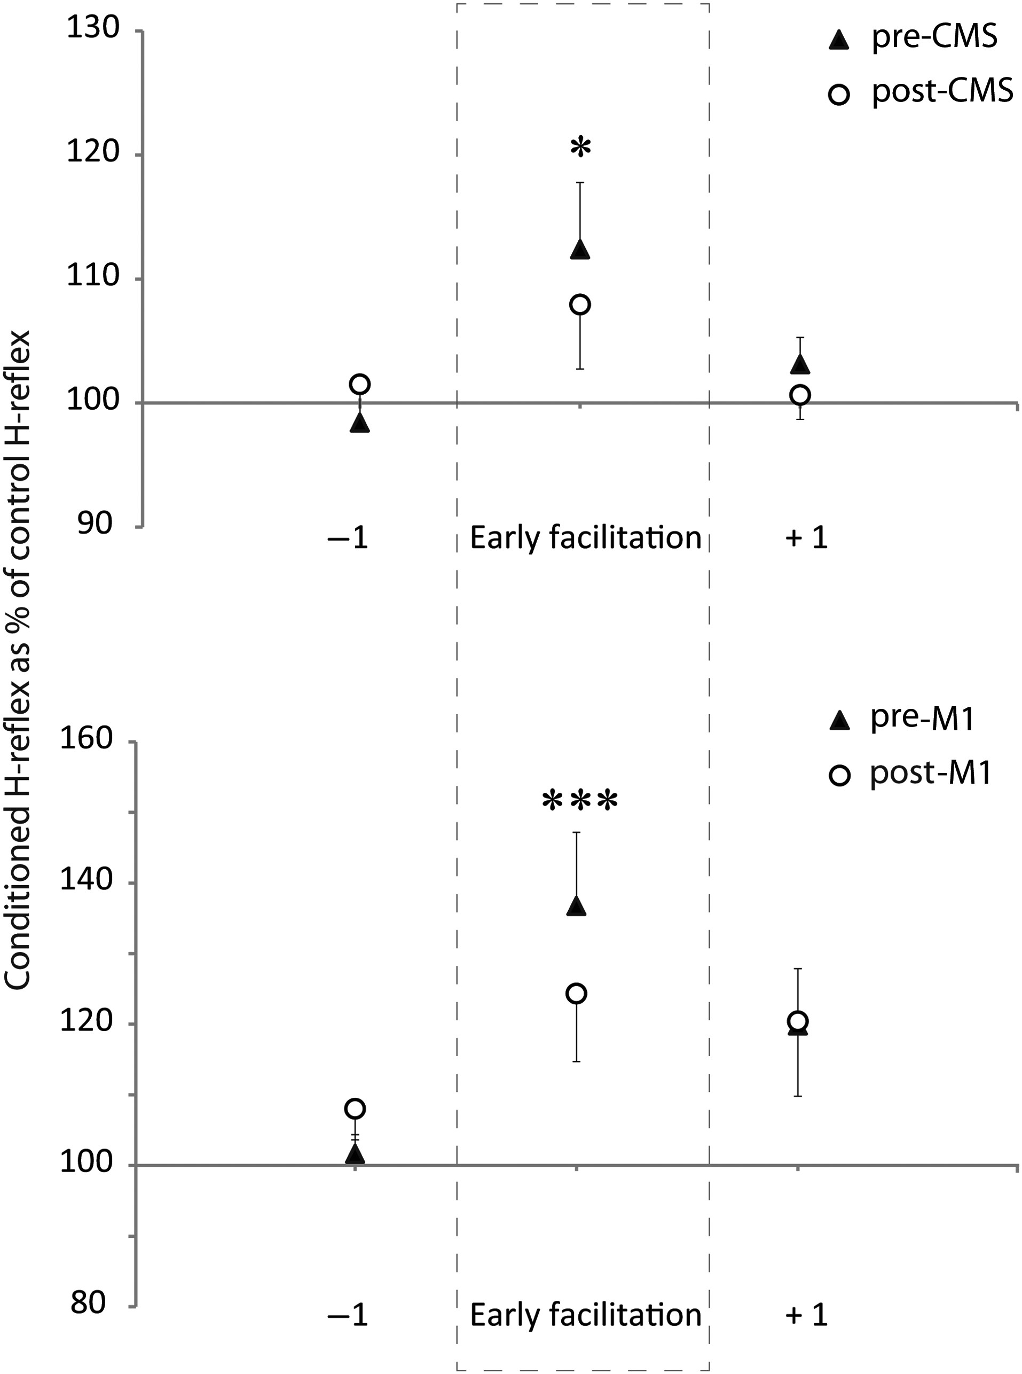
Figure 3. Results from Experiment II. The effects of low-frequency rTMS on the early facilitation obtained with ...
Notes:
Figure 3. Results from Experiment II. The effects of low-frequency rTMS on the early facilitation obtained with CMS-conditioning (A) and M1-conditioning (B). The interstimulus interval (ISI) representing the early facilitation as well as the ISI before (−1) and the ISI after the early facilitation (+1) are displayed. rTMS significantly reduced the early facilitation of both M1- and CMS-conditioning whereas surrounding ISIs (−1 and +1) were not affected.
Unless provided in the caption above, the following copyright applies to the content of this slide: © The Author 2014. Published by Oxford University Press. All rights reserved. For Permissions, please e-mail: journals.permissions@oup.com

Slide 4
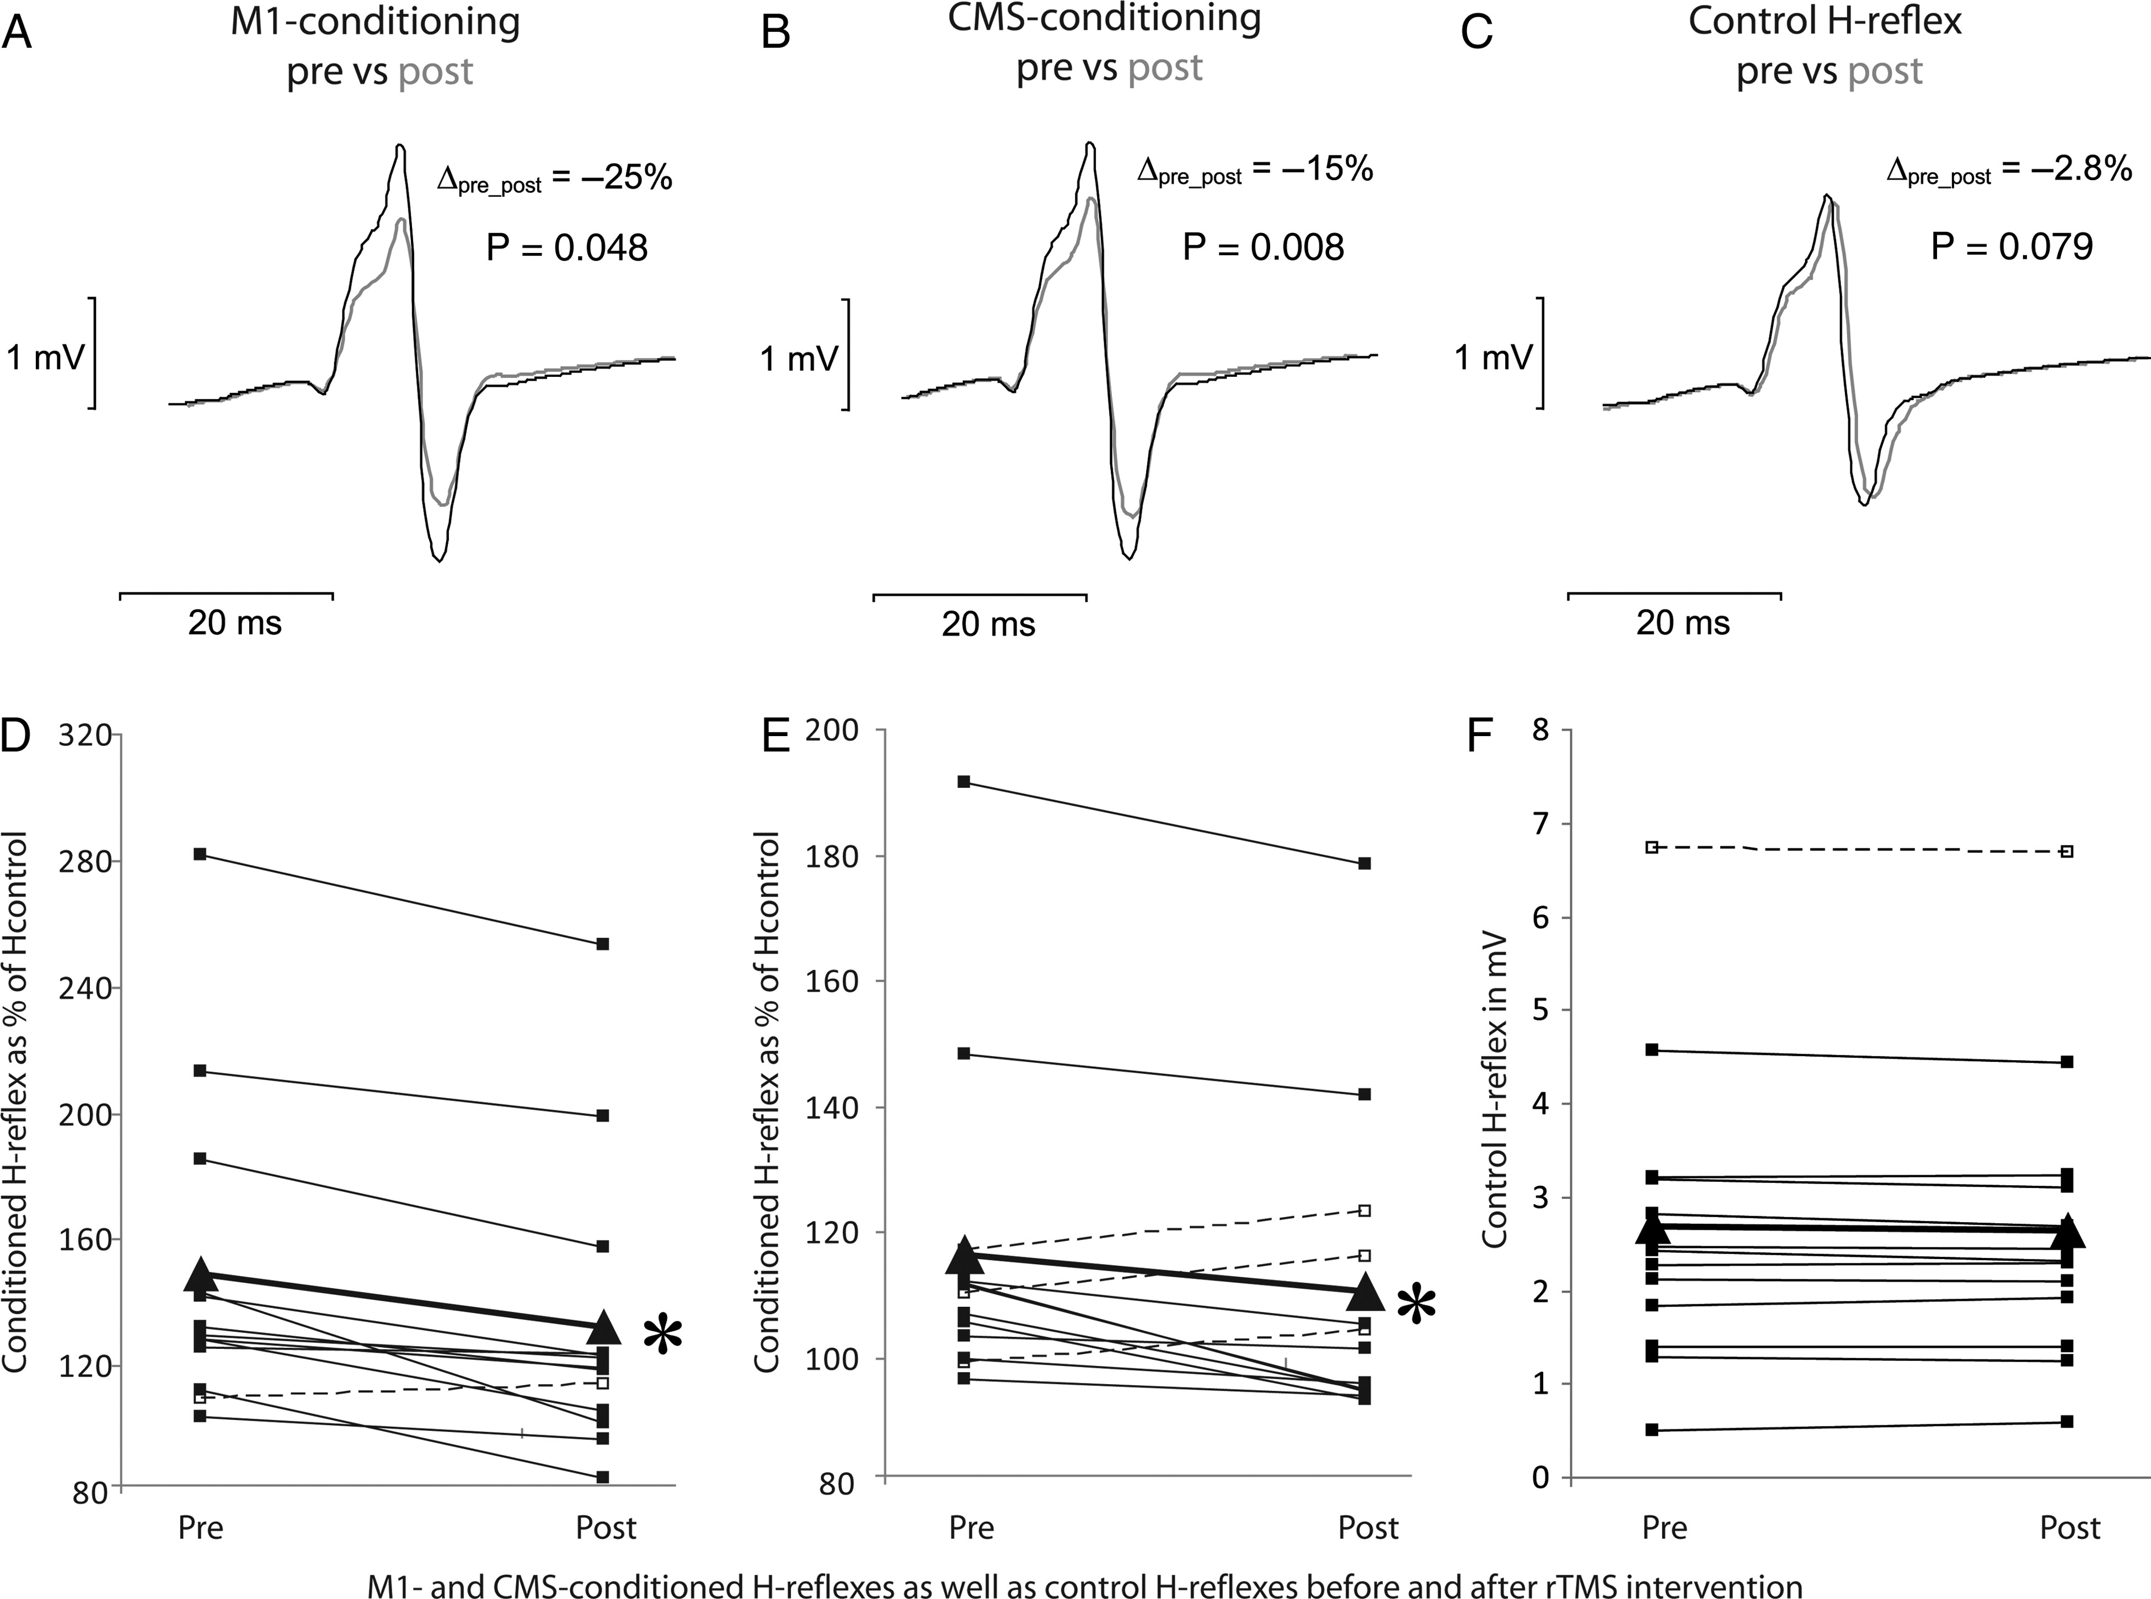
Figure 4. Results from Experiment II. The effects of low-frequency rTMS on the early facilitation obtained with ...
Notes:
Figure 4. Results from Experiment II. The effects of low-frequency rTMS on the early facilitation obtained with M1-conditioning (A and D) and CMS-conditioning (B and E). Furthermore, the size of the control H-reflex is displayed in (C) and (F) to illustrate that the control H-reflex was kept constant. The first row (A, B, C) displays data (averages of 10 traces) from one single representative subject, whereas the second row (D, E, F) shows the mean data of all participating subjects before (pre) and after (post) rTMS. Each dot represents the mean of 10 responses and the triangles (triangle) represent the overall mean. It can be seen that rTMS significantly reduced not only the cortically conditioned H-reflexes (A, D) but also the responses after CMS-conditioning (B, E). P-values in the first row refer to the data of the single subject whereas the stars (asterisk) in the second row indicate significant suppression of the mean (*P < 0.05).
Unless provided in the caption above, the following copyright applies to the content of this slide: © The Author 2014. Published by Oxford University Press. All rights reserved. For Permissions, please e-mail: journals.permissions@oup.com

