Slide 1
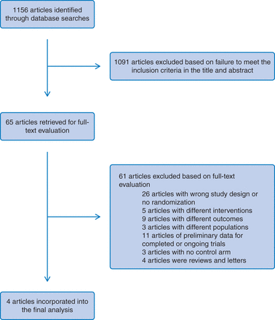
Fig. 1 Flow diagram of studies retrieved, excluded and analyzed according to the search strategy.
Notes:
Fig. 1 Flow diagram of studies retrieved, excluded and analyzed according to the search strategy.
Unless provided in the caption above, the following copyright applies to the content of this slide: © The Author 2013. Published by Oxford University Press on behalf of Faculty of Public Health. All rights reserved. For permissions, please e-mail: journals.permissions@oup.com.

Slide 2
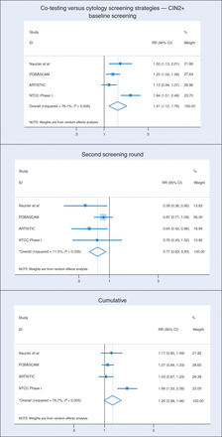
Fig. 2 Pooled CIN 2+ detection rate ratio estimates (with 95% CIs) at baseline, at second screening and over both ...
Notes:
Fig. 2 Pooled CIN 2+ detection rate ratio estimates (with 95% CIs) at baseline, at second screening and over both rounds (cumulative). *Estimates were calculated using random effects model.
Unless provided in the caption above, the following copyright applies to the content of this slide: © The Author 2013. Published by Oxford University Press on behalf of Faculty of Public Health. All rights reserved. For permissions, please e-mail: journals.permissions@oup.com.

Slide 3
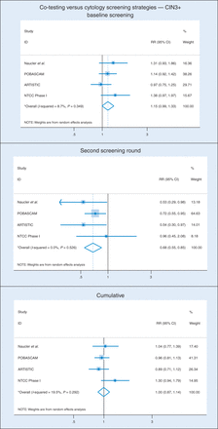
Fig. 3 Pooled CIN 3+ detection rate ratio estimates (with 95% CIs) at baseline, at second screening and over both ...
Notes:
Fig. 3 Pooled CIN 3+ detection rate ratio estimates (with 95% CIs) at baseline, at second screening and over both rounds (cumulative). *Estimates were calculated using random effects model.
Unless provided in the caption above, the following copyright applies to the content of this slide: © The Author 2013. Published by Oxford University Press on behalf of Faculty of Public Health. All rights reserved. For permissions, please e-mail: journals.permissions@oup.com.

Slide 4
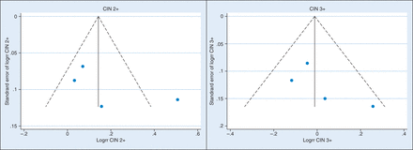
Fig. 4 Funnel plot with pseudo 95% confidence limits for CIN 2+ and CIN 3+.
Notes:
Fig. 4 Funnel plot with pseudo 95% confidence limits for CIN 2+ and CIN 3+.
Unless provided in the caption above, the following copyright applies to the content of this slide: © The Author 2013. Published by Oxford University Press on behalf of Faculty of Public Health. All rights reserved. For permissions, please e-mail: journals.permissions@oup.com.

