Slide 1
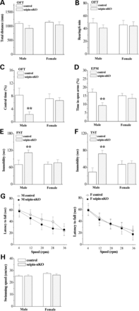
Figure 1. Male seipin-nKO mice, but not female mice, display affective disorders without locomotion deficits. (A–C) ...
Notes:
Figure 1. Male seipin-nKO mice, but not female mice, display affective disorders without locomotion deficits. (A–C) Influence of neuronal seipin deficiency on spontaneous locomotion as assessed by OFT. Bar graph shows travelled distance (A), rearing frequency (B) and time spent in central partition of arena (C) in male and female control mice (open bars) and seipin-nKO mice (hatched bars). (D) Influence of neuronal seipin deficiency on anxiety-like behavior as assessed by elevated plus-maze (EPM). Bar graph shows the time spent in open arms of EPM in male or female control mice and seipin-nKO mice. (E and F) Influence of neuronal seipin deficiency on depression-like behaviors as assessed by FST and TST. Bars represent immobile time during the FST and TST in male or female control mice and seipin-nKO mice. (G) Influence of neuronal seipin deficiency on motor coordination as assessed by the rotarod test. Each point represents group mean time stayed on the rotarod at 4, 12, 20, 28 and 36 rpm rotation speeds in male or female control mice (white point) and seipin-nKO mice (black point). (H) Influence of neuronal seipin deficiency on motor abilities as assessed by the swimming test. Bar graph shows swimming speed (cm/s) in male or female control mice and seipin-nKO mice. Data denote mean ± SEM. **P < 0.01 versus control mice.
Unless provided in the caption above, the following copyright applies to the content of this slide: © The Author 2014. Published by Oxford University Press. All rights reserved. For Permissions, please email: journals.permissions@oup.com

Slide 2
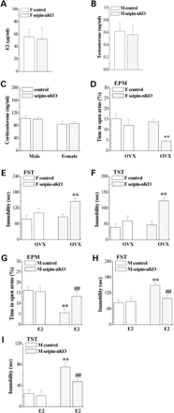
Figure 2. E2 can alleviate affective disorders in male seipin-nKO mice. (A and B) Influence of neuronal seipin ...
Notes:
Figure 2. E2 can alleviate affective disorders in male seipin-nKO mice. (A and B) Influence of neuronal seipin deficiency on levels of sexual hormones. Bars represent the mean levels of plasma E2 in female seipin-nKO mice and testosterone in male seipin-nKO mice. (C) Levels of plasma corticosterone in male or female control and seipin-nKO mice. (D–F) Influence of deleted E2 on affective behaviors of female seipin-nKO mice. Bars indicate the time spent in open arms of EPM (D), the immobile time in FST (E) and TST (F) in sham-op control mice or seipin-nKO mice, and OVX-treated control mice or seipin-nKO mice. **P < 0.01 versus sham-op seipin-nKO mice. (G–I) Effects of E2 on affective disorders in male seipin-nKO mice. Bars indicate the time spent in open arms of EPM (G), the immobile time in FST (H) and TST (I) in vehicle-treated control mice or seipin-nKO mice, and E2-treated control mice or seipin-nKO mice. **P < 0.01 versus vehicle-treated control mice, ##P < 0.01 versus vehicle-treated seipin-nKO mice.
Unless provided in the caption above, the following copyright applies to the content of this slide: © The Author 2014. Published by Oxford University Press. All rights reserved. For Permissions, please email: journals.permissions@oup.com

Slide 3
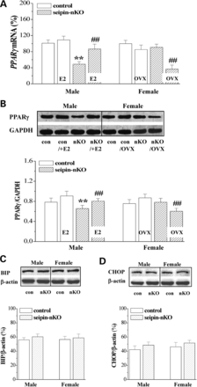
Figure 3. E2 can rescue reduced PPARγ expression in male seipin-nKO mice. (A and B) Influence of neuronal seipin ...
Notes:
Figure 3. E2 can rescue reduced PPARγ expression in male seipin-nKO mice. (A and B) Influence of neuronal seipin deficiency on expression of PPARγ in the hippocampus and cortex, and involvement of E2 in gender-related PPARγ expression induced by seipin-nKO. Levels of PPARγ mRNA (A) and PPARγ protein (B) were compared among vehicle-treated male control (con) or seipin-nKO mice (nKO), E2-treated male control (con/+E2) or seipin-nKO mice (nKO/+E2), sham-op female control or seipin-nKO mice and OVX-treated female control (con/OVX) or seipin-nKO mice (nKO/OVX). Levels of PPARγ mRNA measured by RT-PCR are expressed as a percentage of control values. The densitometric values for western blots of PPARγ protein are normalized to the protein amounts of GAPDH. (C and D) Influence of neuronal seipin deficiency on ER-stress markers BIP and CHOP in the hippocampus and cortex. Bars show the densitometric values for western blots of BIP and CHOP protein normalized to the protein amounts of β-action in male or female control (con) and seipin-nKO (nKO) mice. **P < 0.01 versus vehicle-treated male control mice, ##P < 0.01 versus vehicle-treated male seipin-nKO mice or sham-op female seipin-nKO mice.
Unless provided in the caption above, the following copyright applies to the content of this slide: © The Author 2014. Published by Oxford University Press. All rights reserved. For Permissions, please email: journals.permissions@oup.com

Slide 4
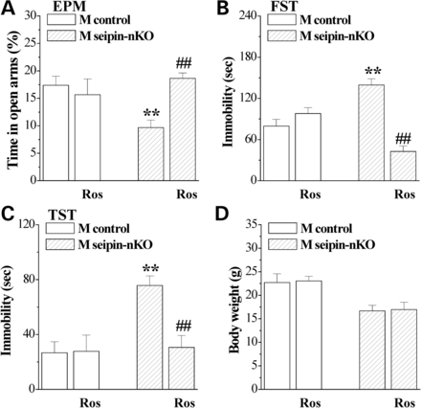
Figure 4. The PPARγ agonist rosiglitazone can alleviate affective disorders in male seipin-nKO mice. Bars indicate the ...
Notes:
Figure 4. The PPARγ agonist rosiglitazone can alleviate affective disorders in male seipin-nKO mice. Bars indicate the means of time spent in open arms of EPM (A), the immobile time in FST (B) and TST (C) in vehicle-treated control mice or seipin-nKO mice, and rosiglitazone (Ros)-treated control mice or seipin-nKO mice. (D) Body weight before and after the administration of rosiglitazone. **P < 0.01 versus vehicle-treated control mice, ##P < 0.01 versus vehicle-treated seipin-nKO mice.
Unless provided in the caption above, the following copyright applies to the content of this slide: © The Author 2014. Published by Oxford University Press. All rights reserved. For Permissions, please email: journals.permissions@oup.com

