Slide 1
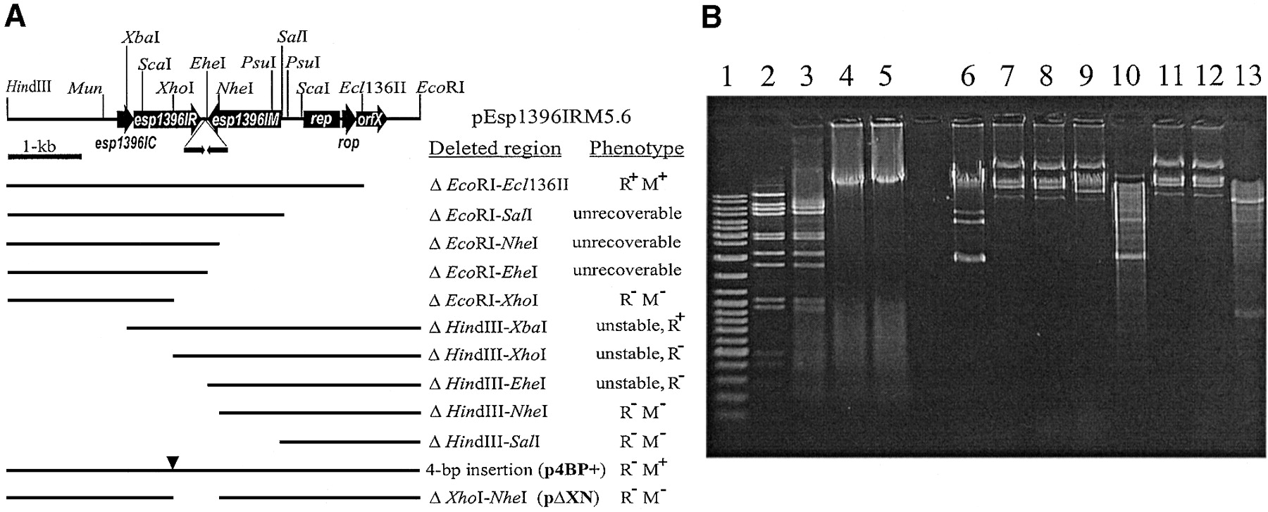
Figure 1. ( A ) Schematic map of pEsp1396IRM5.6 plasmid and deletion mapping of genes encoding the Esp 1396I ...
Notes:
Figure 1. ( A ) Schematic map of pEsp1396IRM5.6 plasmid and deletion mapping of genes encoding the Esp 1396I RM system. Thin line represents the entire pEsp1396 plasmid cleaved with Bgl II and inserted into pUC19, which was opened with Bam HI. Targets for both Hin dIII and Eco RI are from pUC19 multiple cloning site. The identified ORFs are shown in accordance with the sequencing data. Directions of transcription of all identified genes are indicated by arrows. Deletion plasmids constructed in this work are indicated below as thin lines and their relevant phenotypes are indicated on the right. Triangle marks the 4‐bp insertion introduced at the Xho I site in esp1396IR and resulting in p4BP+. Restriction and modification phenotypes were determined as described under Materials and Methods. M + , Mtase protection from Esp 1396I cleavage; M – , no Mtase protection from Esp 1396I cleavage; R + , Enase activity; R – , Enase activity not detectable. ( B ) Restriction and modification activities of cloned genes. Lane 1, DNA ladder; lane 2, λ DNA incubated with Esp 1396I; lanes 3–5, λ DNA incubated with crude extracts prepared from cells carrying either pEsp1396IRM5.6 or derivatives p4BP+ and pΔXN, respectively; lanes 6–9, DNAs isolated from cells carrying pUC19, pEsp1396IRM5.6, p4BP+ and pΔXN, respectively; lanes 10–13, the same as in lanes 6–9 but after the incubation with Esp 1396I.
Unless provided in the caption above, the following copyright applies to the content of this slide:

Slide 2
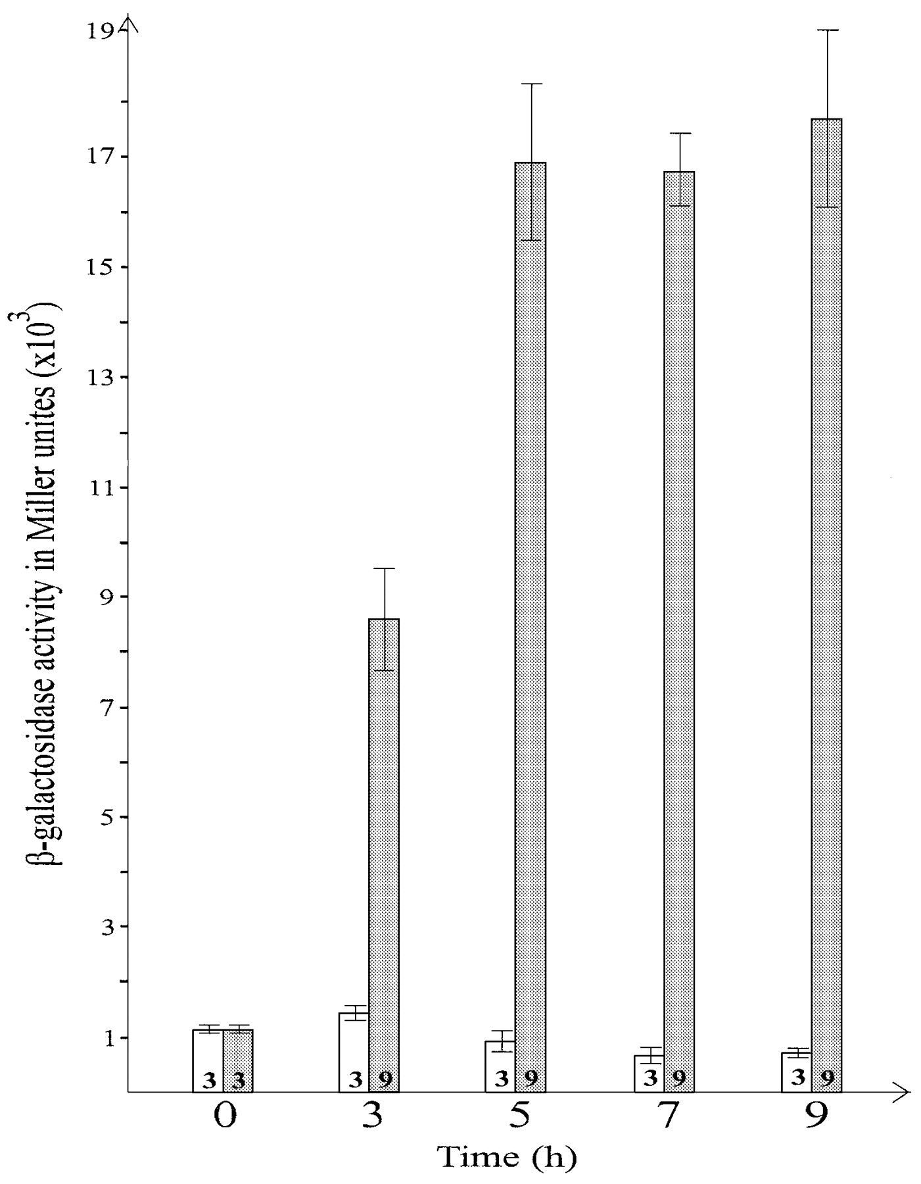
Figure 2. Effect of C. Esp 1396I on the expression of esp1396IM gene. Bacterial strain harboring both plasmid ...
Notes:
Figure 2. Effect of C. Esp 1396I on the expression of esp1396IM gene. Bacterial strain harboring both plasmid pEspM::Lac (contains esp1396IM’::’lacZ gene fusion) and plasmid pZS‐C (contains functionally active gene for regulatory protein under the control of P lac/ara‐1 ) was cultivated either with or without of P lac/ara‐1 inducers arabinose and IPTG. Open columns indicate β‐Gal activity expressed in Miller units in the presence of both inducers (C. Esp 1396I synthesis activated) measured at the time points indicated on the bottom of the scheme; shaded columns indicate β‐Gal activity obtained at the same time points in the absence of both inducers (C. Esp 1396I synthesis repressed). Numbers at the bottom of each column represent the total number of probes measured in three independent experiments for each time point; thin line at the top of each column indicates standard deviation.
Unless provided in the caption above, the following copyright applies to the content of this slide:

Slide 3
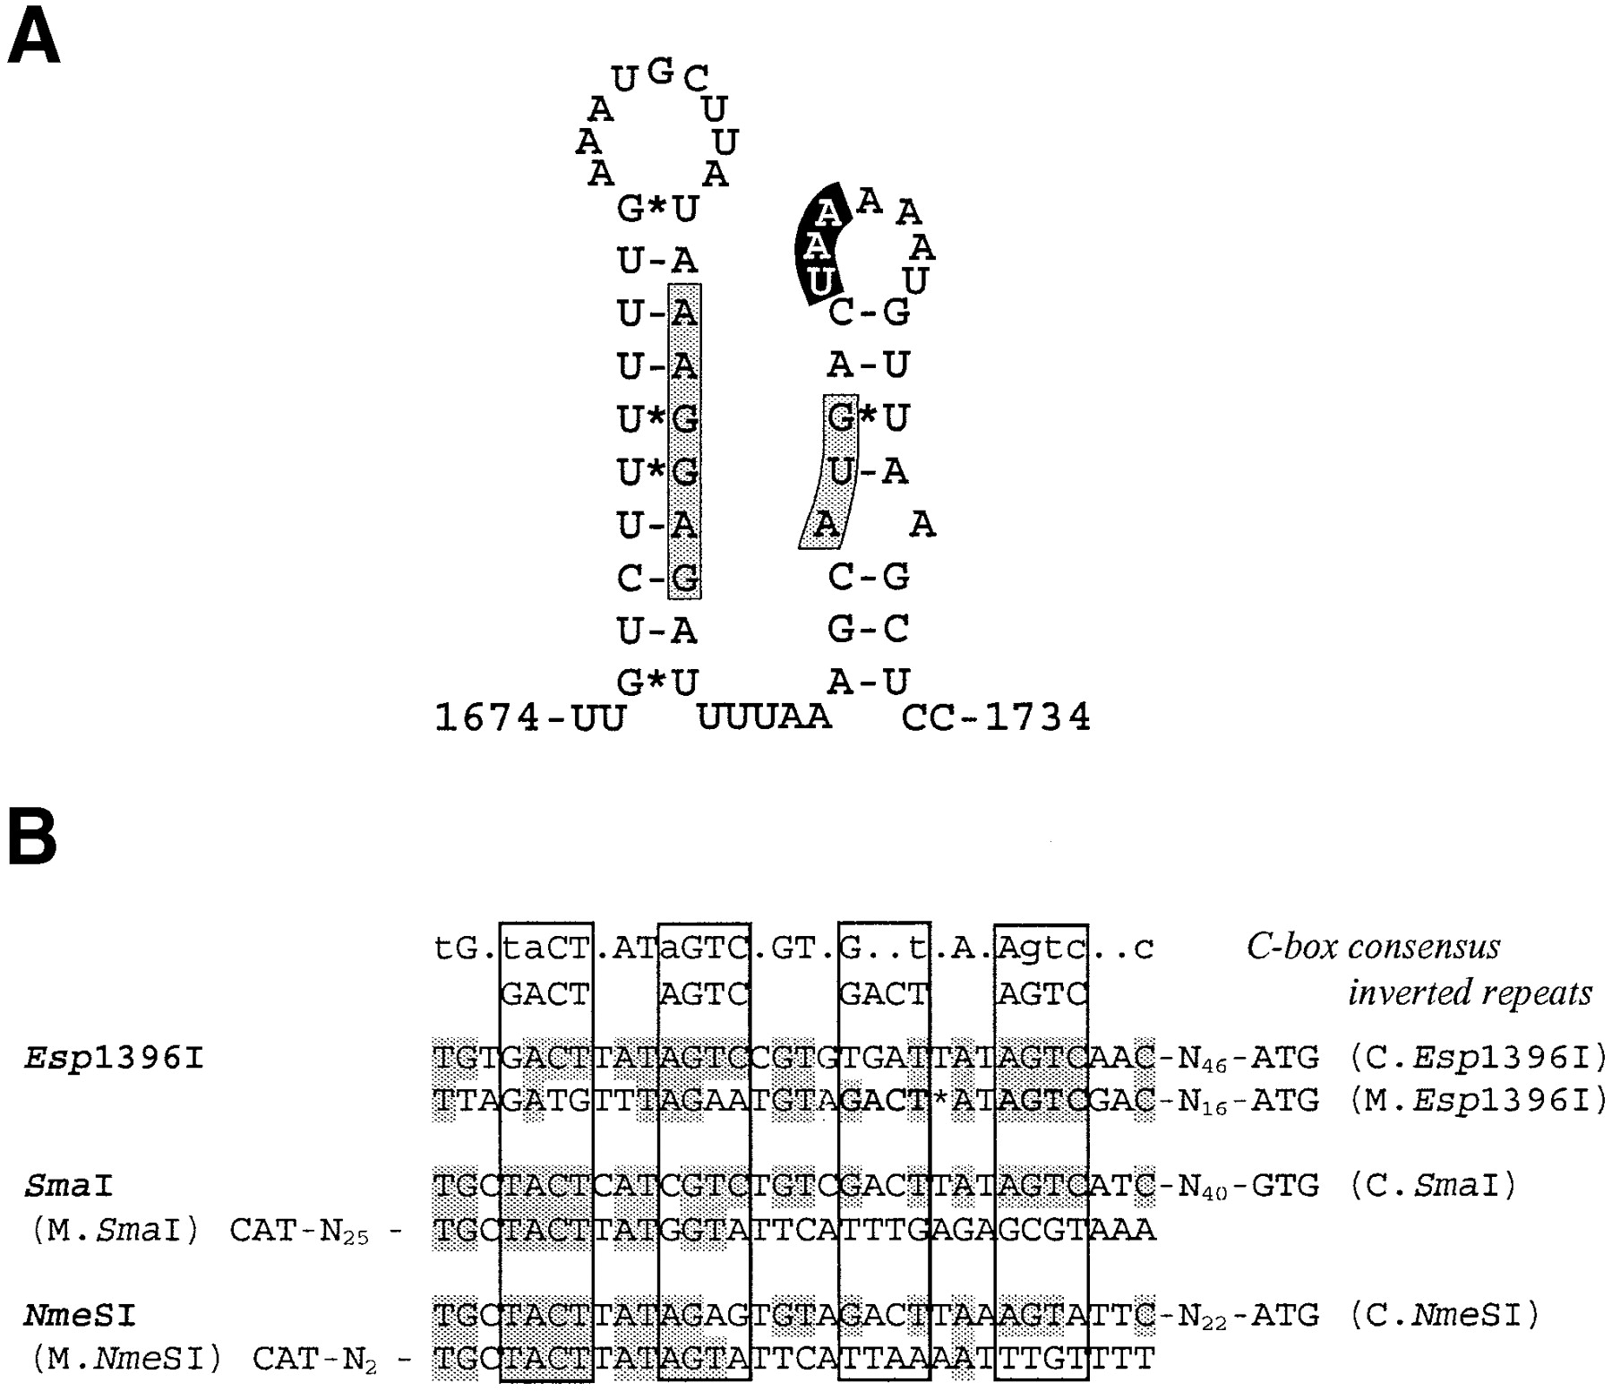
Figure 3. Elements presumably involved in regulation of Esp 1396I RM system genes. ( A ) Predicted secondary ...
Notes:
Figure 3. Elements presumably involved in regulation of Esp 1396I RM system genes. ( A ) Predicted secondary structure of polycistronic mRNA encoding esp1396IC and esp1396IR gene junction. Shine–Dalgarno region and translation start codon for esp1396IR gene are indicated by the gray boxes, stop codon for esp1396IC is indicated by the black box. ( B ) Putative operator sequences for C. Esp 1396I protein. C‐box sequences identified upstream esp1396IC and esp1396IM genes as well as those found upstream regulatory and Mtase genes in Sma I and Nme SI RM systems are aligned. Consensus sequence for C‐box and for inverted repeats as proposed in ( 24 ) is given above. Regions of inverted repeats in the other C‐boxes are boxed. Nucleotides matching those indicated as consensus are shaded. Only one inverted repeat found upstream the esp1396IM gene is bolded.
Unless provided in the caption above, the following copyright applies to the content of this slide:

