Slide 1
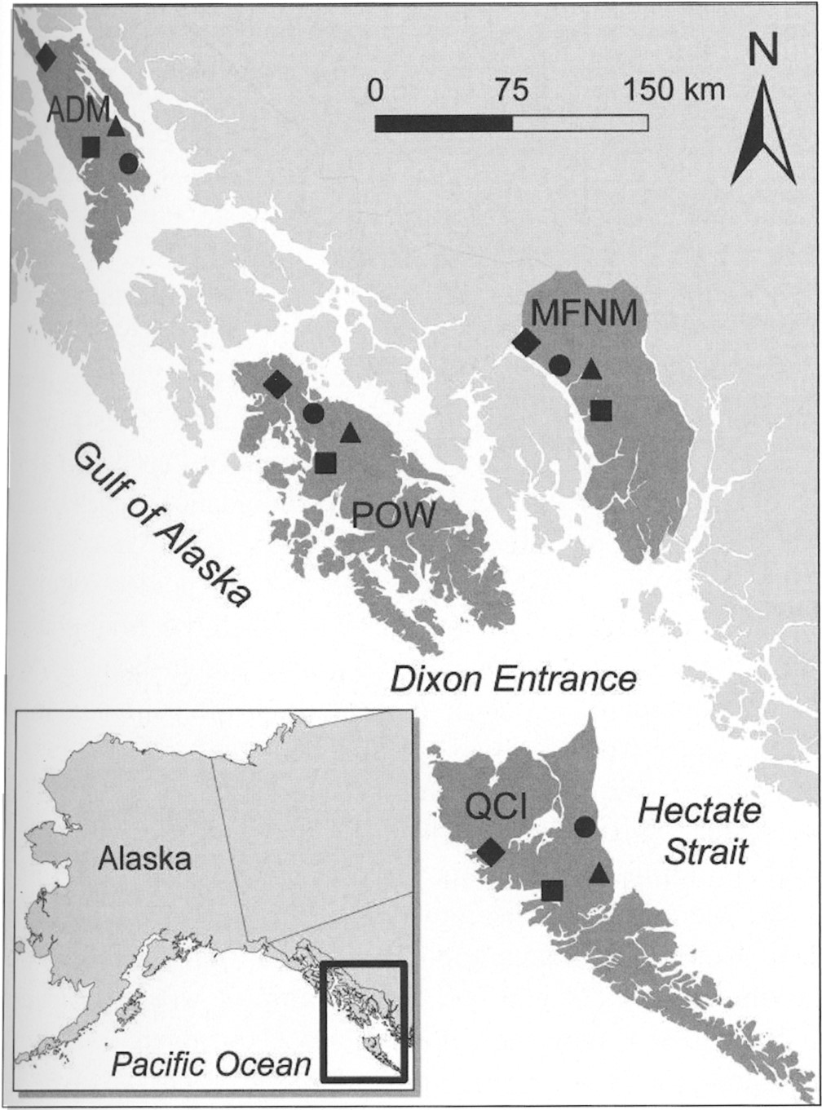
Fig. 1 Location of study sites within southeastern Alaska (Admiralty Island [ADM], Misty Fjords National Monument ...
Notes:
Fig. 1 Location of study sites within southeastern Alaska (Admiralty Island [ADM], Misty Fjords National Monument [MFNM], and Prince of Wales Island [POW]) and northern British Columbia, Canada (Queen Charlotte Islands [QCI]) where we used artificially enriched isotopic baits to mark American (Martes americana) and Pacific (M. caurind) martens for the quantification of dispersal, 2006–2008. Symbols denote the type of enrichment applied within each area: ▲+ = 15N, ■ = 2H, ● = 13C, ♦ = a combination of 15N and 2H.
Unless provided in the caption above, the following copyright applies to the content of this slide: © 2012 American Society of Mammalogists

Slide 2
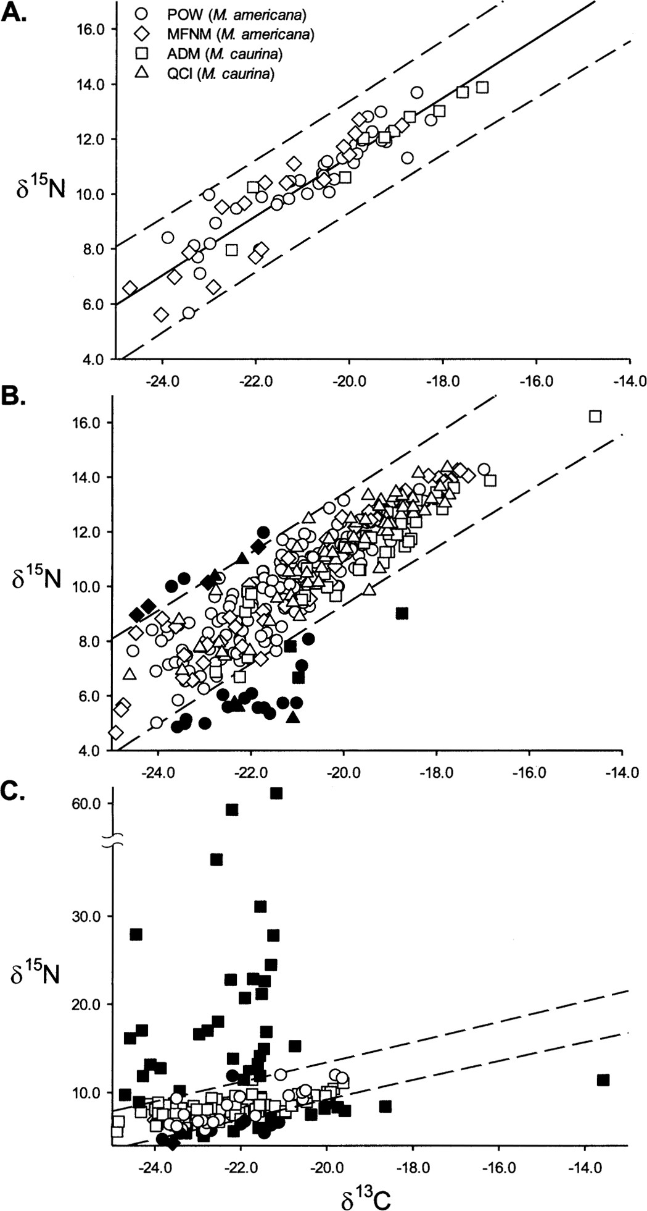
Fig. 2 A) Linear regression model (β₀ = 33.7 ±1.1 and β₁ = 1.1 ± 0.05) and 99% prediction ...
Notes:
Fig. 2 A) Linear regression model (β0 = 33.7 ±1.1 and β1 = 1.1 ± 0.05) and 99% prediction interval of δ15N to δ13C for 69 unmarked martens (Martes americana and M. caurina) from southeastern Alaska. δ15N and δ13C signatures of hair samples from martens in southeastern Alaska (Prince of Wales Island [POW], Misty Fjords National Monument [MFNM], and Admiralty Island [ADM]) and northern British Columbia, Canada (Queen Charlotte Islands [QCI]) collected from B) commercially trapped marten carcasses and C) noninvasively sampled free-ranging martens. We identified samples above the 99% prediction interval as marked with baits enriched in 15N; those below were considered artificially enriched by 13C. Isotopically marked samples are shown in black; unmarked samples are unfilled.
Unless provided in the caption above, the following copyright applies to the content of this slide: © 2012 American Society of Mammalogists

Slide 3
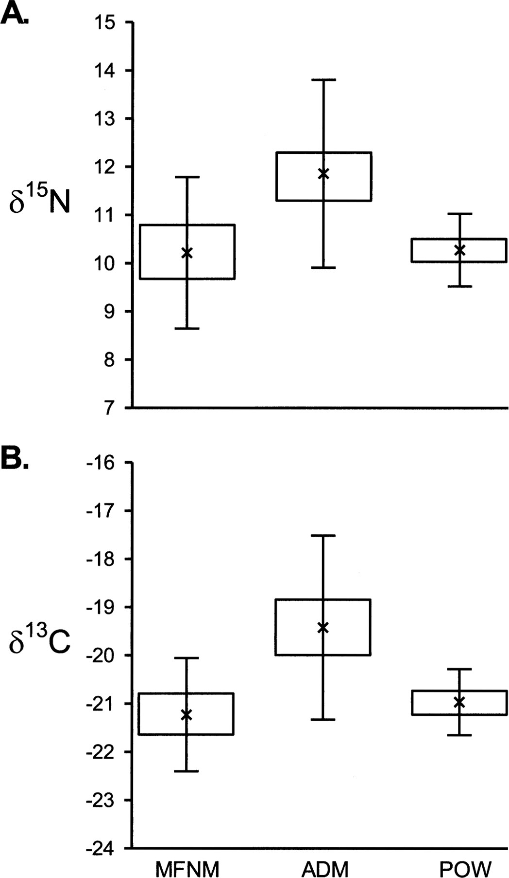
Fig. 3 Boxplot depicting mean, standard error, and 99% prediction interval for A) ¹⁵N (‰) and B) ...
Notes:
Fig. 3 Boxplot depicting mean, standard error, and 99% prediction interval for A) 15N (‰) and B) 13C values obtained from 69 unmarked martens (Martes americana and M. caurina) from 3 sites in southeastern Alaska (Misty Fjords National Monument [MFNM], Prince of Wales Island [POW], and Admiralty Island [ADM]).
Unless provided in the caption above, the following copyright applies to the content of this slide: © 2012 American Society of Mammalogists

Slide 4
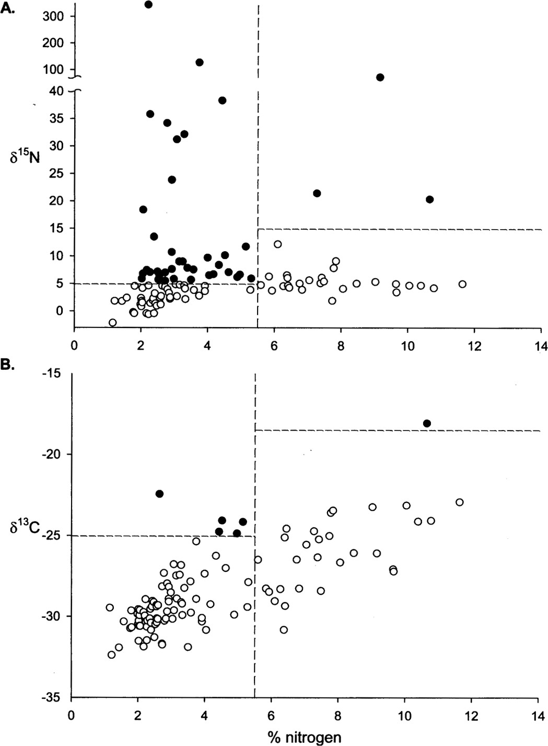
Fig. 4 Isotopic signatures and percent elemental nitrogen of Pacific marten (Martes caurina) feces opportunistically ...
Notes:
Fig. 4 Isotopic signatures and percent elemental nitrogen of Pacific marten (Martes caurina) feces opportunistically collected along trapping lines in Admiralty Island, Alaska. We identified samples as isotopically marked when elemental abundance of nitrogen was 5‰ or >-25‰ signatures in 15N or 13C, respectively. Samples with >5.5% nitrogen (presence of animal tissue) were deemed isotopically marked when 15N was >15‰ or 13C was > —17‰. Thresholds are denoted with dashed lines; enriched samples are shown in black.
Unless provided in the caption above, the following copyright applies to the content of this slide: © 2012 American Society of Mammalogists

Slide 5
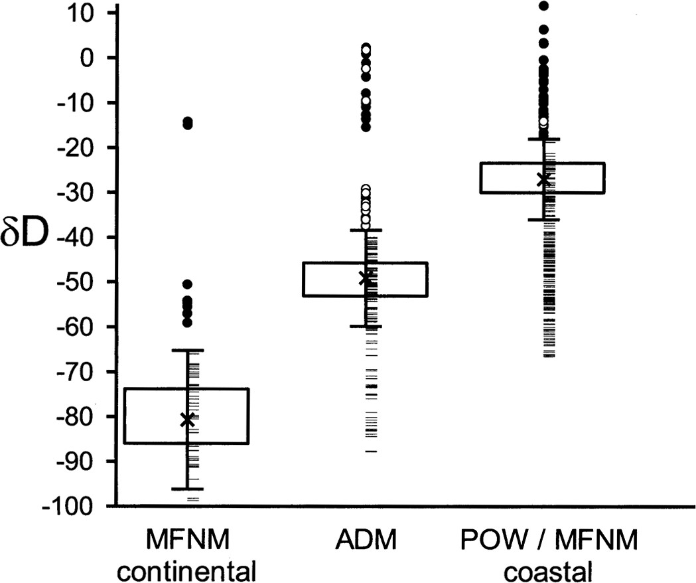
Fig. 5 Distribution of deuterium (‰) for marked and unmarked martens (Martes americana and M. caurina). Boxplots ...
Notes:
Fig. 5 Distribution of deuterium (‰) for marked and unmarked martens (Martes americana and M. caurina). Boxplots depict the mean, standard error, and 99% prediction interval for 64 unmarked martens from 3 sites in southeastern Alaska (Misty Fjords National Monument [MFNM], Prince of Wales Island [POW], and Admiralty Island [ADM]) that differed in natural abundance. Hair samples exceeding the 99% prediction interval were deemed marked with 2H, and are shown as circles (black = commercially trapped marten carcasses; white = noninvasively sampled martens). Hair samples deemed as unmarked are shown with hash marks.
Unless provided in the caption above, the following copyright applies to the content of this slide: © 2012 American Society of Mammalogists

