Slide 1
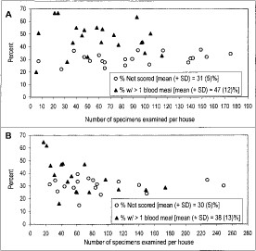
Fig. 1 Number of specimens examined histologically, percentage of specimens that could not be scored, and percentage ...
Notes:
Fig. 1 Number of specimens examined histologically, percentage of specimens that could not be scored, and percentage of specimens that imbibed >1 blood meal per household in Thailand (A) and Puerto Rico (B).
Unless provided in the caption above, the following copyright applies to the content of this slide: © 2000 Entomological Society of America

Slide 2
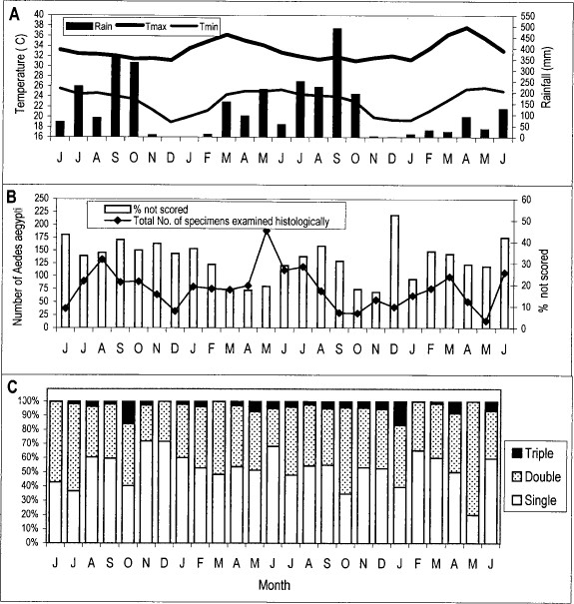
Fig. 2 Seasonal patterns (1990–1992) of temperature and rainfall (A), number of Ae. aegypti examined histologically ...
Notes:
Fig. 2 Seasonal patterns (1990–1992) of temperature and rainfall (A), number of Ae. aegypti examined histologically (B), and number of blood meals imbibed by Ae. aegypti in Thailand (C).
Unless provided in the caption above, the following copyright applies to the content of this slide: © 2000 Entomological Society of America

Slide 3
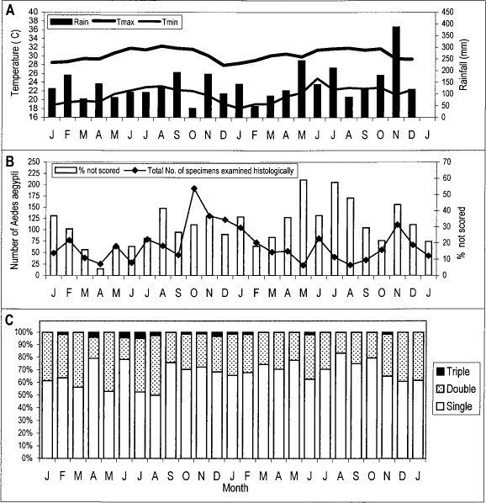
Fig. 3 Seasonal patterns (1991–1993) of temperature and rainfall (A), number of Ae. aegypti examined histologically ...
Notes:
Fig. 3 Seasonal patterns (1991–1993) of temperature and rainfall (A), number of Ae. aegypti examined histologically (B), and number of blood meals imbibed by Ae. aegypti in Puerto Rico (C).
Unless provided in the caption above, the following copyright applies to the content of this slide: © 2000 Entomological Society of America

Slide 4
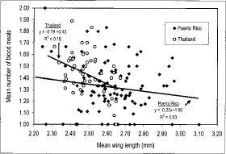
Fig. 4 Relationship between wing length and bloodfeeding frequency of female Ae. aegypti collected weekly in ...
Notes:
Fig. 4 Relationship between wing length and bloodfeeding frequency of female Ae. aegypti collected weekly in Thailand (1990–1992) and Puerto Rico (1991–1993). Linear regression lines and equations for each site are included.
Unless provided in the caption above, the following copyright applies to the content of this slide: © 2000 Entomological Society of America

Slide 5
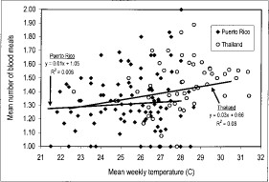
Fig. 5 Relationship between temperature and bloodfeeding frequency of female Ae. aegypti collected weekly in ...
Notes:
Fig. 5 Relationship between temperature and bloodfeeding frequency of female Ae. aegypti collected weekly in Thailand (1990–1992) and Puerto Rico (1991–1993). Linear regression lines and equations for each site are included.
Unless provided in the caption above, the following copyright applies to the content of this slide: © 2000 Entomological Society of America

Slide 6
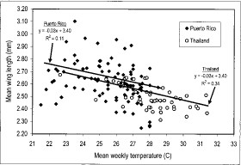
Fig. 6 Relationship between temperature and wing length of female Ae. aegypti collected weekly in Thailand ...
Notes:
Fig. 6 Relationship between temperature and wing length of female Ae. aegypti collected weekly in Thailand (1990–1992) and Puerto Rico (1991–1993). Linear regression lines and equations for each site are included.
Unless provided in the caption above, the following copyright applies to the content of this slide: © 2000 Entomological Society of America

