Slide 1
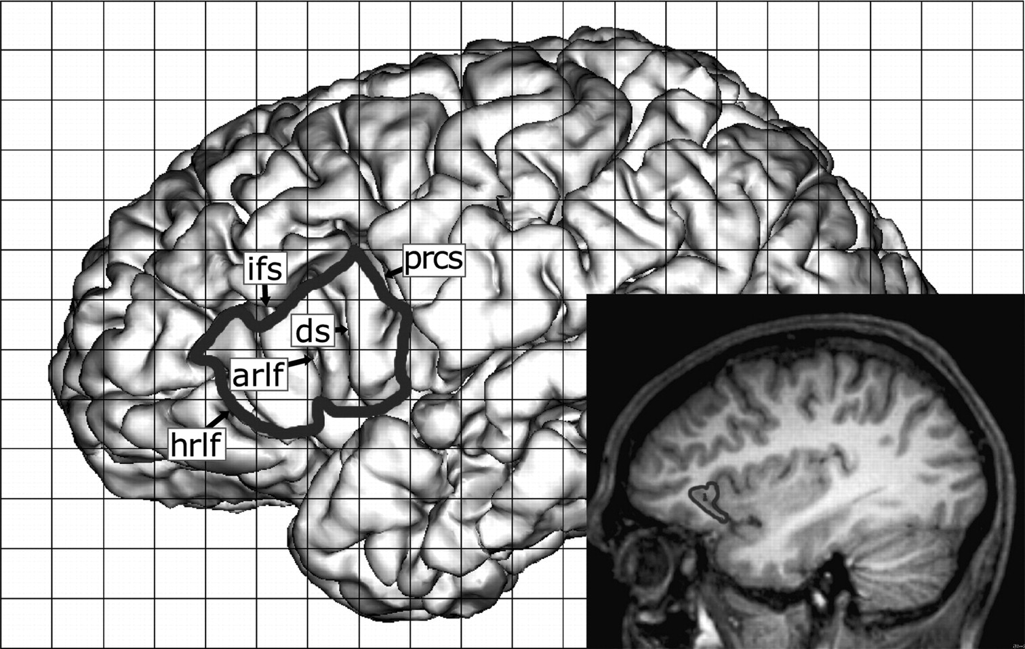
Figure 1. Definition of the ROI in subject I. On the cortex convexity, only the opercular and triangular parts of the ...
Notes:
Figure 1. Definition of the ROI in subject I. On the cortex convexity, only the opercular and triangular parts of the IFG are visible. The deep portion of frontal operculum (cortical band between the lateral opercular part of IFG and the anterior insula) is indicated in the sagittal slice. arlf, denotes ascending branch of the lateral fissure; ds, diagonal sulcus; hrlf, horizontal branch of the lateral fissure; ifs, inferior frontal sulcus; prcs, precentral sulcus.
Unless provided in the caption above, the following copyright applies to the content of this slide: © The Author 2006. Published by Oxford University Press. All rights reserved. For permissions, please e-mail: journals.permissions@oxfordjournals.org

Slide 2
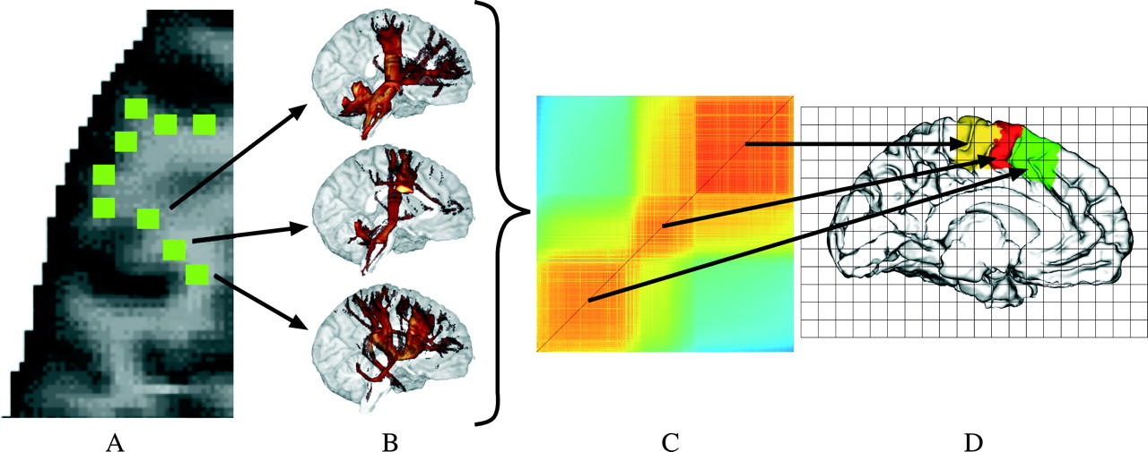
Figure 2. General methodology of connectivity-based cortex parcellation. Seed voxels in white matter near the ...
Notes:
Figure 2. General methodology of connectivity-based cortex parcellation. Seed voxels in white matter near the white–gray matter interface (WGMI), form the ROI (A). For each of these voxels, a tractogram is computed (B). The matrix containing the correlations between all these tractograms is divided into clusters of voxels with similar correlation to other voxels (C). Each of these clusters corresponds to a certain area on the WGMI (D).
Unless provided in the caption above, the following copyright applies to the content of this slide: © The Author 2006. Published by Oxford University Press. All rights reserved. For permissions, please e-mail: journals.permissions@oxfordjournals.org

Slide 3
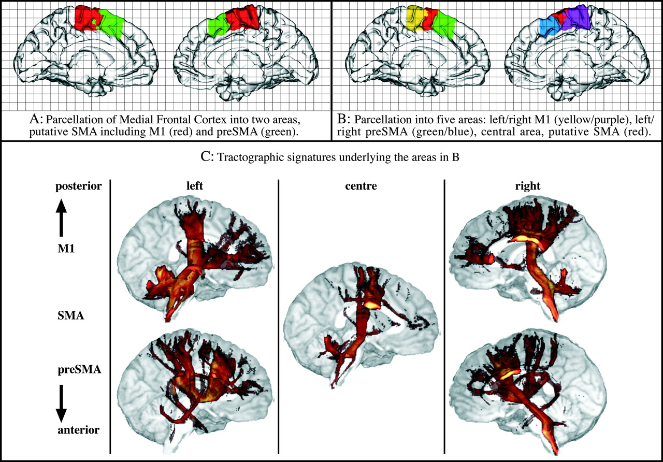
Figure 3. Parcellation of the medial frontal cortex in one subject (subject II). (A) and (B) Color-coded areas are ...
Notes:
Figure 3. Parcellation of the medial frontal cortex in one subject (subject II). (A) and (B) Color-coded areas are projected onto the medial surfaces of the left and right hemispheres. (A) Two clusters divide the area along the AC line into an anterior and a posterior part. (B) Five clusters separate between the hemispheres, leaving one common area just posterior to the AC line. (C) Tractographic signatures of the areas shown in (B) viewed from the midsagittal plane.
Unless provided in the caption above, the following copyright applies to the content of this slide: © The Author 2006. Published by Oxford University Press. All rights reserved. For permissions, please e-mail: journals.permissions@oxfordjournals.org

Slide 4
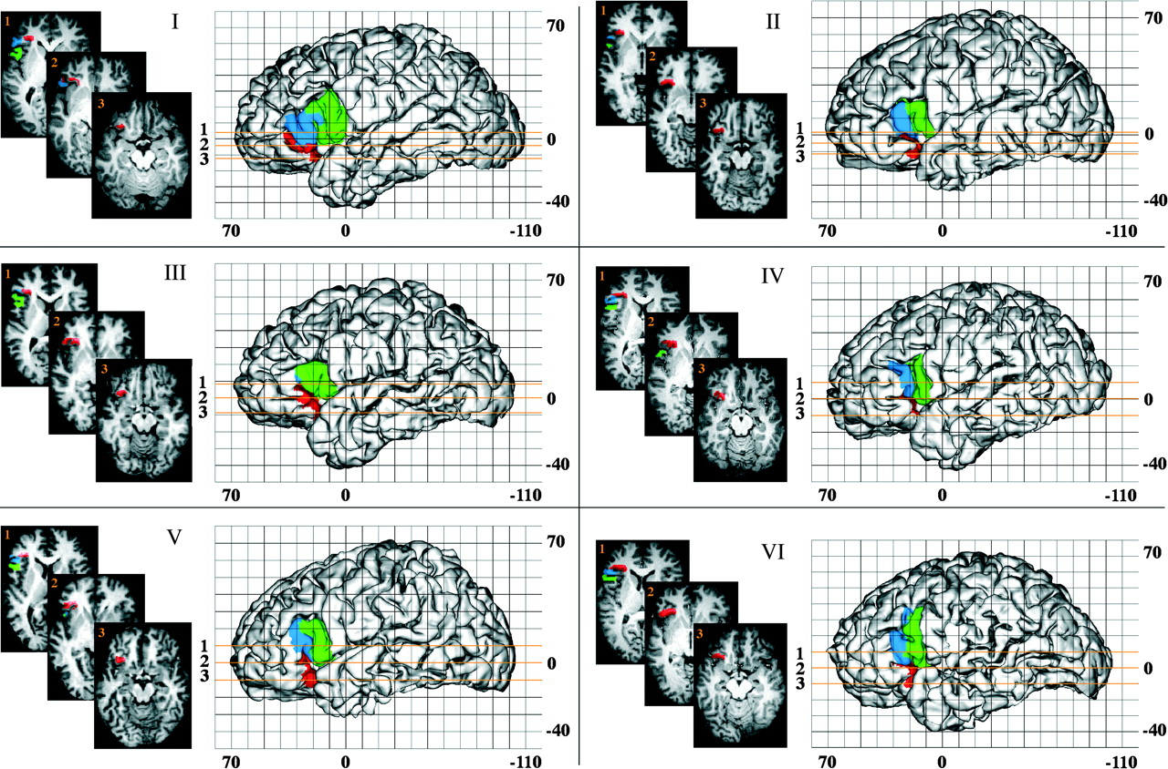
Figure 4. Parcellation results for the IFC into 3 clusters for 6 subjects plotted on the Talairach scaled cortical ...
Notes:
Figure 4. Parcellation results for the IFC into 3 clusters for 6 subjects plotted on the Talairach scaled cortical surfaces. Insets show axial slices at 3 different levels that equidistantly cut through the parcellated areas. Note the high intersubject variability with respect to 1) differences in shape and size of both areas, 2) variability in the sulcal pattern, and 3) in the relationship of areal borders to surrounding sulci.
Unless provided in the caption above, the following copyright applies to the content of this slide: © The Author 2006. Published by Oxford University Press. All rights reserved. For permissions, please e-mail: journals.permissions@oxfordjournals.org

Slide 5
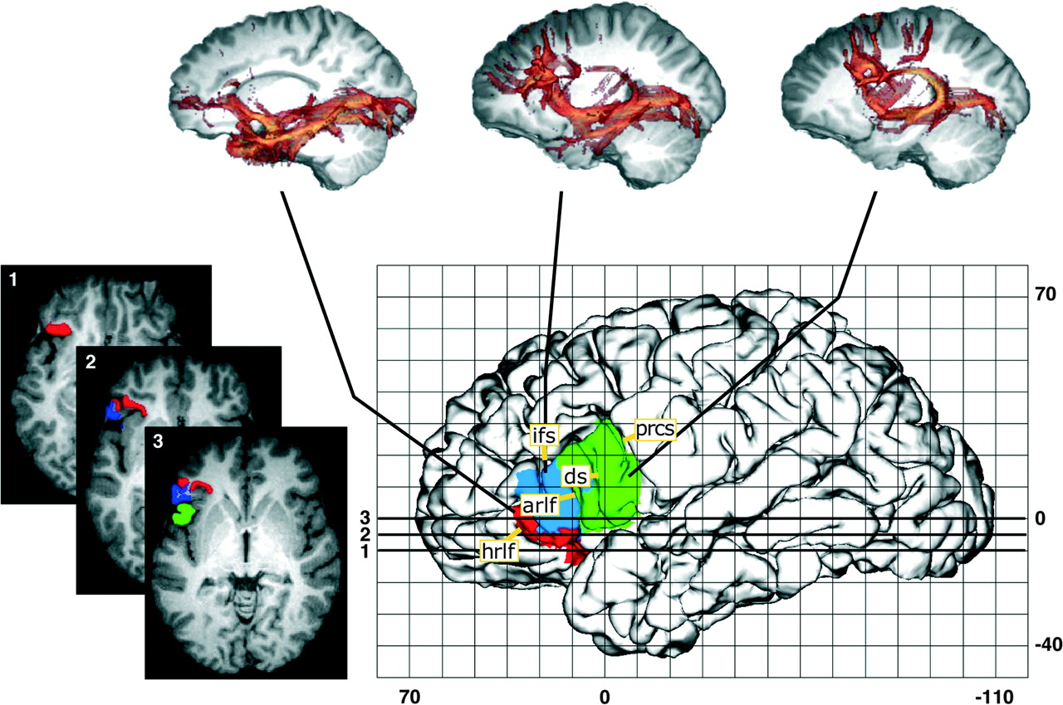
Figure 5. Parcellation and signatures of the left IFC at the example of subject I. arlf, denotes ascending branch of ...
Notes:
Figure 5. Parcellation and signatures of the left IFC at the example of subject I. arlf, denotes ascending branch of the lateral fissure; ds, diagonal sulcus; hrlf, horizontal branch of the lateral fissure; ifs, inferior frontal sulcus; prcs, precentral sulcus.
Unless provided in the caption above, the following copyright applies to the content of this slide: © The Author 2006. Published by Oxford University Press. All rights reserved. For permissions, please e-mail: journals.permissions@oxfordjournals.org

Slide 6
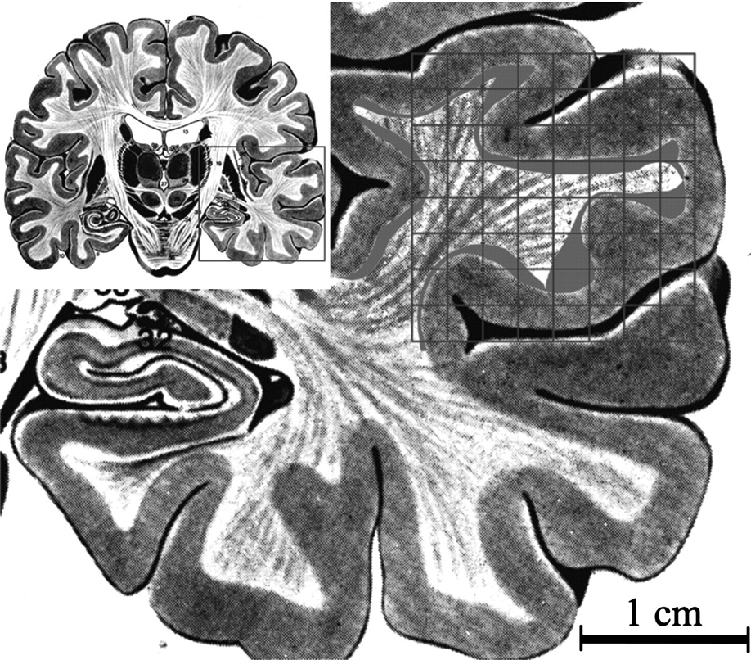
Figure 6. Illustration of typical DTI resolution (2.5 mm) in relation to anatomical structures of the temporal lobe. In ...
Notes:
Figure 6. Illustration of typical DTI resolution (2.5 mm) in relation to anatomical structures of the temporal lobe. In particular, u-fibers are sketched in green and the long association fibers in blue. (The figure has been adapted from Nieuwenhuys and others [1988]).
Unless provided in the caption above, the following copyright applies to the content of this slide: © The Author 2006. Published by Oxford University Press. All rights reserved. For permissions, please e-mail: journals.permissions@oxfordjournals.org

Slide 7
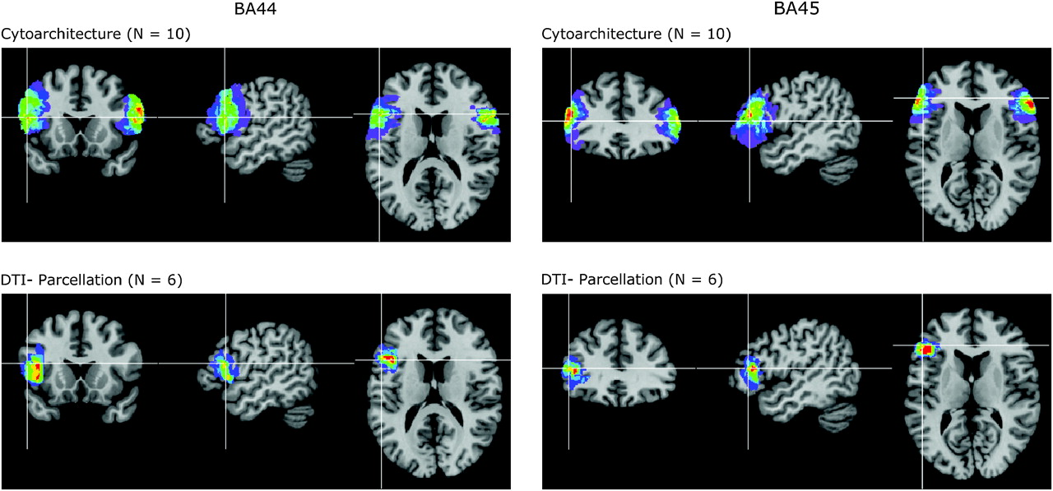
Figure 7. Probability maps of BA 44 and 45 based on cytoarchitectonic (http://www.fz-juelich.de/ime/index.php?index=51, ...
Notes:
Figure 7. Probability maps of BA 44 and 45 based on cytoarchitectonic (http://www.fz-juelich.de/ime/index.php?index=51, see also Amunts and others 1999) and connectivity-based parcellation. Data from the individual subjects were transferred to the spatially normalized, T1-weighted MR single-subject brain of the montreal neurological institute (http://www.bic.mni.mcgill.ca, Collins and others 1994). The number of overlapping brains in each voxel of the standard brain is color coded: The color scale extents from violet (1 subject) to red (6 or 10 subjects, respectively). Coordinates of the curser cross are x = −51, y = 12, z = 17 for BA 44 and x = −47, y = 28, z = 13 for BA 45, respectively. Left in the image is left in the brain.
Unless provided in the caption above, the following copyright applies to the content of this slide: © The Author 2006. Published by Oxford University Press. All rights reserved. For permissions, please e-mail: journals.permissions@oxfordjournals.org

