Slide 1
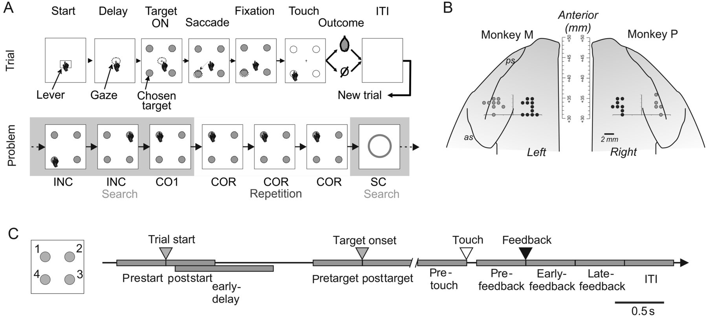
Figure 1. Task, recording sites, and trial epochs for analyses. (A) Problem Solving task. Monkeys had to find by trial ...
Notes:
Figure 1. Task, recording sites, and trial epochs for analyses. (A) Problem Solving task. Monkeys had to find by trial and error which target, presented in a set of 4, was rewarded. Trial: description of events in a trial (see Materials and methods). A juice reward is delivered if the trial was correct while only a blank screen is presented for errors. Problem: In each trial the animal could select a target until the solution was discovered (search period). Each block of trials (or problem) contained a search period and a repetition period during which the correct response was repeated at least 3 times. A Signal-to-Change is presented on the screen to indicate the beginning of a new problem. (B) Recording sites for LPFC (gray spots) and dACC (black spots) for the 2 monkeys. dACC recordings covered a region in the dorsal bank of the anterior cingulate sulcus, at stereotaxic levels superior to A + 30, that is, rostral levels of the midcingulate cortex. Recording sites in LPFC were located on the posterior third of the principal sulcus. (C) Target identifications and definition of epochs used for single unit analyses.
Unless provided in the caption above, the following copyright applies to the content of this slide: © The Author 2014. Published by Oxford University Press. All rights reserved. For Permissions, please e-mail: journals.permissions@oup.com

Slide 2
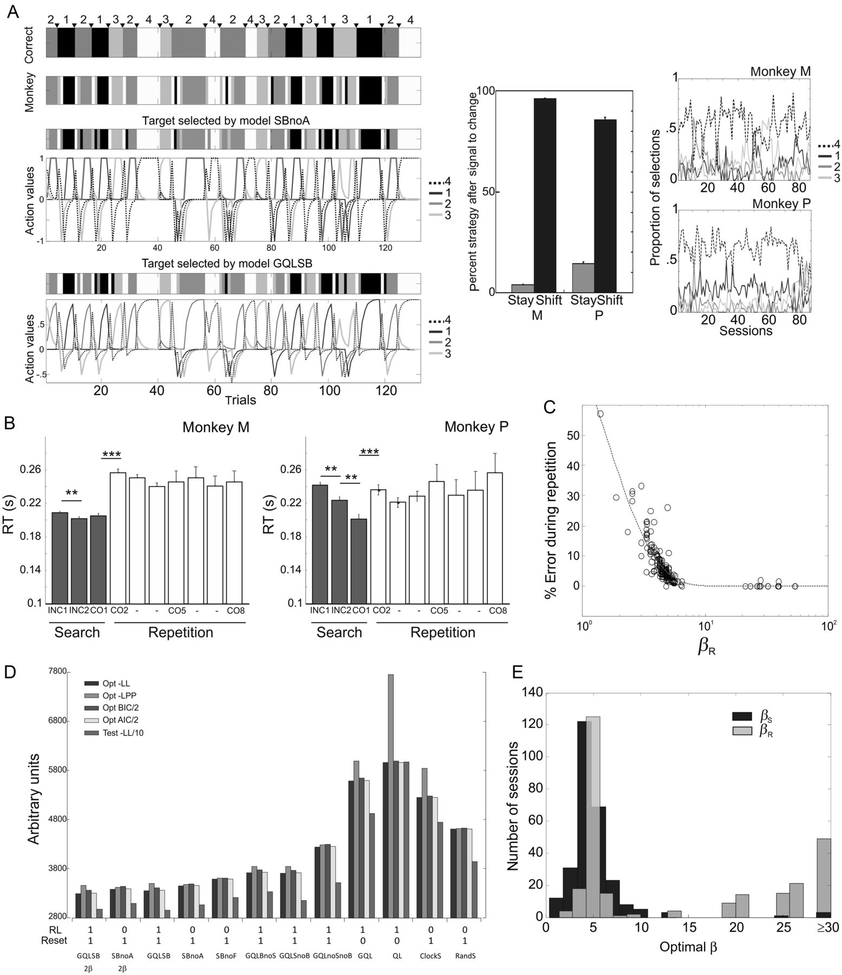
Figure 2. Model-based behavioral analyses. (A, left) Illustration of the trial by trial evolution of action values ...
Notes:
Figure 2. Model-based behavioral analyses. (A, left) Illustration of the trial by trial evolution of action values after meta-parameters optimization so that the model behaves similarly to the monkey. Sample data presented for 100 successive trials. The barcode on the top indicates the current correct target. Each of the 4 targets is associated with one gray level. Head arrows represent the SC presented at the beginning of each new problem. The second barcode indicates the target selected by the animal in each trial. The third barcode indicates the target selected by the model based on the feedback obtained by the animal. Variation of action values for each of the 4 targets are represented by curves. The high learning rate (α = 0.9) that resulted from the optimization produced sharp variations of action values. The data are presented for 2 models (SBnoA and GQLSB). (A, middle) Proportion of shifts after SC for monkeys M and P. (A, right) Proportion of selection of each target in the first trial of each problem across sessions of recordings. Each line represents one target position. (B) Reaction times (RT) measured in 2 monkeys averaged for typical optimal problems: those where the monkey made 2 errors (INC1 and INC2) during the search period, found the correct target (CO1) in the third trial, and repeated the correct choice from 3 to 7 times (CO2–CO8), depending on the problem's length, during repetition trials. **P < 0.005, ***P < 0.001. (C) Percentage of errors made by the animal during the repetition periods against the exploration rate βR of the repetition periods. One data point per session. (D) Scores obtained by each tested model during the model comparison analysis (see Materials and methods). Opt −LL = negative LL on the optimization dataset. −LPP = negative log of posterior probability. BIC = Bayesian information criterion. AIC = Akaike information criterion. Test −LL = negative LL on the test dataset. (E) Distribution of exploration meta-parameters obtained after optimization of the model on monkey's behavior using distinct degrees of freedom during the search period (βS) and the repetition period (βR).
Unless provided in the caption above, the following copyright applies to the content of this slide: © The Author 2014. Published by Oxford University Press. All rights reserved. For Permissions, please e-mail: journals.permissions@oup.com

Slide 3
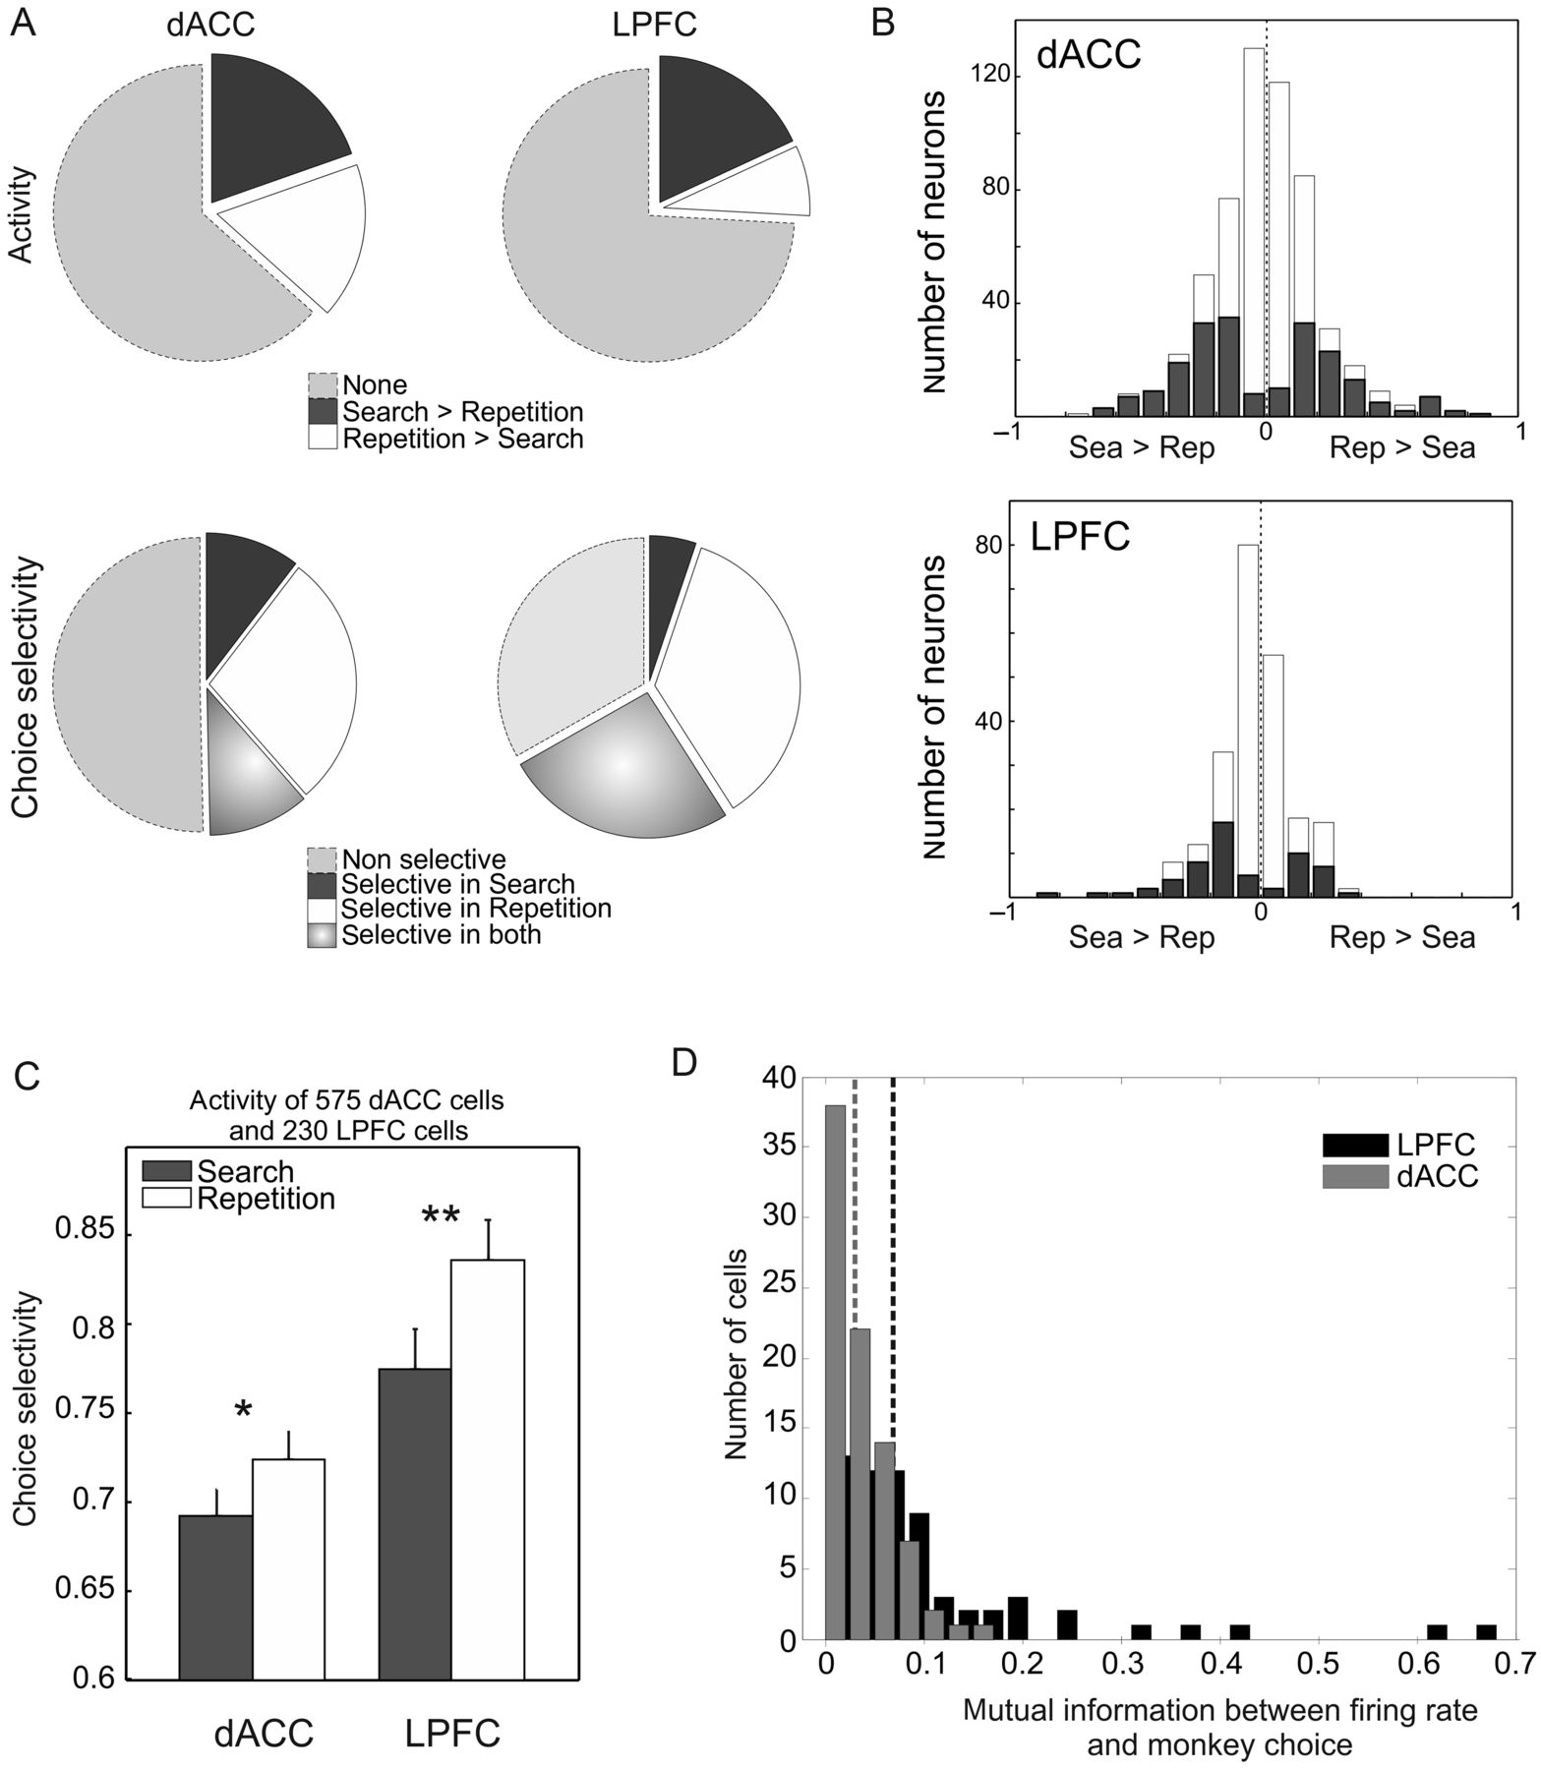
Figure 3. Variations of early–delay activity and choice selectivity. (A, top) Proportions of dACC and LPFC cells with a ...
Notes:
Figure 3. Variations of early–delay activity and choice selectivity. (A, top) Proportions of dACC and LPFC cells with a higher activity during search or repetition. (A, bottom) Proportions of dACC and LPFC cells with a higher choice selectivity during Sea or Rep. (B) Number of cells with significant changes (in gray) in average unit activity between search (Sea) and repetition (Rep). The histograms represent the distribution of indices of variation of activity from search to repetition computed in the early–delay epoch with equation (9) in dACC and LPFC neurons. Gray bars represent neurons with significantly different activity between search and repetition trials (Kruskal–Wallis test, P < 0.05). White bars represent neurons with non-significantly different activity in search and repetition. (C) Increase of choice selectivity from search to repetition in the 2 structures. Stars indicate statistically significant comparisons *P < 0.05, **P < 0.01. (D) Compared with dACC neurons (gray bars), a higher proportion of LPFC neurons showed significant mutual information between the early–delay average firing rate and the animal's choice. Dashed gray and black lines represent the medians for dACC and LPFC, respectively.
Unless provided in the caption above, the following copyright applies to the content of this slide: © The Author 2014. Published by Oxford University Press. All rights reserved. For Permissions, please e-mail: journals.permissions@oup.com

Slide 4
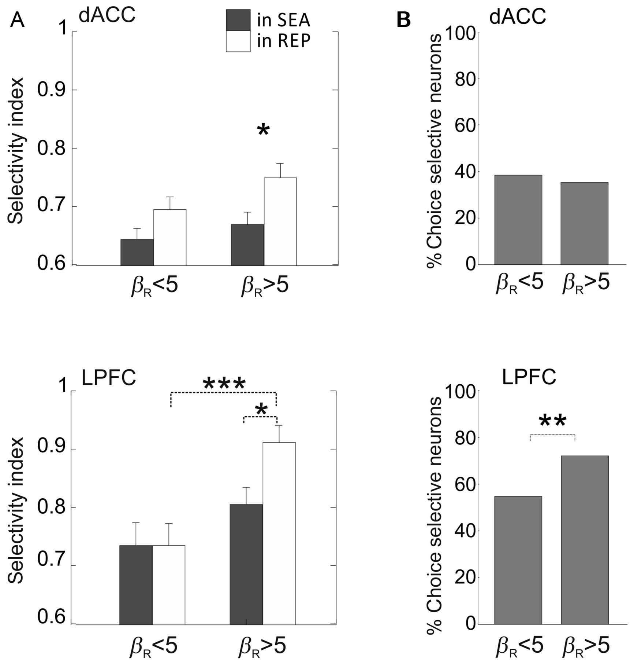
Figure 4. Early–delay choice selectivity varies with exploration level. (A) The average choice selectivity index is ...
Notes:
Figure 4. Early–delay choice selectivity varies with exploration level. (A) The average choice selectivity index is presented for units recorded in dACC (top) and LPFC (bottom), in sessions grouped according to the fitted model's exploration meta-parameters for repetition (βR). The average population index is measured for search (gray bars) and repetition (white bars) trials in the early–delay epoch, separately for sessions where βR was inferior or superior to 5. Stars indicate statistically significant comparisons. *P < 0.05. (B) Proportion of dACC and LPFC early–delay choice selective neurons during repetition periods of sessions where βR was small (5). Only LPFC revealed a significant change in proportion.
Unless provided in the caption above, the following copyright applies to the content of this slide: © The Author 2014. Published by Oxford University Press. All rights reserved. For Permissions, please e-mail: journals.permissions@oup.com

Slide 5
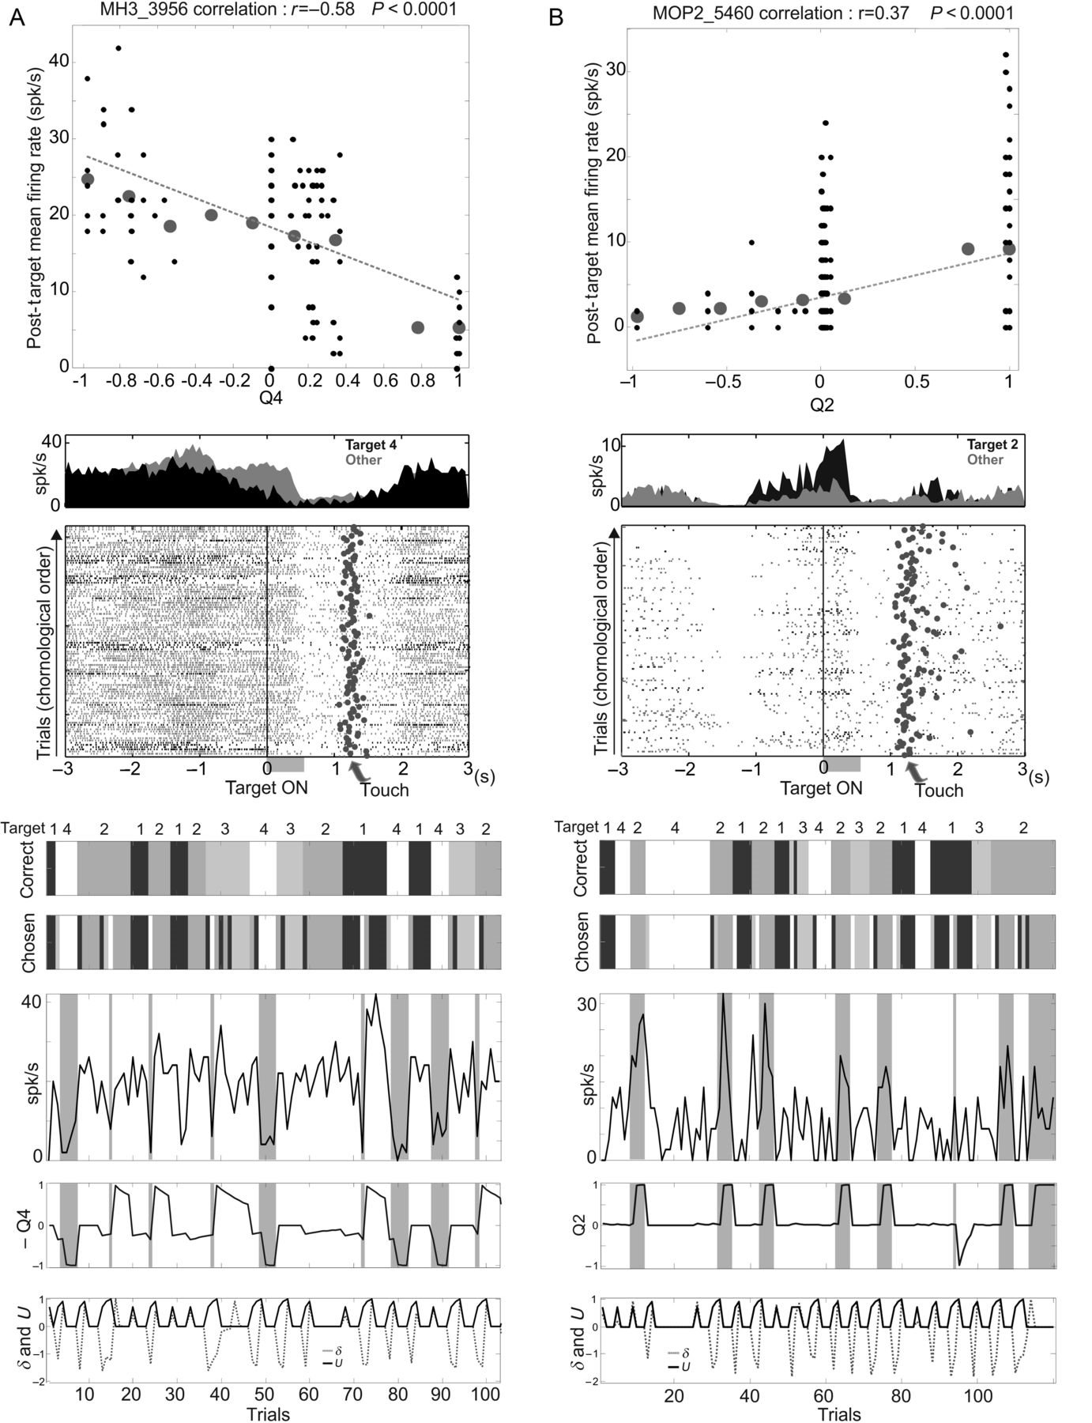
Figure 5. Two examples of action value neurons. (A) dACC unit negatively correlated with the value of Target #4. (Top) ...
Notes:
Figure 5. Two examples of action value neurons. (A) dACC unit negatively correlated with the value of Target #4. (Top) plot of single trial activity (black dots) measured in the post-target epoch against the Q-value, for trials where the animal chose Target 4. Large gray dots represent the average for one decile of the value distribution and are just used for illustration. The dashed line represents the linear regression computed from single trial data. (Middle) peristimulus histograms aligned on target onset (Target ON) and the corresponding raster plots for trials in which the animal chose Target 4 (in black) and for the other trials (in gray). The post-target epoch is represented in gray on the time line. (Bottom) trial-by-trial evolution of the average activity measured in the post-target epoch during successive trials in a session. The upper gray barcode represents the correct target to be chosen (4 grays for 4 target positions; corresponding target number is indicated above the bar code). The second barcode represents the target chosen by the animal in each trial. Below, the graph represents the average activity for each trial and, the trial by trial evolution of key model variables. Gray areas represent trials where the animal selected Target #4. See main text for details. (B) LPFC neuron with a positive correlation with the value of Target #2 during the post-target epoch. Conventions as in A.
Unless provided in the caption above, the following copyright applies to the content of this slide: © The Author 2014. Published by Oxford University Press. All rights reserved. For Permissions, please e-mail: journals.permissions@oup.com

Slide 6
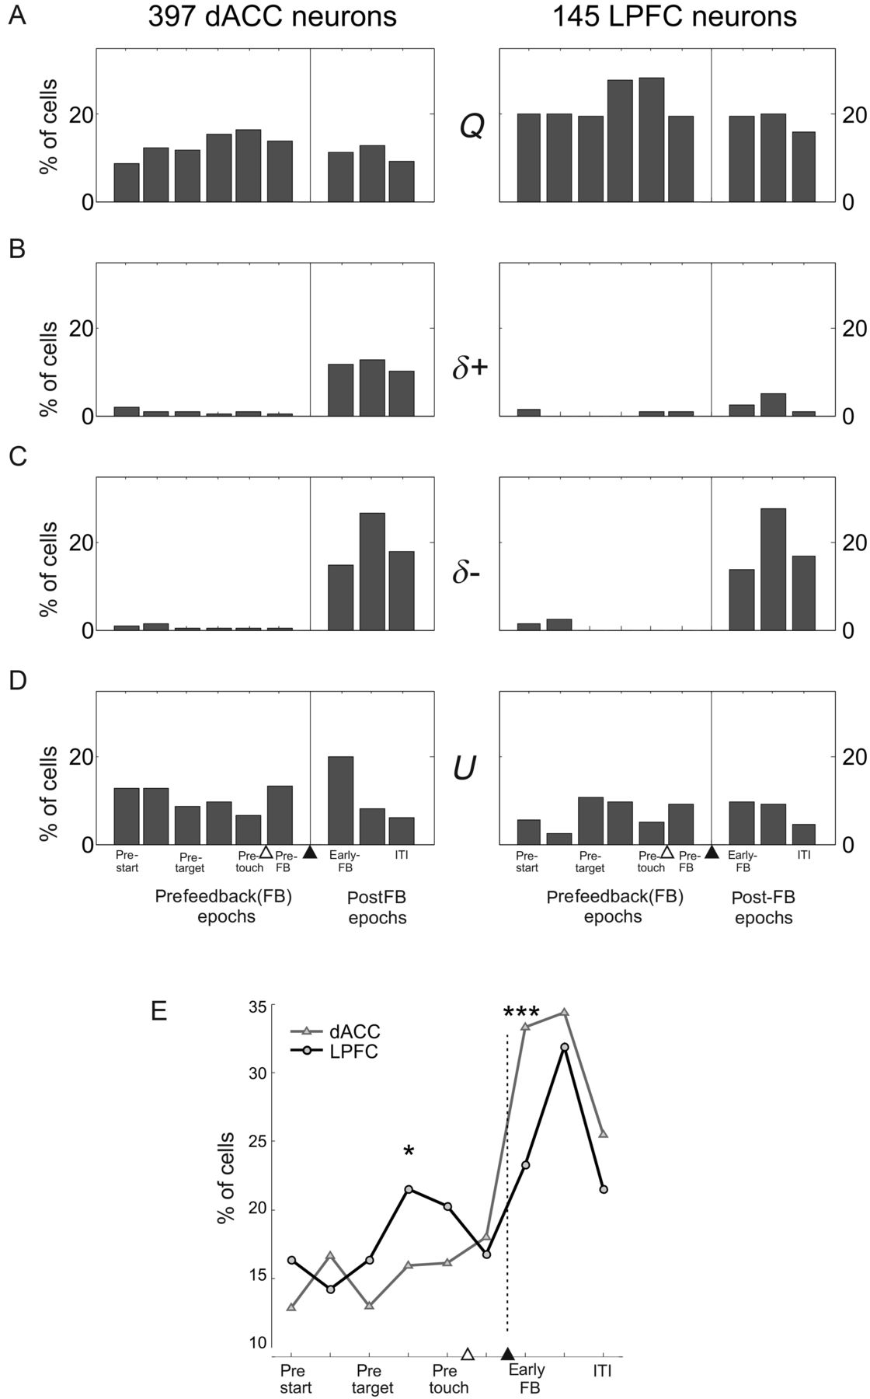
Figure 6. Proportions of dACC and LPFC cells with activity correlated with one of the model variables (Q, δ, and U) in ...
Notes:
Figure 6. Proportions of dACC and LPFC cells with activity correlated with one of the model variables (Q, δ, and U) in one of the 9 trial epochs (bars from left to right: prestart, delay, pretarget, post-target, pretouch, prefeedback, early-feedback, late-feedback, ITI). The white and black arrow heads indicate touch and feedback respectively. There were more LPFC cells correlated with one of the action-values (Q, in A). In B and C, δ+ or δ− represent, respectively, positive and negative correlations with δ. A higher proportion of dACC cells were either positively or negatively correlated with δ (δ+ or δ−) compared with LPFC. These cells mostly responded during postfeedback epochs, and very few cells retained a trace of the previous δ during the beginning of the next trial (prefeedback epochs). There were more U cells in dACC than in LPFC (in D). See text for details. (E) Proportion of cells, for each epoch, showing a significant correlation with at least one model variable.
Unless provided in the caption above, the following copyright applies to the content of this slide: © The Author 2014. Published by Oxford University Press. All rights reserved. For Permissions, please e-mail: journals.permissions@oup.com

Slide 7
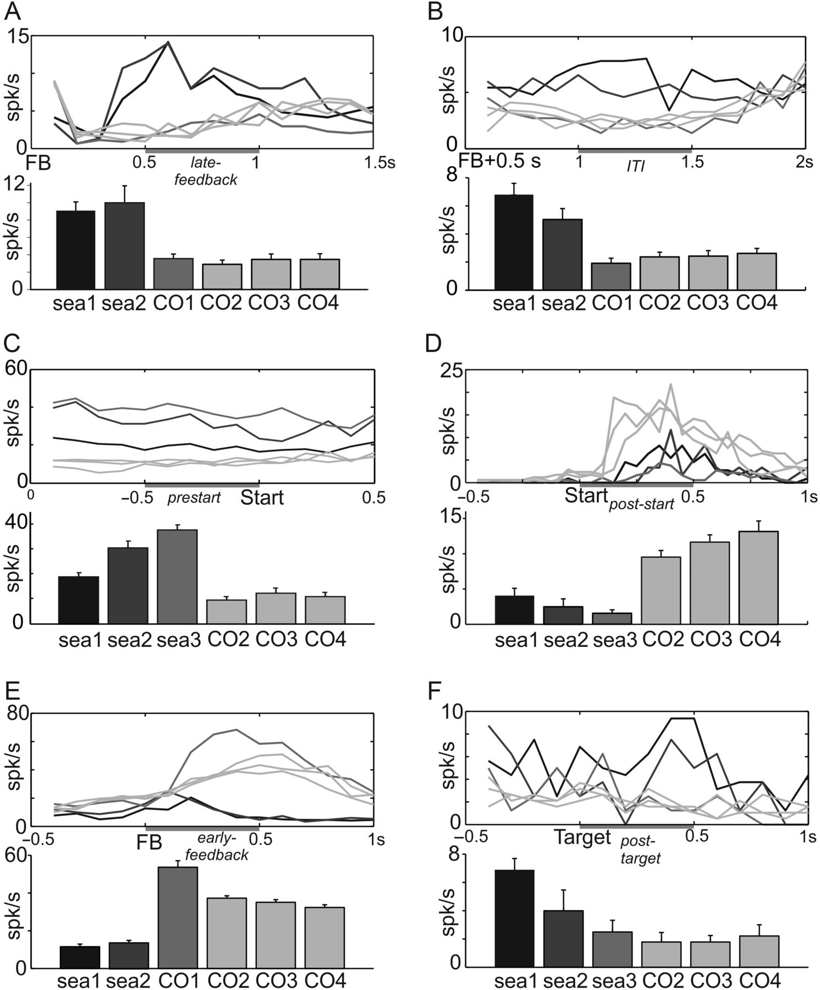
Figure 7. Six examples (A–F) of unit activity correlated with some of the model's variables. Line graphs represent ...
Notes:
Figure 7. Six examples (A–F) of unit activity correlated with some of the model's variables. Line graphs represent average activity aligned on feedback (FB), trial start, or target onset. The gray intensity of lines corresponds to the different trial types as described in the bar graphs below. The gray zone on each time axis represents the epoch used for average measures displayed in the bar graph. Bar graphs represent, for each unit, the average activity measured in the time epoch for the 6 trial types of a typical problem. The trial types in search are: sea1 (first error trial, black), sea2 (second error trial, dark gray), sea3 (third trial in search for activity measured before feedback, gray), and CO1 (first correct trial for activity measured after the feedback, gray in A, B, and E). Trial types in repetition are CO2, CO3, and CO4 (light gray). (A) Example of dACC activity negatively correlated with RPE (δ−). (B) Example of LPFC activity negatively correlated with RPE (δ−). (C) Example of LPFC activity correlated with U. (D) Example of dACC activity negatively correlated with U. (E) Example of dACC activity positively correlated with RPE (δ+). (F) Example of activity discriminating search and repetition but with a different profile than U.
Unless provided in the caption above, the following copyright applies to the content of this slide: © The Author 2014. Published by Oxford University Press. All rights reserved. For Permissions, please e-mail: journals.permissions@oup.com

Slide 8
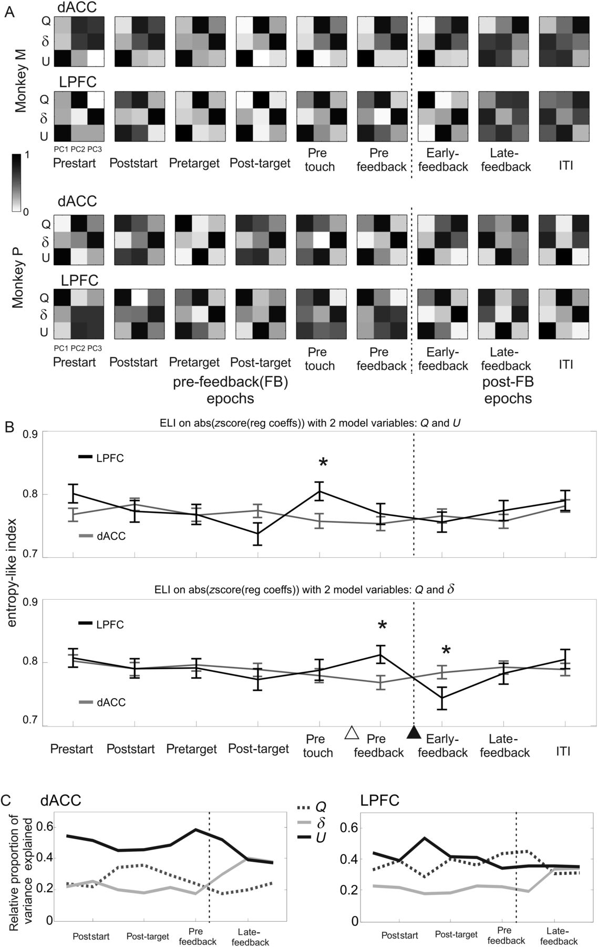
Figure 8. Multiplexing of information and variations during epochs in dACC and LPFC. (A) A PCA was performed on the ...
Notes:
Figure 8. Multiplexing of information and variations during epochs in dACC and LPFC. (A) A PCA was performed on the regression coefficients found for each neuron and for each model variable (Q: the action value of the animal's preferred target, δ, and U; Model GQLSB2β). The absolute value of the eigen values for each principal component computed during the early-feedback epoch are shown in each matrix for one trial epoch. Black denotes strong weights. Data are presented for each monkey M and P. (B) Evolution of the entropy-like factor on regression coefficients computed for 2 variables Q and U, and Q and δ. A * indicates a statistically significant difference between dACC (in gray) and LPFC (in black). (C) Proportion of total variance explained by each model variable over the 3 PCs for dACC and LPFC data along trial epochs. See main text for details.
Unless provided in the caption above, the following copyright applies to the content of this slide: © The Author 2014. Published by Oxford University Press. All rights reserved. For Permissions, please e-mail: journals.permissions@oup.com

Slide 9
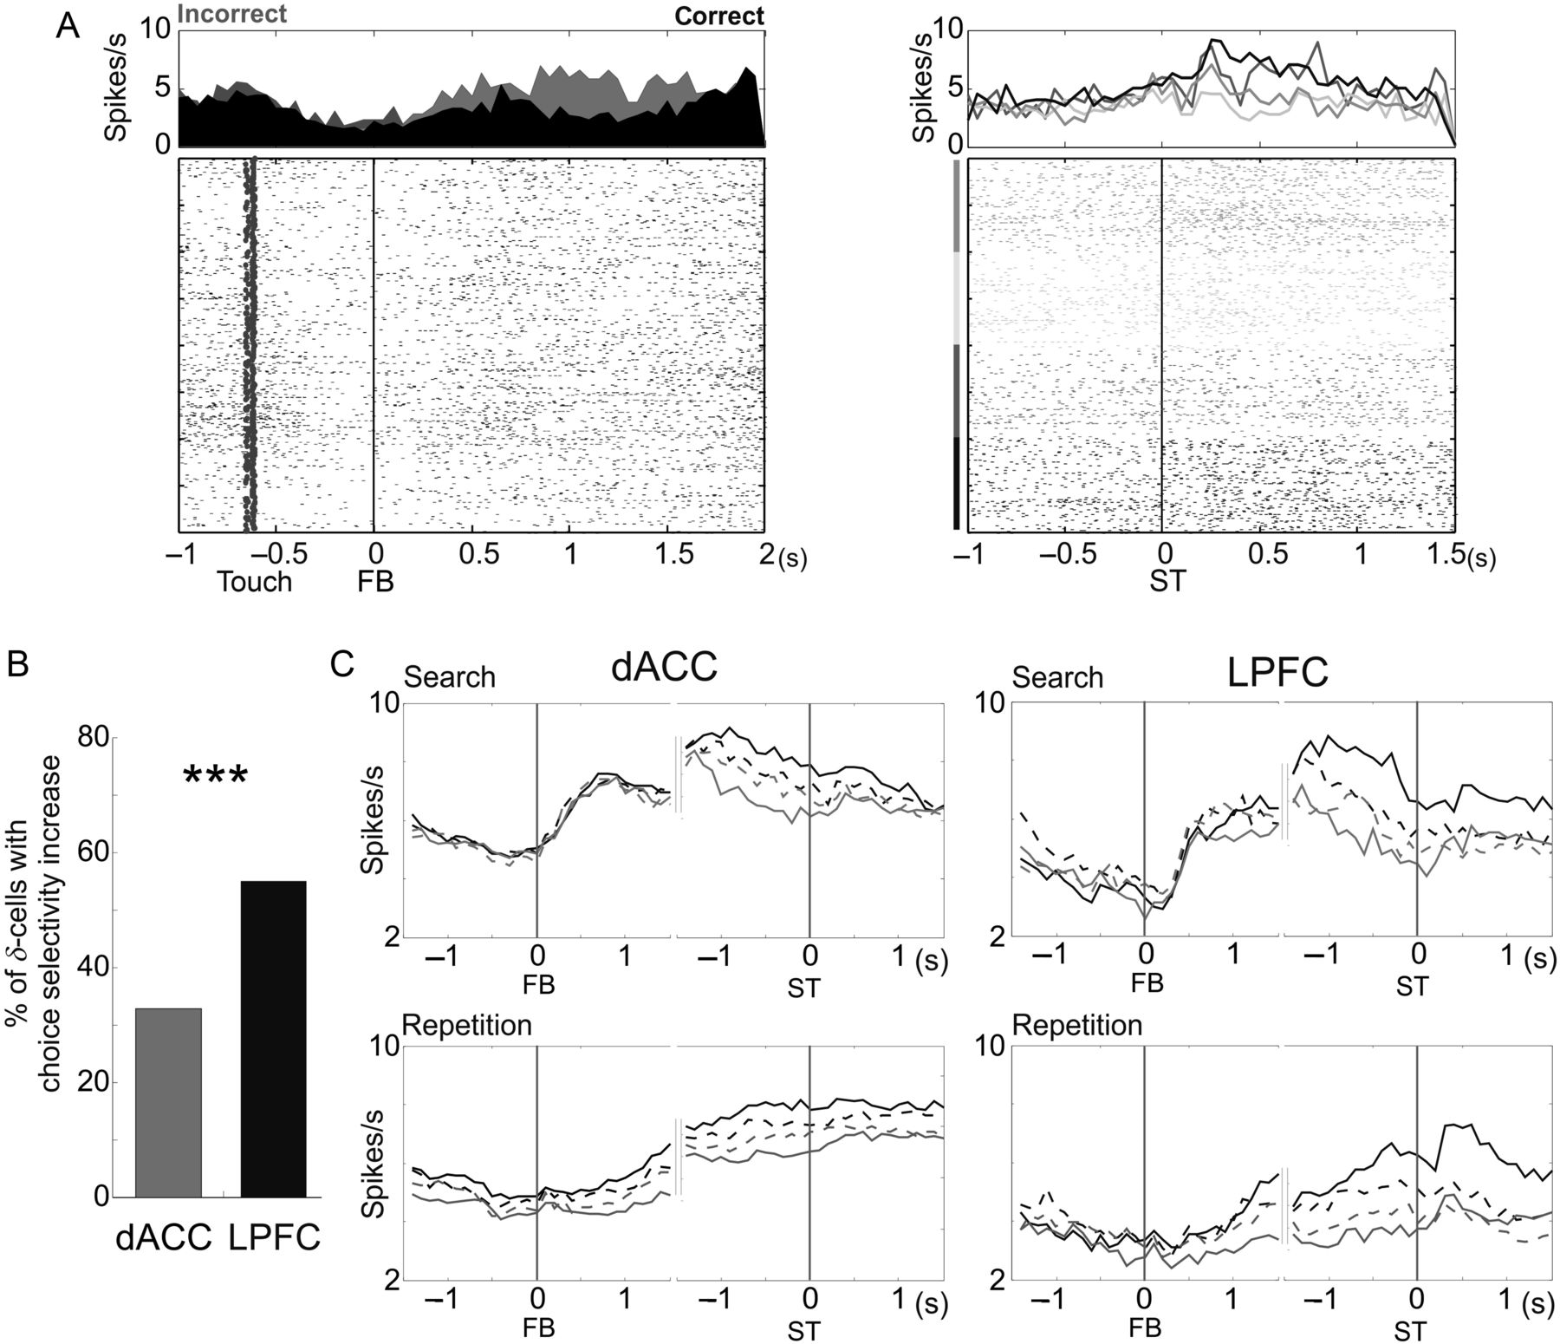
Figure 9. Variations of choice selectivity in δ cells. (A) Example of a LPFC cell responding after errors (activity ...
Notes:
Figure 9. Variations of choice selectivity in δ cells. (A) Example of a LPFC cell responding after errors (activity negatively correlated with δ in the late-feedback epoch) and showing an increase in choice selectivity at the beginning of trials. Left: error trials are illustrated in gray, correct trials in black. Right: trials are grouped by chosen targets. 4 gray curves for 4 target locations. (B) Percentage of dACC and LPFC δ cells showing a significant increase in choice selectivity from search to repetition. (C) Averaged population activity (50 ms bins) of all dACC (left) and LPFC (right) units negatively correlated with δ. For each cell, the activity was averaged separately for trials in which the animal selected the cell's preferred target (black plain line), the second preferred target (black dashed line), the third (gray dashed line) or the least preferred target (gray plain line). The activity is represented in 3 s windows centered on the feedback time (FB, left) and on the next trial start (ST, right), for search trials (top) and repetition trials (bottom). In LPFC, negative δ cells showed an increase in choice selectivity in the poststart epoch of repetition trials.
Unless provided in the caption above, the following copyright applies to the content of this slide: © The Author 2014. Published by Oxford University Press. All rights reserved. For Permissions, please e-mail: journals.permissions@oup.com

