Slide 1
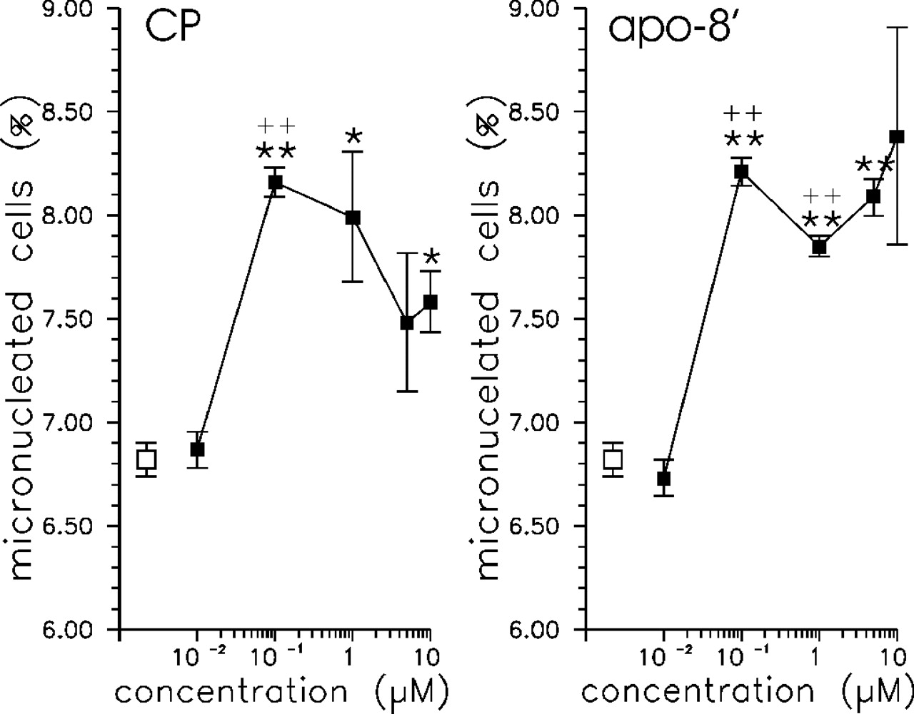
Fig. 1. Frequencies of micronucleated cells in control cultures (open squares) and cultures treated with CP and ...
Notes:
Fig. 1. Frequencies of micronucleated cells in control cultures (open squares) and cultures treated with CP and apo8′-carotenal (closed squares). Data represent the means ± SEM of three independent experiments. *P ≤ 0.05; **P ≤ 0.005 compared with the control. ++P ≤ 0.005 compared with the preceding concentration.
Unless provided in the caption above, the following copyright applies to the content of this slide: Carcinogenesis vol.25 no.5 © Oxford University Press 2004; all rights reserved.

Slide 2
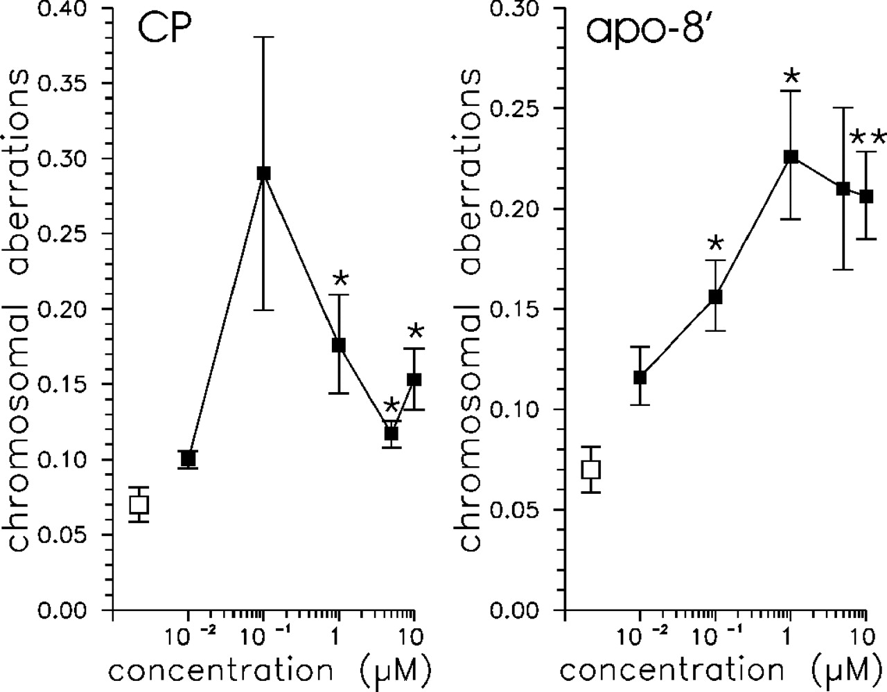
Fig. 2. Frequencies of chromosomal aberrations in control cultures (open squares) and cultures treated with CP and ...
Notes:
Fig. 2. Frequencies of chromosomal aberrations in control cultures (open squares) and cultures treated with CP and apo8′-carotenal. Data represent the means ± SEM of three independent experiments. *P ≤ 0.05; **P ≤ 0.005.
Unless provided in the caption above, the following copyright applies to the content of this slide: Carcinogenesis vol.25 no.5 © Oxford University Press 2004; all rights reserved.

Slide 3
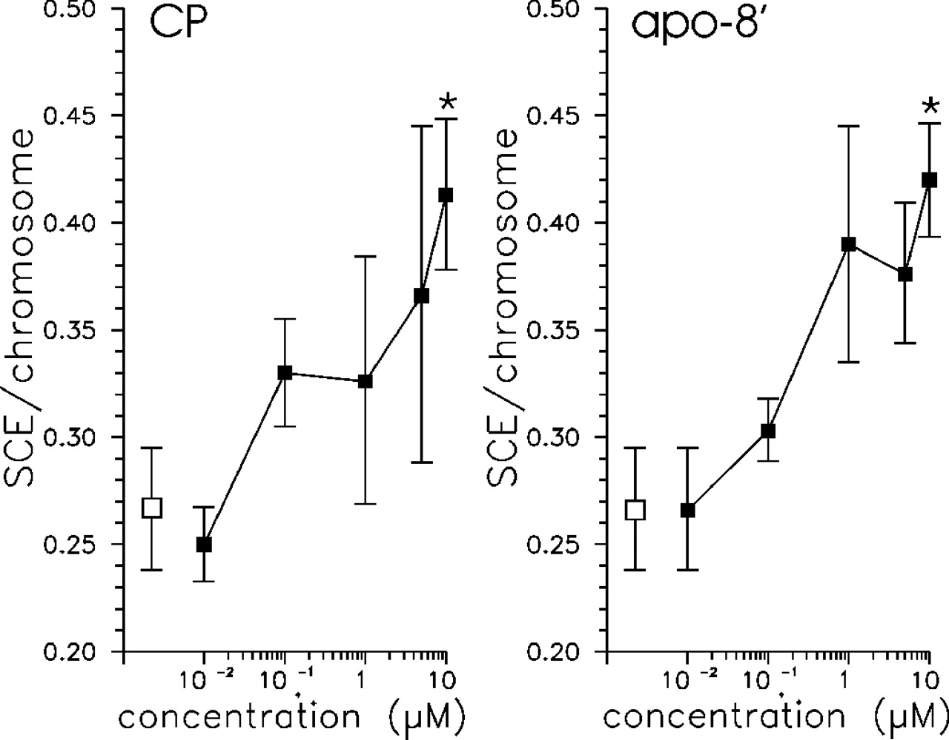
Fig. 3. Frequencies of sister chromatid exchanges in control cultures (open squares) and cultures treated with CP ...
Notes:
Fig. 3. Frequencies of sister chromatid exchanges in control cultures (open squares) and cultures treated with CP and apo8′-carotenal. Data represent the means ± SEM of three independent experiments. *P ≤ 0.05; **P ≤ 0.005.
Unless provided in the caption above, the following copyright applies to the content of this slide: Carcinogenesis vol.25 no.5 © Oxford University Press 2004; all rights reserved.

