Slide 1
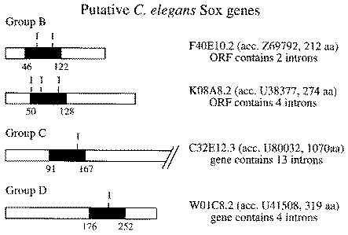
Figure 1 Sox proteins in C.elegans. Four putative translation products corresponding to Sox proteins were identified ...
Notes:
Figure 1 Sox proteins in C.elegans. Four putative translation products corresponding to Sox proteins were identified in genomic sequences from C.elegans using the BLAST search program. The location of the HMG domain within the respective protein is indicated by a black box. The position of introns within the HMG domain is indicated (I).
Unless provided in the caption above, the following copyright applies to the content of this slide: © 1999 Oxford University Press

Slide 2
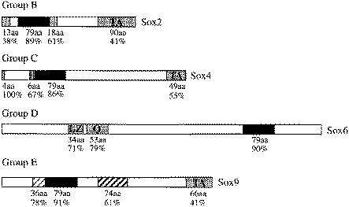
Figure 2 Conserved regions within groups of Sox proteins. In addition to the HMG domain (black box), further regions ...
Notes:
Figure 2 Conserved regions within groups of Sox proteins. In addition to the HMG domain (black box), further regions are conserved between several members of the same group of Sox proteins as indicated by differently shaded and striped boxes. One member of group B-E is shown. Sox2 was compared with Sox1 and Sox3 (99), Sox4 with Sox11, Sox22 and rtSox24 (26), Sox6 with L-Sox5, xSox12 and Sox13 (116), Sox10 with Sox9 and SoxP1 (44). The number of amino acids (aa) and the percentage of amino acid identity (%) between compared Sox proteins is listed below the conserved regions. LZ, leucine zipper; Q, glutamine-rich domain; S, serine-rich domain; TA, transactivation domain
Unless provided in the caption above, the following copyright applies to the content of this slide: © 1999 Oxford University Press

Slide 3
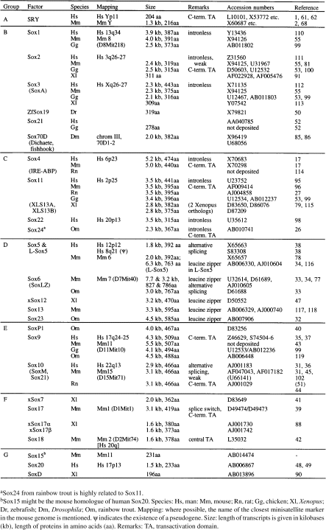
Table 1
Notes:
Table 1
Unless provided in the caption above, the following copyright applies to the content of this slide: © 1999 Oxford University Press

Slide 4
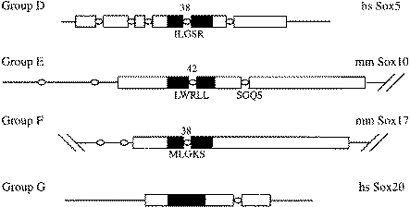
Figure 3 Gene structure for Sox proteins. Selected Sox genes are shown. Members of the Sox group E are known to share ...
Notes:
Figure 3 Gene structure for Sox proteins. Selected Sox genes are shown. Members of the Sox group E are known to share the same genomic organization in their open reading frame. The open reading frame is indicated as a box, the HMG domain is marked in black. Introns are depicted as ellipses. The exact position of introns within the HMG domain and the flanking amino acid sequences are indicated.
Unless provided in the caption above, the following copyright applies to the content of this slide: © 1999 Oxford University Press

Slide 5
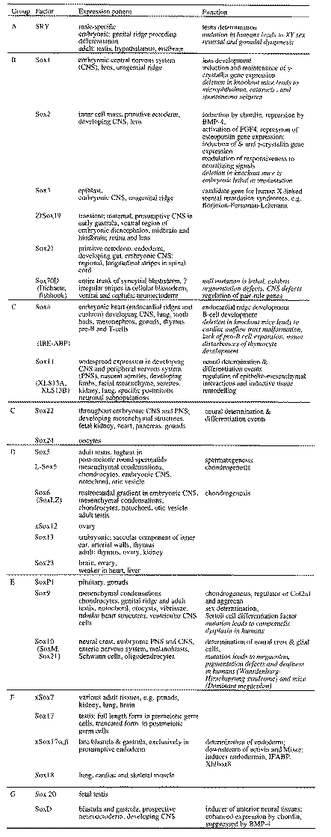
Table 2 Summary of expression patterns and biological function of Sox proteins
Notes:
Table 2 Summary of expression patterns and biological function of Sox proteins
Unless provided in the caption above, the following copyright applies to the content of this slide: © 1999 Oxford University Press

