Slide 1
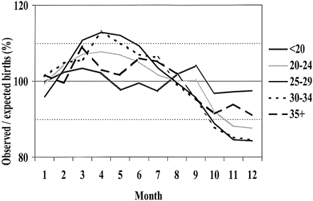
Figure 1. Seasonal variation in births by maternal age group.
Notes:
Figure 1. Seasonal variation in births by maternal age group.
Unless provided in the caption above, the following copyright applies to the content of this slide: © European Society of Human Reproduction and Embryology

Slide 2
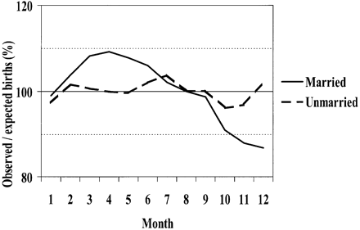
Figure 2. Seasonal variation in births by maternal marital status.
Notes:
Figure 2. Seasonal variation in births by maternal marital status.
Unless provided in the caption above, the following copyright applies to the content of this slide: © European Society of Human Reproduction and Embryology

Slide 3
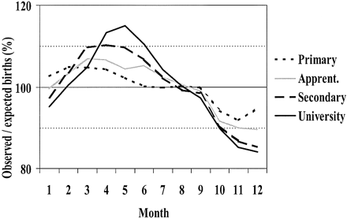
Figure 3. Seasonal variation in births by maternal education.
Notes:
Figure 3. Seasonal variation in births by maternal education.
Unless provided in the caption above, the following copyright applies to the content of this slide: © European Society of Human Reproduction and Embryology

Slide 4
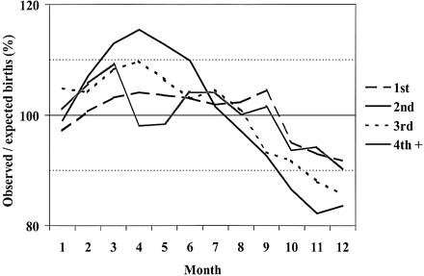
Figure 4. Seasonal variation in births by birth order.
Notes:
Figure 4. Seasonal variation in births by birth order.
Unless provided in the caption above, the following copyright applies to the content of this slide: © European Society of Human Reproduction and Embryology

