Slide 1
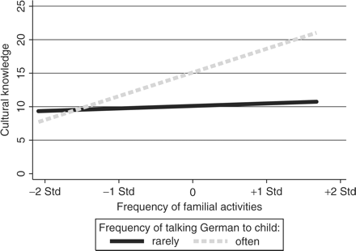
Figure 1 The interaction between familial activities and communication language in Turkish families. Source: Project ...
Notes:
Figure 1 The interaction between familial activities and communication language in Turkish families. Source: Project ‘Preschool Education and Educational Careers among Migrant Children’, own calculations. Notes: Predicted values from Model 8, Table 3 for Turkish families with a 42-month-old boy, both parents born in Turkey, intermediate education, intermediate class position, two children, no house, no crèche attendance, no club/playgroup, child already in preschool, mean level of German proficiency, only few German friends. Frequency ‘rarely’: one standard deviation below the mean. Frequency ‘often’: one standard deviation above the mean.
Unless provided in the caption above, the following copyright applies to the content of this slide: © The Author 2009. Published by Oxford University Press. All rights reserved. For permissions, please e-mail: journals.permissions@oxfordjournals.org

