Slide 1
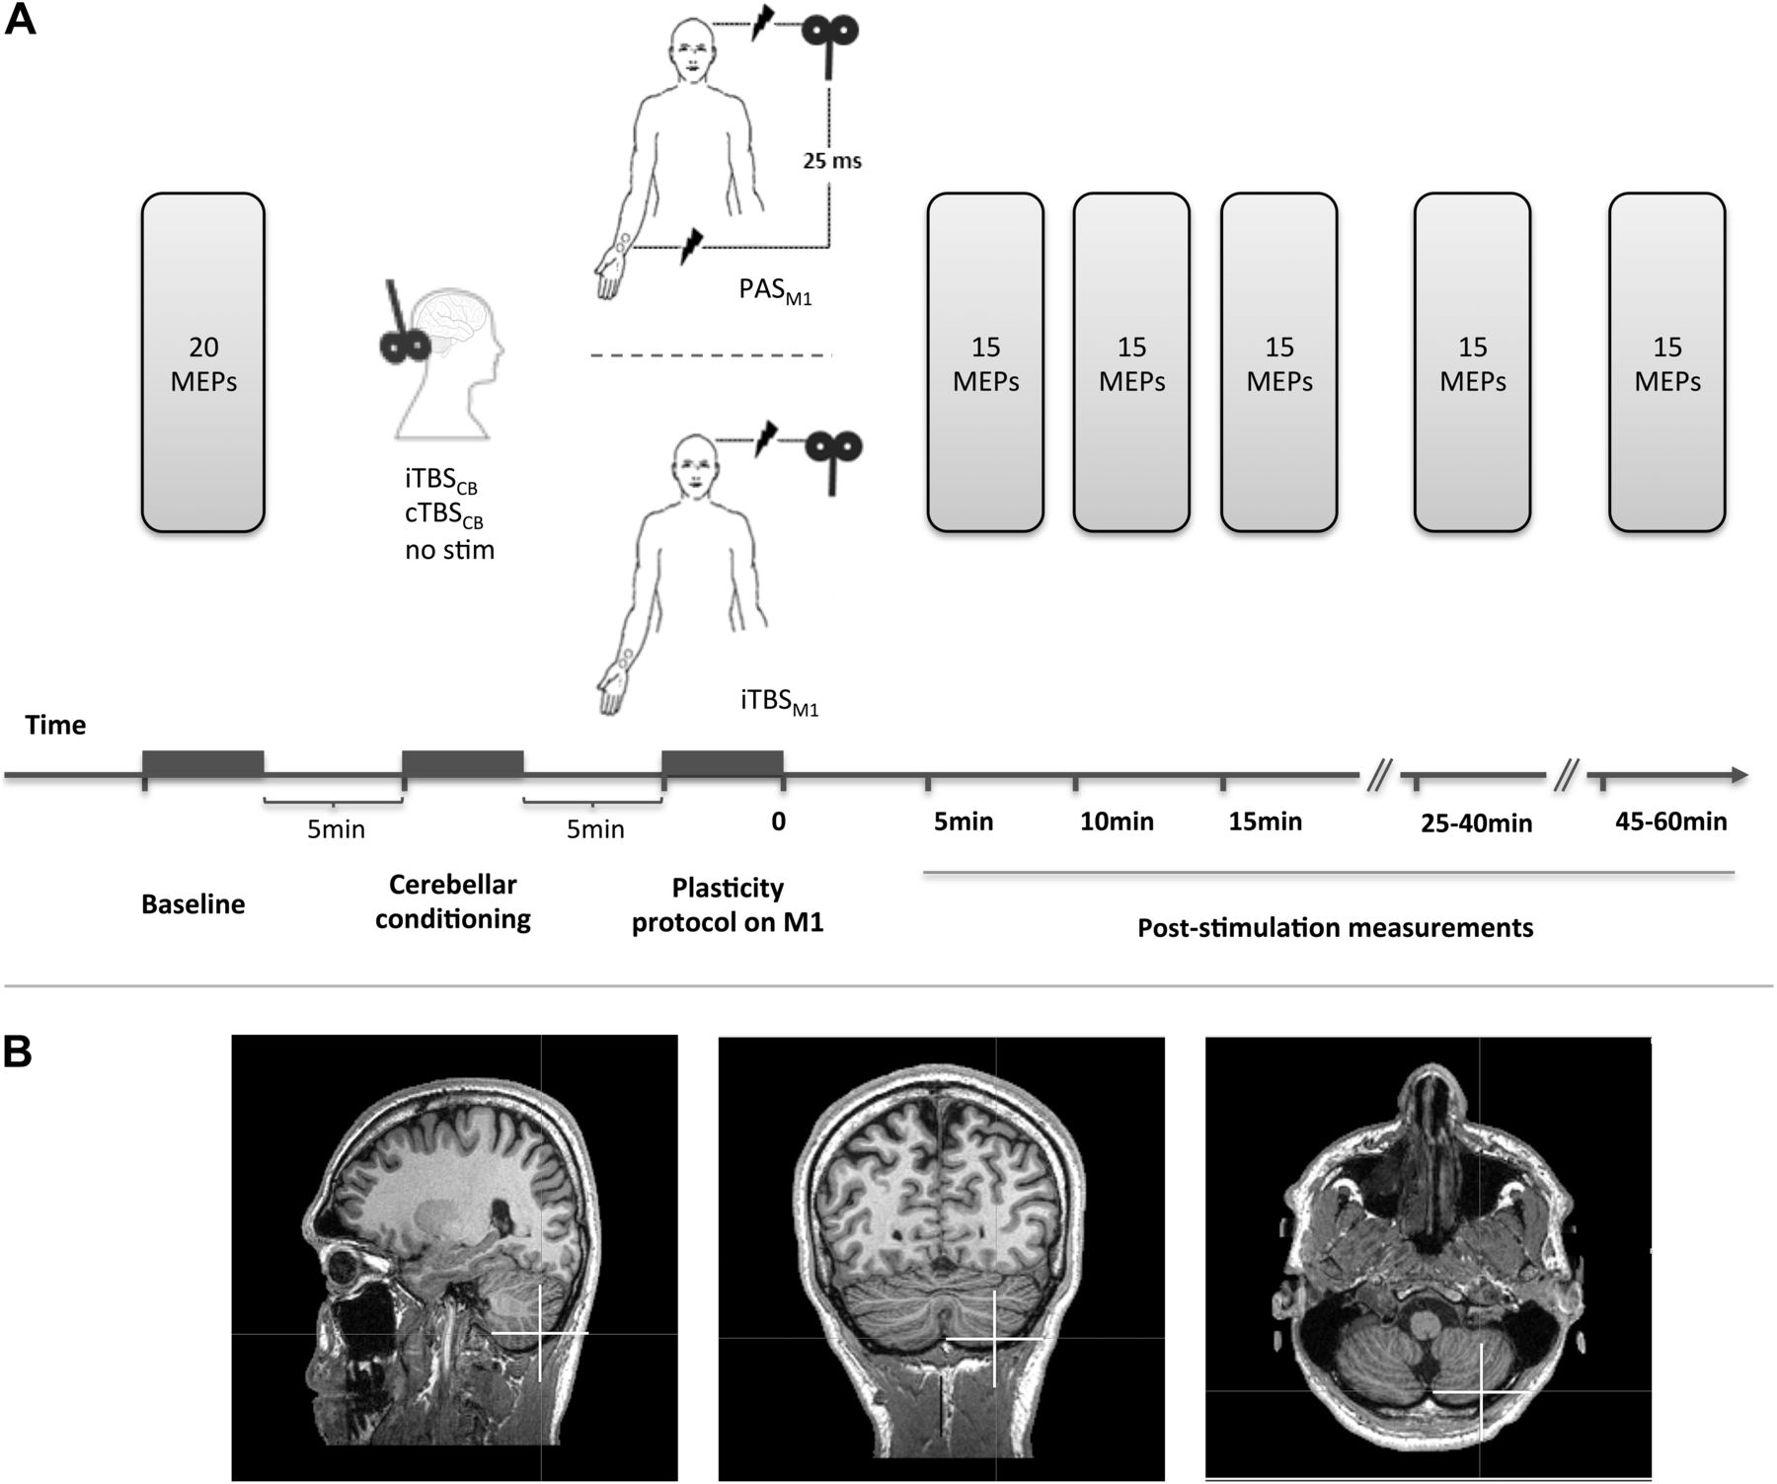
Figure 1. Experimental setup: (A) The MEP amplitudes were measured before and after each plasticity inducing protocol. ...
Notes:
Figure 1. Experimental setup: (A) The MEP amplitudes were measured before and after each plasticity inducing protocol. The protocols consisted of PAS or facilitatory TBS (iTBSM1) of the left primary motor cortex (M1). PAS was delivered alone, or preceded by facilitatory (iTBSCB → PAS) or inhibitory (cTBCCB → PAS) stimulation of the right posterior CB. Facilitatory TBS was delivered to left M1 alone, or preceded by facilitatory (iTBSCB → iTBSM1) or inhibitory (cTBSCB → iTBSM1) stimulation of the right posterior CB. (B) The cerebellar stimulation targeted the posterior part of lobule VIII of the right CB (white cross).
Unless provided in the caption above, the following copyright applies to the content of this slide: © The Author 2012. Published by Oxford University Press. All rights reserved. For permissions, please e-mail: journals.permissions@oup.com

Slide 2
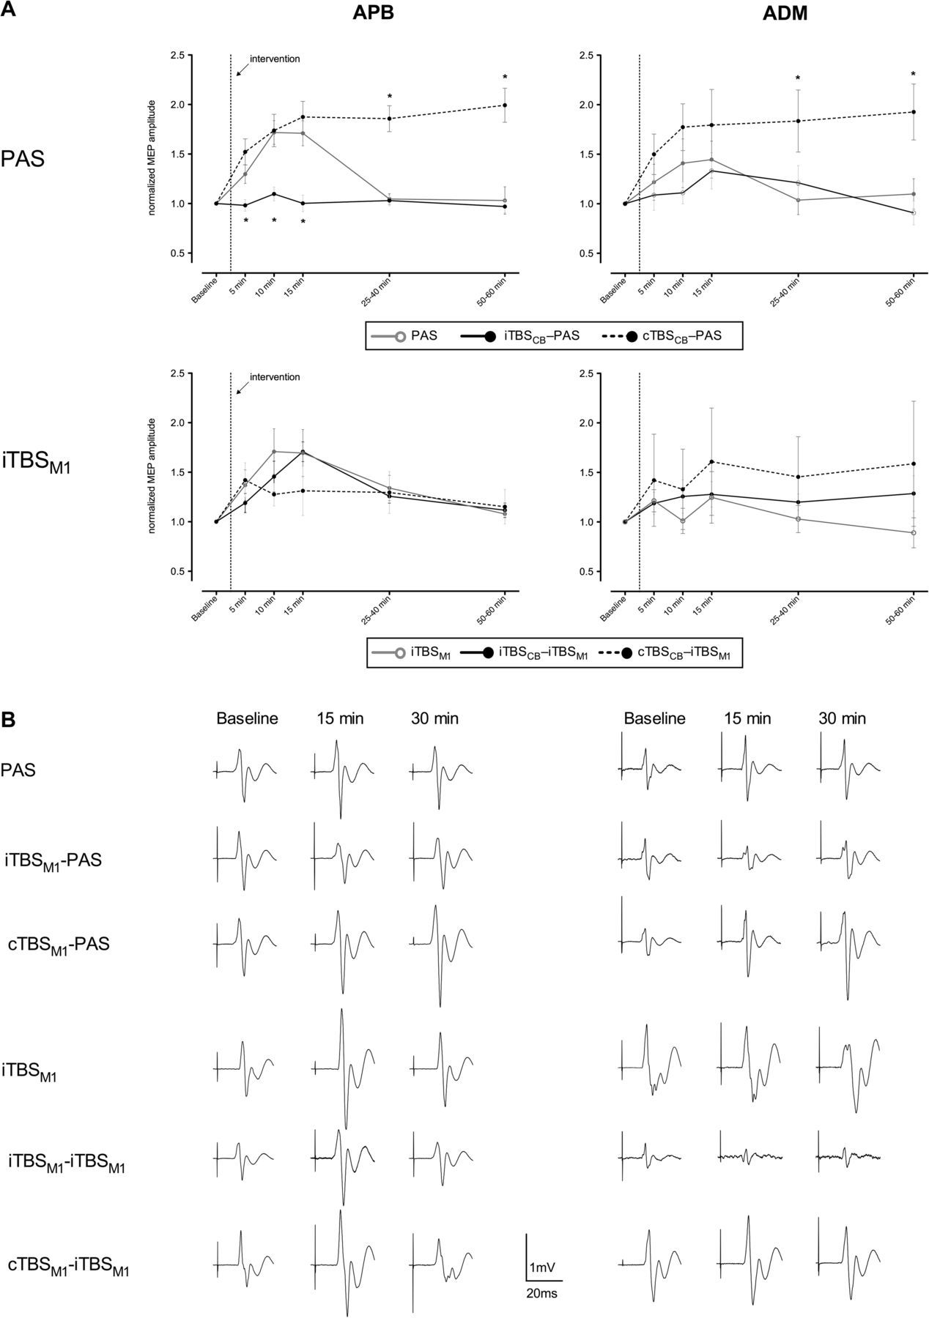
Figure 2. Mean MEPs after each intervention: (A) The “PAS” panels show the effects of PAS and of the cerebellar priming ...
Notes:
Figure 2. Mean MEPs after each intervention: (A) The “PAS” panels show the effects of PAS and of the cerebellar priming on PAS in the same group of subjects. The iTBSM1 panels show the effects of iTBSM1 alone and of the cerebellar priming on iTBSM1 in the same group of subjects, except for the cTBSM1 → iTBSM1 protocol that was performed as a control experiment on a separate set of subjects (analyzed separately vs. their own iTBSM1 session). The MEPs were averaged at several time points before and after each plasticity inducing protocol, then normalized to the prestimulation mean values. Data are presented as means ± standard error. (*) indicates normalized mean MEP amplitudes significantly different from the values obtained after PAS alone (in the “PAS” panels) and after iTBSM1 alone (in the “iTBSM1” panels) at corresponding time points. (B) Examples of nonnormalized mean MEPs from the same subject (except the cTBSCB → iTBSM1 session) representative for each session.
Unless provided in the caption above, the following copyright applies to the content of this slide: © The Author 2012. Published by Oxford University Press. All rights reserved. For permissions, please e-mail: journals.permissions@oup.com

Slide 3
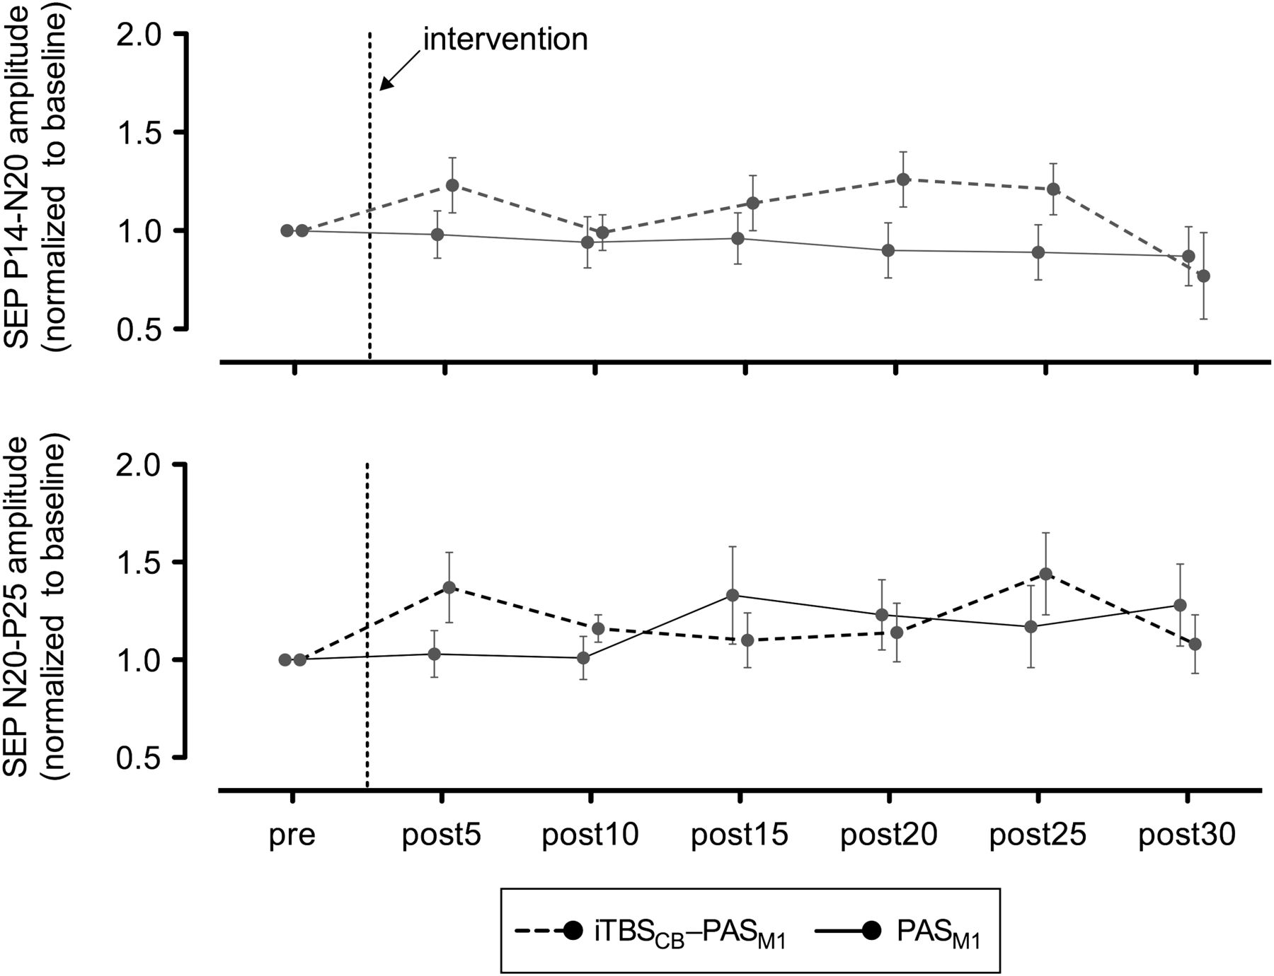
Figure 3. Mean SEPs before and after PAS alone or iTBS_{CB} → PAS, normalized to baseline. Data are presented ...
Notes:
Figure 3. Mean SEPs before and after PAS alone or iTBSCB → PAS, normalized to baseline. Data are presented as means ± standard error.
Unless provided in the caption above, the following copyright applies to the content of this slide: © The Author 2012. Published by Oxford University Press. All rights reserved. For permissions, please e-mail: journals.permissions@oup.com

Slide 4
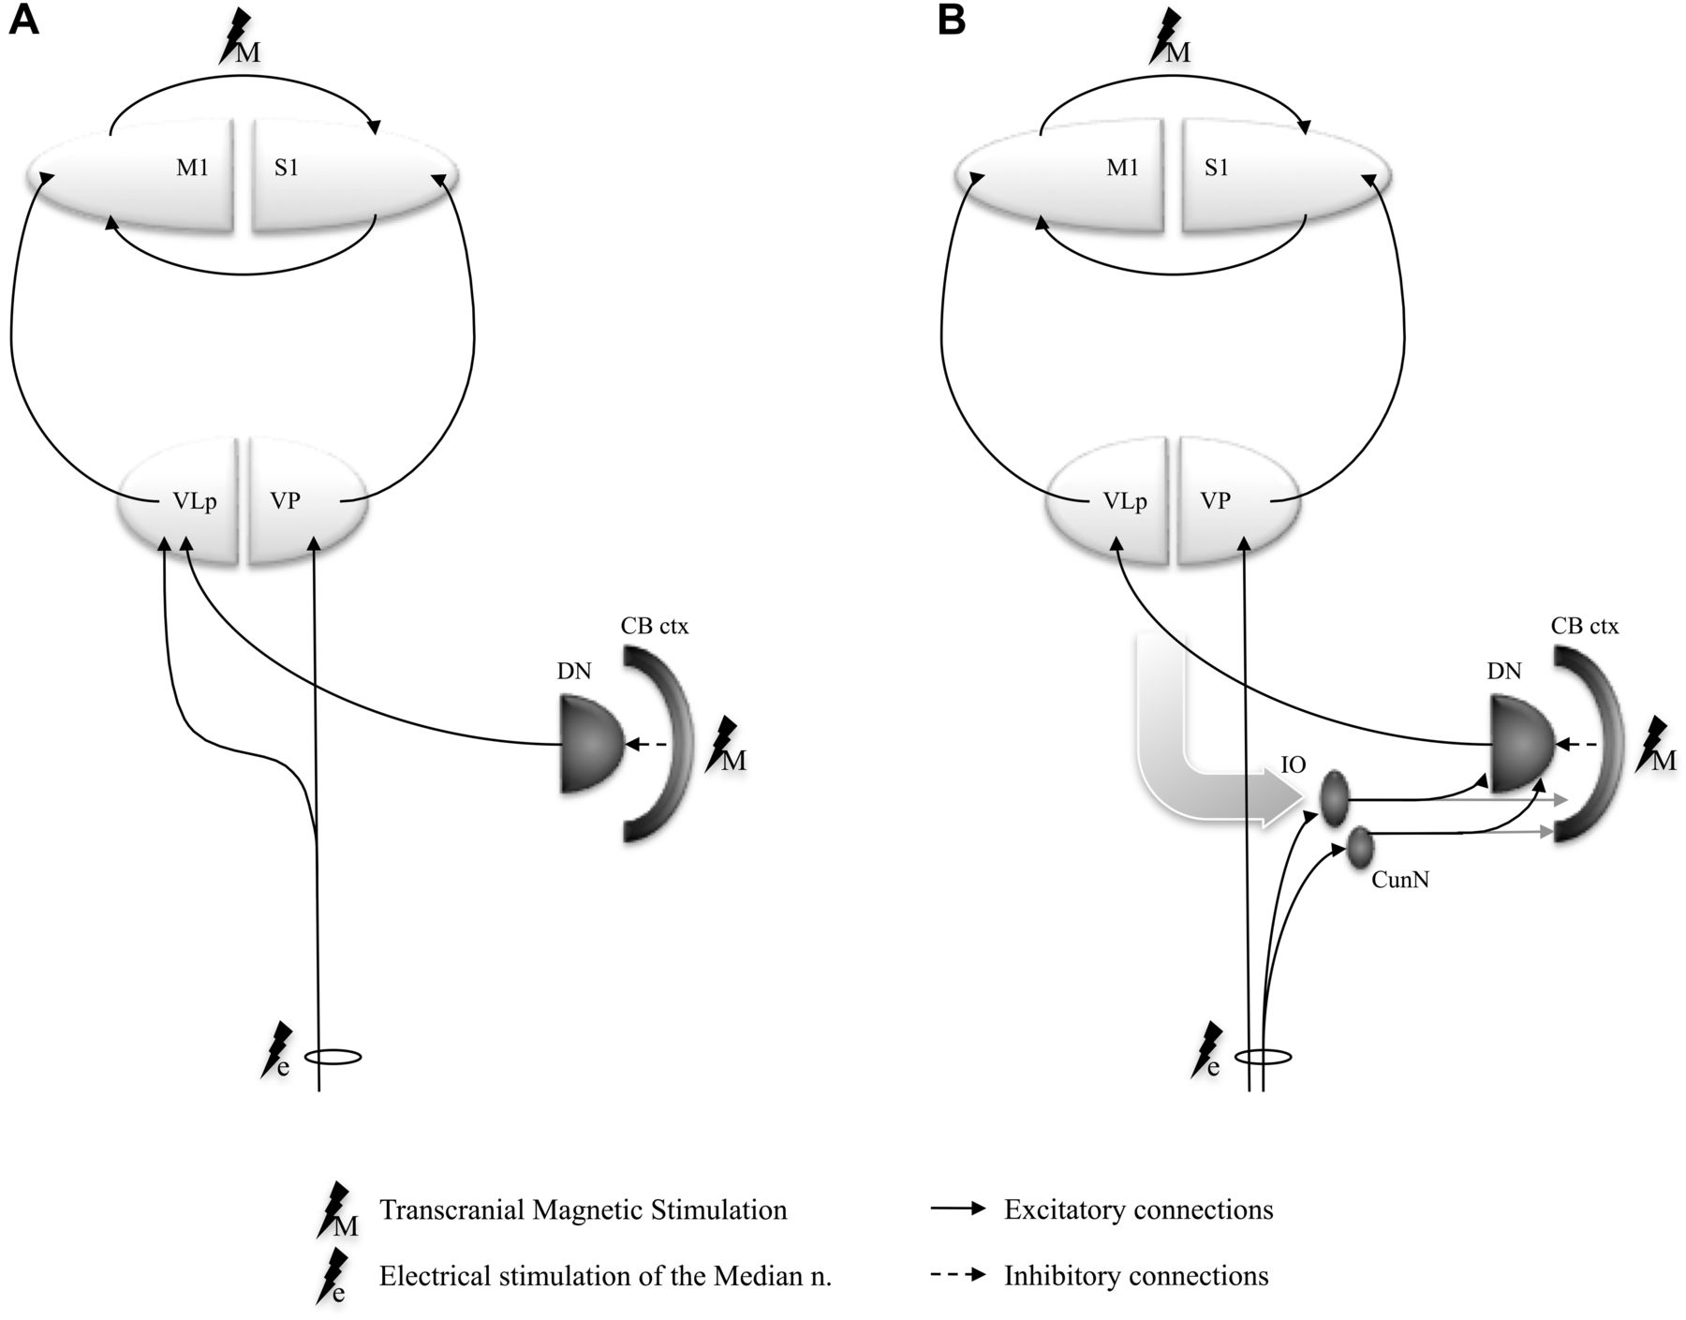
Figure 4. Schematic representation of the spino-cerebello-thalamo-cortical circuit models controlling the peripheral ...
Notes:
Figure 4. Schematic representation of the spino-cerebello-thalamo-cortical circuit models controlling the peripheral afferent information flow to M1: (A) afferents are modulated at thalamic level (VLp) by the cerebellar efferents; (B) afferent inputs are conveyed through inferior olive to the dentate nuclei to interact with the cerebello-thalamo-cortical system. The gray curved arrow stands for all nonspinal inputs to the inferior olive. (CB ctx, stimulated cerebellar cortex; DN, dentate nuclus; IO, inferior olive; VLp, posterior part of the ventrolateral thalamic nucleus [VIM in Hassler's nomenclature]; VP, ventral posterior thalamic nucleus, pars caudalis).
Unless provided in the caption above, the following copyright applies to the content of this slide: © The Author 2012. Published by Oxford University Press. All rights reserved. For permissions, please e-mail: journals.permissions@oup.com

