Slide 1
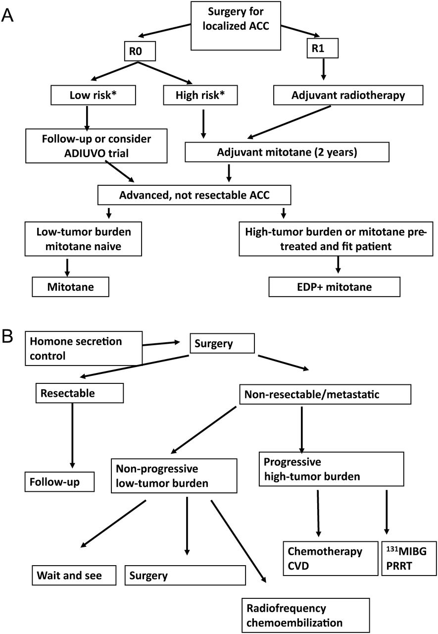
Figure 1 Algorithm on management according to stage, risk factors, and disease characteristics for adrenocortical ...
Notes:
Figure 1 Algorithm on management according to stage, risk factors, and disease characteristics for adrenocortical carcinoma (ACC) (A) and pheochromocytoma (B). *Low-risk ACC is defined stage I–II and Ki67 expression in ≤10% of neoplastic cells, high-risk ACC: stage III or Ki67 expression in >10% of neoplastic cells.
Unless provided in the caption above, the following copyright applies to the content of this slide: © The Author 2012. Published by Oxford University Press on behalf of the European Society for Medical Oncology. All rights reserved. For permissions, please email: journals.permissions@oup.com

