Slide 1
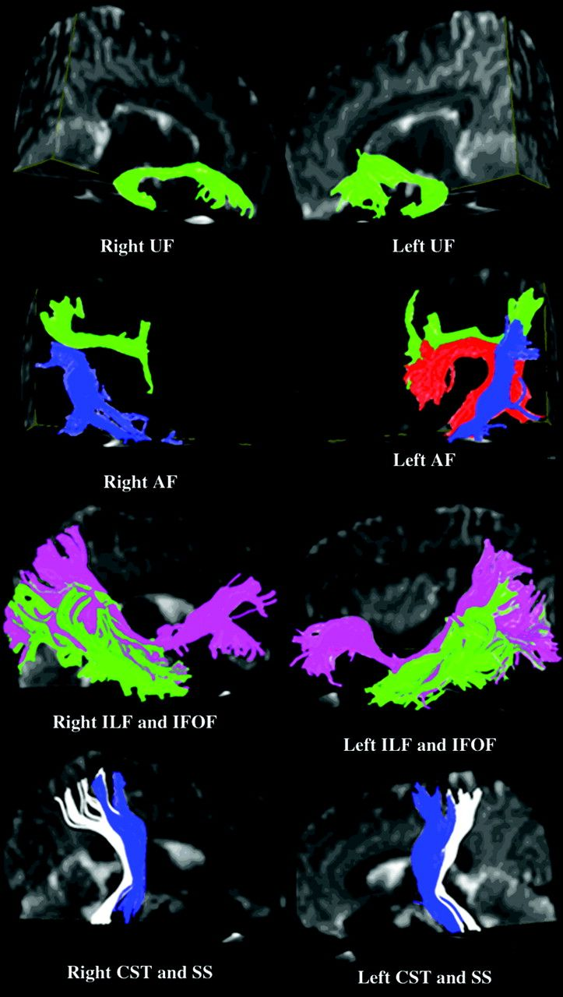
Figure 1. Illustrative color figure displaying 3D views of reconstructed fiber tracts overlaid on B₀ ...
Notes:
Figure 1. Illustrative color figure displaying 3D views of reconstructed fiber tracts overlaid on B0 (reference or no diffusion weighted) images. AF with 3 segments: FT (red fibers), FP (green fibers), and TP (blue fibers); ILF (green); IFOF (pink); CST (blue); and SS (white). Note the absent FT segment of right AF in this subject.
Unless provided in the caption above, the following copyright applies to the content of this slide: © The Author 2007. Published by Oxford University Press. All rights reserved. For permissions, please e-mail: journals.permissions@oxfordjournals.org

Slide 2
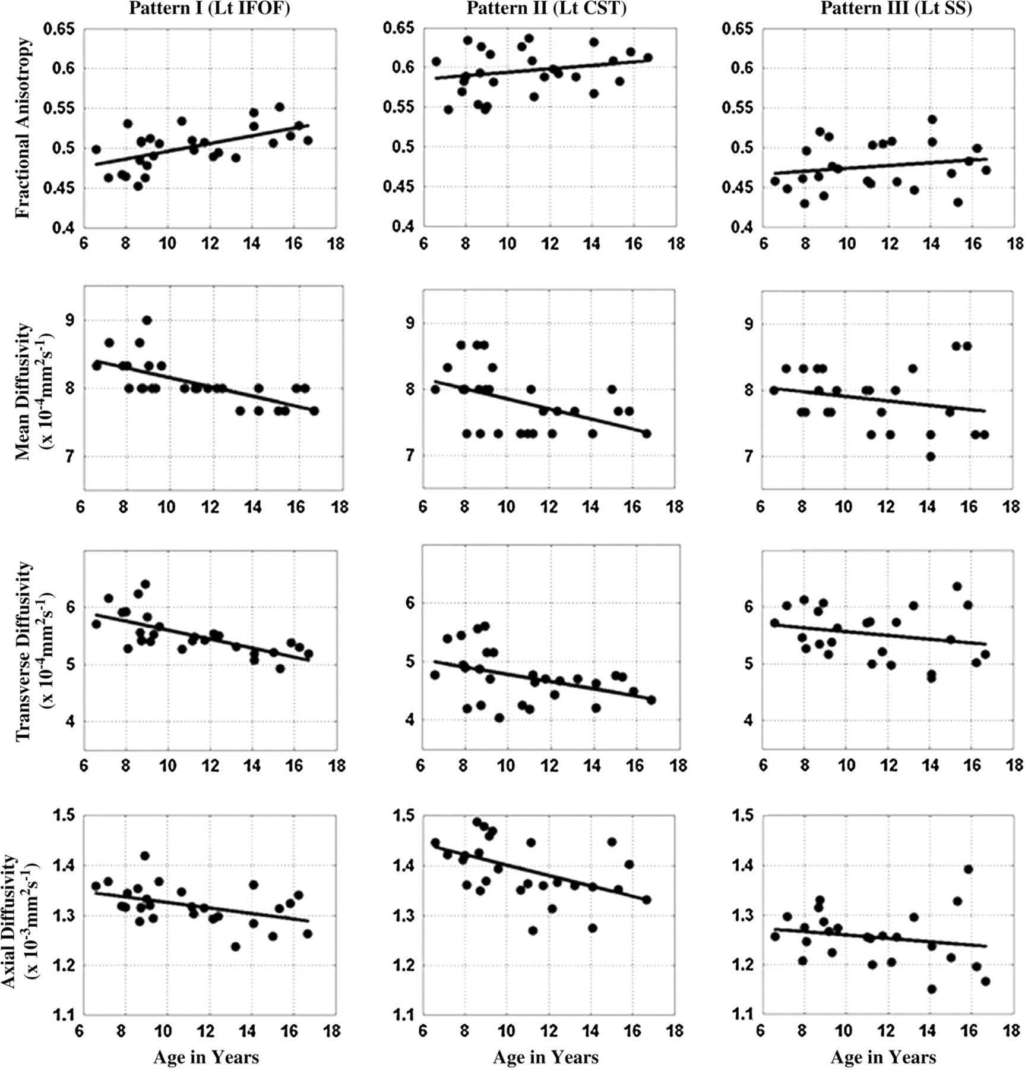
Figure 2. Illustrative scatter plots showing various patterns of white matter maturation captured by DTT. (A) Pattern ...
Notes:
Figure 2. Illustrative scatter plots showing various patterns of white matter maturation captured by DTT. (A) Pattern I: significant increase in FA with age accompanied by significant decreases in all 3 diffusivities (e.g., left IFOF). (B) Pattern II: significant decreases in all 3 diffusivities with age, but no significant changes in FA with age (e.g., left CST). (C) Pattern III: no significant changes in FA or diffusivity with age (e.g., left SS).
Unless provided in the caption above, the following copyright applies to the content of this slide: © The Author 2007. Published by Oxford University Press. All rights reserved. For permissions, please e-mail: journals.permissions@oxfordjournals.org

