Slide 1
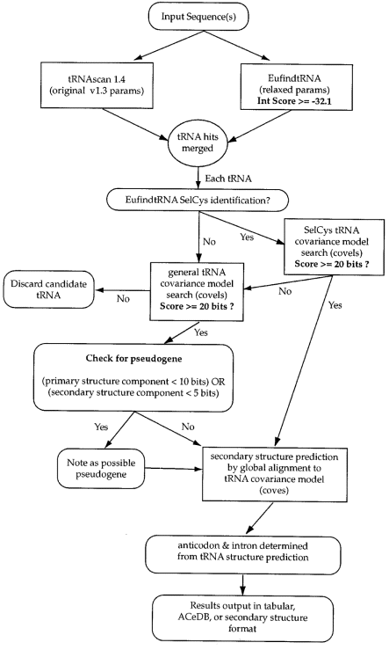
Figure 1 Schematic diagram of tRNAscan-SE algorithm. Steps carried out by tRNAscan-SE are shown in ovals and ...
Notes:
Figure 1 Schematic diagram of tRNAscan-SE algorithm. Steps carried out by tRNAscan-SE are shown in ovals and rounded-edge boxes. tRNA selection and analysis performed by external programs are shown in rectangles.
Unless provided in the caption above, the following copyright applies to the content of this slide: © 1997 Oxford University Press

Slide 2
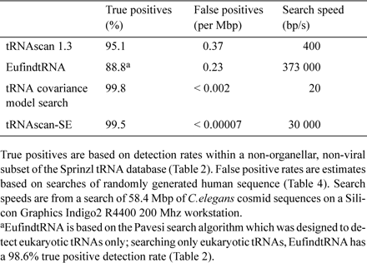
Table 1 Overall detection rates of tRNA search programs
Notes:
Table 1 Overall detection rates of tRNA search programs
Unless provided in the caption above, the following copyright applies to the content of this slide: © 1997 Oxford University Press

Slide 3
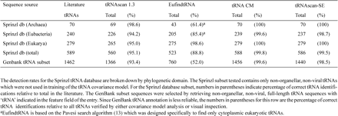
Table 2 tRNA prediction within annotated database subsets
Notes:
Table 2 tRNA prediction within annotated database subsets
Unless provided in the caption above, the following copyright applies to the content of this slide: © 1997 Oxford University Press

Slide 4
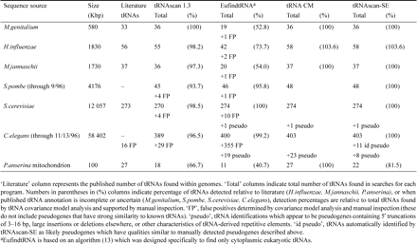
Table 3 tRNAs identified in genomic databases by various search methods
Notes:
Table 3 tRNAs identified in genomic databases by various search methods
Unless provided in the caption above, the following copyright applies to the content of this slide: © 1997 Oxford University Press

Slide 5
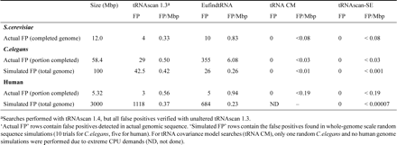
Table 4 False positive rates for actual and simulated genomes
Notes:
Table 4 False positive rates for actual and simulated genomes
Unless provided in the caption above, the following copyright applies to the content of this slide: © 1997 Oxford University Press

Slide 6
Table 5 Analysis time in hours required for various complete genomes and tRNA search algorithms
Notes:
Table 5 Analysis time in hours required for various complete genomes and tRNA search algorithms
Unless provided in the caption above, the following copyright applies to the content of this slide: © 1997 Oxford University Press

