Slide 1
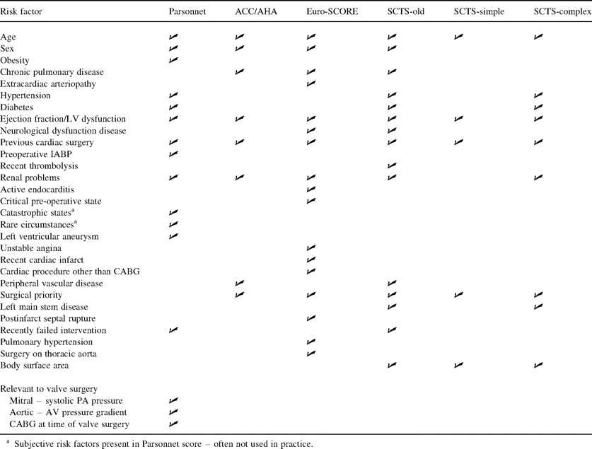
Table 1 Risk factors for in-hospital mortality considered in each model
Notes:
Table 1 Risk factors for in-hospital mortality considered in each model
Unless provided in the caption above, the following copyright applies to the content of this slide: © Elsevier Science B.V. 2003

Slide 2
Table 2 Comparison of observed and predicted mortality for six risk stratification models
Notes:
Table 2 Comparison of observed and predicted mortality for six risk stratification models
Unless provided in the caption above, the following copyright applies to the content of this slide: © Elsevier Science B.V. 2003

Slide 3
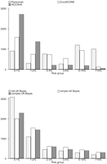
Fig. 1 Distribution of patients across risk groups by risk model.
Notes:
Fig. 1 Distribution of patients across risk groups by risk model.
Unless provided in the caption above, the following copyright applies to the content of this slide: © Elsevier Science B.V. 2003

Slide 4
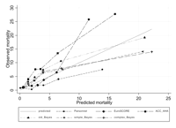
Fig. 2 A comparison of observed and predicted number of deaths by risk model.
Notes:
Fig. 2 A comparison of observed and predicted number of deaths by risk model.
Unless provided in the caption above, the following copyright applies to the content of this slide: © Elsevier Science B.V. 2003

Slide 5
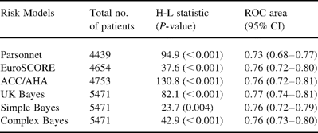
Table 3 Results of calibration as measured by the Hosmer-Lemeshow test and of discrimination (ROC area) for six risk ...
Notes:
Table 3 Results of calibration as measured by the Hosmer-Lemeshow test and of discrimination (ROC area) for six risk stratification models
Unless provided in the caption above, the following copyright applies to the content of this slide: © Elsevier Science B.V. 2003

