Slide 1
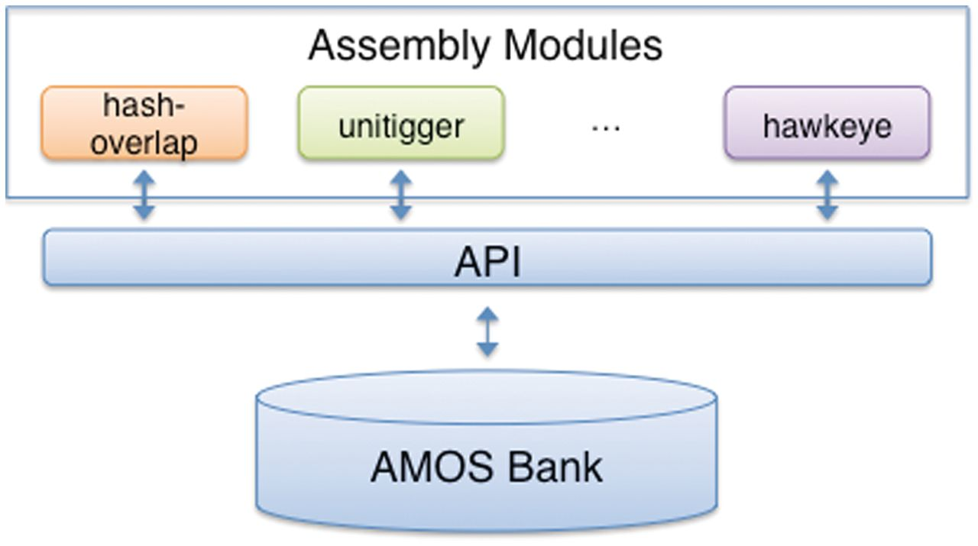
Figure 1: AMOS modular design. Individual assembly modules, such as for computing overlaps between reads ...
Notes:
Figure 1: AMOS modular design. Individual assembly modules, such as for computing overlaps between reads (hash-overlap), for refining the overlaps between reads into contigs (unitigger), and the GUI Hawkeye, interact using well defined APIs through a lightweight central database called an AMOS bank.
Unless provided in the caption above, the following copyright applies to the content of this slide: © The Author 2011. Published by Oxford University Press. For Permissions, please email: journals.permissions@oup.com

Slide 2
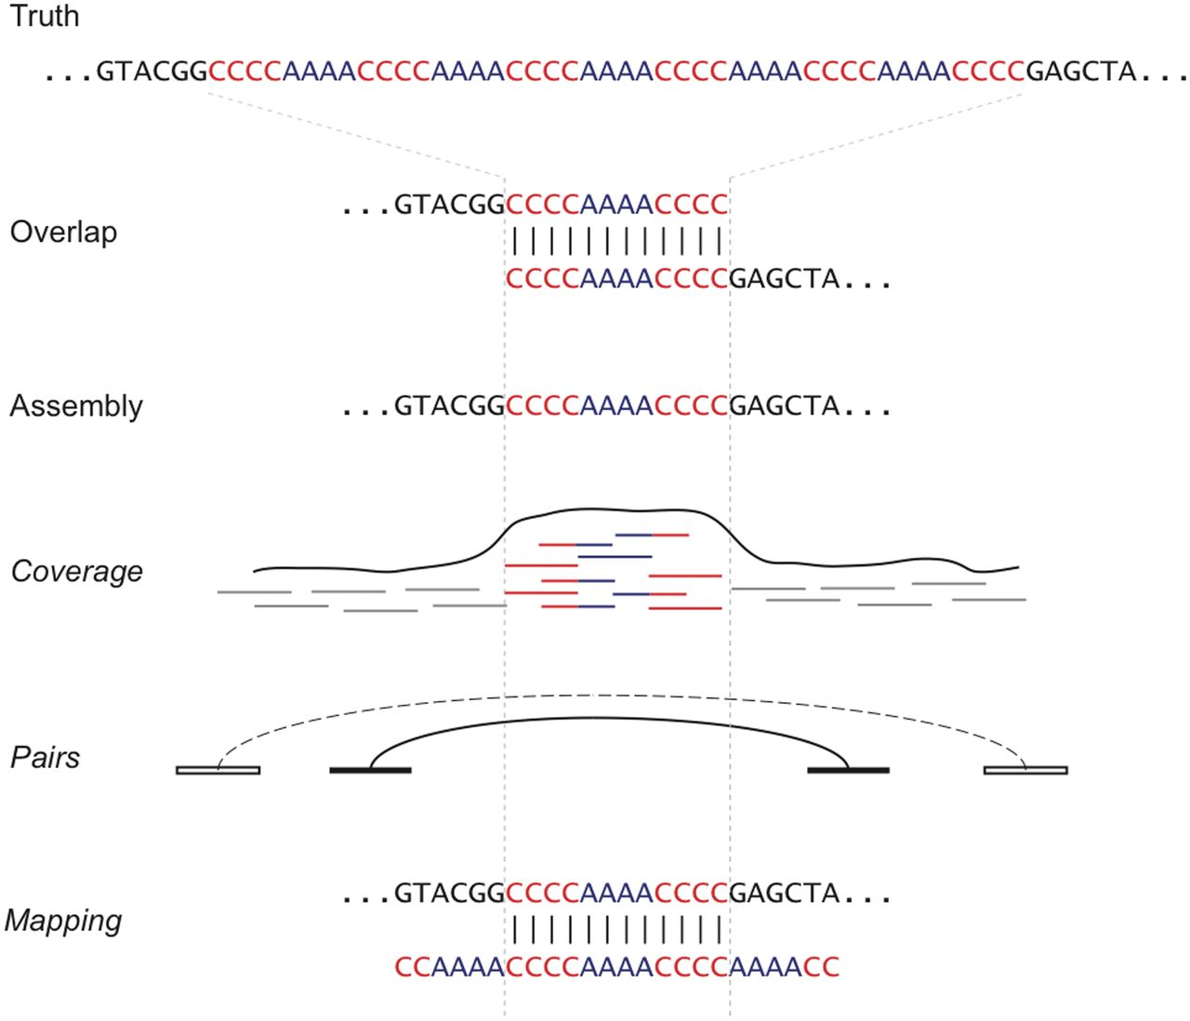
Figure 2: Assembly artifacts resulting from a tandem repeat collapse style mis-assembly. In this small illustration, ...
Notes:
Figure 2: Assembly artifacts resulting from a tandem repeat collapse style mis-assembly. In this small illustration, the motif {CCCCAAAA} repeats in tandem in the original genome sequence. No single read spans the repetitive sequence and so the assembler has created a minimal reconstruction from two overlapping reads. This results in three signatures of mis-assembly: increased coverage, compressed pairs and partial read mappings. Increased coverage is caused by short reads internal to a repeat copy ‘piling up’ within the remaining copies. This can be observed both in the read tiling, or with the K* k-mer statistic introduced by AMOSvalidate. Compressed pairs (black) are anchored in neighboring unique sequence and are compressed relative to their expected separation (dotted). Finally, reads discarded by the assembler for apparent chimerism can sometimes be remapped to the assembly to identify the exact boundary of the collapsed repeat. The tails of these reads will fail to align, or will wrap around to the other side of the repeat.
Unless provided in the caption above, the following copyright applies to the content of this slide: © The Author 2011. Published by Oxford University Press. For Permissions, please email: journals.permissions@oup.com

Slide 3
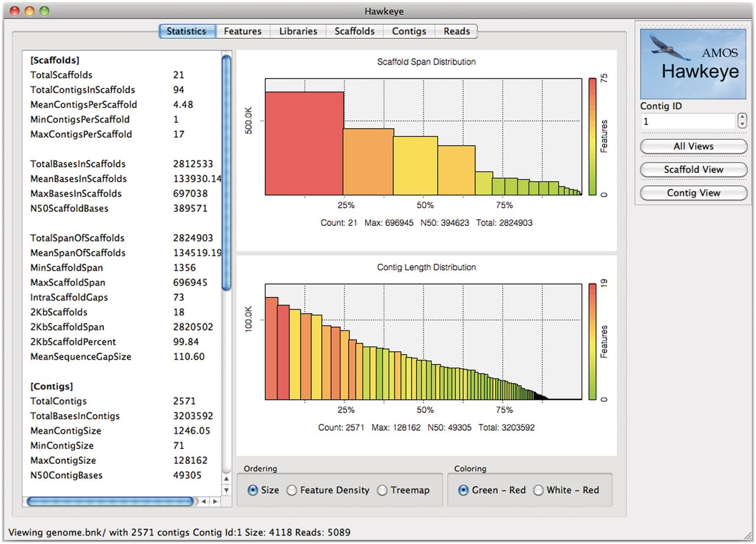
Figure 3: The Hawkeye LaunchPad displays the overall summary of the assembly using an interactive barchart of the ...
Notes:
Figure 3: The Hawkeye LaunchPad displays the overall summary of the assembly using an interactive barchart of the scaffold (top) and contig (bottom) sizes and quality. The left panel displays common statistics such as counts and sizes of those sequences. Additional tabs display statistics and histograms for the features, libraries, scaffolds, contigs and reads.
Unless provided in the caption above, the following copyright applies to the content of this slide: © The Author 2011. Published by Oxford University Press. For Permissions, please email: journals.permissions@oup.com

Slide 4
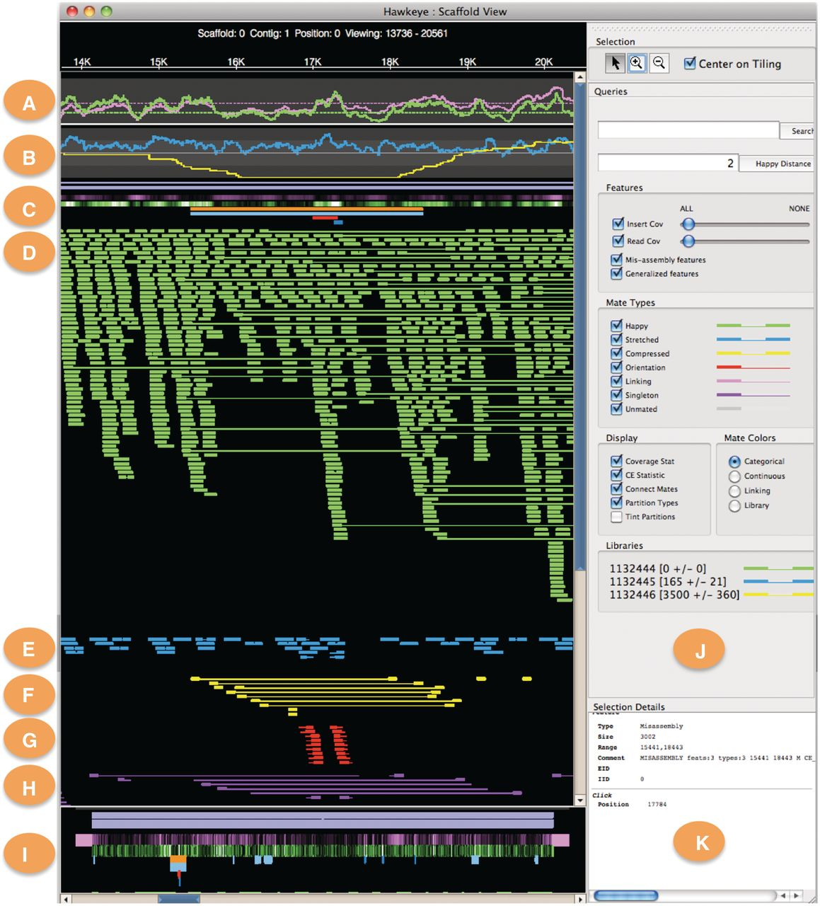
Figure 4: The Hawkeye Scaffold View displays the placement of individual reads and mates within the contigs (D–H), ...
Notes:
Figure 4: The Hawkeye Scaffold View displays the placement of individual reads and mates within the contigs (D–H), along with coverage statistics (A), mate statistics (B) and other features (C).
Unless provided in the caption above, the following copyright applies to the content of this slide: © The Author 2011. Published by Oxford University Press. For Permissions, please email: journals.permissions@oup.com

Slide 5
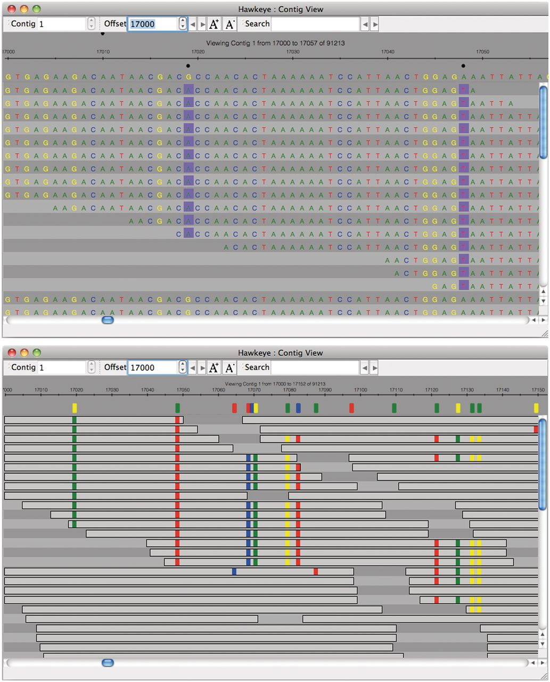
Figure 5: The Hawkeye Contig View (top) displays the individual bases in the assembly. Once the font size becomes ...
Notes:
Figure 5: The Hawkeye Contig View (top) displays the individual bases in the assembly. Once the font size becomes smaller than would be visible (bottom), Hawkeye switches to an abstract view using colored rectangles to indicate bases that disagree with the consensus.
Unless provided in the caption above, the following copyright applies to the content of this slide: © The Author 2011. Published by Oxford University Press. For Permissions, please email: journals.permissions@oup.com

Slide 6
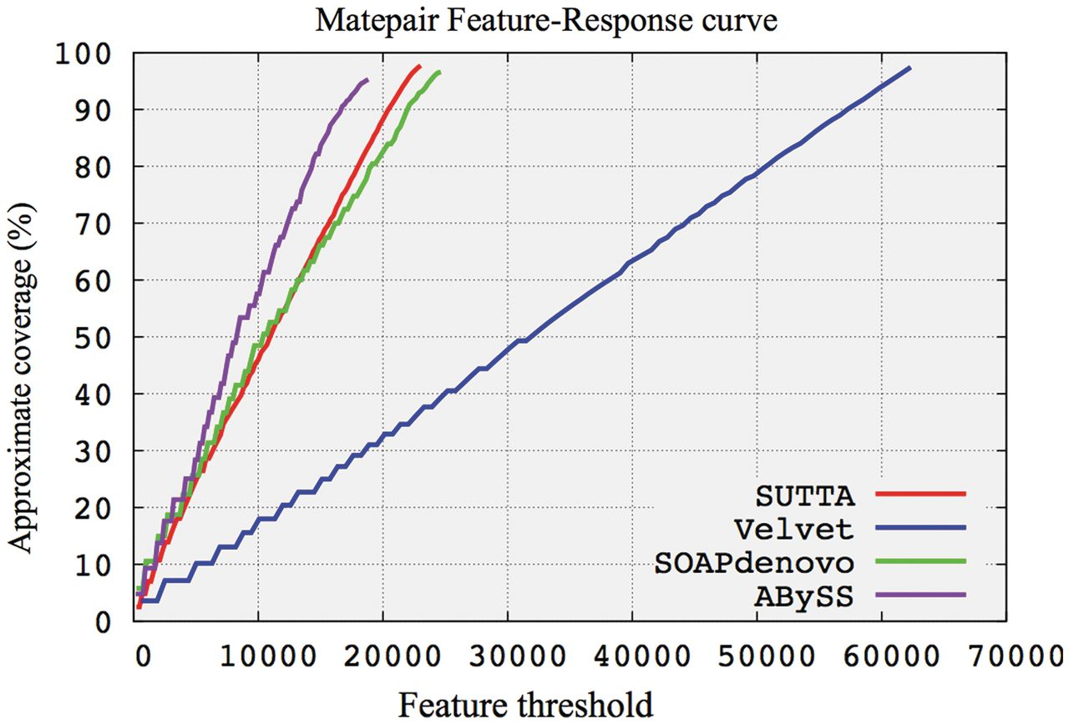
Figure 6: Feature-Response Curve comparison using the mate-pair feature type for Escherichia coli. The data set ...
Notes:
Figure 6: Feature-Response Curve comparison using the mate-pair feature type for Escherichia coli. The data set consists of 20.8 million paired-end 36-bp Illumina reads from a 200-bp insert E. coli strain K12 MG1655.
Unless provided in the caption above, the following copyright applies to the content of this slide: © The Author 2011. Published by Oxford University Press. For Permissions, please email: journals.permissions@oup.com

Slide 7
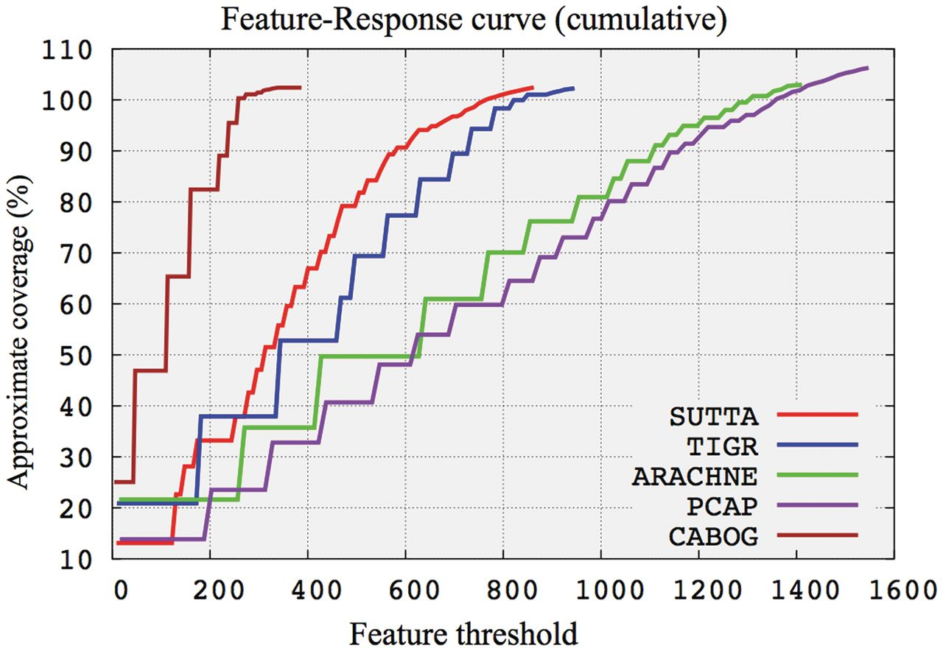
Figure 7: Feature-Response Curve comparison using the mate-pair feature type for Staphylococcus epidermidis. The data ...
Notes:
Figure 7: Feature-Response Curve comparison using the mate-pair feature type for Staphylococcus epidermidis. The data set consists of 60 761 paired-end Sanger reads of 900 bp average length for a total coverage of ∼20×.
Unless provided in the caption above, the following copyright applies to the content of this slide: © The Author 2011. Published by Oxford University Press. For Permissions, please email: journals.permissions@oup.com

