Slide 1
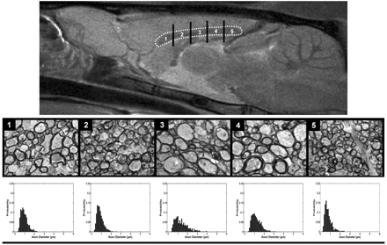
Figure 1 MRI and histological analysis of the corpus callosum. A mid-saggital T₂-weighted MRI of the rat ...
Notes:
Figure 1 MRI and histological analysis of the corpus callosum. A mid-saggital T2-weighted MRI of the rat brain with an inset containing the corpus callosum. The corpus callosum is sectioned into five segments from which histological specimens were taken. For each segment a representative electron-microscopy image is given along with the corresponding ADD histogram. Note the difference in ADD along different areas of the structure.
Unless provided in the caption above, the following copyright applies to the content of this slide: © The Author (2009). Published by Oxford University Press on behalf of the Guarantors of Brain. All rights reserved. For Permissions, please email: journals.permissions@oxfordjournals.org

Slide 2
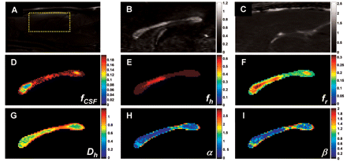
Figure 2 AxCaliber analysis of the rat corpus callosum. (A) A mid-saggital T₂-weighted MRI with an inset ...
Notes:
Figure 2 AxCaliber analysis of the rat corpus callosum. (A) A mid-saggital T2-weighted MRI with an inset containing the ROI (B) and (C) FA and mean ADC maps of the same slice in (A) computed from DTI dataset. (D–F) The volume fractions of each of the AxCaliber components: CSF (D), hindered (E) and restricted/axonal (F). (G) Map of the ADC of the hindered component of AxCaliber. (H and I) Maps of the α and β parameters of the γ-distribution representing the computed ADD.
Unless provided in the caption above, the following copyright applies to the content of this slide: © The Author (2009). Published by Oxford University Press on behalf of the Guarantors of Brain. All rights reserved. For Permissions, please email: journals.permissions@oxfordjournals.org

Slide 3
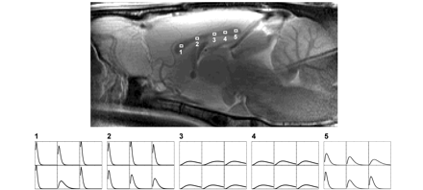
Figure 3 Axon diameter distribution analysis along the corpus callosum. A mid-saggital T₂-weighted MRI with ...
Notes:
Figure 3 Axon diameter distribution analysis along the corpus callosum. A mid-saggital T2-weighted MRI with five regions of interest outlined representing the five segments shown in Fig.1. Each region was consisted of 2 × 3 voxels. The computed ADD from AxCaliber for each voxel within each region is depicted at the bottom. Note the homogenous pattern of ADD within each region and the large differences between them. All ADDs are in the same proportion, the x-axis represents the axon diameters (from 0 to 6 μm) and the y-axis represents the probability (from 0 to 0.3).
Unless provided in the caption above, the following copyright applies to the content of this slide: © The Author (2009). Published by Oxford University Press on behalf of the Guarantors of Brain. All rights reserved. For Permissions, please email: journals.permissions@oxfordjournals.org

Slide 4
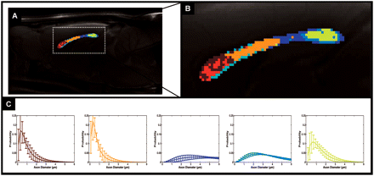
Figure 4 Cluster analysis of the axon diameter distribution along the corpus callosum. (A) A mid-saggital ...
Notes:
Figure 4 Cluster analysis of the axon diameter distribution along the corpus callosum. (A) A mid-saggital T2-weighted MRI with the AxCaliber clusters superimposed, enlarged at (B). (C) The AxCaliber averaged ADDs for the different clusters given in (A) and (B); note that the colours of the graphs match the clusters’ colours.
Unless provided in the caption above, the following copyright applies to the content of this slide: © The Author (2009). Published by Oxford University Press on behalf of the Guarantors of Brain. All rights reserved. For Permissions, please email: journals.permissions@oxfordjournals.org

Slide 5
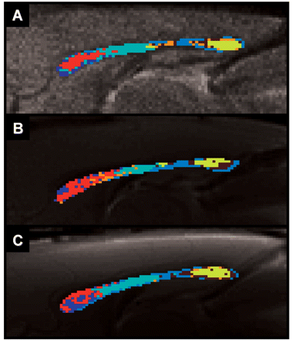
Figure 5 Cluster analysis of the axon diameter distribution for different rats (A–C). A mid-saggital ...
Notes:
Figure 5 Cluster analysis of the axon diameter distribution for different rats (A–C). A mid-saggital T2-weighted MRI with the AxCaliber cluster superimposed for three different rats. Note that the colours of the clusters for the three rats are matched. Also note the high similarity of the cluster pattern among the rats.
Unless provided in the caption above, the following copyright applies to the content of this slide: © The Author (2009). Published by Oxford University Press on behalf of the Guarantors of Brain. All rights reserved. For Permissions, please email: journals.permissions@oxfordjournals.org

Slide 6
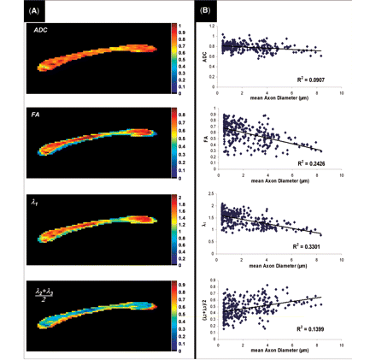
Figure 6 Comparison of AxCaliber with DTI. (A) The indexed DTI maps of the ADC, FA and longitudinal (λ₁) ...
Notes:
Figure 6 Comparison of AxCaliber with DTI. (A) The indexed DTI maps of the ADC, FA and longitudinal (λ1) and radial diffusivities [(λ2 + λ3)/2] of the same rat shown in Figs 1–3. (B) Correlation between each of the DTI indices and AxCaliber's mean axon diameter (averaged from the computed ADD). Note that the correlations are relatively poor. The statistical significance in correlations was P < 0.00001).
Unless provided in the caption above, the following copyright applies to the content of this slide: © The Author (2009). Published by Oxford University Press on behalf of the Guarantors of Brain. All rights reserved. For Permissions, please email: journals.permissions@oxfordjournals.org

