Slide 1
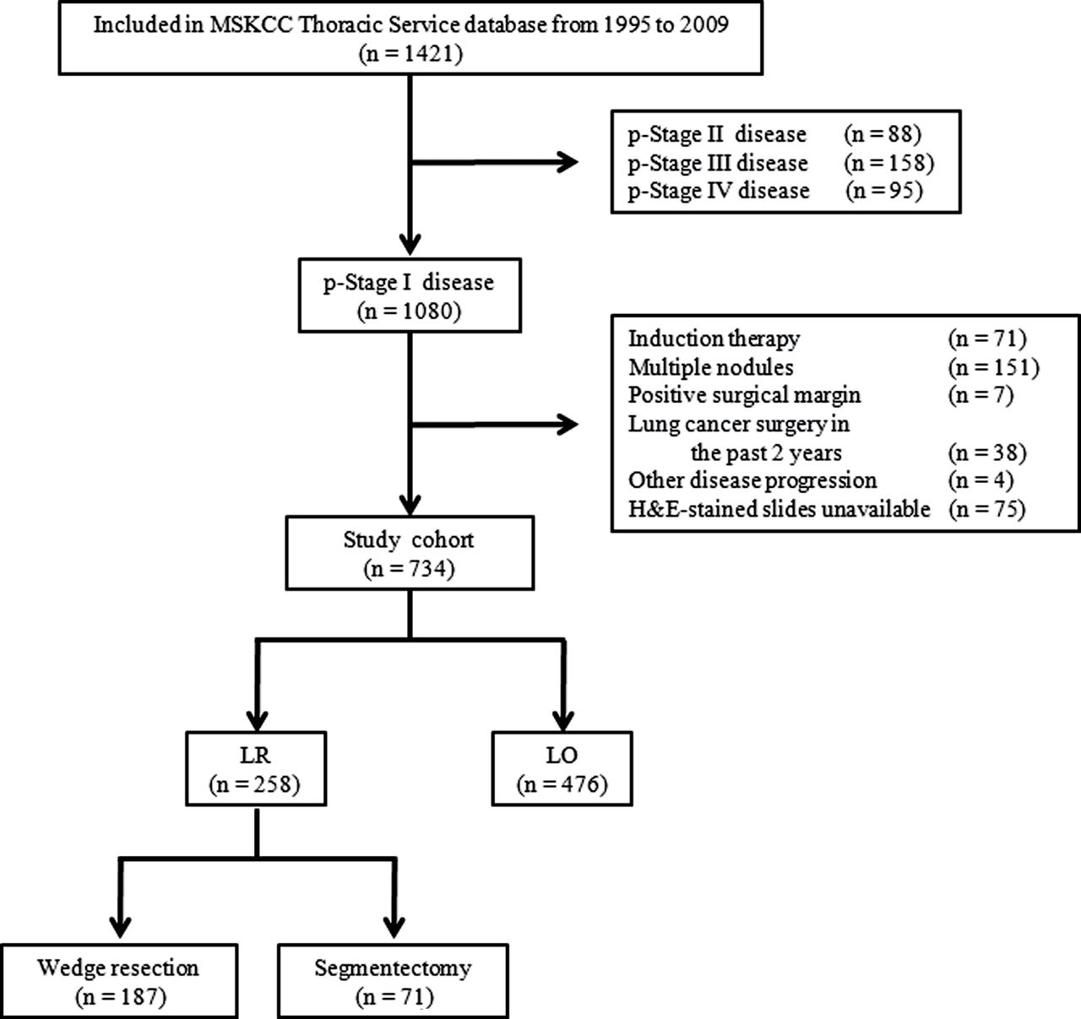
Figure 1. Study cohort flow chart. Between 1995 and 2009, 1421 patients with lung adenocarcinoma of 2cm or less were ...
Notes:
Figure 1. Study cohort flow chart. Between 1995 and 2009, 1421 patients with lung adenocarcinoma of 2cm or less were identified. After exclusion, 734 were included in the analysis, of whom 258 underwent limited resection (LR) and 476 underwent lobectomy (LO). H&E = hematoxylin and eosin; MSKCC = Memorial Sloan-Kettering Cancer Center.
Unless provided in the caption above, the following copyright applies to the content of this slide: © The Author 2013. Published by Oxford University Press. All rights reserved. For Permissions, please e-mail: journals.permissions@oup.com.

Slide 2
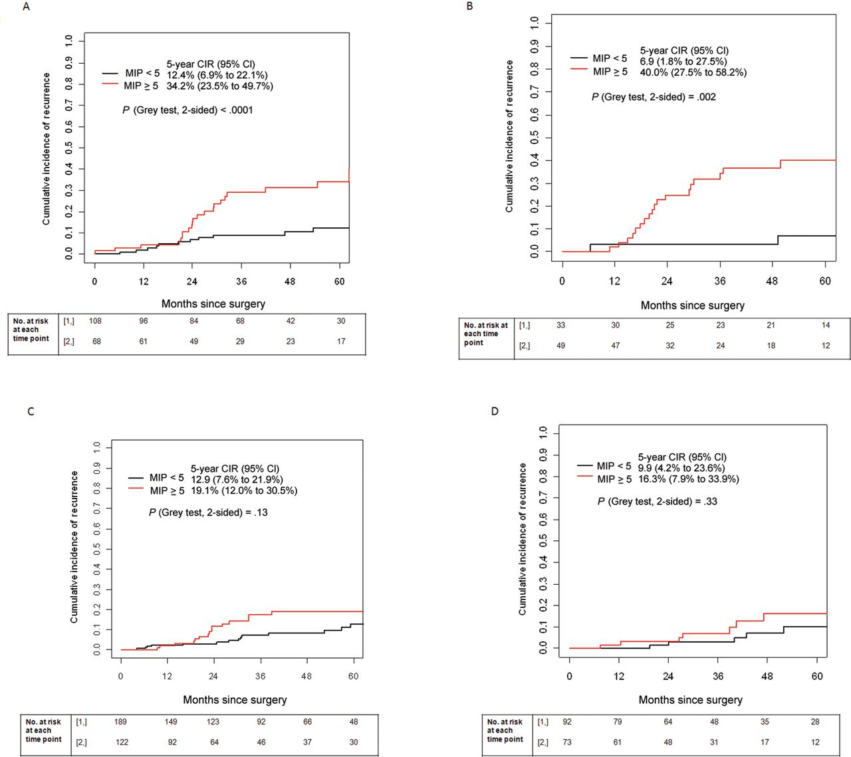
Figure 2. Five-year cumulative incidence of recurrence (CIR) by extent of resection and percentage of micropapillary ...
Notes:
Figure 2. Five-year cumulative incidence of recurrence (CIR) by extent of resection and percentage of micropapillary (MIP) component. A and B) Five-year CIR for the training (A) and validation (B) sets, stratified by MIP percentage, in the limited resection group. C and D) Five-year CIR for the training (C) and validation (D) sets, stratified by MIP percentage, in the lobectomy group. CI = confidence interval
Unless provided in the caption above, the following copyright applies to the content of this slide: © The Author 2013. Published by Oxford University Press. All rights reserved. For Permissions, please e-mail: journals.permissions@oup.com.

Slide 3
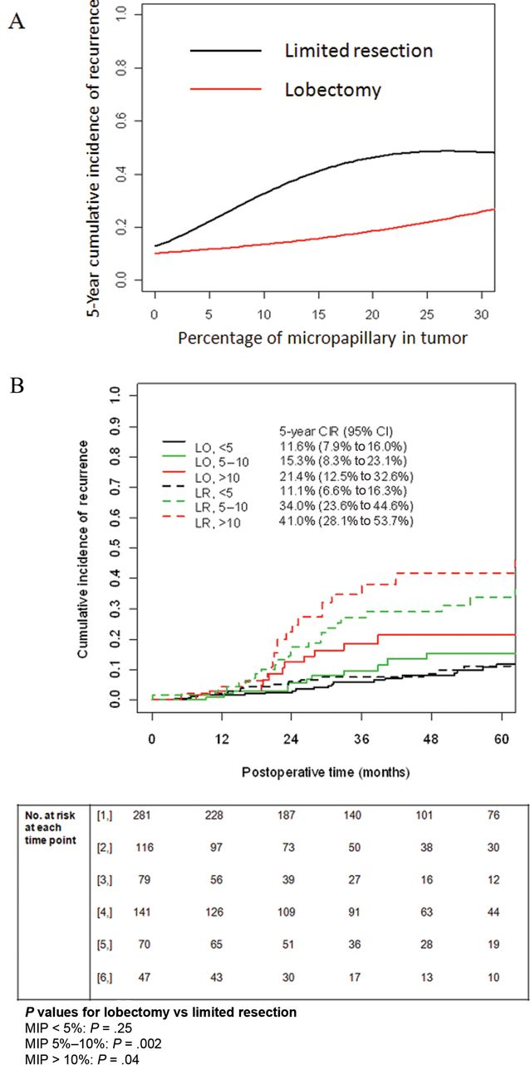
Figure 3. Five-year cumulative incidence of recurrence as a function of micropapillary percentage. A) Five-year cumulative incidence of recurrence (CIR) among the training set, as a function of the ...
Notes:
Figure 3. Five-year cumulative incidence of recurrence as a function of micropapillary percentage. A) Five-year cumulative incidence of recurrence (CIR) among the training set, as a function of the micropapillary (MIP) percentage for each surgical treatment group. B) CIR among the training set for patients with tumors with an MIP component of less than 5%, 5% to 10%, or greater than 10% who underwent lobectomy, compared with those who underwent limited resection. CI = confidence interval; LO = lobectomy; LR = limited resection.
Unless provided in the caption above, the following copyright applies to the content of this slide: © The Author 2013. Published by Oxford University Press. All rights reserved. For Permissions, please e-mail: journals.permissions@oup.com.

