Slide 1
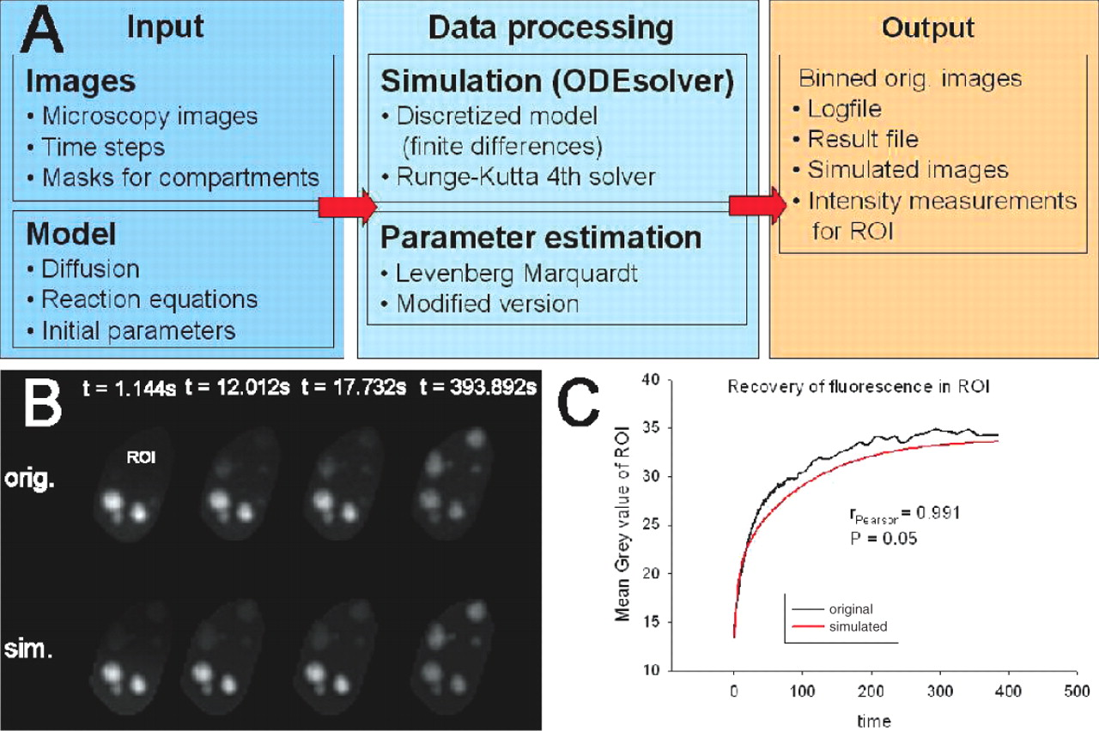
Fig. 1 (A) The structure of Tropical. (B) Four out of the original 149 FRAP images (top) of B23 and the ...
Notes:
Fig. 1 (A) The structure of Tropical. (B) Four out of the original 149 FRAP images (top) of B23 and the corresponding simulated images of B23 (bottom) at selected time points. ROI indicates the region used to plot the recovery curve. (C) The fluorescence recovery curve of the B23 model shows a good fit [149 time points, values taken from ROI plotted in (B)].
Unless provided in the caption above, the following copyright applies to the content of this slide: © 2006 The Author(s)This is an Open Access article distributed under the terms of the Creative Commons Attribution Non-Commercial License (http://creativecommons.org/licenses/by-nc/2.0/uk/) which permits unrestricted non-commercial use, distribution, and reproduction in any medium, provided the original work is properly cited.

