Slide 1
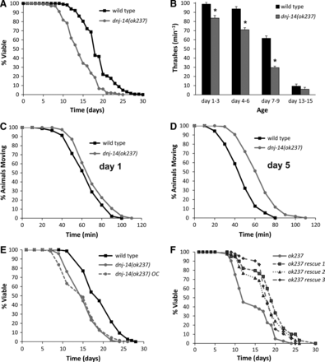
Figure 1. Phenotypic analysis of dnj-14(ok237) mutants. (A) dnj-14 mutants have a short lifespan. Data shown are pooled ...
Notes:
Figure 1. Phenotypic analysis of dnj-14(ok237) mutants. (A) dnj-14 mutants have a short lifespan. Data shown are pooled from seven independent lifespan assays comparing synchronized wild-type (Bristol N2) and dnj-14(ok237) strains (n = 230 and 213 worms, respectively). (B) dnj-14 mutants have a minor locomotion defect. The rate of thrashing in solution was measured in animals of the indicated age ranges after synchronization. Data are shown as mean ± SEM from two independent assays (n = 20–50 worms of each strain per time point; *P < 0.05). (C and D) dnj-14 mutants have a minor, age-dependent neurotransmission defect. The time taken for paralysis to be induced by aldicarb was not significantly different from N2 controls in 1-day-old dnj-14 mutants (C), but was significantly delayed in 5-day-old (D) animals. Data shown are pooled from 3 independent assays (n = 60 worms for each strain). (E) Out-crossed dnj-14 mutants retain a short lifespan. The dnj-14(ok237) strain was out-crossed six times with the wild-type N2 strain and then lifespan analysis performed. Data shown are pooled from three independent lifespan assays comparing synchronized out-crossed (OC) and non-out-crossed strains (n = 68–74 worms for each strain). (F) The short lifespan of the dnj-14 strain can be rescued by a dnj-14 transgene. A construct containing the coding region and putative upstream promoter of the dnj-14 gene was injected into dnj-14(ok237) worms and then lifespan analysis performed. Data shown are from a single lifespan assay (n = 40, 32, 34 and 26 worms for untransformed, rescue 1, rescue 2 and rescue 3 strains, respectively).
Unless provided in the caption above, the following copyright applies to the content of this slide: © The Author 2014. Published by Oxford University Press.This is an Open Access article distributed under the terms of the Creative Commons Attribution License (http://creativecommons.org/licenses/by/4.0/), which permits unrestricted reuse, distribution, and reproduction in any medium, provided the original work is properly cited.

Slide 2
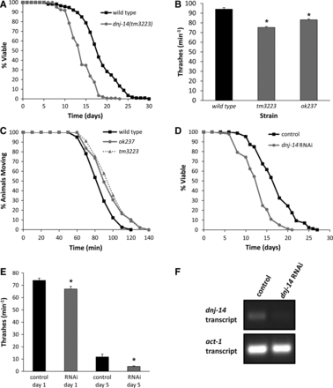
Figure 2. Multiple dnj-14 alleles and RNAi produce similar phenotypes. (A) dnj-14(tm3223) mutants have a short ...
Notes:
Figure 2. Multiple dnj-14 alleles and RNAi produce similar phenotypes. (A) dnj-14(tm3223) mutants have a short lifespan. Data shown are pooled from four independent lifespan assays comparing synchronized wild-type (N2) and dnj-14(tm3223) strains (n = 113 and 144 worms, respectively). (B) Distinct dnj-14 alleles produce a similar small locomotion defect. The rate of thrashing in solution was measured in 5-day-old animals. Data are shown as mean ± SEM from two independent assays (n = 35 worms for each strain; *P < 0.05). (C) Distinct dnj-14 alleles produce a similar small neurotransmission defect. The time taken for paralysis to be induced by aldicarb was measured in 5-day-old animals. Data shown are pooled from two independent assays (n = 41, 49 and 45 worms for N2, ok237 and tm3223 strains, respectively). (D) RNAi of dnj-14 shortens lifespan. RNAi-sensitive eri-1 strains were maintained on control NGM plates or plates containing bacteria harbouring a dnj-14 RNAi feeding plasmid. Data shown are pooled from two independent lifespan assays (n = 86 and 101 worms for control and dnj-14 RNAi, respectively). (E) RNAi of dnj-14 causes a small locomotion defect. The rate of thrashing in solution of eri-1 worms was measured in control or RNAi-treated animals of the indicated ages. Data are shown as mean ± SEM from individual assays (n = 15 worms of each strain per age-point; *P < 0.05). (F) Validation of RNAi knockdown. RNA was prepared from eri-1 worms (control and RNAi-treated) and used to generate cDNA for subsequent RT-PCR amplification using primers specific for dnj-14 and act-1.
Unless provided in the caption above, the following copyright applies to the content of this slide: © The Author 2014. Published by Oxford University Press.This is an Open Access article distributed under the terms of the Creative Commons Attribution License (http://creativecommons.org/licenses/by/4.0/), which permits unrestricted reuse, distribution, and reproduction in any medium, provided the original work is properly cited.

Slide 3
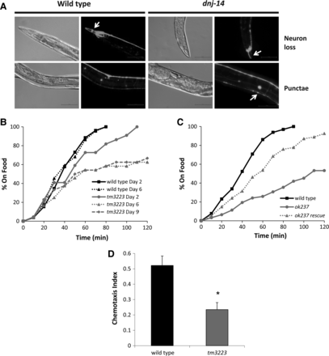
Figure 3. Age-dependent sensory neuron impairment in dnj-14 mutants. (A) Neurodegeneration in dnj-14(ok237) mutants. ...
Notes:
Figure 3. Age-dependent sensory neuron impairment in dnj-14 mutants. (A) Neurodegeneration in dnj-14(ok237) mutants. Worms were injected with a rab-3-promoter-driven GFP construct to visualize all neurons, synchronized and grown for at least 9 days and then immobilized for GFP imaging. Representative images of the loss of cell bodies and processes in the head region (neuron loss) and the presence of large fluorescent aggregates in the dorsal nerve cord (punctae) that were typically observed are shown. Scale bar 50 µm. (B) Food sensing defect in dnj-14 mutants. The time taken for wild-type and dnj-14(tm3223) worms of the indicated age to move to a bacterial food source was measured. Data shown are from individual assays, using 22–26 worms of each strain per age-point. (C) Transgenic rescue of the dnj-14 food sensing defect. The time taken to move to a bacterial food source was measured in 6-day-old wild-type, dnj-14(ok237) and dnj-14(ok237) rescue strains (the latter containing an extrachromosomal dnj-14 transgene). Data shown are pooled from two independent assays (n = 54–65 worms per strain). (D) Chemotaxis defect in dnj-14 mutants. The proportion of wild-type and dnj-14(tm3223) worms that had moved to the attractant, isoamyl alcohol, within 90 min was measured in 2-day-old animals. Data shown are pooled from six independent assays (n = 168–170 worms of each strain; *P < 0.05).
Unless provided in the caption above, the following copyright applies to the content of this slide: © The Author 2014. Published by Oxford University Press.This is an Open Access article distributed under the terms of the Creative Commons Attribution License (http://creativecommons.org/licenses/by/4.0/), which permits unrestricted reuse, distribution, and reproduction in any medium, provided the original work is properly cited.

Slide 4
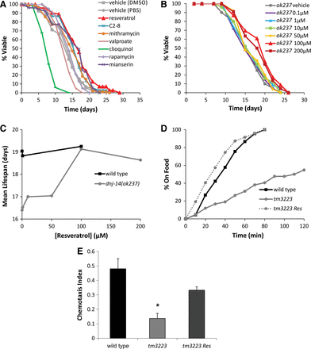
Figure 4. Resveratrol rescues dnj-14 mutant phenotypes. (A) Drug screen for compounds able to increase the short ...
Notes:
Figure 4. Resveratrol rescues dnj-14 mutant phenotypes. (A) Drug screen for compounds able to increase the short lifespan of dnj-14 mutants identifies resveratrol. dnj-14(ok237) worms were grown from L4 stage on NGM plates containing the indicated compounds or appropriate vehicle controls. Data shown are pooled from two independent lifespan assays (n = 67 to 115 worms used per condition). (B and C) Concentration-dependency of resveratrol. dnj-14(ok237) worms were grown from L4 stage on NGM plates containing the indicated concentrations of resveratrol. Data shown are derived from a single lifespan assay using 21–25 worms for each drug concentration and are displayed as raw survival curves (B) and as mean lifespans (C). (D) Resveratrol rescues the dnj-14 food sensing defect. The time taken for 6-day-old N2 and dnj-14(tm3223) worms grown in the absence or presence of 100 µm resveratrol to move to a bacterial food source was measured. Data shown are pooled from two independent assays (n = 42–47 worms per strain per condition). (E) Resveratrol rescues the dnj-14 chemotaxis defect. The proportion of wild-type and dnj-14(tm3223) worms that had moved to the attractant, isoamyl alcohol, within 90 min was measured in 2-day-old animals grown in the absence or presence of 100 µm resveratrol. Data shown are pooled from three independent assays (n = 85–102 worms per strain per condition; *P < 0.05).
Unless provided in the caption above, the following copyright applies to the content of this slide: © The Author 2014. Published by Oxford University Press.This is an Open Access article distributed under the terms of the Creative Commons Attribution License (http://creativecommons.org/licenses/by/4.0/), which permits unrestricted reuse, distribution, and reproduction in any medium, provided the original work is properly cited.

Slide 5
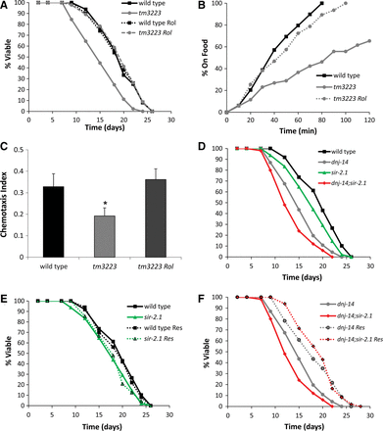
Figure 5. Resveratrol activity is mimicked by PDE inhibition and is independent of SIR-2.1. (A) Rolipram, a cAMP PDE ...
Notes:
Figure 5. Resveratrol activity is mimicked by PDE inhibition and is independent of SIR-2.1. (A) Rolipram, a cAMP PDE inhibitor, rescues the short lifespan of dnj-14 mutants. N2 or dnj-14(tm3223) worms were grown from L4 stage on NGM plates containing 100 µm rolipram or vehicle control. Data shown are pooled from two independent lifespan assays (n = 45–50 worms per condition). (B) Rolipram rescues the dnj-14 food sensing defect. The time taken for 6-day-old N2 and dnj-14(tm3223) worms grown on NGM plates in the absence or presence of 100 µm rolipram to move to a bacterial food source was measured. Data shown are pooled from two independent assays (n = 47–52 worms per condition). (C) Rolipram rescues the dnj-14 chemotaxis defect. The proportion of wild-type and dnj-14(tm3223) worms that had moved to the attractant, isoamyl alcohol, within 90 min was measured in 2–6-day-old animals grown in the absence or presence of 100 µm rolipram. Data shown are pooled from five independent assays (n = 151–160 worms per condition; *P < 0.05). (D–F) Effect of resveratrol on lifespan of dnj-14 and sir-2.1 mutants. Worms of the indicated genotypes were grown from L4 stage in the absence (D) or presence (E and F) of 100 µm resveratrol. Data shown are pooled from two independent lifespan assays comparing synchronized single and double mutant animals using 46–50 worms for each strain/condition.
Unless provided in the caption above, the following copyright applies to the content of this slide: © The Author 2014. Published by Oxford University Press.This is an Open Access article distributed under the terms of the Creative Commons Attribution License (http://creativecommons.org/licenses/by/4.0/), which permits unrestricted reuse, distribution, and reproduction in any medium, provided the original work is properly cited.

